Slide 1
Child Development
Foothill College

Slide 2
The Program will increase your understanding of
Children and the Families to which they belong
The importance of relationships in all human learning
The needs and characteristics of children birth through middle childhood and influences on their lives as related to high quality care and education
Diversity through genuine acceptance of each individual’s uniqueness
Developmentally Appropriate Practices from Birth to School-age
Professionalism demonstrated through reflective practice, mutual communication, ethical standards, professional behavior, and lifelong learning

Slide 3
Courses & Specialty Certificates Prepare you to:
Meet or exceed the hiring requirements required by Title 22 state licensing regulations
Complete the requirements needed to obtain California Child Development permits
Continue your education and earn an AA in Child Development. Some child development coursework may be transferable to a 4 year college or transfer to earn a bachelor’s degree

Slide 4
What does it take to be successful in this rewarding career?
Thorough knowledge of child development
Knowledge of yourself and dedication to learning
Emotional well-being and physical endurance
Creativity and a sense of humor
Flexibility and appreciation of children’s learning preferences
Ability to articulate clearly both verbally and in writing
Commitment to excellence and ongoing professional development

Slide 5
What kind of opportunities are there in this field?
Teaching in or directing a child development program
Operating your own family-run child care
Parent or adult educator
Pediatric nurse
Childbirth educator
Early interventionist
Speech therapist
Child psychologist
Elementary school instructional aide or elementary school teacher

Slide 6
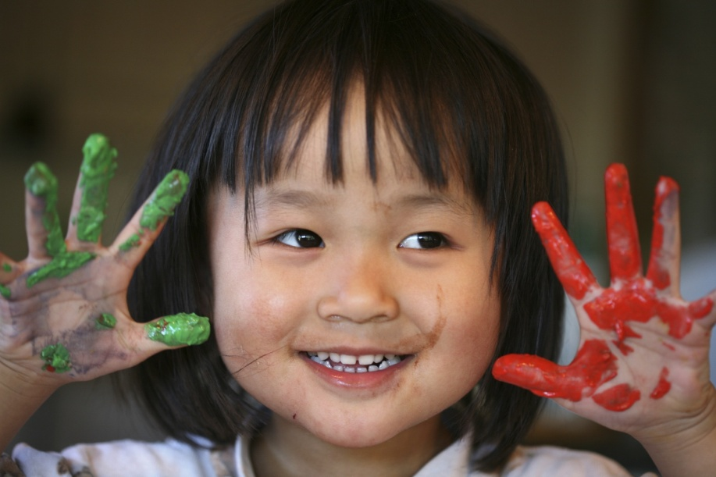
What classes are taught?
18 quarter Core Courses- take these first:
CHLD 1 Child Growth/Development: Prenatal to Early Childhood (4)
CHLD 2 Child Growth/Development: Middle Childhood to Adolescence (4)
CHLD 88 Child Family and Community(4)
CHLD 56N Principles and Practices of Teaching Young Children (4)
CHLD 88B Positive Behavior Management (2)
23 quarter Core Courses -Take these courses next:
CHLD 51A Affirming Diversity in Education (4)
CHLD 56 Observation and Assessment (4)
CHLD 86A Mentoring the Early Childhood Professional (4)
CHLD 86B Practicum Student Teaching (5)
CHLD 89 Curriculum for Early Care and Education Programs (3)
CHLD 95 Health, Safety and Nutrition in Children’s Programs (3)
Core courses =
41 quarter units

Slide 7
Other Classes
Working with School-Age Children
Caring for Infants and Toddlers in Groups
Infant and Toddler Development
Supporting Children with Special Needs in Children’s Programs
Development of Children with Special Needs
Artistic and Creative Development
Planning Creative Activities for Children
Mentoring the Early Care and Education
Professional
Science and Nature
Planning Creative Dramatics
Music and Movement in the Early Years
Administration and Supervision of Children's Programs Part 1 & 2
Language, Literacy and the Developing Child

Slide 8
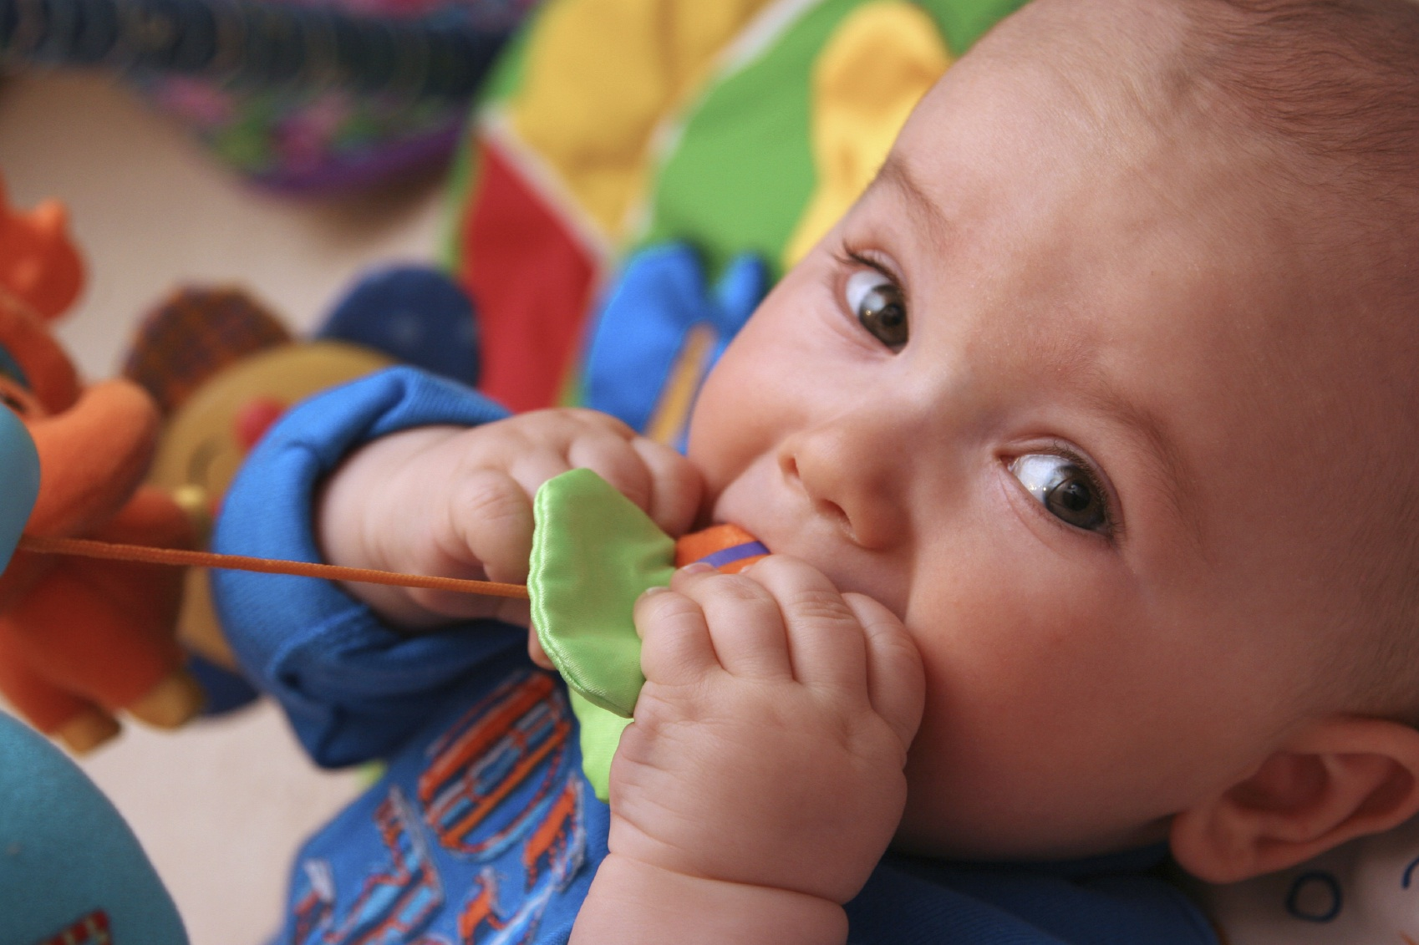
Class Locations & Times
Middlefield Campus in Palo Alto
Main Campus in Los Altos Hills
Online classes
Fast track and weekend classes
Night, morning and some afternoon classes

Slide 9
Foothill College offers classes
Fall
Winter
Spring
Summer
*Plan to take the CORE courses first

Slide 10
To get started
Visit www.foothill.edu/childdevelopment
Email childdev@foothill.edu
Like us on Facebook for updates: Foothill Child Development Department
Check out the Real Life link on the website to see what classes are all about

Slide 11
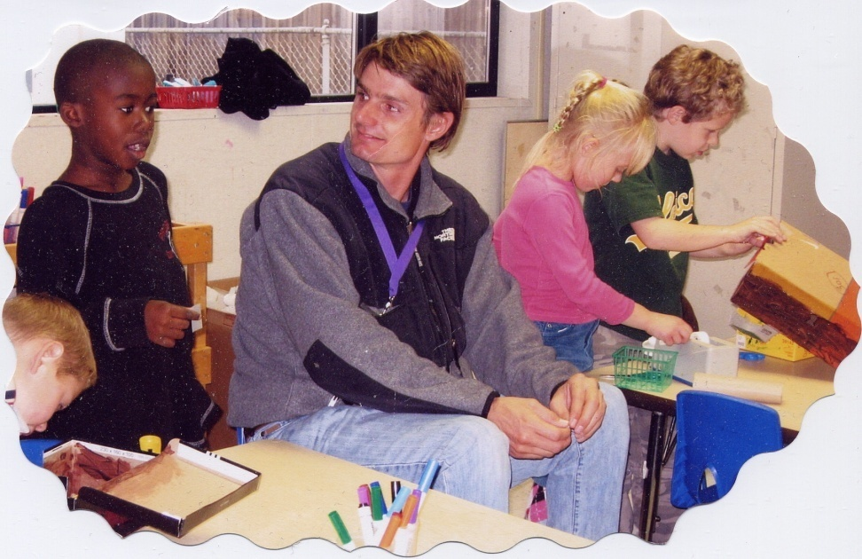
Welcome to Foothill’s Child Development Program!
(You’re going to love being here!)

