Slide 1
Budget Reduction Proposal Foothill College
Bret Watson
VP Finance & Administrative Services
October 14, 2020

Slide 2
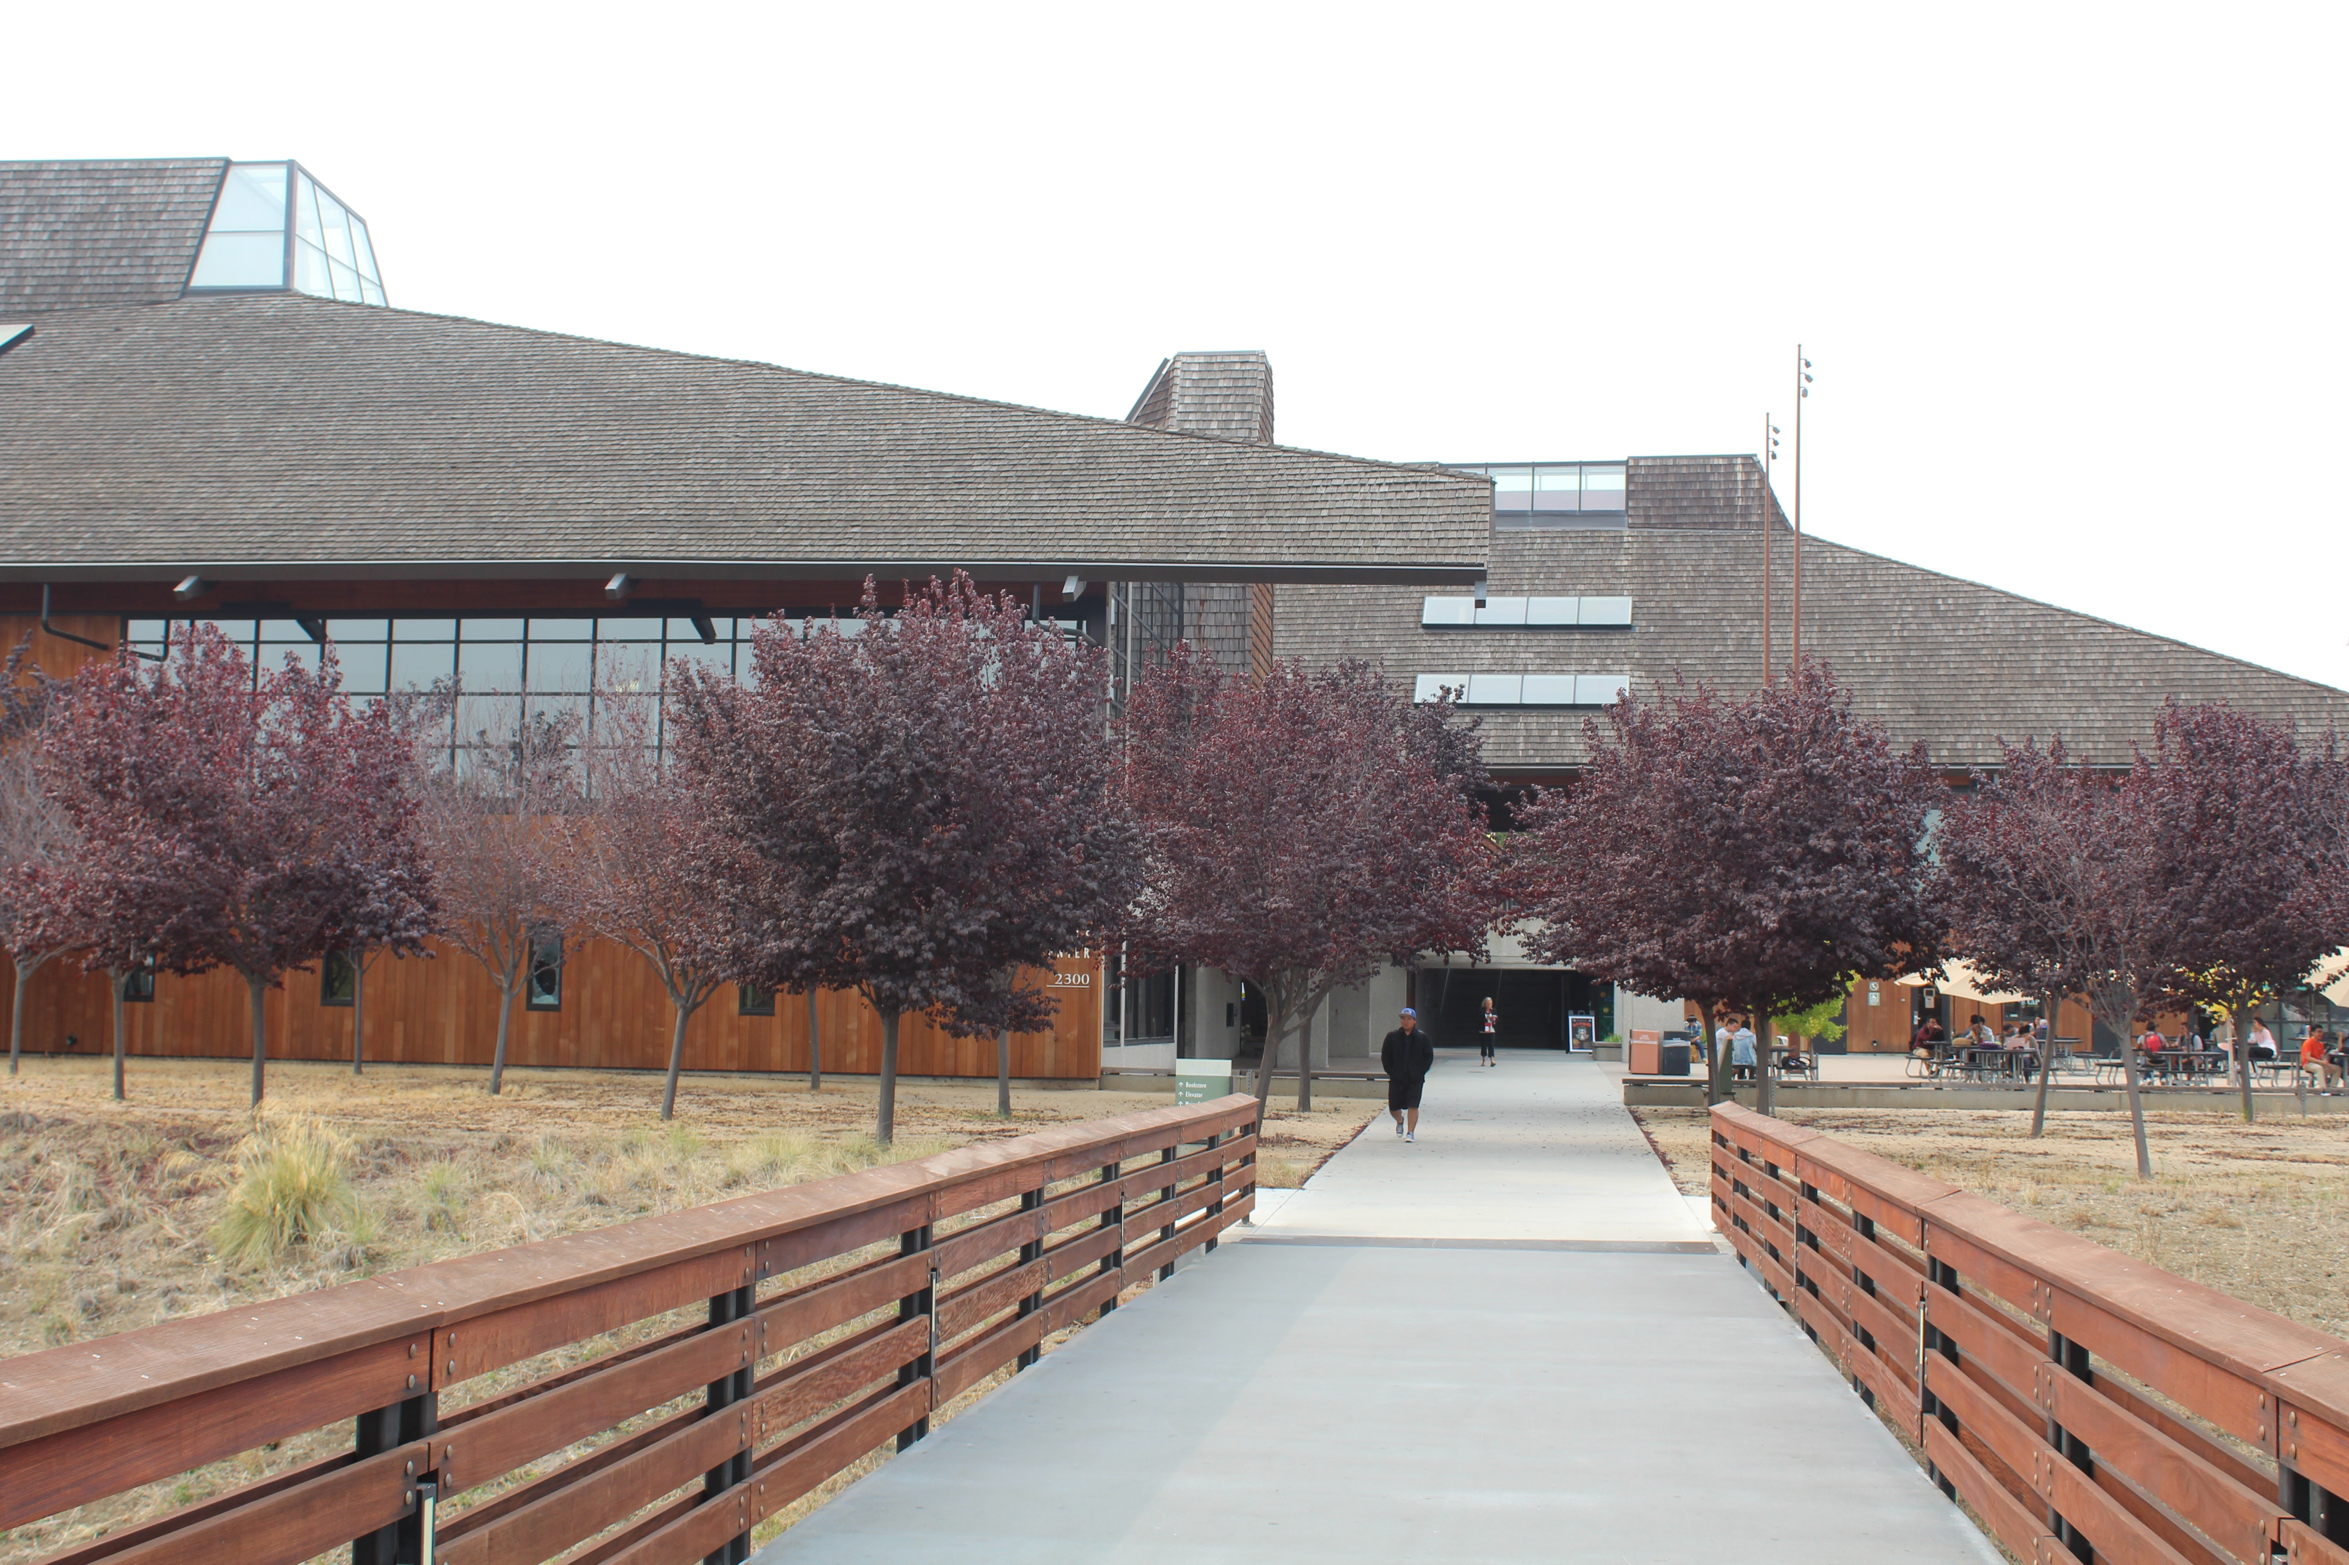
Our Mission
Believing a well-educated population is essential to sustaining and enhancing a democratic society, Foothill College offers programs and services that empower students to achieve their goals as members of the workforce, as future students, and as global citizens. We work to obtain equity in achievement of student outcomes for all California student populations, and are guided by our core values of honesty, integrity, trust, openness, transparency, forgiveness, and sustainability. Foothill College offers associate degrees and certificates in multiple disciplines, and a baccalaureate degree in dental hygiene.

Slide 3
Joint Advisory & R&R Guiding Principles:
Student-Centered Decision-Making Guiding Principles – DRAFT
As of 8.21.20
Remain cognizant of the spirit of the student open letter (Spring 2020) to Foothill College’s academic senate. Decide where this link would go, for transparency purposes.
Guiding Principles for the students, staff, faculty, and administrators of Foothill College
The numbering is in no particular order; it’s simply meant to make the document easier to utilize.
  Foothill College commits to collaborative decision-making with consistent and transparent communication, which includes the interests of Students, Faculty, Administration, and Staff.
  Foothill College acknowledges that students are the best experts on student needs and experiences and commits to student involvement at every level of decision making.
  Foothill College commits to preserving and/or strengthening instructional and student services programs that actively support and empower disproportionately impacted student groups.
  Foothill College commits to providing equity-minded professional development for faculty, staff, and administrators.
  Foothill College commits to considering the impact of budget actions on students, staff, faculty, and administrators of color.
  Foothill College commits to considering the impact of budget actions on historically marginalized groups* within the community.
    i. *race, ethnicity, national origin, ancestry, color, sex, gender identity, gender expression, sexual orientation, physical disability, mental disability, medical condition, genetic information, marital status, age, religious creed, military status, veteran’s status, or any other status legally protected from discrimination
  Foothill College commits to strategic re-envisioning and restructuring of the services and programs that are marked for reductions.
  Foothill College commits to minimizing the impact on students by exploring consolidation and look for efficiencies within programs on the Foothill campus, and possibly with De Anza, before embarking on program elimination. (Programs include both academic and student services).

Slide 4
State & FHDA Budget Update:
State revenue kept at 2019-20 levels.
  No reductions to State Apportionment
  No 2.3% COLA
  Deferrals ($1.45 billion for CCC System)
Hold harmless is extended two more years ending 2023-24
FHDA remains on hold harmless provision of the SCFF for 2020-21 (not Basic Aid)
Local property taxes are projected 3% higher for current year and enrollment fees are flat
FHDA Non-resident revenue projected to be down by 20% (Tentative Budget reflected 30% down)
Projected General Fund revenue for FHDA for 2020-21 is $192.0 million, while projected expenses are estimated at $192.3 million
  Approx. $14.1 of the $192 million revenue is temporary revenue (hold harmless provision of SCFF)
  The project expenses of $192.3 does not include district’s estimate of the Reclassification and Compensation costs estimated to be approx. $3 million
Potential of $1.45 billion in deferrals at the State
  No new federal aid package at this time
  Less impact to FHDA because majority of revenue comes from local property taxes, enrollment fees and non-resident tuition

Slide 5
Budget Reduction Figure Update:
District’s revised reduction target is $9 million
Assigning costs to each campus and central services
  $3.15 million - Foothill (approx. 6% of General Fund budgeted expenses)
  $4.5 million - De Anza
  $1.35 million - Central Services

Slide 6
District’s Latest Budget Info:
  Proposed Changes if we do not start 2021-22 with a balanced budget
    Encouraged to identify one-time funds to reach target
    May use the following sources:
      “B” Budget Carryforward (Foothill’s Carryover for 2019/20 was $5.6 million)
        Division & departmental “B” budget carryforward
        Classified and administrator positions vacancies
      Salary savings from non-backfilled positions (administrators & classified positions is approx. $300k)
      Unpaid leaves
      Capital Outlay Funds (Fund 400) approx. $5.7 million
      Categorical Programs/Grants (121/131)
      Enterprise funds (does not pertain to Foothill College)
      Other items
        Self-Sustaining Fund (115)
        SRP (13 vacant faculty positions, 1 vacant classified ISP position)

Slide 7
Foothill’s Proposed One-time Budget Solution:
    “B” Budget Carryforward (Foothill’s Carryover includes administrator/classified vacancies was $5.6 million)
      Utilize $2.35 million
    Salary savings from non-backfilled positions (administrator and classified positions)
      Approx. $300k
    SRP (faculty)
      $500k comes from Capital Funds (Fund 400)
      Use one-time funds to temporarily buyout 3rd year of SRP costs.
      Total proposed budget solutions is $3.15 million

Slide 8
Long Term Budget Reduction Considerations:
Re-imagining the college through equity
Hiring Holds (analyze all vacant positions)
Ongoing “B” Budget
  Reduce and redistribute based on data analysis to promote equity and parity
Investment Strategy
Consolidation of Programs/Reorganization
  Instruction, Student Services, Administrative Services
Reduction of Programs

Slide 9
Budget Dates:
May 14, 2020 – Governor’s May Revise (State Budget)
June 8, 2020 – FHDA’s Tentative Budget
  Based on Governor’s May Revise
June 15, 2020 – State Budget from Legislature to Governor
July 1, 2020 – Governor signs budget
August 2020 – State Budget Revision
October 5, 2020 – FHDA’s Final Budget
November 1, 2020 – Position reduction list to Human Resources (not necessary at this time)

Slide 10
Governance Meetings:
Joint Advisory/Revenue and Resource Council
Sept. 14, 2020 – First Read of Foothill’s One-time Budget Proposal
Oct. 16, 2020 (3:30pm – 5pm) – Second/Final Read
https://foothill.edu/gov/ac-rr-joint-meetings.html

Slide 11
Questions?

