Slide 1
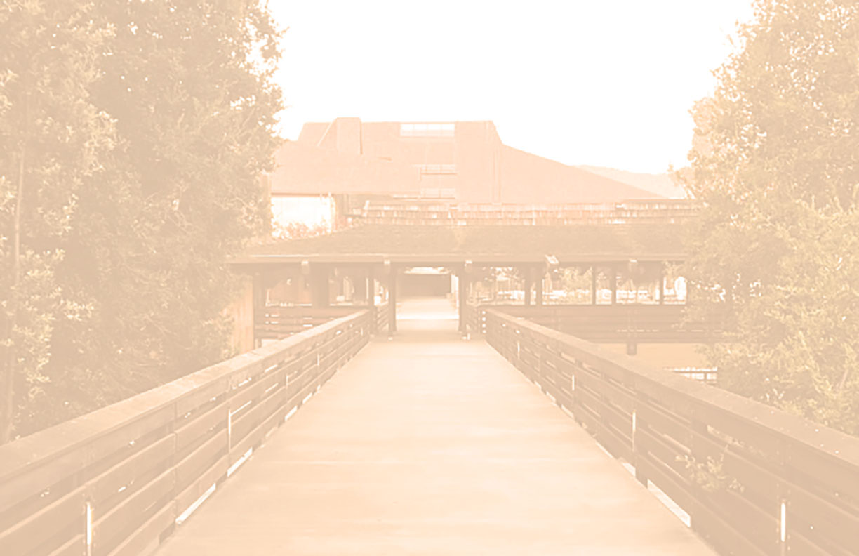
MEASURES G AND C
PROJECT UPDATES
FH Academic Senate Presentation
27 February 2023

Slide 2
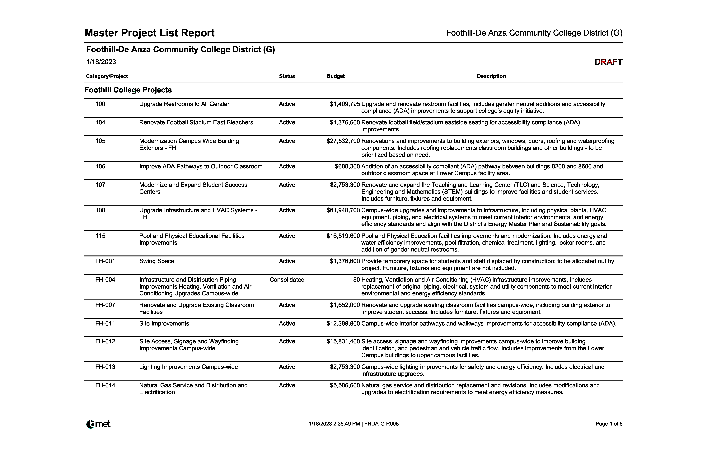
MEASURE G – PROJECT LIST

Slide 3
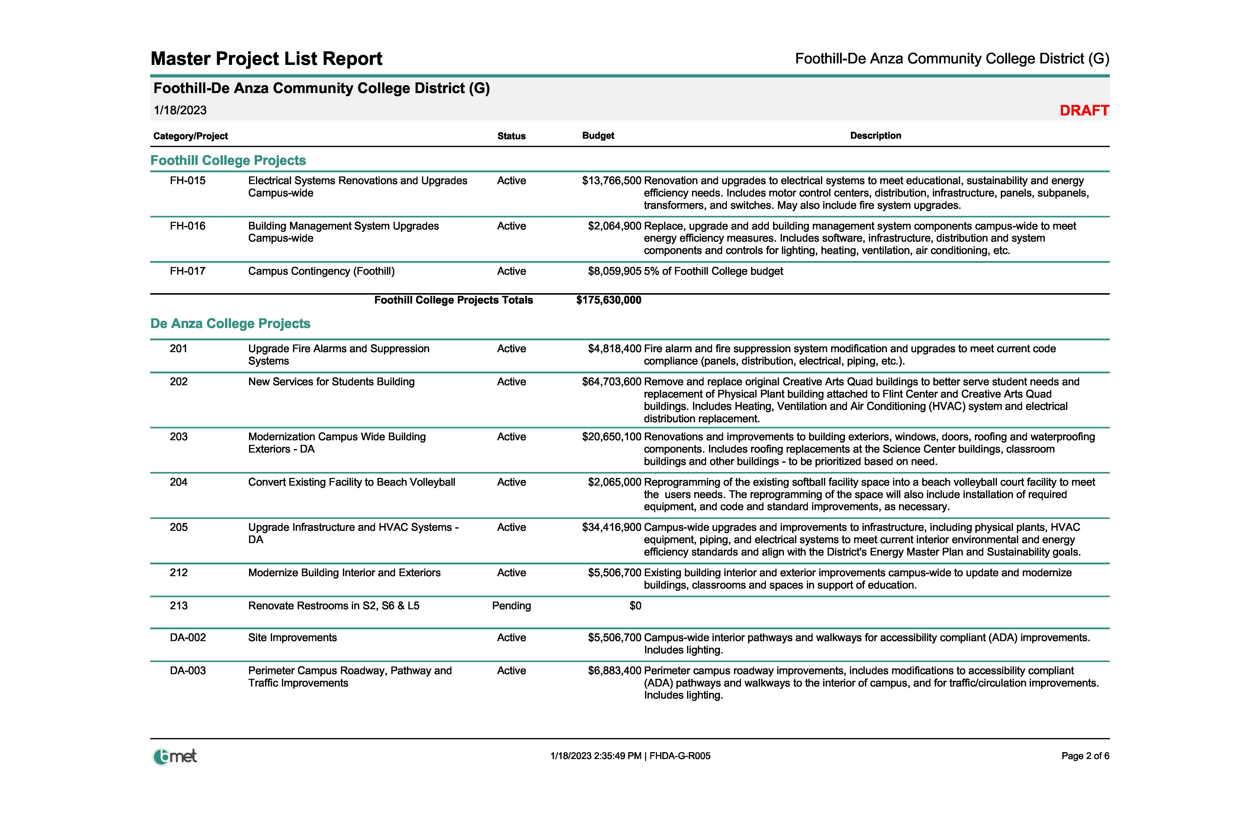
MEASURE G – PROJECT LIST

Slide 4
DESIGN PROCESS
▪ Kick-off meeting scheduled after Board approval and Agreements executed. Who?
What? When?
▪ Who are the stakeholders? Decision Makers vs. Input providers.
• Stakeholders – anyone who has an interest in the project.
• Decision Makers – Scope and Budget - Senior Leadership
• Input Providers – Influences the Decision Makers – Faculty, Students,
Outside Community
▪ What is District goals of the project and confirmation of the budget.
▪ When is the anticipated completion?
▪ Communication through periodic updates.

Slide 5
DESIGN PROCESS
MEASURE G PROJECTS

Slide 6
UPGRADE RESTROOMS TO ALL GENDER
▪ Scope: Upgrade and renovate restroom facilities, includes gender neutral
additions and accessibility compliance (ADA) improvements, to support
college’s equity initiative.
▪ Design Team: Stienberg Hart (Architects), College, Facilities and Gilbane
▪ Current Project Budget: $1,409,795 (Original Budget $688,300)
▪ Status: Division of the State Architect’s Office (DSA) Submittal February, 2023

Slide 7
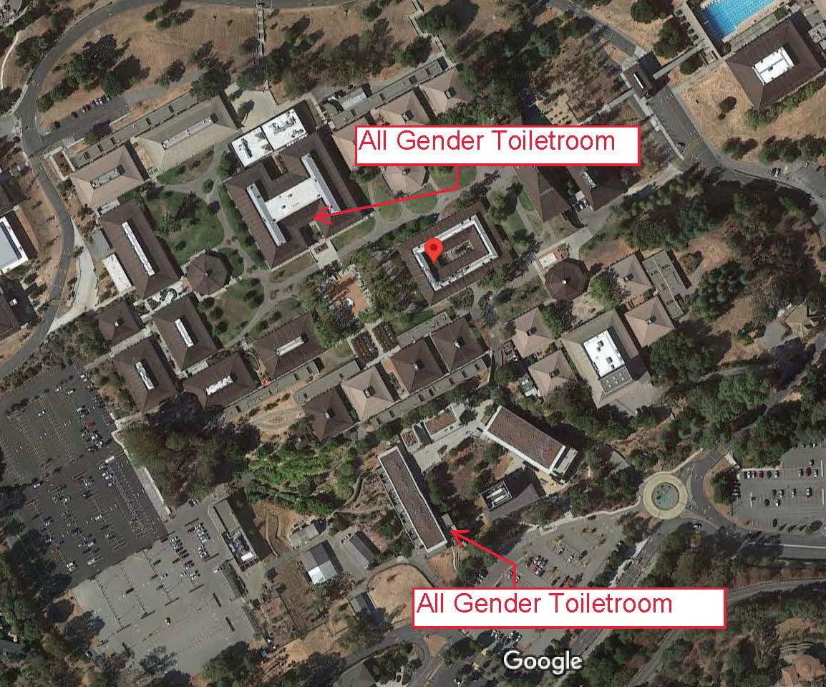
UPGRADE RESTROOMS TO ALL GENDER

Slide 8
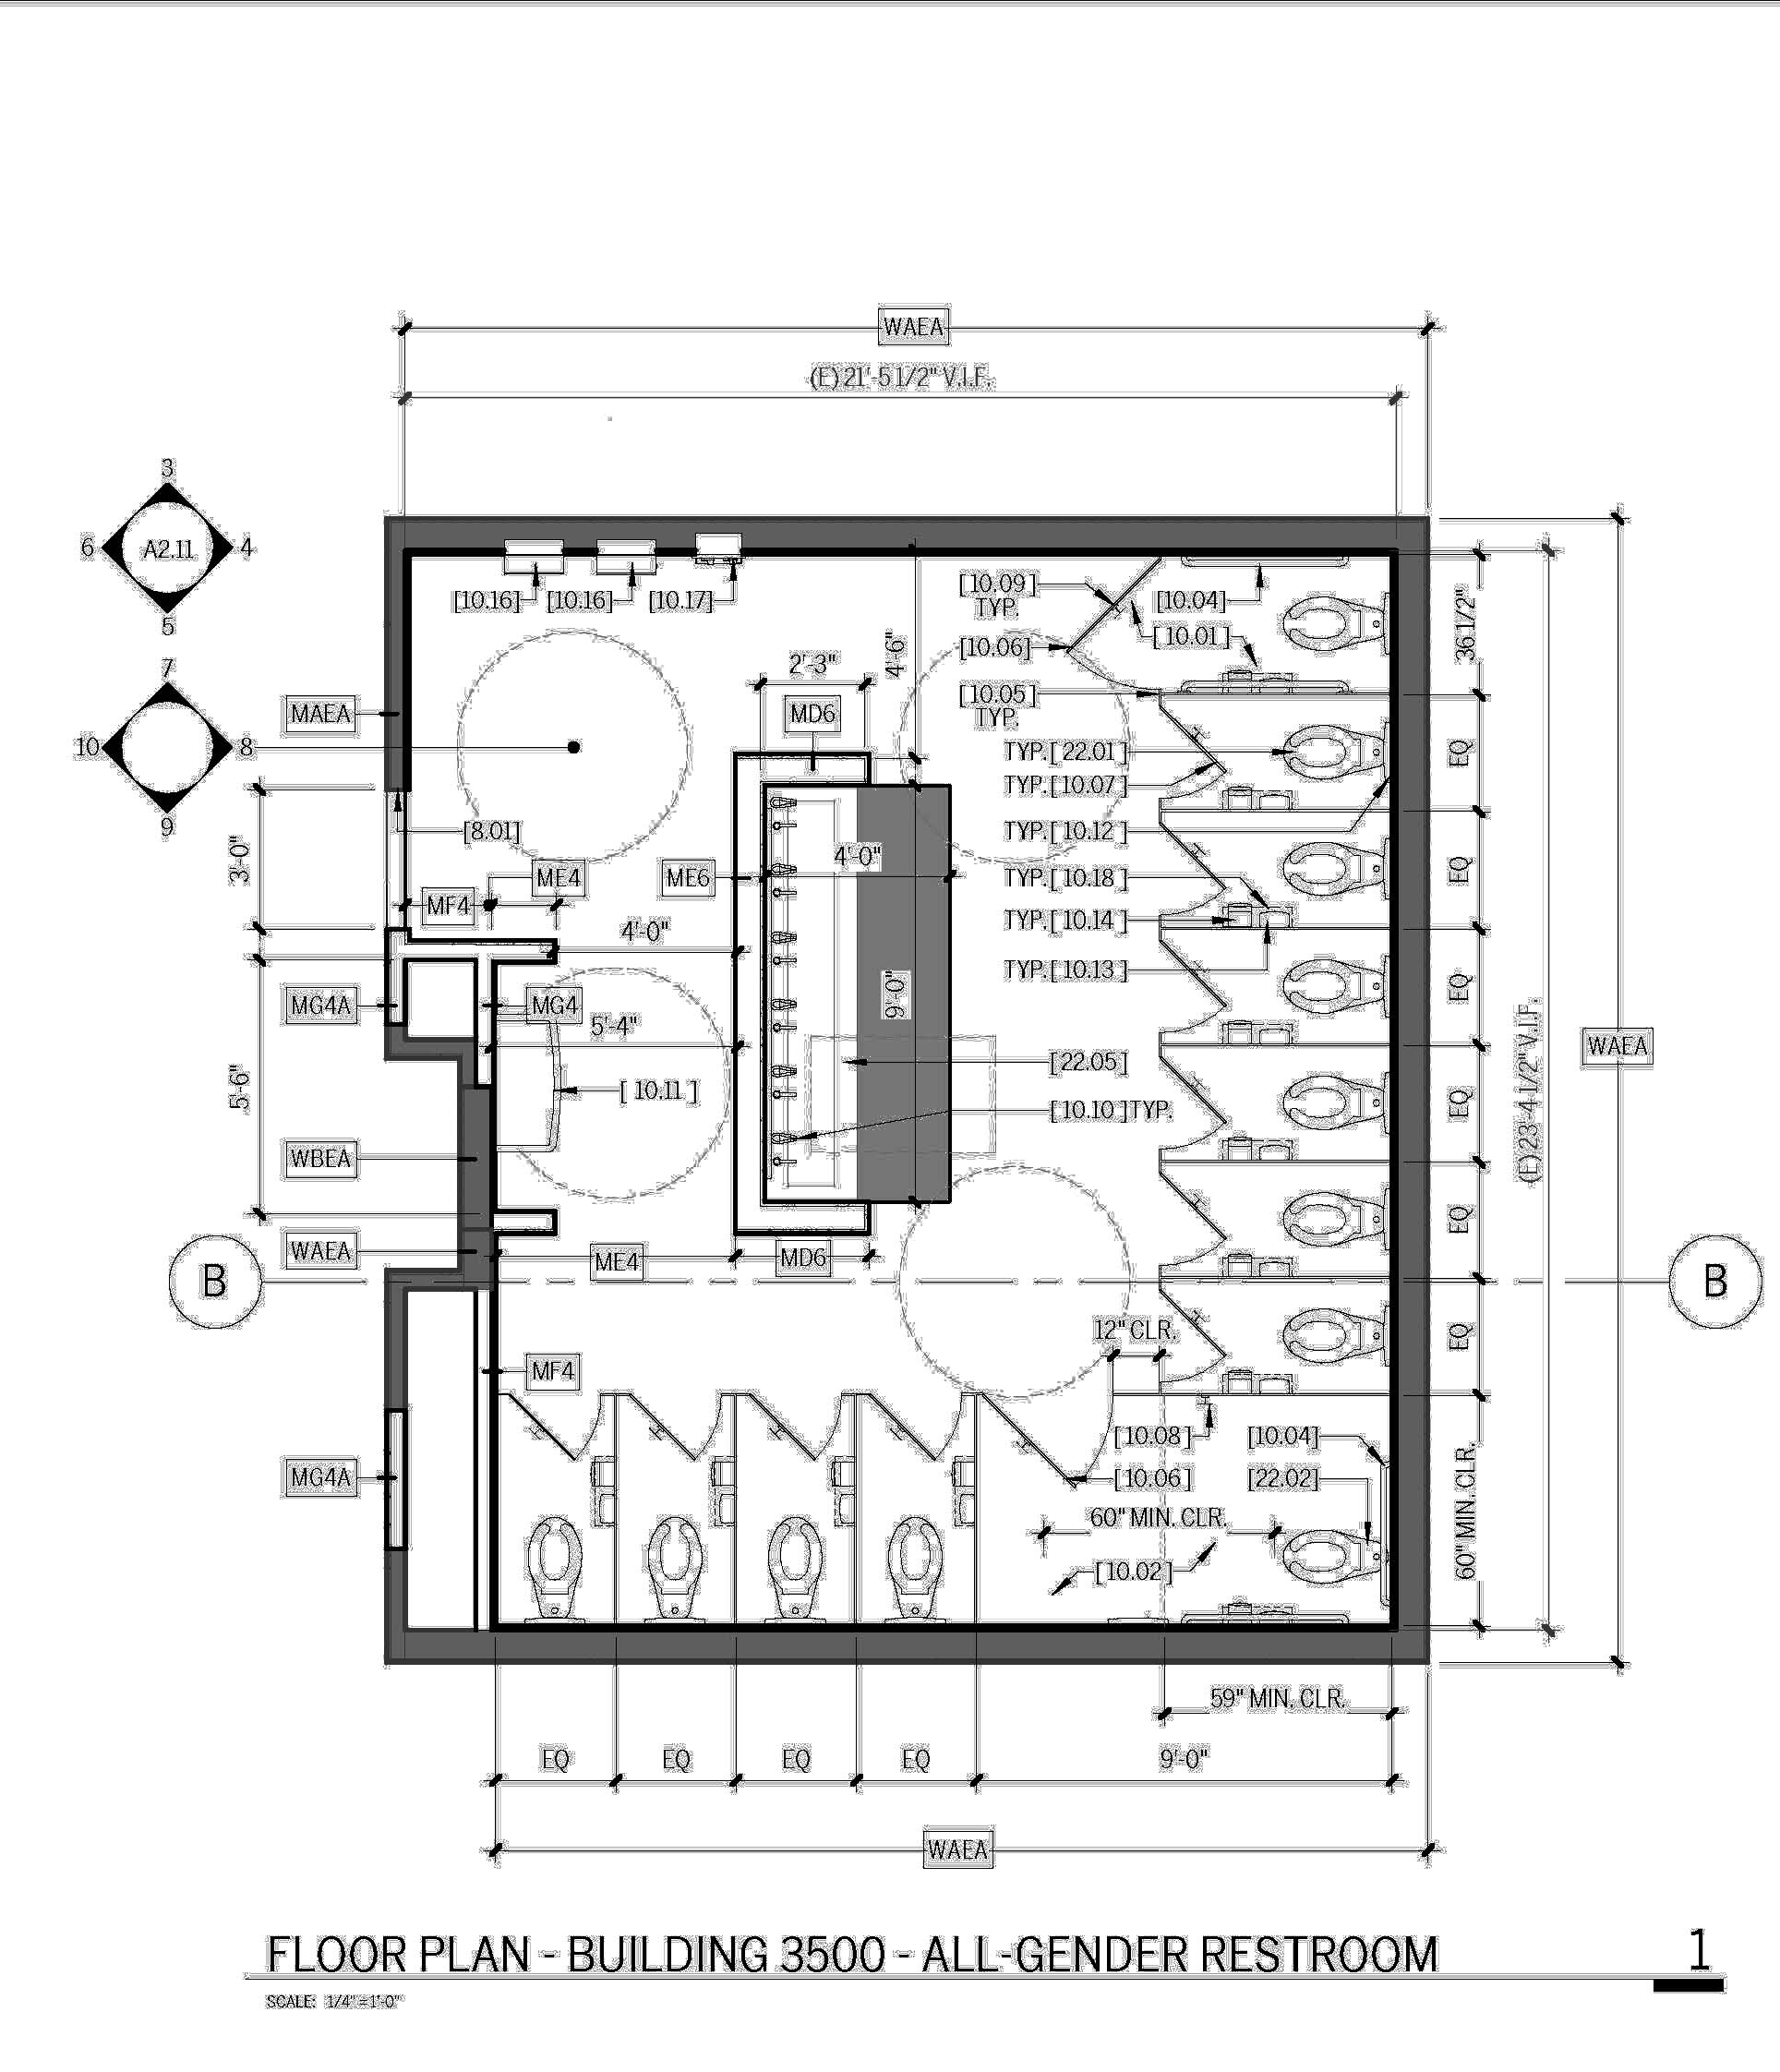
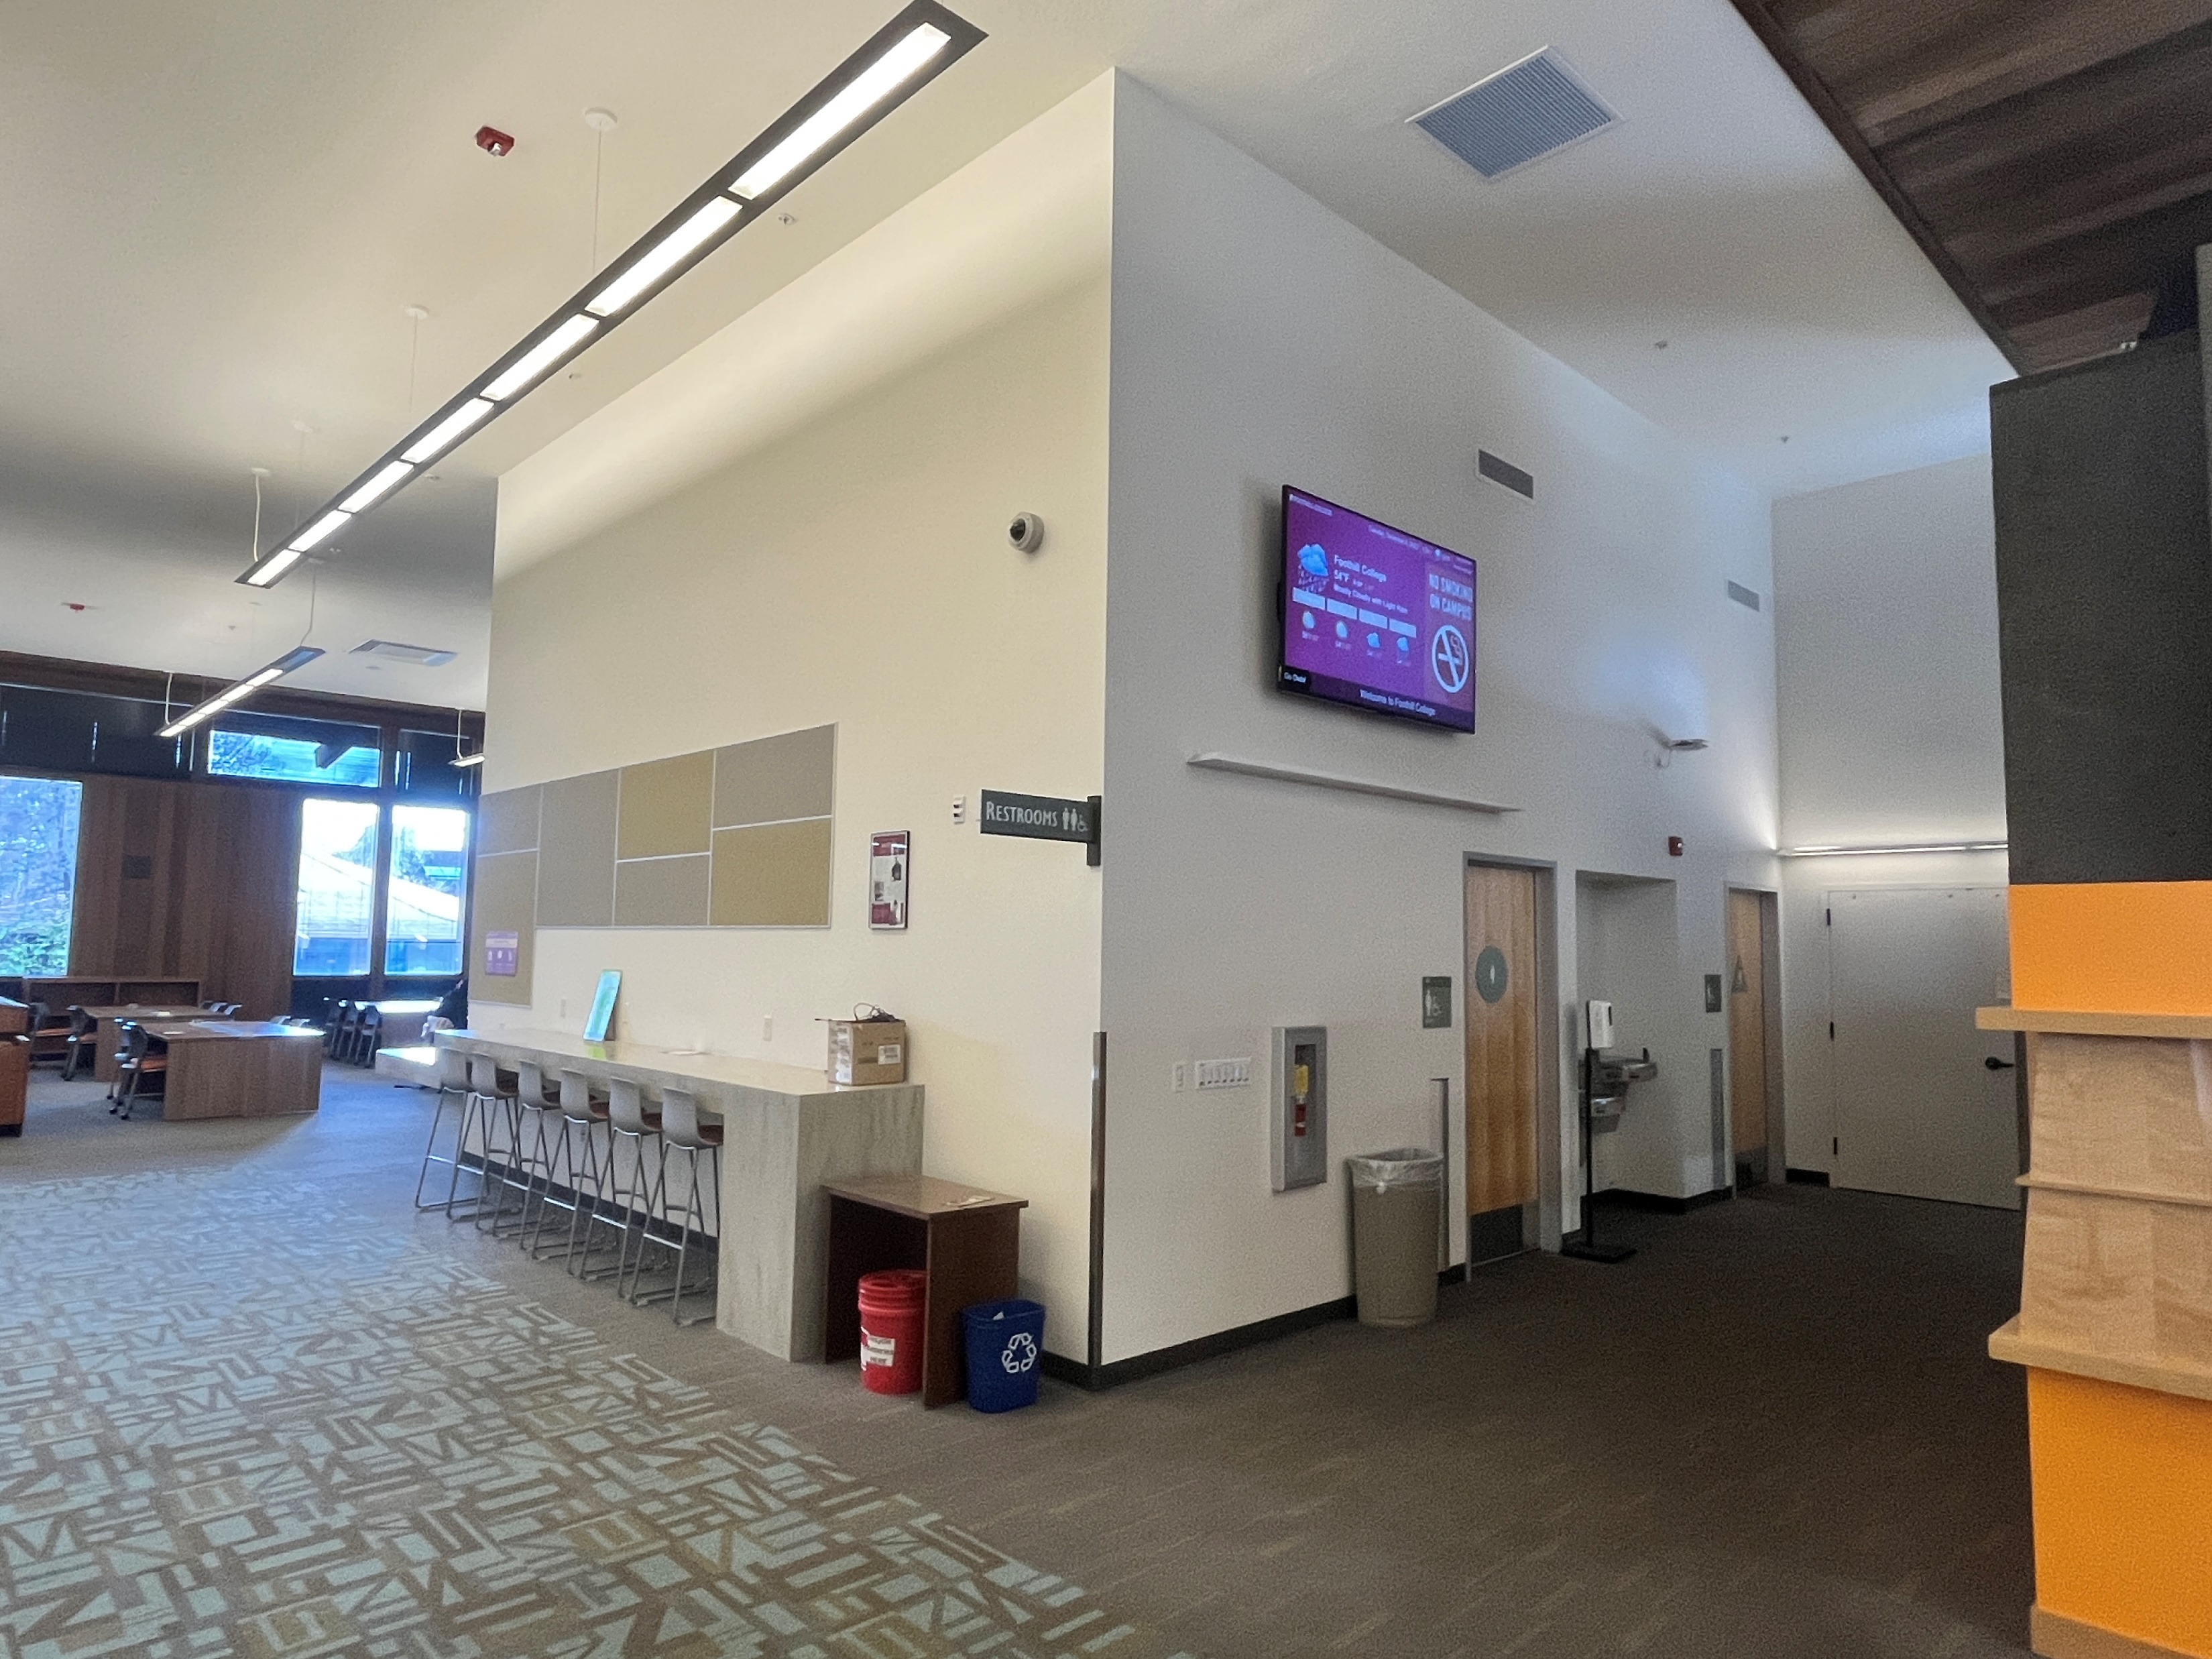
UPGRADE RESTROOMS TO ALL GENDER

Slide 9
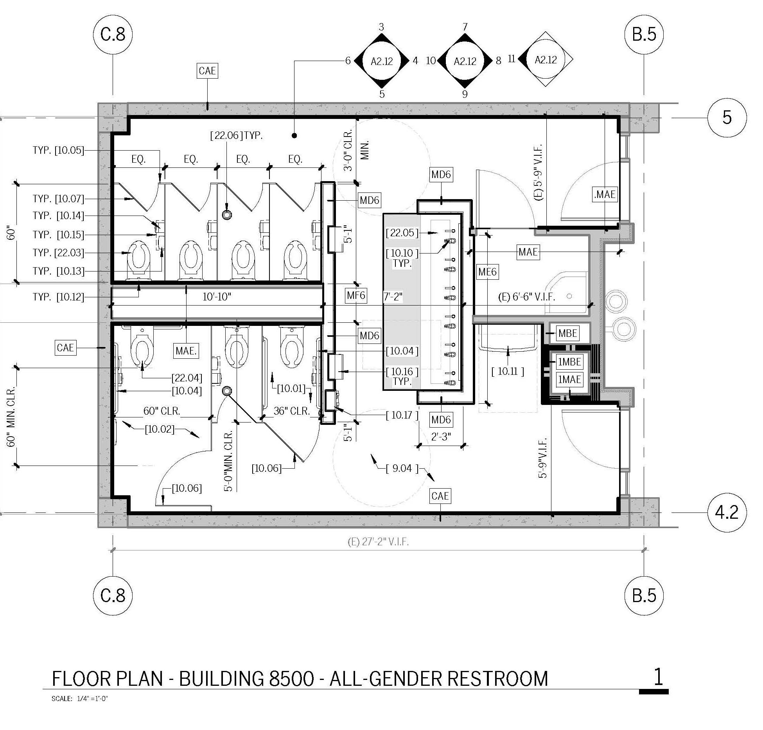
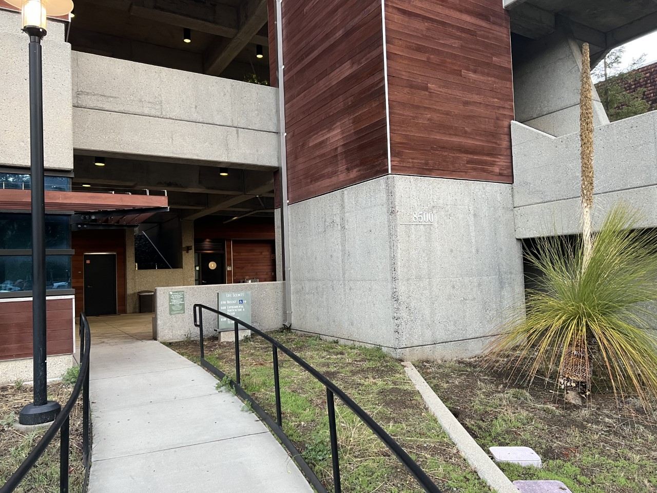
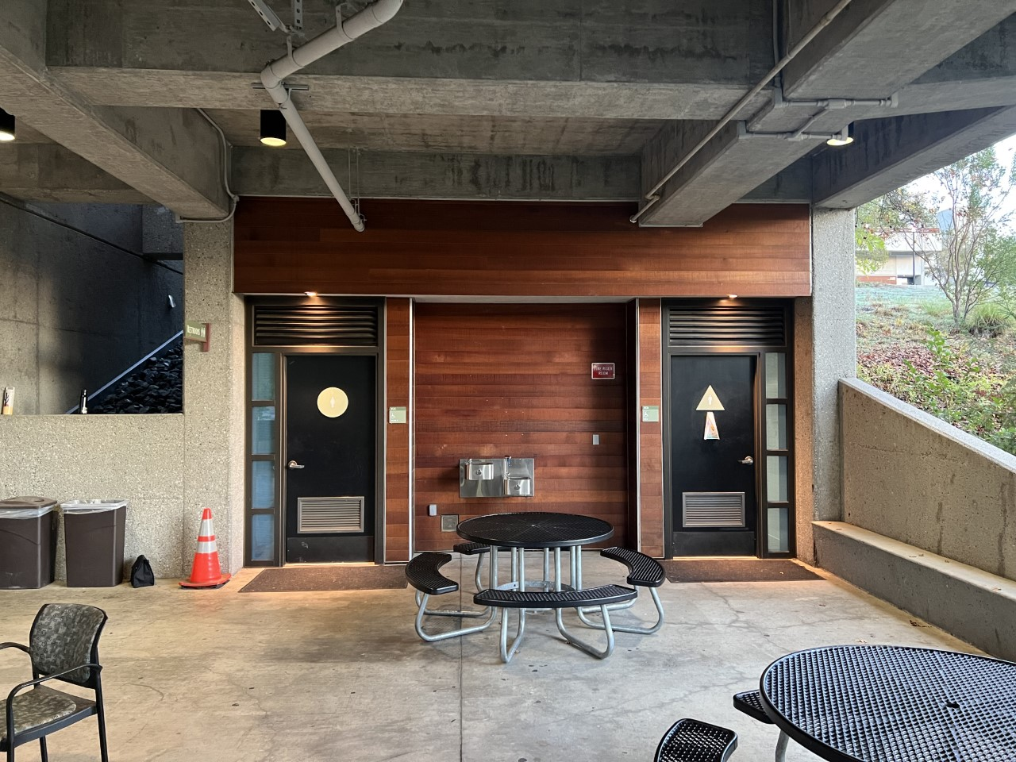
UPGRADE RESTROOMS TO ALL GENDER

Slide 10
RENOVATE FOOTBALL STADIUM EAST BLEACHERS
▪ Scope: Renovate football field/stadium east side seating for accessibility
compliance (ADA).
▪ Design Team: Loving & Campos(Architects), College Athletics, Facilities and
Gilbane
▪ Current Project Budget: $1,376,600
▪ Status: Division of the State Architect’s Office (DSA) Submittal December, 2022

Slide 11
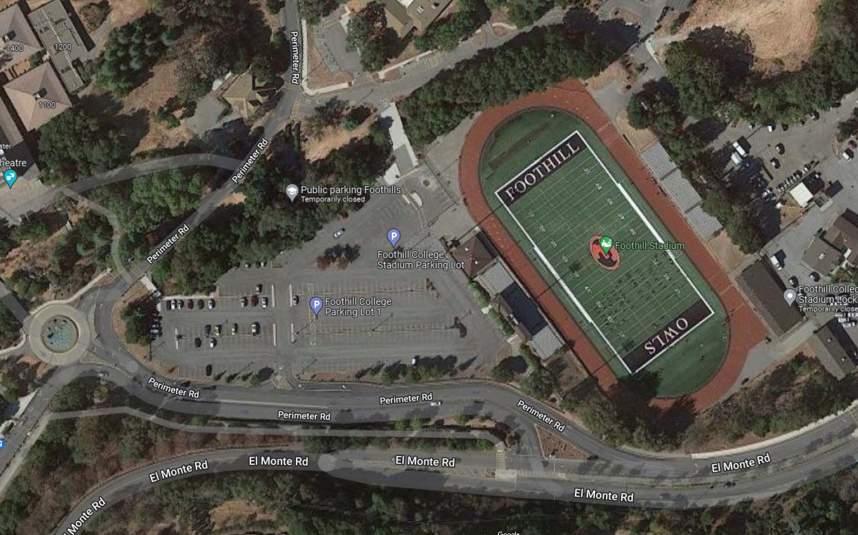
RENOVATE FOOTBALL STADIUM EAST BLEACHERS

Slide 12
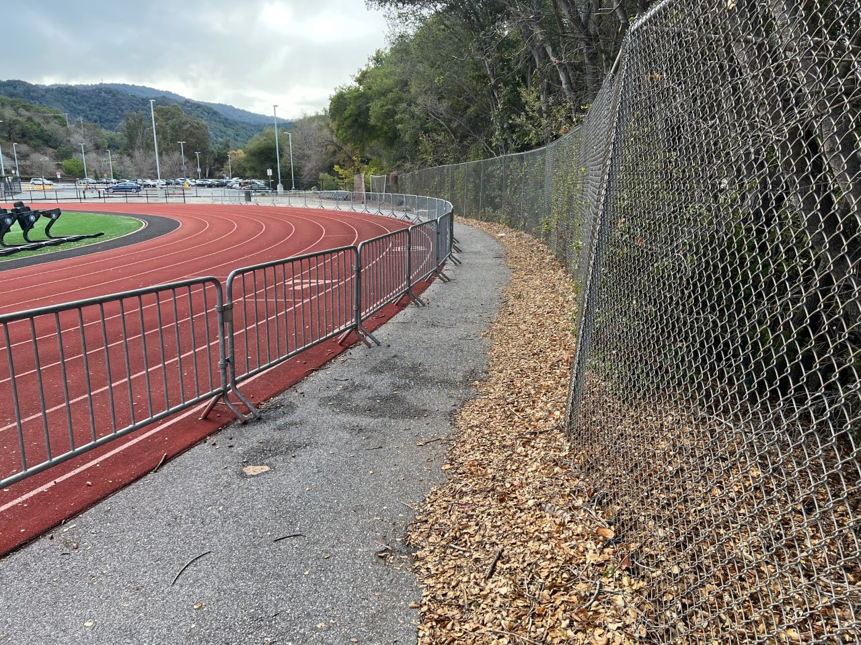
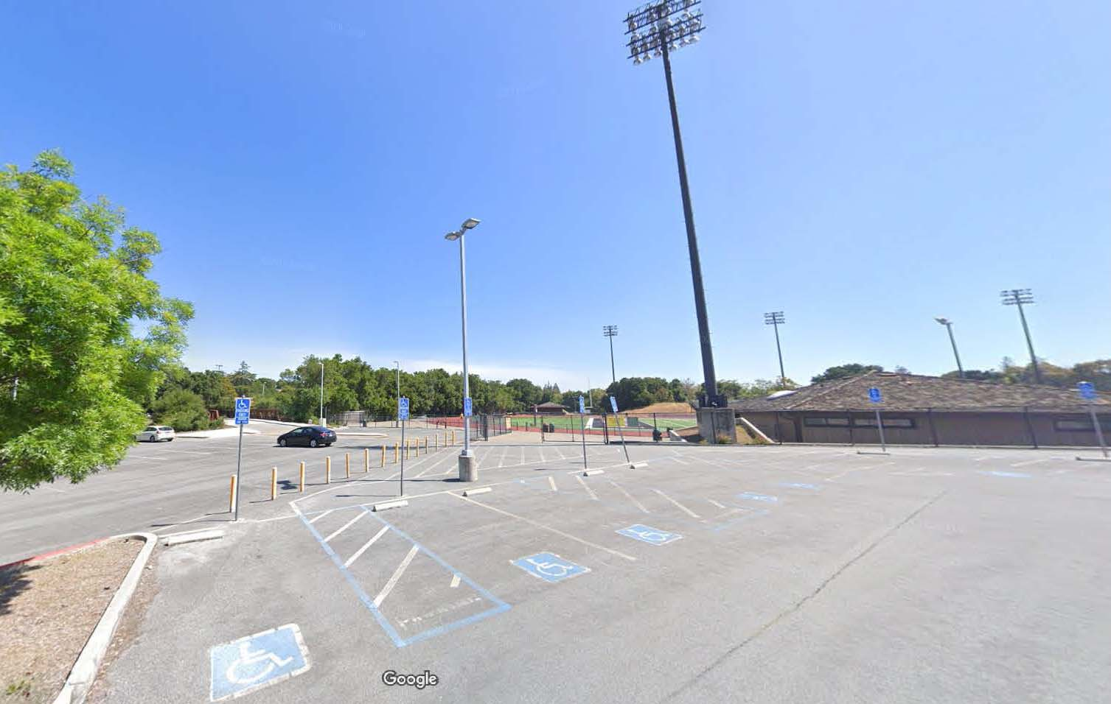
RENOVATE FOOTBALL STADIUM EAST BLEACHERS
Accessible Parking Stalls in Lot 1
Curved Path to East Bleachers.

Slide 13
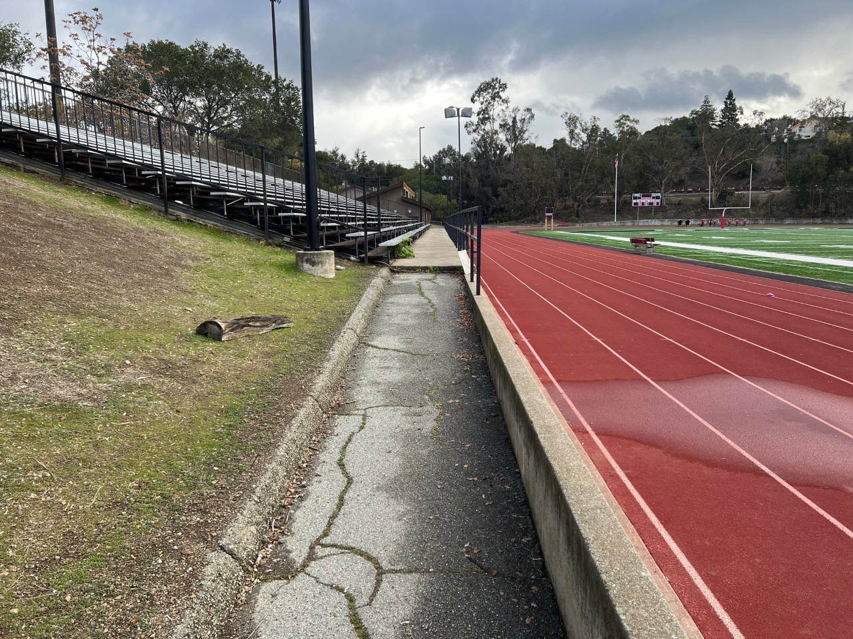
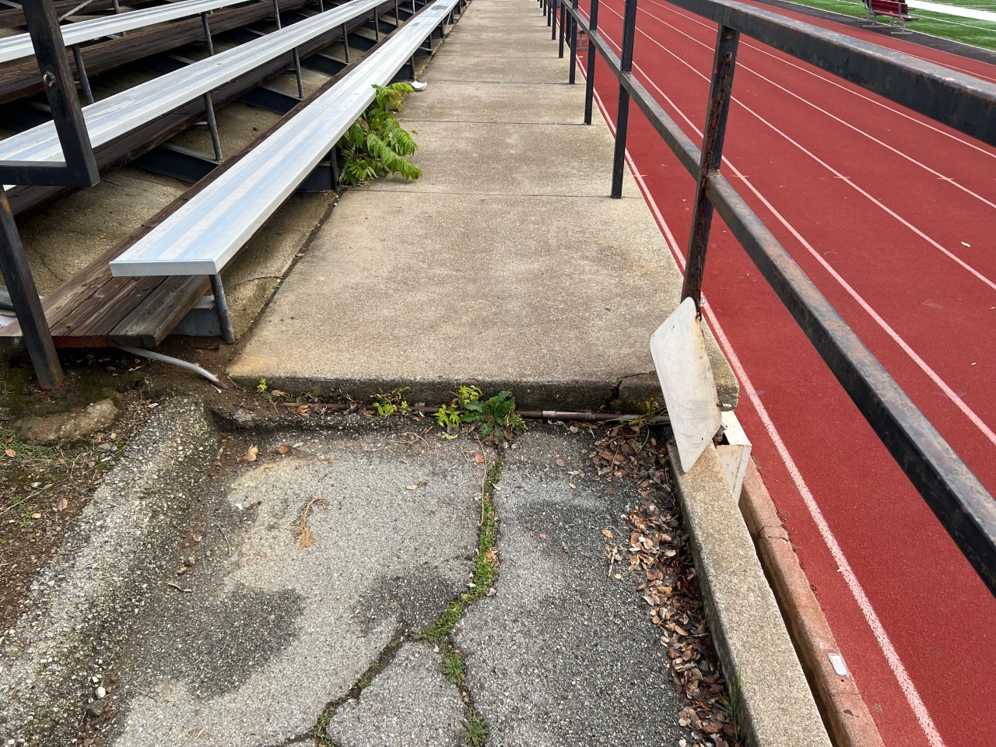
RENOVATE FOOTBALL STADIUM EAST BLEACHERS
Non Accessible ramp
Step to bleacher

Slide 14
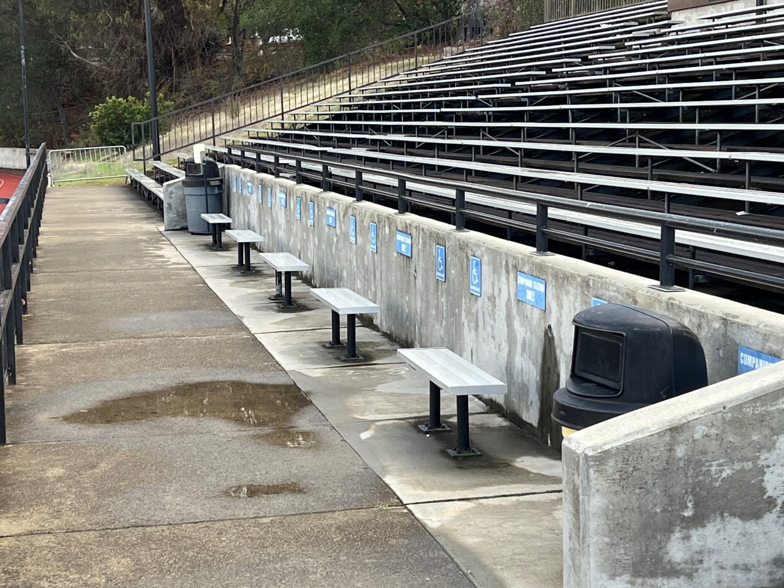
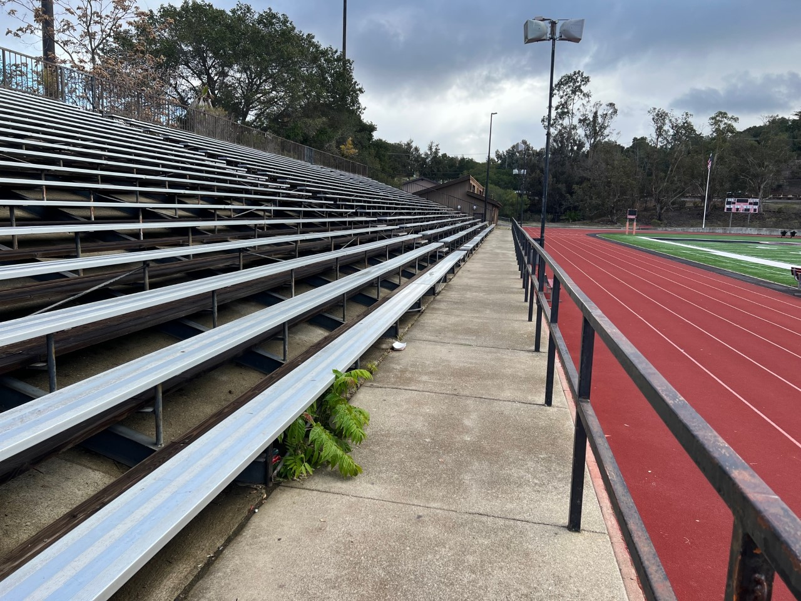
RENOVATE FOOTBALL STADIUM EAST BLEACHERS
No companion seating, match West bleacher
West bleacher companion seating

Slide 15
ACCESSIBILITY PATHWAY AND OUTDOOR GARDEN CLASSROOM
▪ Scope: Addition of an accessibility compliant (ADA) pathway between Buildings
8200 and 8600 and outdoor classroom space at Lower Campus facility
area.
▪ Design Team: Loving & Campos(Architects), College, Facilities and
Gilbane
▪ Current Project Budget: $688,300, likely to be higher
▪ Status: Architect resolving structural and waterproofing issues, part of walkway is
above Lohman Theater dressing rooms

Slide 16
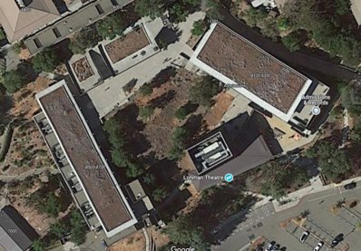
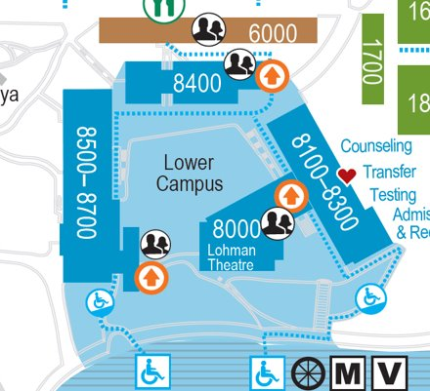
ACCESSIBILITY PATHWAY AND OUTDOOR GARDEN CLASSROOM

Slide 17
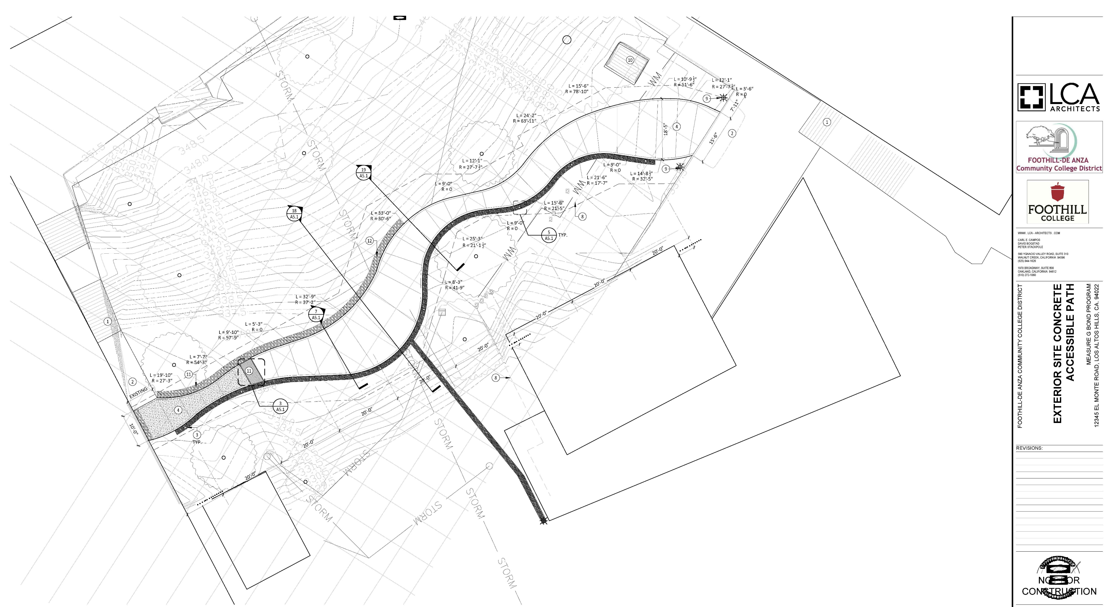
ACCESSIBILITY PATHWAY AND OUTDOOR GARDEN CLASSROOM

Slide 18
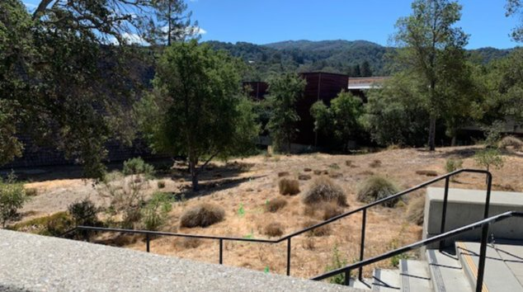
ACCESSIBILITY PATHWAY AND OUTDOOR GARDEN CLASSROOM

Slide 19
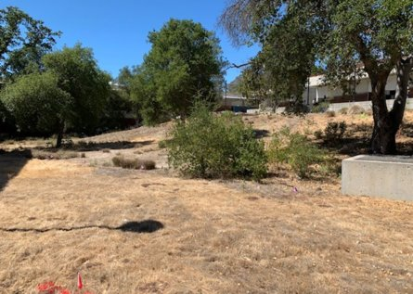
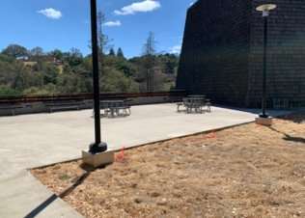
ACCESSIBILITY PATHWAY AND OUTDOOR GARDEN CLASSROOM

Slide 20
POOL AND PHYSICAL EDUCATION FACILITIES
▪ Scope: Pool and Physical Education Facilities improvements and modernization.
Includes energy and water efficiency improvements, pool filtration,
chemical treatment, lighting, lockers rooms and addition of all gender
neutral restrooms.
▪ Design Team: Loving & Campos(Architects), College Athletics, Facilities and
Gilbane
▪ Current Project Budget: $16,519,600
▪ Status: Kick off meeting with College Athletics, Facilities, Gilbane,
Communications to be held on February 3 to discuss scope and budget.

Slide 21
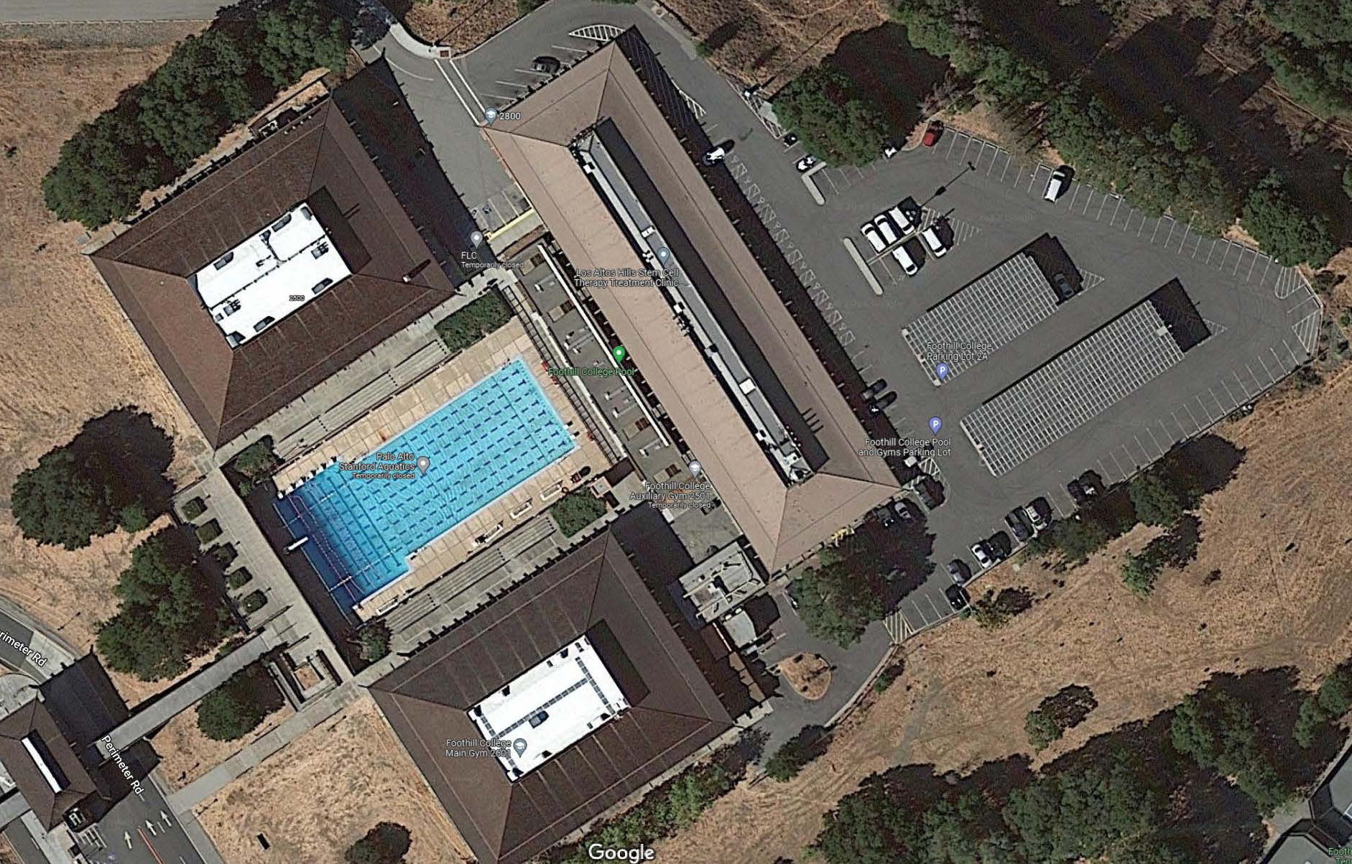
POOL AND PHYSICAL EDUCATION FACILITIES

Slide 22
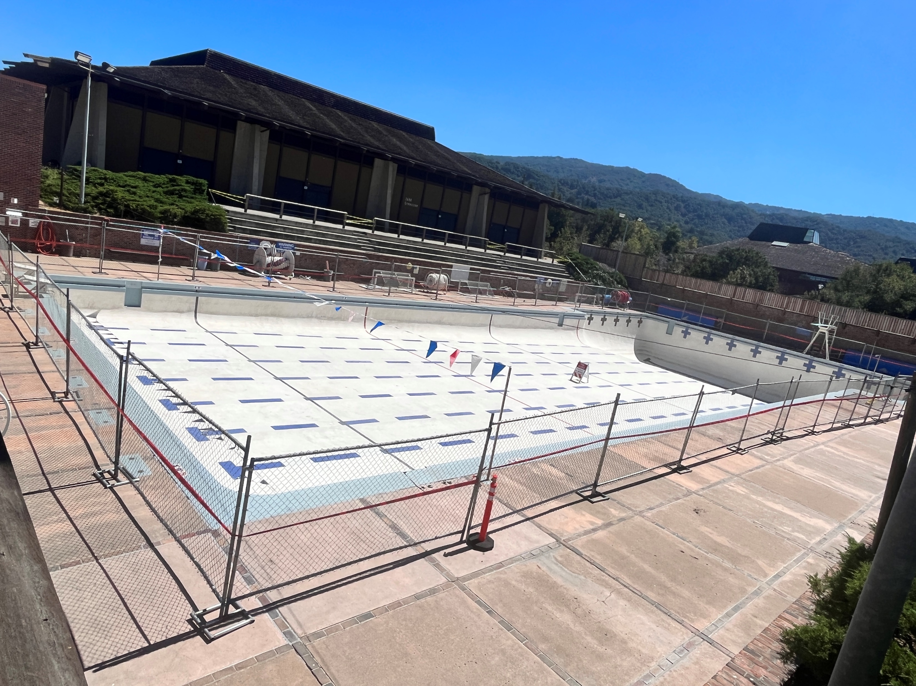
POOL AND PHYSICAL EDUCATION FACILITIES

Slide 23
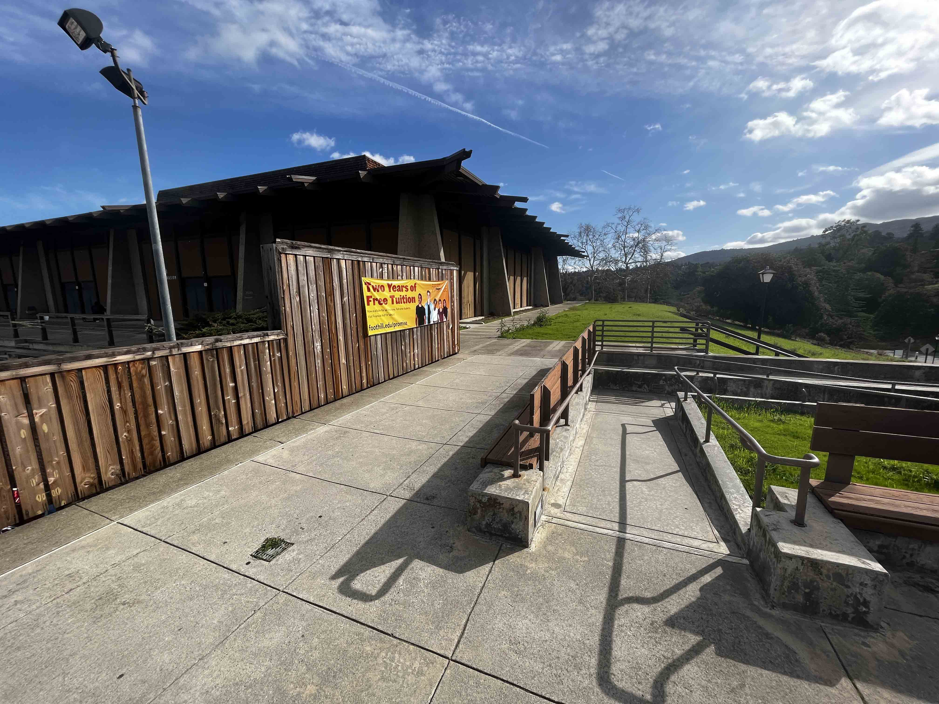
POOL AND PHYSICAL EDUCATION FACILITIES

Slide 24
DESIGN PROCESS
MEASURE C AND G PROJECT

Slide 25
SUNNYVALE EDUCATION CENTER HVAC SYSTEM
REPLACEMENT AND CLASSROOM RENOVATION
▪ Scope: Replace existing mechanical multi stack system with a new HVAC
system including a new chiller, controls, and individual heating/cooling
units in each classroom to supplement the HVAC system. Modernize
classrooms to house new programs(Rad. Tech, Pharma. Tech and Resp.
Tech.) that are currently at Foothill College, but will be relocated to the
Sunnyvale Ed Center.
▪ Design Team: PBK(Architects), Rad Tech., Pharma. Tech., Resp. Tech, Facilities
and Gilbane
▪ Current Project Budget: $12,000,000
▪ Status: Kick off meeting with Architect, various departments, and Facilities
held last November 2023. Site Visits to Foothill in December, 2022.
Site visits to existing facilities to be held.

Slide 26
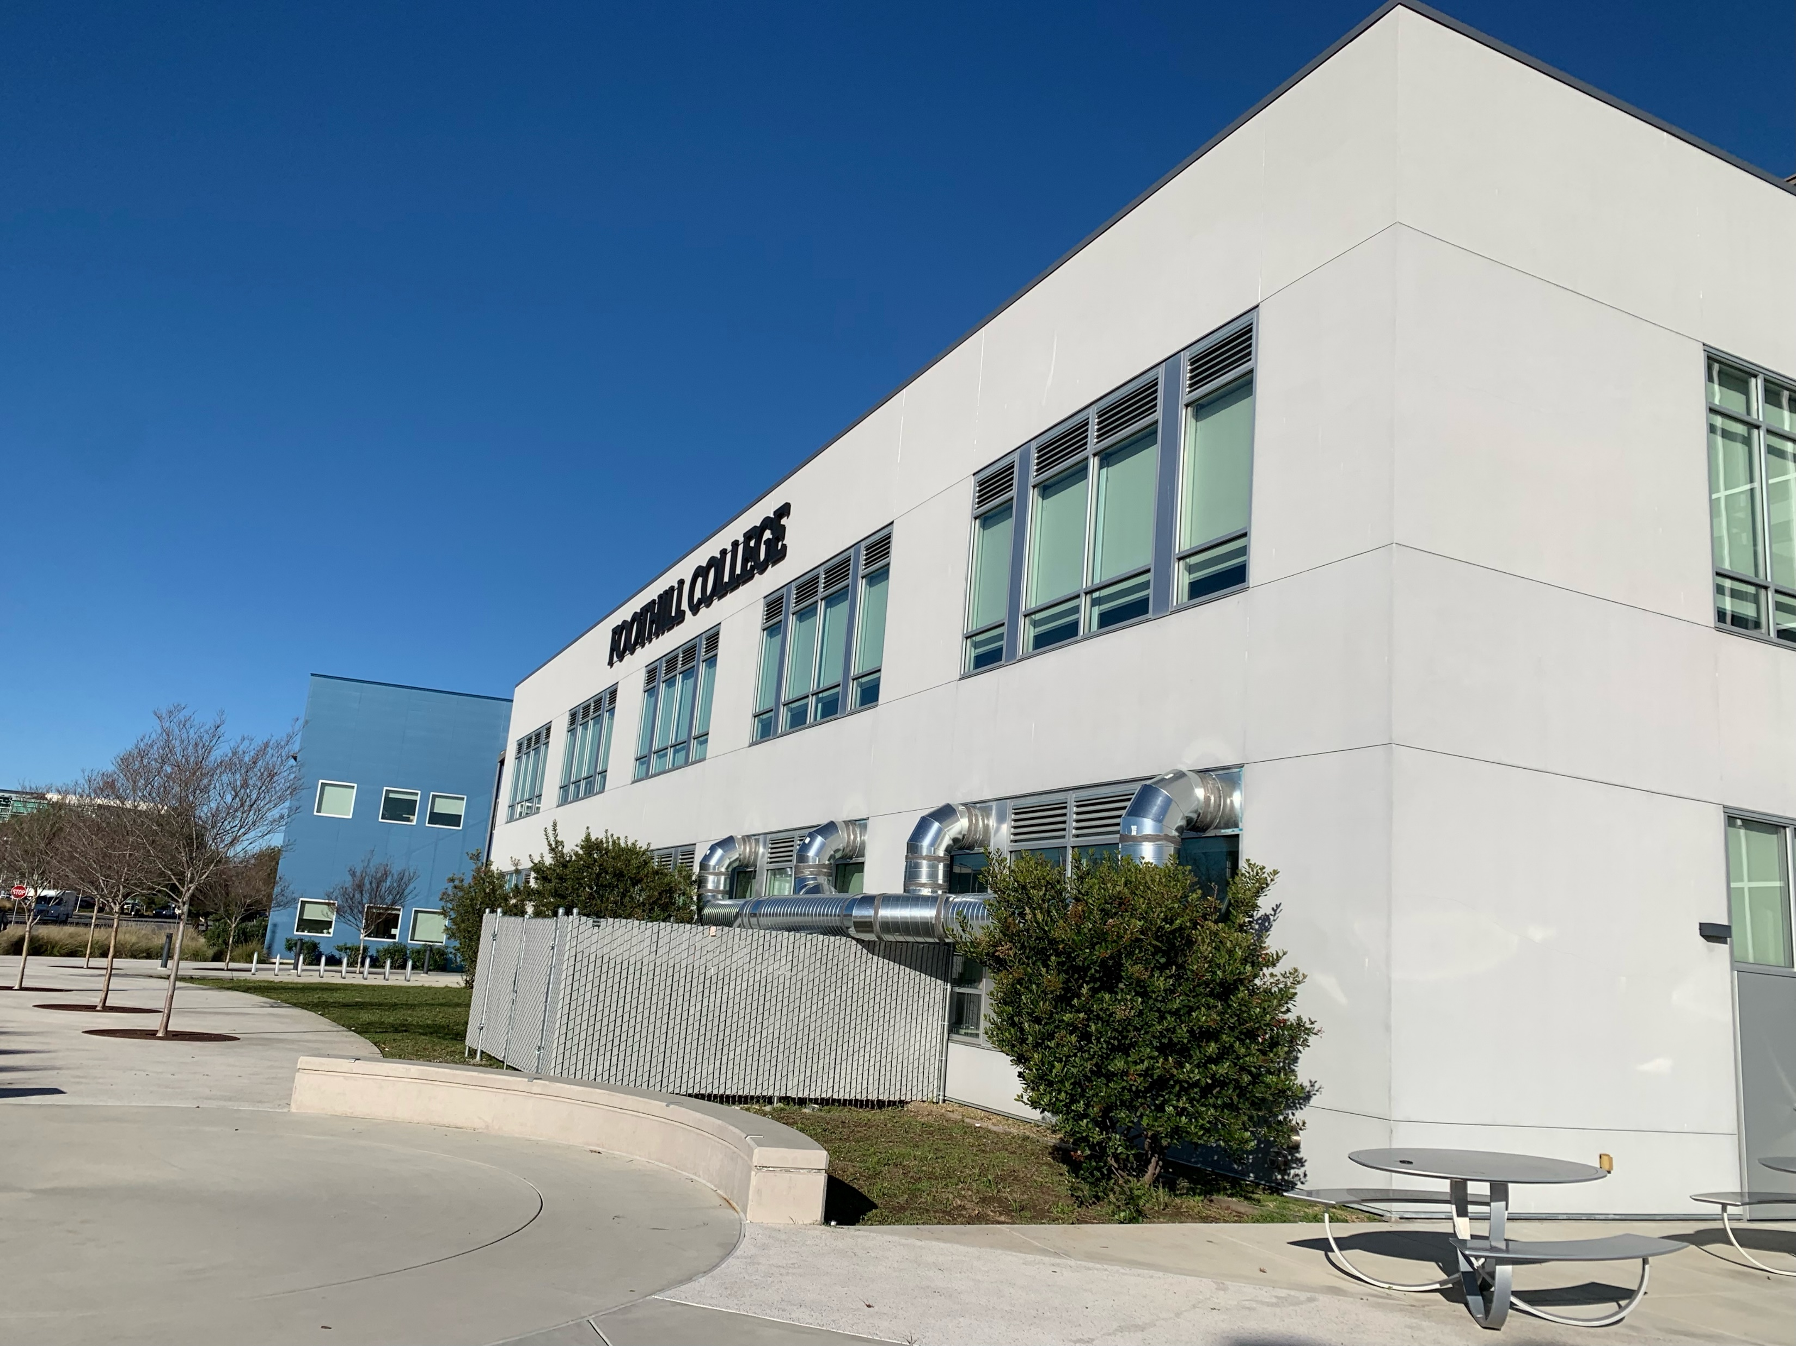
SUNNYVALE EDUCATION CENTER HVAC SYSTEM
REPLACEMENT AND CLASSROOM RENOVATION

Slide 27
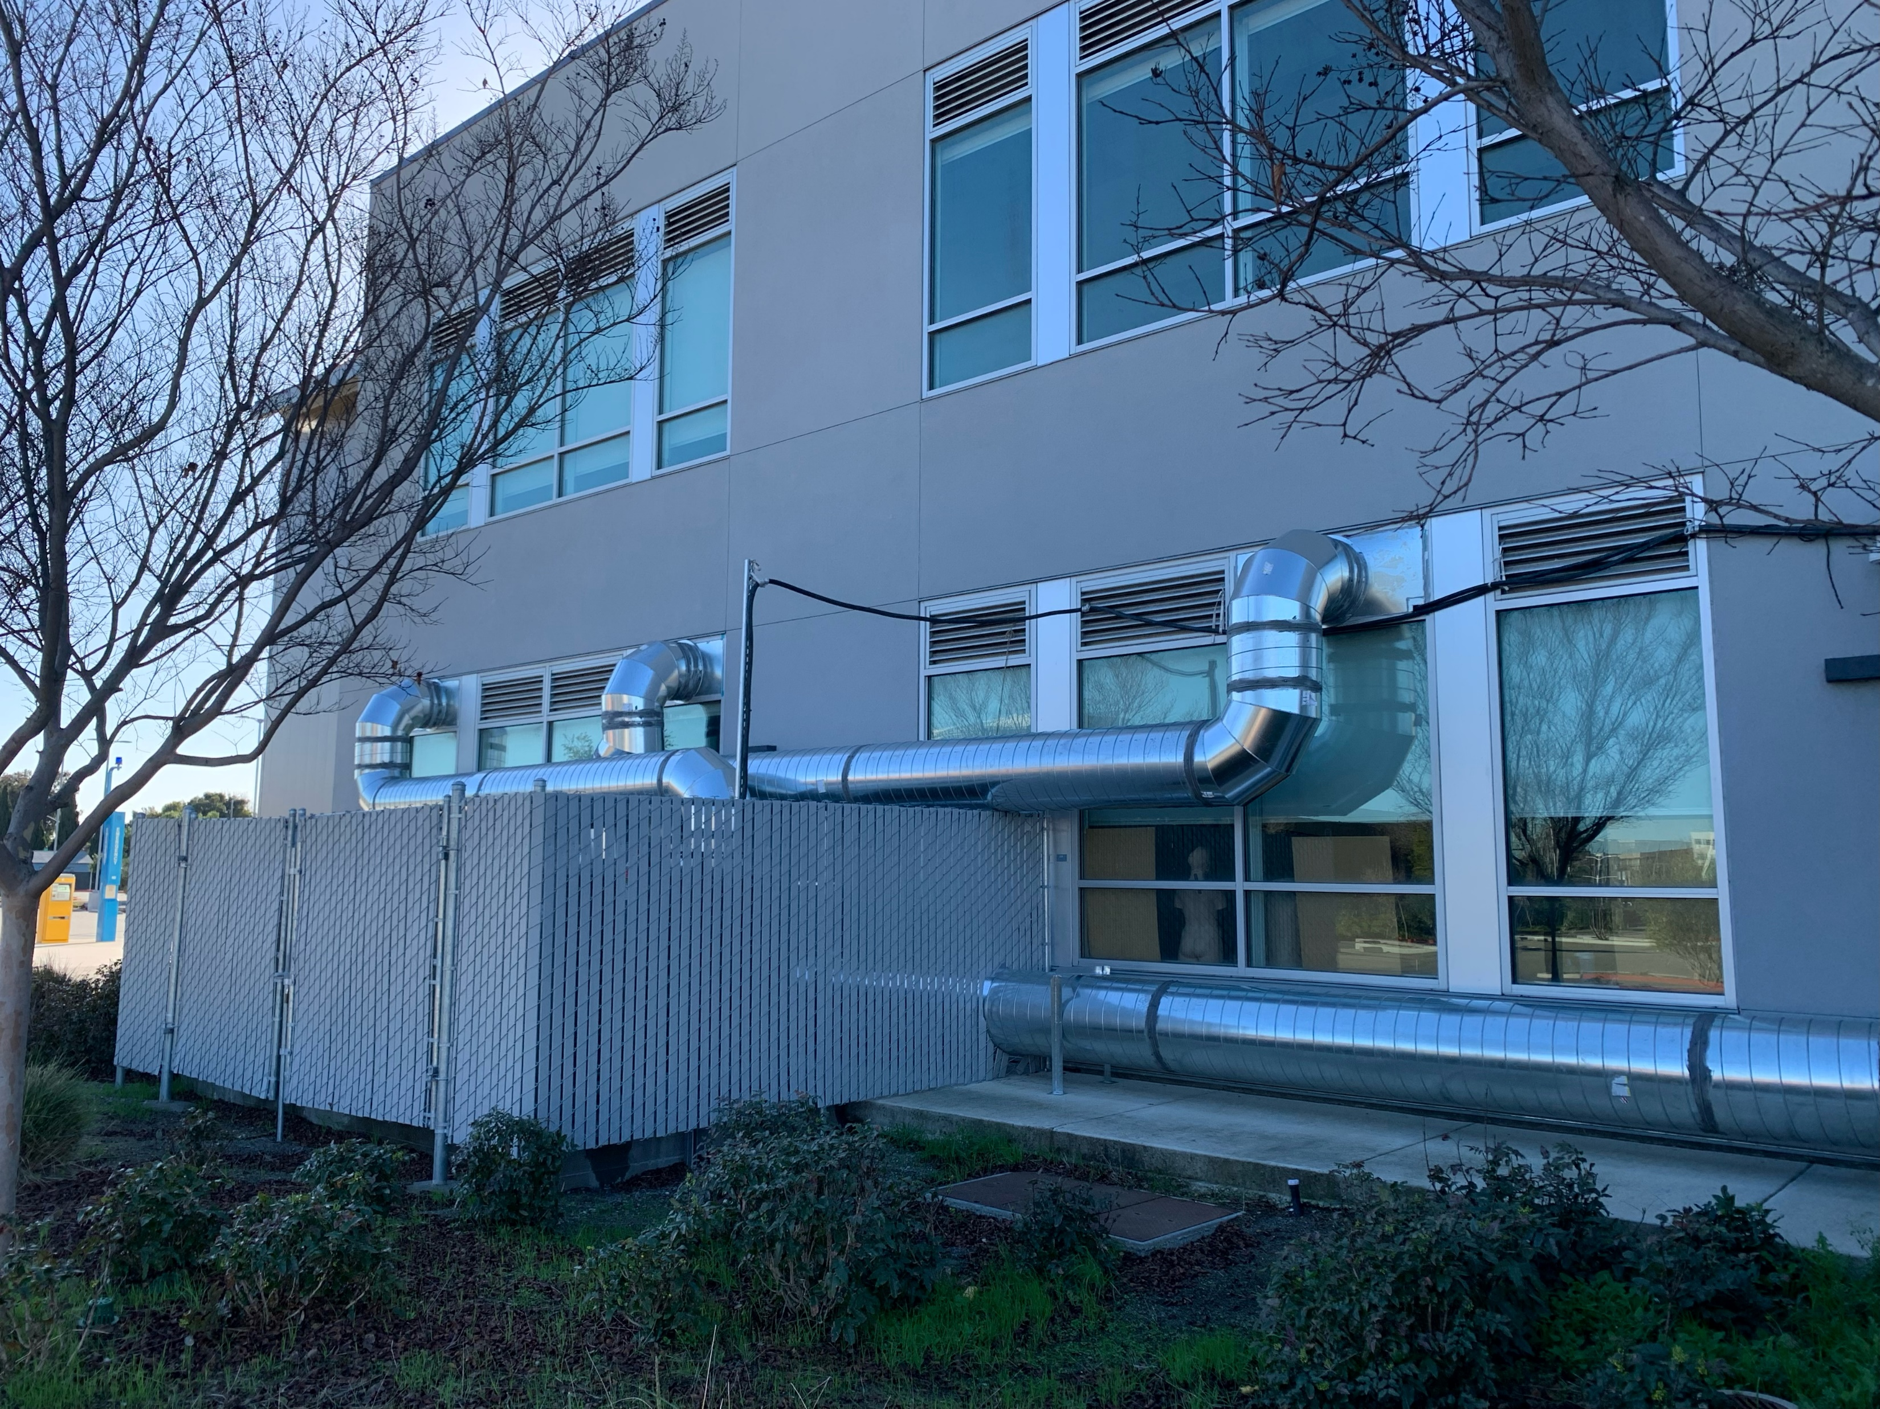
SUNNYVALE EDUCATION CENTER HVAC SYSTEM
REPLACEMENT AND CLASSROOM RENOVATION

Slide 28
QUESTIONS

