Slide 1

Introducing the new…
Office of Global Experiential Learning
Presentation to the Foothill Academic Senate on November 7, 2022
by
Kathryn Maurer, Faculty Coordinator of Global Experiential Learning

Slide 2

What is Global Experiential Learning?
And why not Campus Abroad?
Study abroad and globally-oriented local educational opportunities infused with values & learning outcomes focused on developing students as global citizens

Slide 3
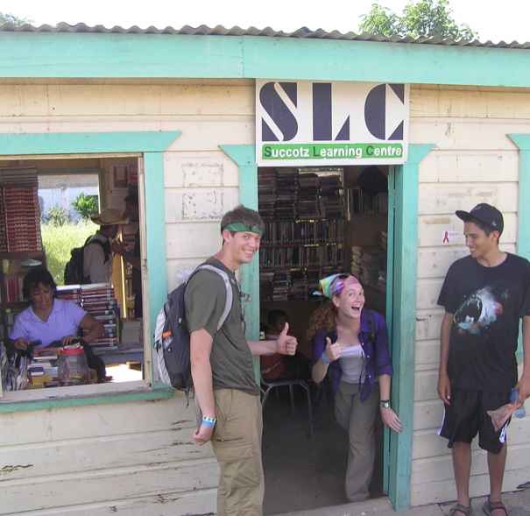
Path to Global Citizenship through
Foothill Global Experiential Learning
Academic and extra-curricular programs infused with experiential learning
  global interconnectedness
  cultural competence/cultural humility
  intercultural communication and foreign language learning
  service learning
  community/civic engagement
  sustainable development
  indigenous knowledge
  life-long friendships around the world

Slide 4
Other benefits of study abroad
Sets students apart:
Less than 10% of US college students study abroad
Shows college admissions and employers skills such as intercultural awareness, diversity, problem solving, “thinking out of the box”…
Sets students up for success:
Personal skills you gain: independence, creativity, tolerance, openness, initiative, a sense of humor, adaptability, flexibility, values, patience…
Gives students a once-in-a-lifetime experience:
85% of students agree that studying abroad was the most meaningful experience of their undergraduate education.

Slide 5
Why an FGEL Office?
Student “One stop shop”
  Find opportunities across programs, divisions, colleges (link to De Anza)
  Liaison to supports (academic counseling, financial aid & scholarships, application support, disability resources & veterans services, etc.)
Faculty support
  Program and curriculum development
  Budgeting and financing
  Insurance and liability
  Resources for supporting students abroad
  Recruitment
College alignment with priorities and values
  Strategic Vision for Equity
  Institutional Learning Outcomes
  Investment of college resources – equitable and transparent prioritization and selection process

Slide 6
Current FGEL Programs
Study abroad programs (a.k.a. Campus Abroad)
  Florence, Italy – 8 weeks in Spring 2023
  London, England – 9 weeks in Fall 2023
Guatemala Teachers Corps Program (Winter & Spring 2023)
Anthropology Field Schools (local Fall 2022, TBD Summer 2023: Ireland? Hawaii? Ecuador? Belize?)
Dream Volunteer Service Trip to Guatemala (Summer 2023)
Global Medical/Dental Brigades (Summer 2023)
NEW--REVIVAL!

Slide 7


Stepping Into Global Citizenship:
Discovery and Experience in Florence
Global Citizen. Global City.
Study abroad in
London
Spring Quarter 2023
Fall Quarter 2023

Slide 8


Foothill Global Experiential Learning Study Abroad Program Highlights
8 or 9 weeks abroad (“in country”)
10-12 week instructional program (online before/after study abroad)
12-15 units of UC/CSU-transferable academic coursework supporting a program theme (program learning outcomes) taught by Foothill faculty
  Honors courses also!
Local host (AIFS Abroad) and classes held at international education center
Field trips, excursions, optional overnight trips, etc.
Life & culture program: events, classes, museums, etc.
Accommodation in student apartments or homestays
24/7 emergency support and medical insurance

Slide 9

Financial Aid, Scholarships & Fundraising
Collaboration with Financial Aid – FAFSA, etc.
Internal Scholarships
  Equity, Diversity & Inclusion scholarships
  Ambassador Scholarships
External Scholarship Assistance
FHDA Foundation Fundraising
Private Donations (link on foothill.edu/global website)
THE GREAT BRITISH BAKESALE – NOVEMBER 16TH 11-1

Slide 10


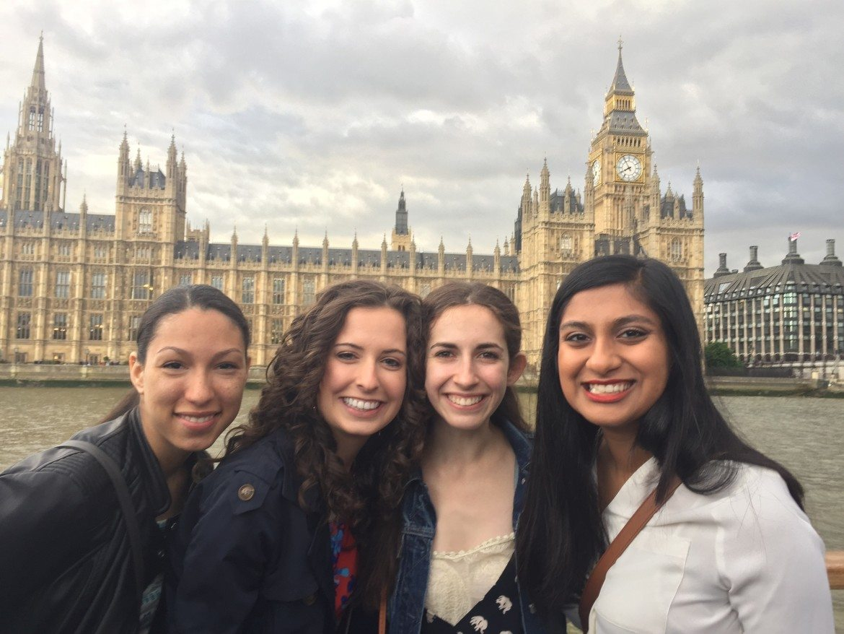
For More
Information

Slide 11
Some questions for academic senate
Questions? Reactions? Feedback?
What does academic senate want to be…
  Informed about? …and how/with what frequency?
  Involved with? …and how?
Advice we need from you:
  How can the Office of Global Experiential Learning ensure that our programming and student/faculty support is:
  Broadly known and understood by faculty, staff and students?
  Inclusive of input from our campus community?
  Sustainable?

