Slide 1
Intro to the Foothill
College Academic Senate
President Isaac Escoto
Vice President/CCC Faculty Co-Chair Rachelle Campbell
Secretary/Treasurer Katherine Schaefers

Slide 2

Why are we here?
Title 5 gives us the power and responsibility to make recommendations to our Board of Trustees regarding academic and professional matters (the 10+1)
Ed Code (law) specifies
additional roles and
responsibilities

Slide 3
Academic and Professional Matters (a.k.a. the 10 + 1)
Curriculum, including establishing prerequisites & placing courses within disciplines
  e.g. establishing prereq policies and procedures, assigning courses to disciplines (min quals)
Degree and certificate requirements
  e.g. Core courses, support courses, general education requirements, minimum units in residence, etc.
Grading policies
  e.g. plus/minus grading
Educational program development
  e.g. proposing/implementing new programs
Title 5, section 53200 (c)

Slide 4
Academic and Professional Matters (a.k.a. the 10 + 1)
Standards or policies regarding student preparation and success
  e.g. Student Learning Outcomes, assessment and placement, Student Support Services Program Planning, etc.
District and college governance structures, as related to faculty roles
  e.g. faculty roles on PaRC, Core Mission Work Groups, etc.
Faculty roles and involvement in accreditation processes, including self-studies and annual reports
Title 5, section 53200 (c)

Slide 5
Academic and Professional Matters (a.k.a. the 10 + 1)
Policies for faculty professional development activities
  e.g. inclusion of part time faculty, advocating for specific PD topics or events
Processes for program review
  e.g. via IP&B, Program Review Committee
Processes for institutional planning and budget development
  E.g. via Planning and Resource Council, Operations Planning Committee, district budget committee
Plus 1: Other academic + professional matters as mutually agreed upon between the governing board and the senate
Title 5, section 53200 (c)

Slide 6
Additional Roles/Responsibilities per California Ed Code (Law)
87359(b) – Equivalency to Minimum Qualifications
87360(b) – Hiring Criteria
87610.1(a) – Tenure Evaluation Procedures
87458(a) – Administrative Retreat Rights
87663(f) – Evaluation Procedures
87743.2 – Faculty Service Areas

Slide 7
87359(b) – Equivalency to Minimum Qualifications
The district governing board and the academic senate must develop and agree jointly upon the process, criteria and standards for determining equivalency to minimum qualifications for faculty
Needs to reasonably ensure that the board will rely primarily on the academic senate for advice/judgment about what is/isn’t equivalent to the min quals
Academic senate must have opportunity to present its views before board makes a decision to hire someone who does not explicitly meet min quals, and this must be included in written record (i.e. minutes)

Slide 8
87359(b) – Equivalency to Minimum Qualifications In practice
There has to be board policy/procedure about equivalency determination process. The academic senates are on the hook to help develop the policy/procedure, and senate needs to agree before the board formally adopts it
The academic senates/faculty decide who meets equivalency to min quals
If board and faculty disagree about whether someone meets equivalency, the senate gets to go on formal record to express their views before board makes final decision.

Slide 9
87360(b) – Hiring Criteria
The board and academic senate have to come to mutual agreement about criteria and policy/procedures for faculty hiring

Slide 10
87458(a) – Administrative Retreat Rights
If an administrator’s contract ends and they were not previously a tenured faculty member in the district, they may be able to become a first-year probationary faculty member if certain conditions apply. One of these is that they must meet min quals. The board has to rely primarily on the academic senate for this determination.

Slide 11
87663(f) – Evaluation Procedures
Full time faculty are supposed to be evaluated at least once every three years (nine quarters)
Our Faculty Association is on the hook to consult with the academic senate if/when engaging in collective bargaining about faculty evaluation procedures

Slide 12
87743.2 – Faculty Service Areas
Our Faculty Association needs to consult with the academic senate to propose/establish our official district Faculty Service Areas

Slide 13
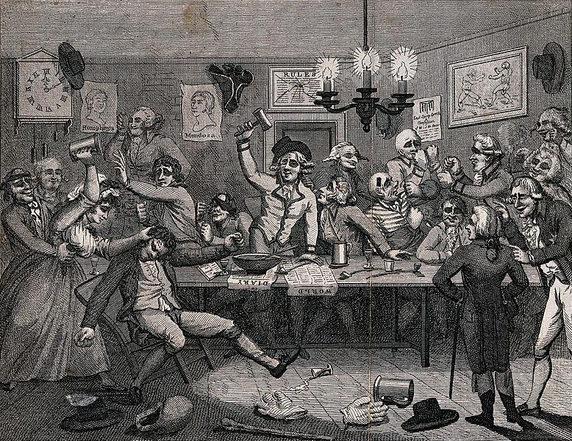
Recommend via “Collegial Consultation”
Board of Trustees (or designees – e.g. college administrators) will consult collegially with the academic senate on policies/procedures re: academic and professional matters
(image from Creative Commons)
Title 5, section 53203

Slide 14

How do we “make recommendations” via collegial consultation?
  We appoint faculty to represent us on shared governance committees when charge concerns 10+1 matters
    Reps responsible for preparing for and reporting out from meetings;
    Imperative to have good communication with senate and faculty at large

Slide 15
How do we “make recommendations”?
  Formal resolutions calling for action and/or asserting a particular position
  Discussions with and presentations to the Board of Trustees
  Liaison with Faculty Association re: matters of joint interest

Slide 16
Academic Senates Powers: Primary Reliance vs. Mutual Agreement
For some matters, BoT relies primarily on academic senate’s advice and judgment
  senate recommendations normally accepted
  senate recs rejected only in exceptional circumstances; rationale must be communicated in writing
For remaining matters, BoT seeks mutual agreement with academic senate
  if unable to reach after good faith effort, basically board can only act for compelling legal, fiscal or organizational reasons (see 53203 for exact language)
(paraphrased from Title 5 §53203)

Slide 17
FHDA Board Policy 2223
Academic and Professional Matter Area | Primary Reliance | Joint Development*
Curriculum | X
Degree/Certificate Requirements
Gen ed, program-specific | X
Units for degree |  | X
Grading policies | X
Ed program development |  | X
Standards re: student prep and success | X
Governance structures as r/t faculty roles |  | X
Faculty involvement in accreditation |  | X
Policies for faculty professional development | X
Policies for program review |  | X
Processes for planning & budget |  | X
Other stuff | determined on individual basis by board or designee
*mutual agreement

Slide 18
Areas where FA always consults with the Academic Senate
87610.1 Tenure Evaluation
87663 (f) Faculty evaluation procedures
87743.2 Faculty Service Areas
The Senate works with FA in areas that are consultation areas to ensure collegiality; we hold liaison meetings, are involved in tenure committee training and evaluation committee meetings, have a liaison to the Senate who attends all meetings, and use other means of communication and consultation.

Slide 19
Foothill’s Academic Senate
All Foothill faculty are members
Each division entitled voting to two voting senators*:
Biological and Health Sciences
Business and Social Sciences
Counseling
Apprenticeship Programs
Fine Arts and Communication
  PSME
  Kinesiology/Athletics
  Language Arts
  *Library Sciences
  *Student Resources and Support
  Two Part-time Faculty Reps
“Executive Committee” = senators
“Executive Council” = senate officers
*as of 2016/2017 senate structure; see resolution passed 5/1/17

Slide 20
Senator Responsibilities
Prepare for and attend senate meetings
Promptly report out from senate meetings/activities to constituents, and actively solicit discussion and feedback
Represent your constituents (not yourself)
Vote
Bring division matters to the senate (10+1) and author resolutions as appropriate
Participate in committees as a senate representative or liaison

Slide 21
Senate Procedures
“Flexible” Robert’s Rules of Order http://www.robertsrules.org/
Covered by Brown Act, so all meetings are open
One week advance for agenda items (i.e. MONDAY 5 p.m.)
Normally present action item as info/discussion for first reading, except in cases of urgency
Quorum = majority of those eligible to vote
Vote by proxy with three day advance in writing to the secretary
Agendas are distributed no later than the Thursday prior to a meeting

Slide 22
Senate Procedures
Mindful of using meeting time respectfully, effectively
Consent Calendar:
  Items needing action but thought not to need discussion
  Any senator can “pull” an item from consent calendar for discussion
Committee Reports:
  All committees are expected to report out to the Senate at least once a year; some committees, such as curriculum, will report out at all or most meetings
  If info only submit info to secretary in writing for inclusion in compilation of committee reports
  If discussion/action required, notify officers to allocate time on agenda (one week in advance)

Slide 23
Senate Procedures: Resolutions
Resolution process:
  mechanism by which senate takes formal action
  streamlines communication with constituents
Must be distributed with the agendas, and come for first/second read before action as per Robert’s rules
Guidelines/advice for writing resolutions at http://www.foothill.edu/staff/Curriculum/documents/Resolution_Writing_Advice.pdf

Slide 24
College Curriculum Committee
The most important of the subcommittees of the Academic Senate
Representation from all divisions

Slide 25
Other Committees
Planning and Resource Council (PaRC)
Workgroups:
  Operations and Planning Committee (OPC)
  Basic Skills
  Transfer
  Workforce
Committee on Online Learning (COOL)
Academic Integrity Committee
Program Review Committee
Professional Development Committee

Slide 26
District Committees
Academic and Professional Matters (APM)
Chancellor’s Advisory Council (CAC)
District Budget Committee
Human Resources Advisory Committee (HRAC)

Slide 27
Resources
www.asccc.org
  Committee information, resolutions, papers, rostrum articles, etc
“Empowering Local Senates: Roles & Responsibilities of and Strategies for Effective Senates” (Spring 07)
http://www.foothill.edu/senate/index.php

