Slide 1

Program Review
Integrated Planning & Budget Taskforce

Slide 2
Programs Strengths
Ranked #1 nationally, ASHP/ACPE Accredited, cohort-based Community College Pharmacy Technology Program.
Short-term, low barrier, affordable, equitable CTE program.
Diverse student population with high success and program completion rates with no achievement gaps.
100% pass rate on national board certification exam (PTCE)
Strong labor demand with wide-range of employment opportunities.
Outstanding reputation with industry partners and stakeholders.
Notes:
Directions for the Slide - From the Self-Study Report, please identify all program strengths/outcomes as outlined in the document.

Slide 3
Programs’ Actions for Improvement Identified
Restructure and align curriculum to decrease unit load to create a sequential, 2-tier accredited Pharmacy Technology Program.
  Entry-Level Certificate: 6 months
  Advanced-Level Certificate: 9 months
Create a dual enrollment “Pharmacy Careers Pathway” with stackable certificates.
  Pharmacy Assistant (Aide/Clerk) Certificate
  Basic Pharmacy Technician Certificate
Partner with Boys and Girls Club, Veteran's Administration VITALS program, educational entities and employers to support the program graduates.
Connect with NOVA, Adult Ed, and regional recruitment events to increase marketing and outreach.
Notes:
Directions for the Slide - From the Self-Study Report, please identify all actions for improvement outlined in the document.

Slide 4
Resources Needed
Marketing, Outreach, and Dual Enrollment Support
  Staff and funding
Faculty
  Increase in Program Director re-assign time or contract revision—10 to 12 month.
  PT/FT faculty
Funding for program expenditures
  Accredited Program:
    Software, equipment, and lab supplies
    Accreditation Annual Fee
  Dual Enrollment Program:
    Expense sharing with educational partners
Facility
  Lab and classroom to safely accommodate cohort size
Notes:
Directions for the Slide - What do you need to make the improvements and or take actions?

Slide 5
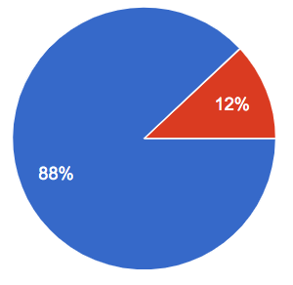
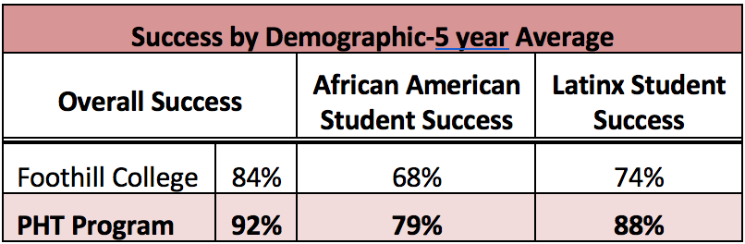

Program Data
2019 Employment Rate
Program Diversity
Notes:
Directions for the Slide - Please add any data table you would you like to share.

Slide 6
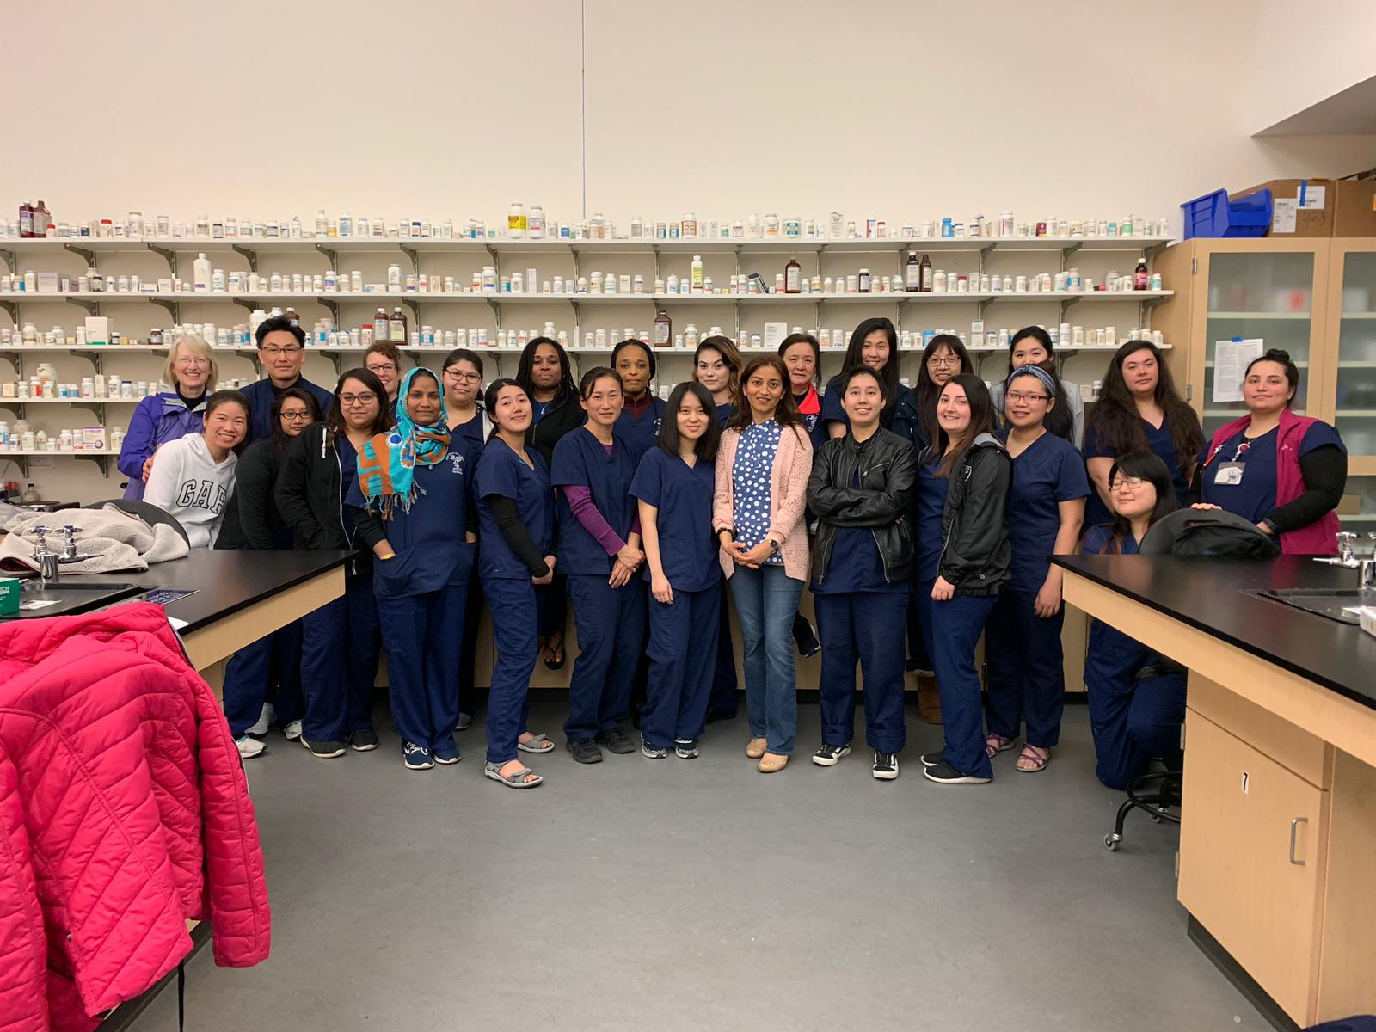
Questions
Class of 2019

