Slide 1
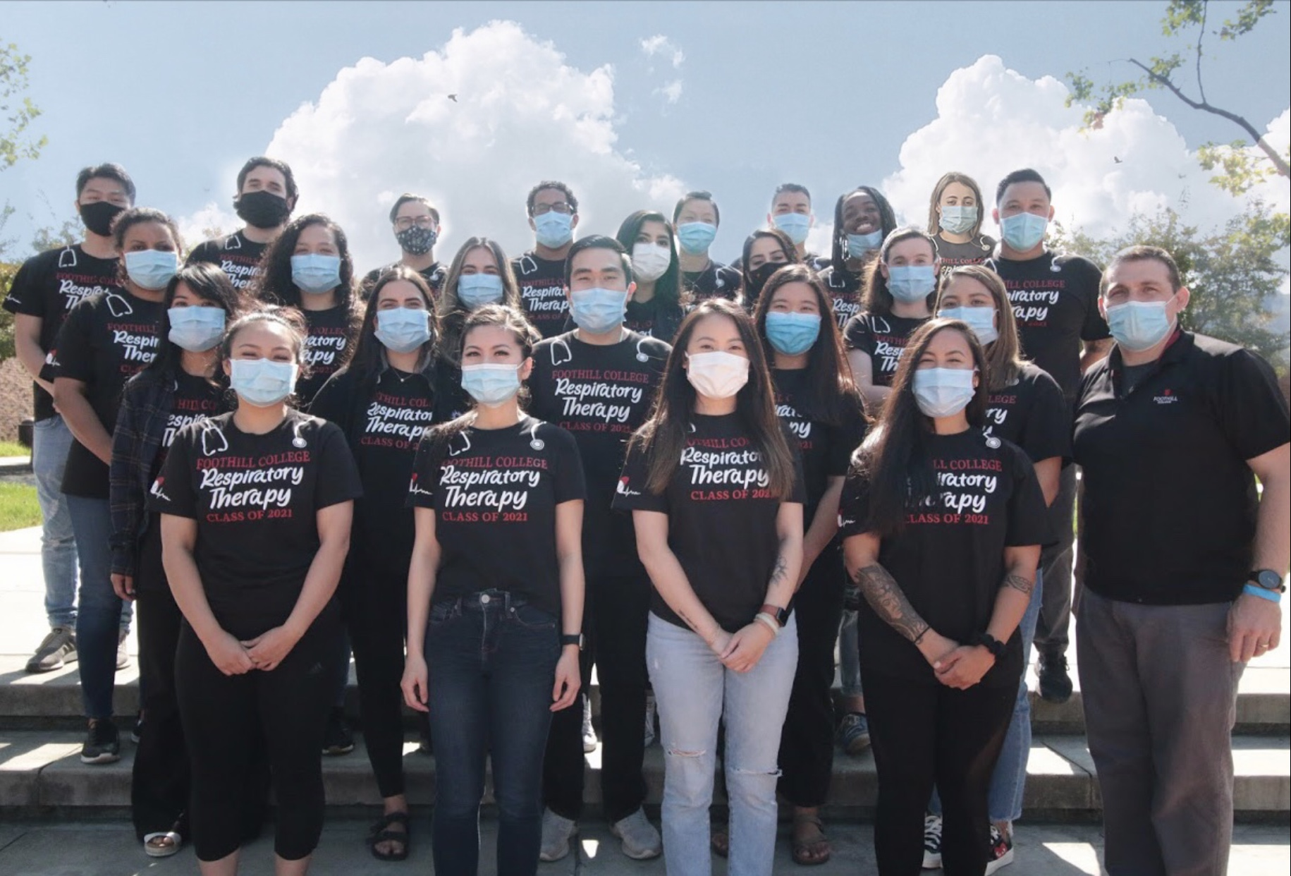
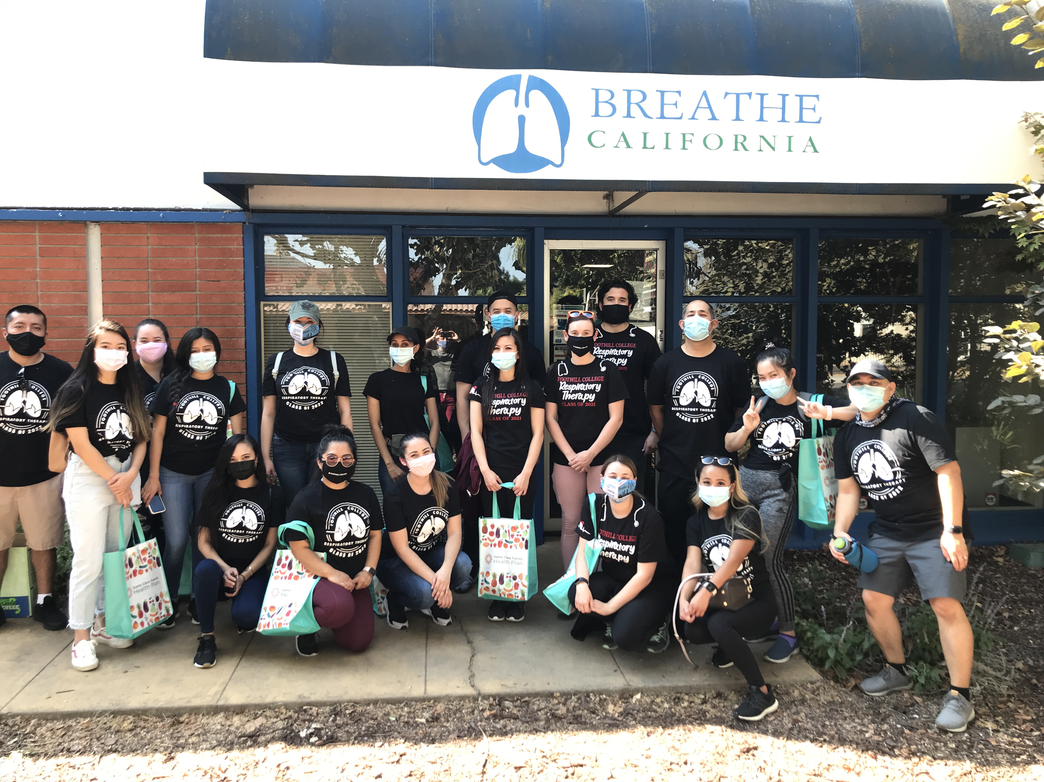
Program Review Respiratory Therapy Program
Brenda Hanning, Program Director
Integrated Planning & Budget Taskforce
Notes:
Welcome, my name is Brenda Hanning. I am the PD for the RT Program here at FHC, I am also a proud RCP.
Volunteering and community service are built into our program structure. Collectively, our students volunteer over 1500 hours each year. The picture on the right shows our students at a volunteer event with Breath California. These are the graduating classes of 2021 and 2022, future essential workers.

Slide 2
Programs Strengths
We are the oldest community college-based respiratory therapy program. We have been serving our neighboring communities for over 50 years.
Our National Board exams pass rates are 100% and 95%. The overall attrition rate is less than 10%.
We are committed to ensure that each student succeeds, providing support as needed.
All students succeed at 94% or greater regardless of their demographic group.
Labor market data shows a growing need for respiratory therapists due in part to the ageing population.
Notes:
When there was a call out for PPE and ventilators, our program transferred 10 of our ventilators to SCVM. We also registered our PPE inventory to the state and made it available if needed.
Pass rates are 100% on the written board exam (158% of the National average) and 95% on the clinical simulation exam (121% of the National average).
We provide tutoring, including one-on-one help. We work with our affiliates to tailor clinical rotations for students, we conduct review sessions, skills review sessions, and invite guest speakers to address specific topics that we cover.
Our students go on to be front line workers, many in our bay area hospitals. They embark on a new gratifying career and they start earning a living wage. The job placement rate for our program is over 85%.

Slide 3
Programs’ Actions for Improvement Identified
Our new Interventional Pulmonology Assistant Certificate is the first of its kind. The Certificate Program will be featured and presented nationally at the American Association For Respiratory Care’s yearly convention in December. We believe there is great potential for growth with this new program.
We continue to work towards expanding our clinical internships. This year we expanded clinical placement in three Hospitals and acquired a new clinical affiliate.
Gaining clinical placement positions will allow us to increase enrollment.
Notes:
In collaboration with ECH, we developed the IPA program to serve this new medical specialty.
It has attracted students from all parts of California as well as many other states. RCP’s assist Interventional Pulmonologists in performing over 40 different procedures.
Covid19 has created many challenges. Clinical affiliates canceled all student internships in April. Our DCE was able to secure Summer quarter clinical rotations for all students allowing them to complete double rotations and make up their missing hours.
Foothill facilitated the students’ clinical rotations by providing PPE for them. Our program fit tested students and provided their PPE as a condition for their rotations.

Slide 4
Program Data
Program | Enr 2015-16 to 2019-20 | Overall Success | % African American Students | African American Student Success | % Latinx Students | Latinx Student Success
RSPT | 4326 | 95.9% | 381 8.8% | 94.2% | 783 18.1% * | 94.6%
Allied Health | 28283 | 95.1% | 1074 3.8% | 91.6% | 6009 21.2% | 92.4%
Foothill | 632018 | 80.4% | 28919 4.6% | 67.7% | 151640 24.0% | 73.7%
*Latinx % for 2017-18 and 2018-19 are closer to the FH percentages at 24%. The trend is positive.
Notes:
I believe our program exemplifies and represents diversity. As a Latina working with my counterpart Lisa Hills, an African American we have dedicated ourselves to promoting our program and attracting students from underserved populations. Through outreach, committee work, and community collaborations we have seen the number of Latinx, and African American applicants increase. We are both committed to eliminating the achievement gap.

Slide 5
Resources Needed
Equipment to support our program.
  Mechanical ventilators are life saving machines that are managed by RTs. The program needs to provide a good representation of industry standard equipment in order to prepare students and develop competency.
  Software upgrades are needed to prepare students for their board exams.
  Simulation mannequins are vital for students to develop patient assessment skills in a safe environment that does not put patients at risk.
A third FT instructor, a position that was eliminated a few years ago. A third faculty position can help promote outreach and continue to support our efforts to ensure diversity within our program.
Facility upgrade. The program needs a modern lab that can accommodate equipment and students in a safe environment that promotes learning. A dedicated space for simulation training and interprofessional collaboration between programs would take our program to the next level.
Notes:
Equipment is needed on an ongoing basis.
Software updates are needed about every two years.
Our program has one high-fidelity newborn mannequin and two outdated adult mannequins that are over 12 years old. Students would benefit from being able to practice on new adult and pediatric high-fidelity mannequins.
The program would benefit from a third FT Faculty position.
Enrollment for the new IPA program can be improved with proper marketing and outreach.
Students would benefit from the consistency of having a dedicated FT Faculty member.
Increase clinical placement opportunities through outreach and networking with Hospitals and Clinics. This in turn would allow us to increase our enrollment.
Program needs and responsibilities could better be managed. Ordering of equipment, equipment repairs, onboarding of new students (background checks, drug testing, and clinical attestations), and accreditation are just a few examples of the many program-related responsibilities that are ongoing.
A new updated facility that could house multiple allied health programs and a state-of-the art simulation center would provide interprofessional education which is considered the gold standard.

Slide 6
Questions

