Slide 1
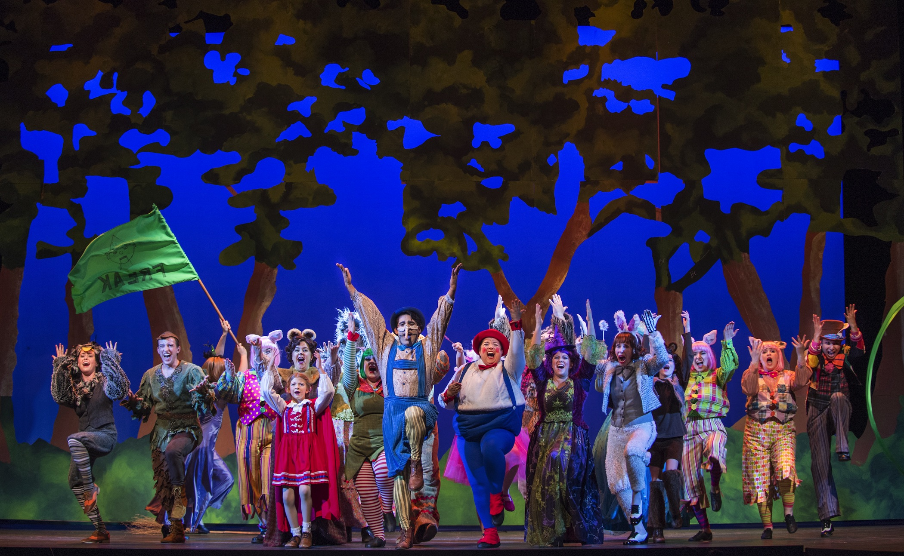
Program Review
Theatre Department
Integrated Planning & Budget Taskforce

Slide 2
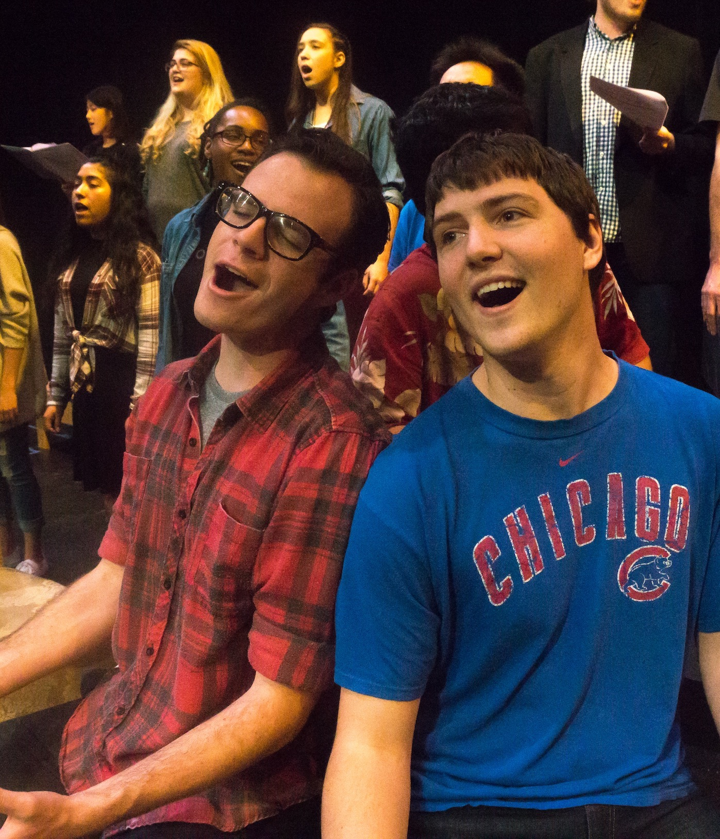
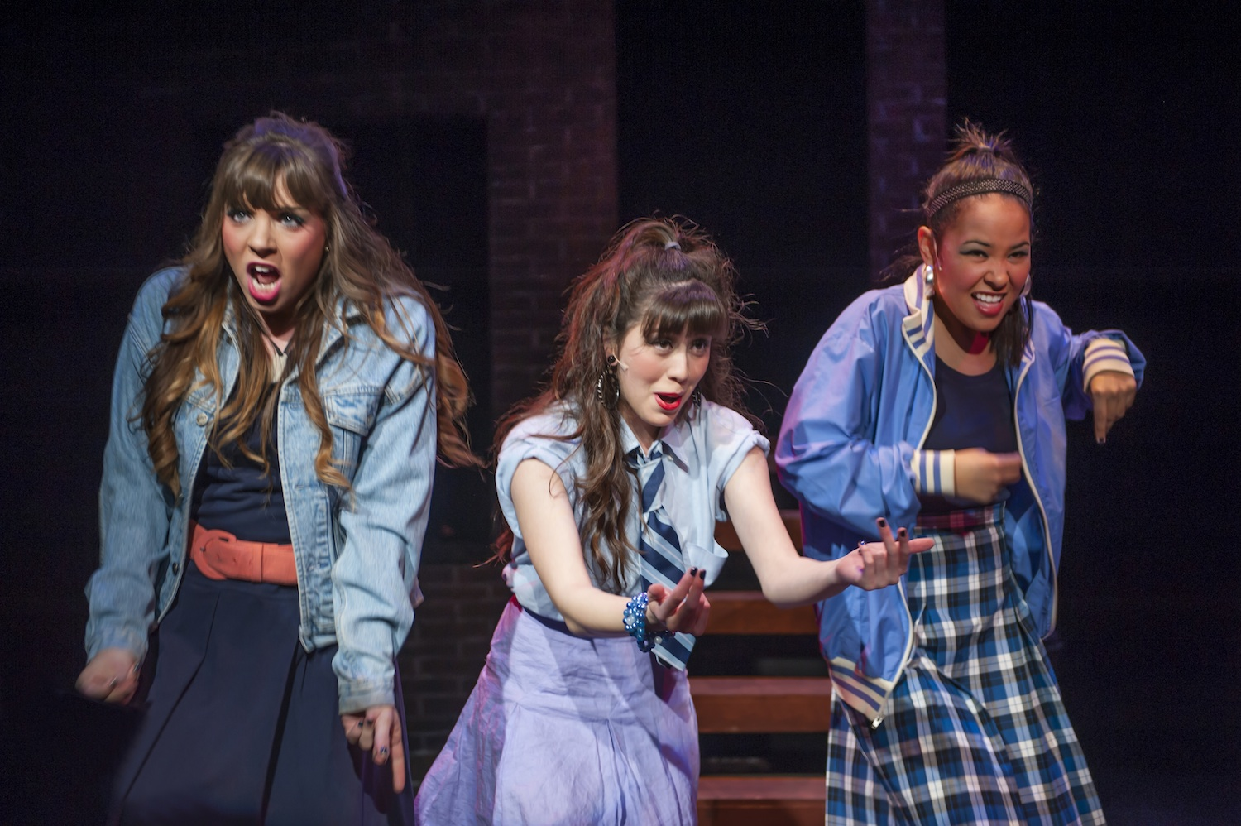
Programs Strengths
Since 2015-16 and including 2019-20
  20% increase in unduplicated headcount
  39% productivity increase since 2015-16.
Focused options for degree and/or certificate success, establishing clearer pathways towards degrees and certificates
Valuable relationship with the community as both highly-visible and service-learning based program.

Slide 3
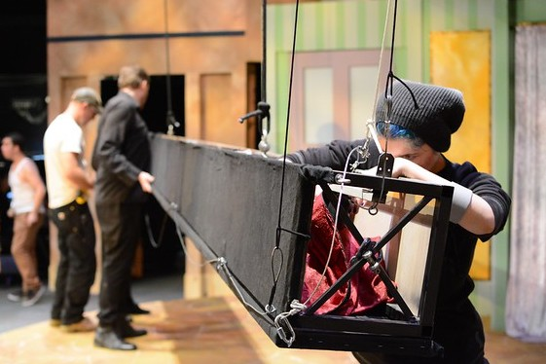
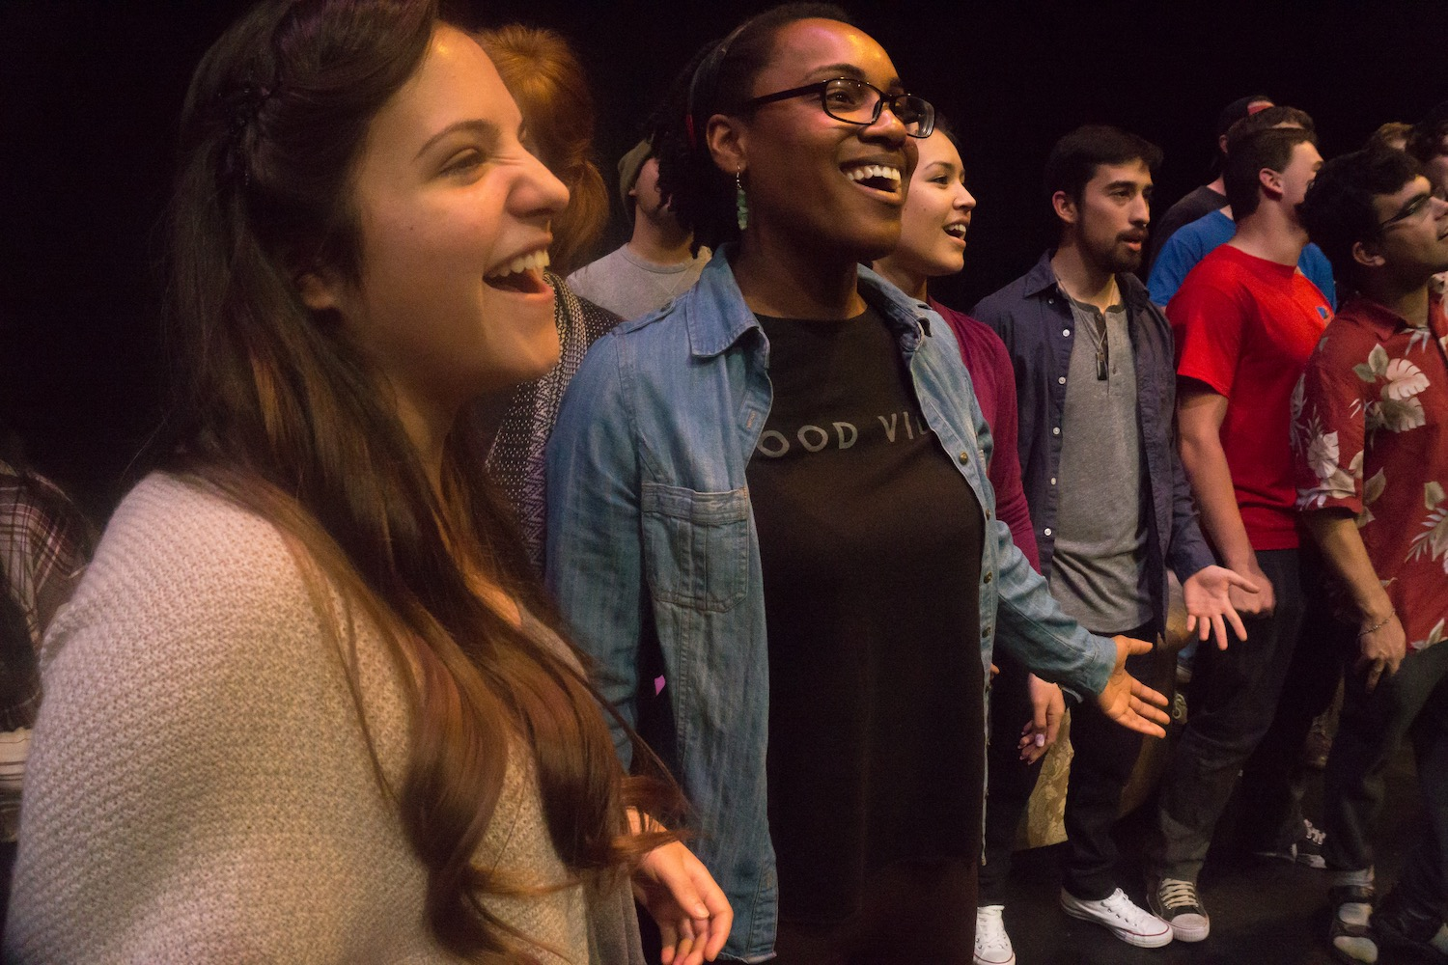
Actions for Improvement Identified
Target enrollment of underserved student populations.
Implement Equity Plan developed w/ Equity Office.
Maintain and increase productivity and FTES levels:
  Offer late start sections of higher enrollment online courses
  Offer stacked sections of courses to increase productivity
  Streamlined, defined pathways and scheduling
  Attract new students through expanded online course offerings.
Pursue additional OEI approvals for ADT classes.

Slide 4
Program Data
THTR all classes | 15-16 | 16-17 | 17-18 | 18-19 | 19-20 | % inc.
Unduplicated Headcount | 410 | 441 | 496 | 620 | 492 | 20.00%
Census Enrollment | 760 | 801 | 842 | 984 | 755 | -0.66%
Sections | 73 | 66 | 71 | 67 | 70 | -4.11%
WSCH | 1470 | 1442 | 1713 | 1806 | 1557 | 5.93%
FTES (end of term) | 98 | 96 | 114 | 120 | 104 | 5.96%
FTEF (end of term) | 4.26 | 3.80 | 3.87 | 3.99 | 3.23 | -24.21%
Productivity (WSCH/FTEF) | 345 | 380 | 442 | 453 | 482 | 39.77%
THTR Tech classes (100600) | 15-16 | 16-17 | 17-18 | 18-19 | 19-20 | %inc
Unduplicated Headcount | 80 | 76 | 95 | 79 | 110 | 37.5%
Census Enrollment | 126 | 126 | 157 | 130 | 183 | 45.2%
Sections | 25 | 24 | 28 | 22 | 34 | 36.0%
WSCH | 255 | 316 | 391 | 319 | 501 | 96.1%
FTES (end of term) | 17 | 21 | 26 | 21 | 33 | 97.2%
FTEF (end of term) | 1.10 | 0.83 | 0.95 | 0.77 | 0.75 | -32.2%
Productivity (WSCH/FTEF) | 232 | 381 | 413 | 414 | 670 | 189.2%
2017-20 | Enroll | Success | Rate | W | success n/inc W
F2F | 1365 | 1280 | 93.8% | 58 | 97.9%
HYBRID | 125 | 112 | 89.6% | 5 | 93.3%
ONLINE | 1090 | 757 | 69.4% | 138 | 79.5%

Slide 5
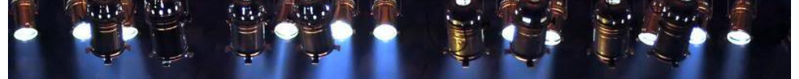
Resources Needed
Adjunct faculty for department
  The range of course offerings demand expertise for completion and degree success, especially in the Technical Theatre courses
  Adjunct faculty brings greater potential for diversity
Replace retiring FT faculty
  One FT faculty retired 2018 (Bergmann)
  Second nearing retirement (McLeod)
  Opportunity to restructure dept. and add diversity to faculty ranks
Hire Technical Staff for Department and Lohman Theatre
  Many duties of current FT faculty are outside teaching
  Increase revenue from rental of facility
Upgrade Facilities & Equipment
  Smithwick: 60 yrs old, needs a complete overhaul
  Lohman: 12 yrs old, equipment not up to current tech standards

Slide 6
Questions

