Slide 1
Proposed Reorganization

Slide 2
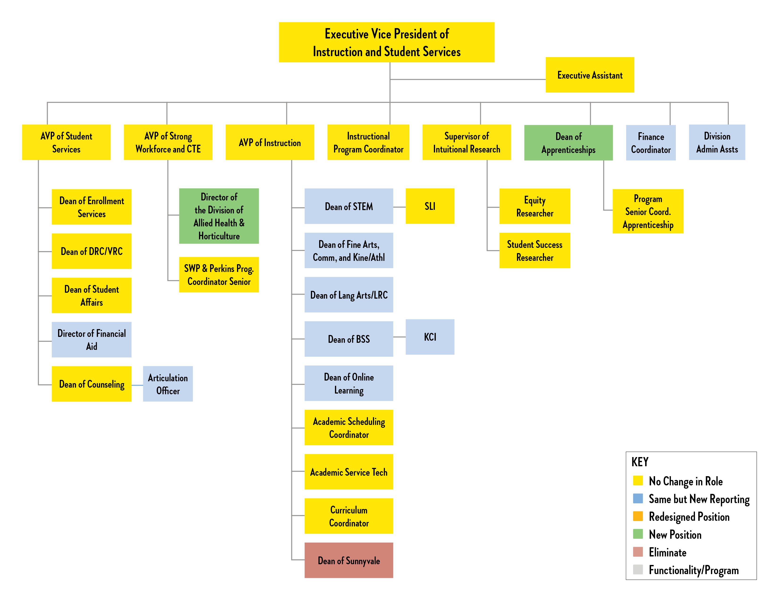

Slide 3
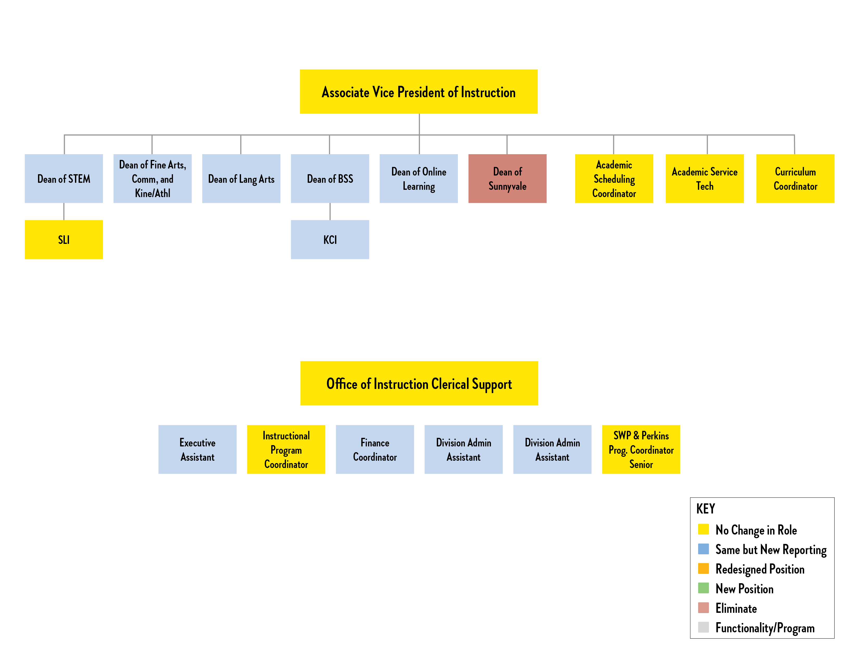

Slide 4
Strategic Reorganization of the Office of Instruction
Improve services to students
Nine classified staff will support the Instruction Hub
  Includes 4 Deans, 1 Director, 3 AVPs, 1 Exe. VP
Interdisciplinary, college-wide collaborative thinking
  Moving us as a college away from silo thinking
Moving to more efficient and streamlined processes
  Includes more electronic forms, less paper processes, less steps to approval of forms
This consolidation brings approximately $524,000 in budget reductions
With college-wide approval, offices will move in July 2019
Potential use of the division offices for students, part-time faculty, learning communities, Dream Center

Slide 5
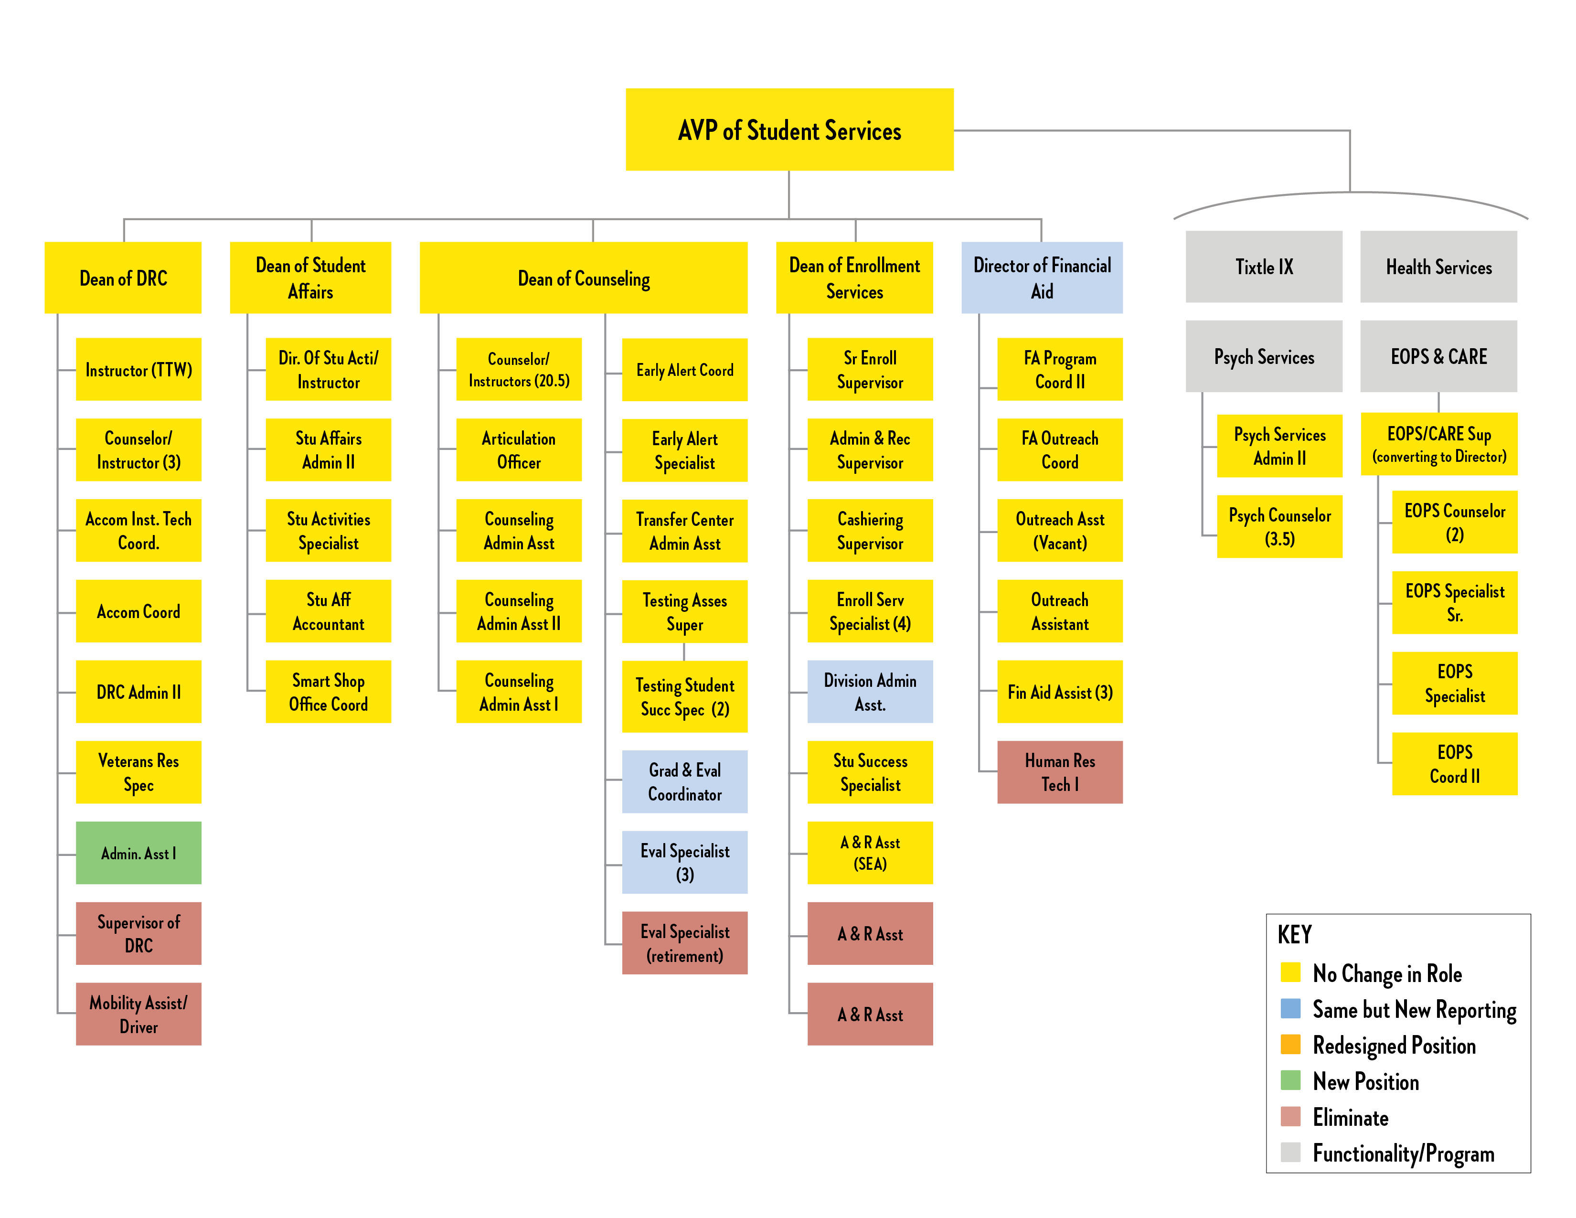

Slide 6
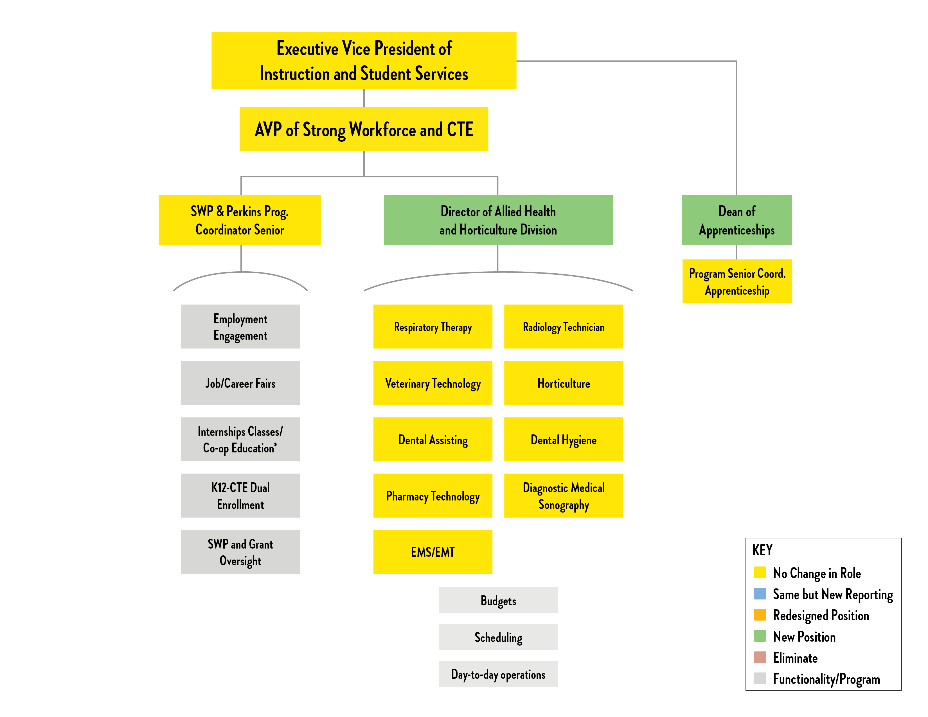

Slide 7
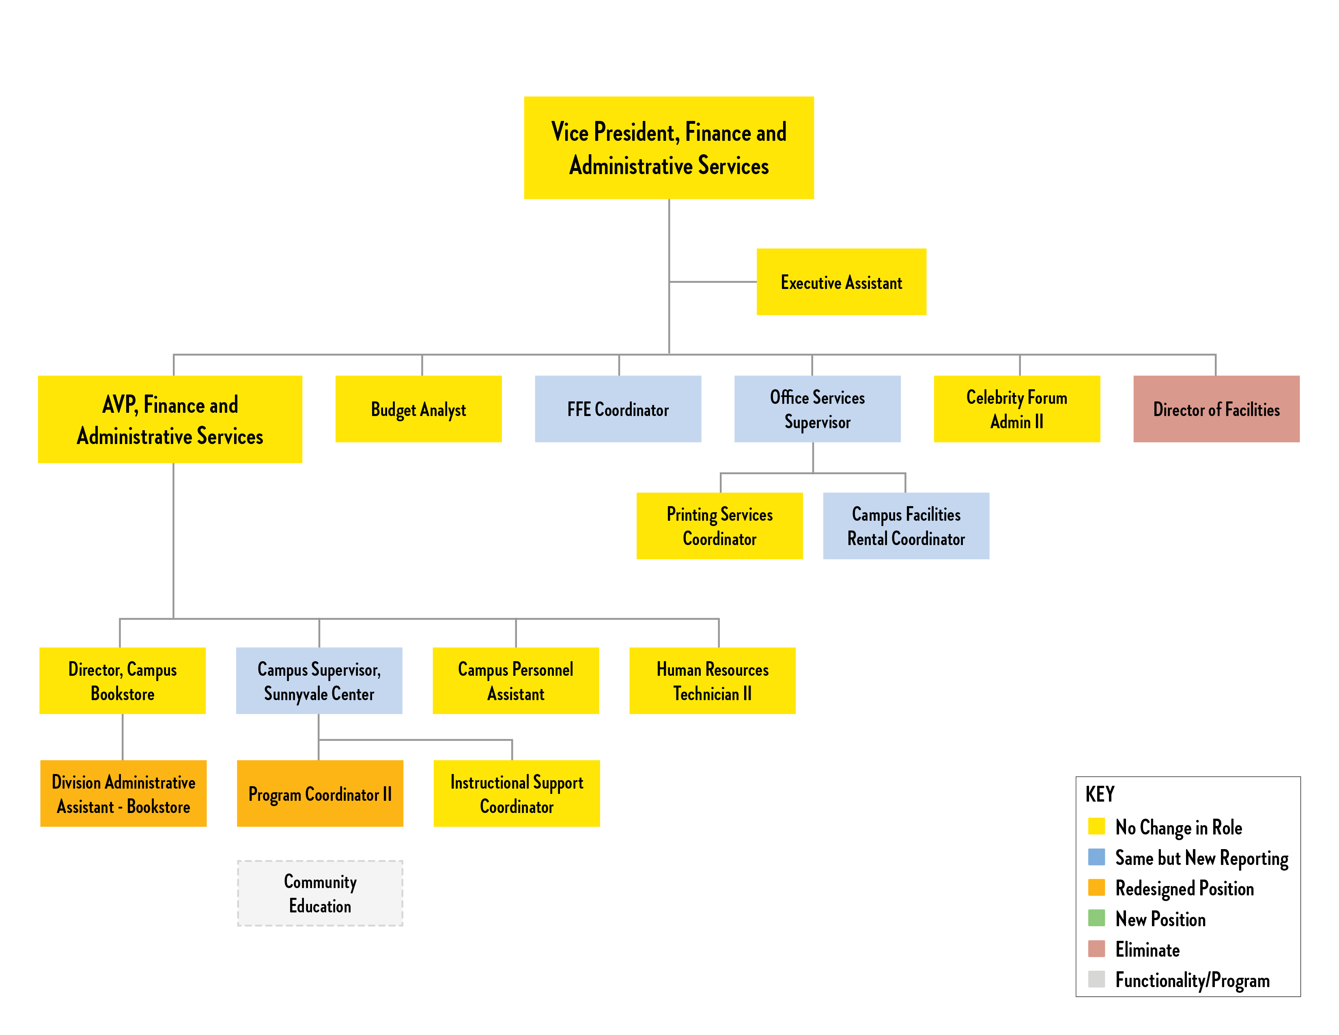

Slide 8
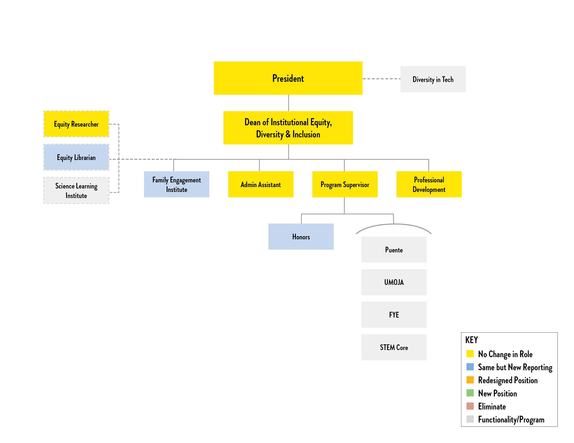

Slide 9
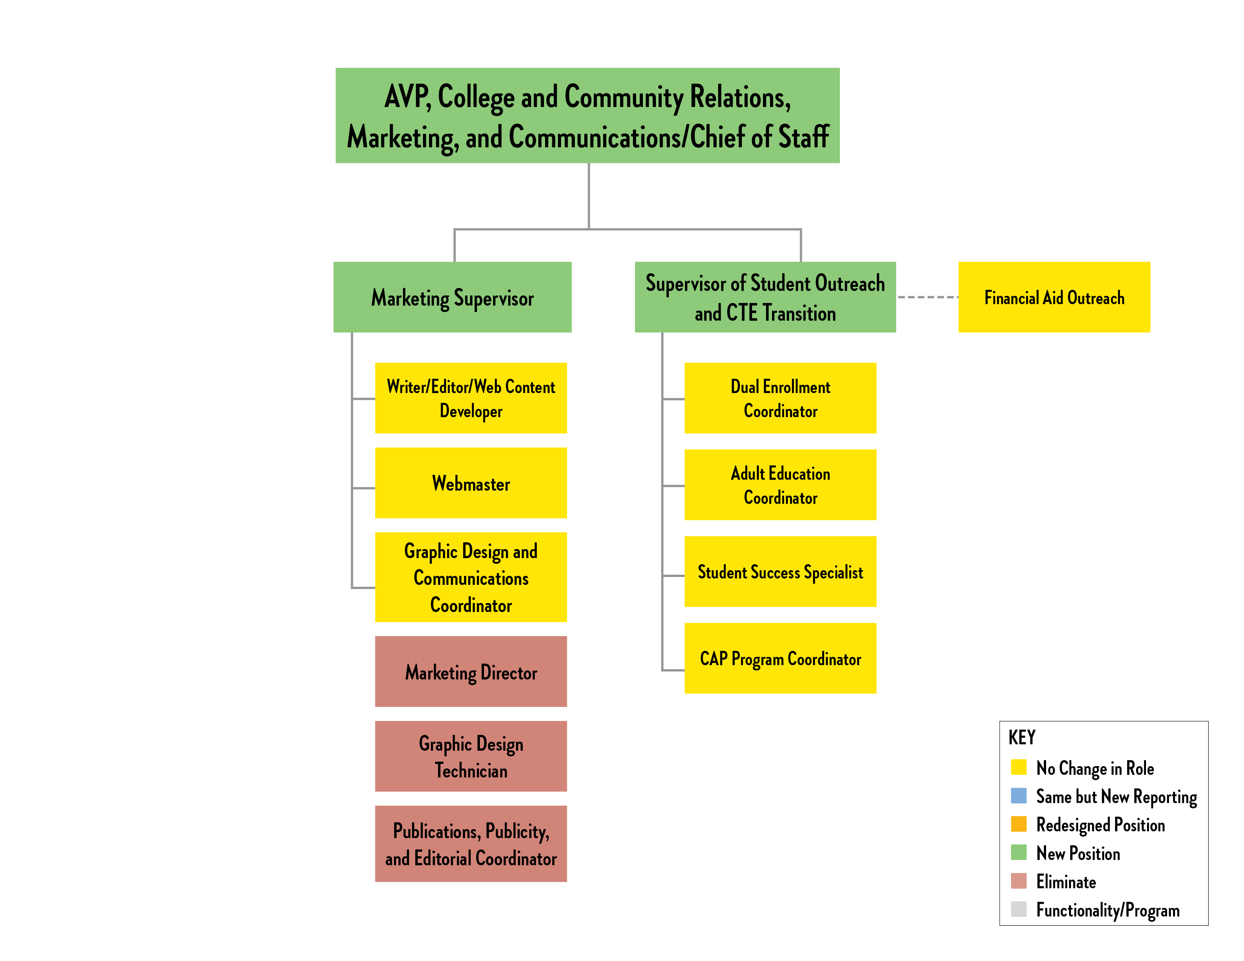

Slide 10
Marketing, Outreach, and Communication
The AVP, College and Community Relations, Marketing, and Communications will oversee Marketing, Outreach, and Communications (both internal and external).
This position will coordinate all outreach activities and work closely with Student Services, Admissions and Records, and Instruction. Outreach activities include expanding dual enrollment opportunities, tabling at high schools, etc., developing closer relationships with local businesses, and increasing retention and recruitment through better communication with students.
Marketing/Outreach will share a Hub with all staff offices around that common space. This will engender more creative collaboration and invite all campus constituencies to be more actively engaged in our outreach efforts. If approved, offices will be reassigned in July 2019.

