Slide 1
RP Group Strengthening Student Success 2021
Proposal for Foothill’s E&E Council June 18, 2021

Slide 2
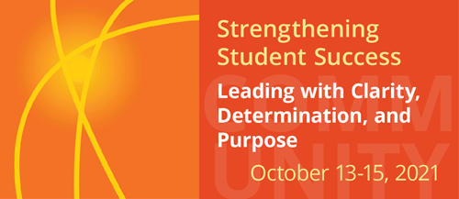
Logistics
Virtual (Zoom) conference
9AM to 3PM each day
Registration $275/pp or $247.50/pp for group of 10+ (must name names, can’t place-hold)
Early bird reg ends August 31

Slide 3
2021 CONFERENCE GOALS
Deepen understanding of critical issues that shape student success in California Community Colleges
Learn how colleges advance student success with practical, equitable, anti-racist, and evidence-based practices
Apply concepts highlighted at the conference to our own work to create student-ready, anti-racist, and equitable institutions
Actively engage students more deeply in the work of our colleges to design an anti-racist and equitable student experience
Develop and strengthen networks with colleagues and other stakeholders
Increase our collective capacity to lead change at our colleges

Slide 4
2021 CONFERENCE STRANDS
Collaborating Across Sectors and Segments: Anti-Racist Partnerships and Networks Creating Equitable Outcomes
Redressing Structural Inequities to Achieve More Equitable Institutions
Achieving Equity in the Classroom: Critical Changes to Address Inequities, Champion Anti-Racism, and Improve Learning
Building Culturally Robust and Positive Practices that Increase Student Agency: Professional Learning and Leadership Development
Strategic and Integrated Planning to Create Caring, Equitable, and Anti-Racist Campus Communities
Creating Equitable Support Systems for Students and Employees that Address Basic Needs and Physical and Mental Well-Being

Slide 5
Making the Most of Your Team’s SSSC Experience
The SSS Conference highlights practice at all levels of the community college from individual interactions to institutional change.
Strands and sessions address issues that cross the internal boundaries of the college. So, it is natural that more colleges send cross-functional teams composed of faculty, counselors, administrators, researchers and others from across the campus. Professional learning is powerful when it is shared.
Coming collaboratively allows a team to organize and attend more sessions. This approach saves money and provides your team with ideas and connections that can motivate and encourage them as they work to implement changes on your campus. If you and your colleagues are attending SSSC as a team, we offer the following recommendations for making the most of your experience:

Slide 6
Before the conference
Meet either in a formal meeting or an informal get-together. This may be a chance to meet colleagues from across your college who you didn’t know before.
Look over the conference schedule to identify possible sessions of interest, particularly topics that are currently a focus of work at your college.
Organize who will cover different sessions, given that there are always several potentially interesting sessions in the same time slot.

Slide 7
During the conference
Touch base with your colleagues via text or other team platform (such as Slack or Microsoft Teams) when you hear something you really like. Share ideas while they are fresh and in the moment.
Zoom with each other for breakfast to share your insights from the previous days’ sessions or at an “after-hours” session to debrief the days’ learning.
Keep track of ideas and people from sessions that you and your colleagues want to follow-up with. You might make notes individually or create a shared Google doc, Jamboard, or Padlet to post your “aha” moments during the conference.

Slide 8
After the conference
Meet to discuss how to apply the ideas you have gathered.
Decide how to share ideas with a broader college audience.
Plan how you will contact people or programs that you want to learn more about.

