Slide 1
College Mission Review Introduction

Slide 2
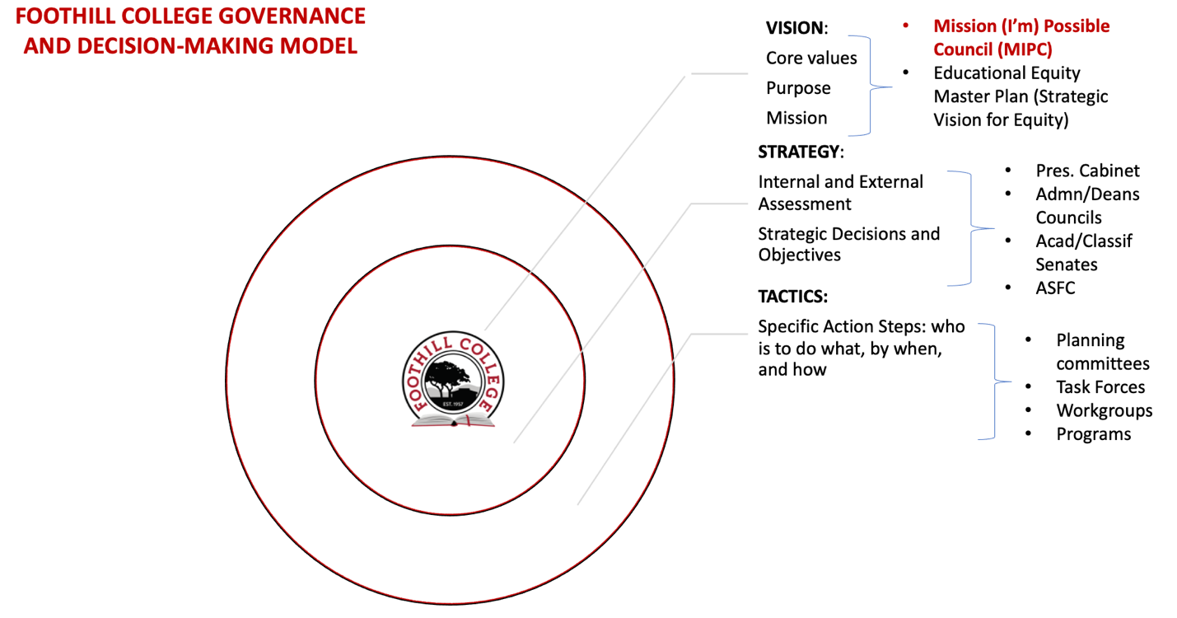

Slide 3
What is a Vision Statement?
What we seek to accomplish
Aspirational goals
Brings mission and values together

Slide 4
What is a Vision Statement?
Our Values
  Honesty | Integrity | Trust | Openness | Transparency | Forgiveness | Sustainability
Our Purpose
  To provide access to educational opportunity for all with innovation and distinction

Slide 5
Foothill Vision Statement
Approved by
PaRC Fall 2014
Foothill College educates students from diverse backgrounds that represent the demographics of the Bay Area, with particular attention to underserved and underrepresented populations. Foothill students master content and skills which are critical for their future success. They develop and act upon a sense of responsibility to be stewards of the public good.

Slide 6
Foothill Mission Statement
Approved by
PaRC 04/2017, BOT 05/2017
Believing a well-educated population is essential to sustaining and enhancing a democratic society, Foothill College offers programs and services that empower students to achieve their goals as members of the workforce, as future students, and as global citizens. We work to obtain equity in achievement of student outcomes for all California student populations, and are guided by our core values of honesty, integrity, trust, openness, transparency, forgiveness, and sustainability. Foothill College offers associate degrees and certificates in multiple disciplines, and a baccalaureate degree in dental hygiene.

Slide 7
College Mission vs. Mission Statement
College Mission
  Drives institutional priorities
  Guides institutional decision-making
  Assessed for effectiveness
  Not limited to mission statement
Mission Statement
  Brief statement
  Periodic review
  Updated as necessary
Notes:
College mission can be represented by more than just the mission statement.
Can include, vision statement, values, strategic planning documents, KPIs, etc.

Slide 8
What is a Mission Statement?
What our institution does
Why we do it
Who we do it for

Slide 9
What is a Mission Statement?
Identifies principles that serve as the foundation for:
  Program goals
  Student learning
  Institutional effectiveness

Slide 10
Why do we review the Mission?
Ensures reflection of evolving:
  Student populations served
  Student needs/goals
  College priorities
  Learning outcomes

Slide 11
Part of the College Planning Calendar
Year 1
2017-18
Year 2
2018-19
Year 3
2019-20
Year 4
2020-21
Year 5
2021-22
Year 6
2022-23
Year 7
2023-24
Year 1
2024-25
Site visit
VFS/SEA metrics (CO)
Program review
Revise budget request process
Strategic Vision for Equity
Write midterm report
Governance evaluation
Plan update: facilities master plan
Submit midterm report
ISER kickoff & training
ISER team formation
Mission review
Write ISER
Plan updates: EMP, online learning, tech
Student Equity Plan 2.0 due (CO)
Submit ISER
Draft report received (formative review
Site visit (summative review)
*Annual Assessment/Evaluation & Planning/Resource Prioritization
Notes:
Kurt

Slide 12
Accreditation Implications
Standard I.A. (Mission)
  Individual Standard statements (4)
  College to provide evidence
    Institutional Self-Evaluation Report (ISER)
    Due December 2023

Slide 13
Standard I.A.1 Mission
The mission describes the institution’s broad education purposes, its intended student population, the types of degrees and other credentials it offers, and its commitment to student learning and student achievement.

Slide 14
Standards I.A.2 Mission
The institution uses data to determine how effectively it is accomplishing its mission, and whether the mission directs institutional priorities in meeting the educational needs of students.

Slide 15
Standard I.A.3 Mission
The institution’s programs and services are aligned with its mission. The mission guides institutional decision-making, planning, and resource allocation and informs institutional goals for student learning and achievement.

Slide 16
Standard I.A.4
I.A.4 is only individual Standard statement explicitly mentioning the mission statement.
The institution articulates its mission in a widely published statement approved by the governing board. The mission statement is periodically reviewed and updated as necessary.

Slide 17
Evaluating the Mission Statement
Do the statement(s) reflect:
  What we do?
  What we are trying to achieve?
  What values/principles guide our work?

Slide 18
Mission + EEMP Updates
Part of the 7-year planning cycle involves a regular review of the college mission statement along with an update of the Educational Equity Master Plan (EEMP)
Spring 2023
Revise EEMP draft
Approve EEMP
Format EEMP
Winter 2023
Align planning documents to revised mission statement, including EEMP
Spring 2022
Fall 2022
Submit EEMP to Board
Review ISER draft
Form Mission Review Group
Review
FH mission statement
FHDA mission statement
Standard I.A: Mission
CCCCO mission statement
5-yr enrollment trends
Draft updated mission statement
Summer 2022
Approve mission statement
Submit mission statement to Board
Review mission statement feedback
Revise mission statement
Draft EEMP
Review EEMP draft
Solicit EEMP feedback
Review external/internal scan data
Identify institutional priorities
Form EEMP Update Group
Survey college community/community members
DRAFT
02.11.2022. rev. 02.15.2021

