Slide 1
Buildings, Grounds and Sustainability
Bret Watson
VP Finance & Administrative Services
November 3, 2023

Slide 2
Buildings, Grounds, and Sustainability Committee
Architectural Integrity of Campus
Signage and Lighting
Grounds issues
Sustainability
  GHG Reduction
  Energy Usage
  Water Conservation
  Recology – Waste Reduction

Slide 3
Members:
Asha Jossis
Audrey Capristo
Peter Chow (Danmin Deng)
Bob Cormia
Julie Ceballos
Simon Pennington
Samuel Connell
Joel Cortez
Gian Amrik (Student)
Mike Teijeiro
Bret Watson

Slide 4
Lighting Project
Measure G
  Project 112 - Upgrade Campus Wide Lighting for Safety and Energy Efficiency
  Budget $2,753,300

Slide 5
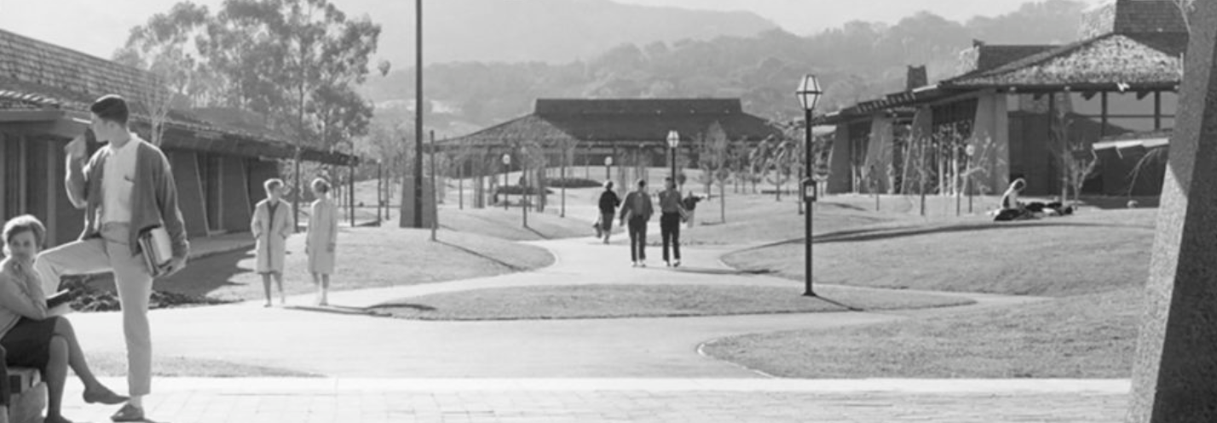
Path Lighting at Foothill College (The Past)

Slide 6
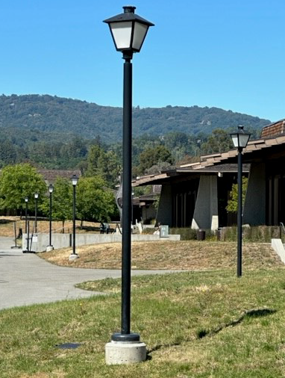
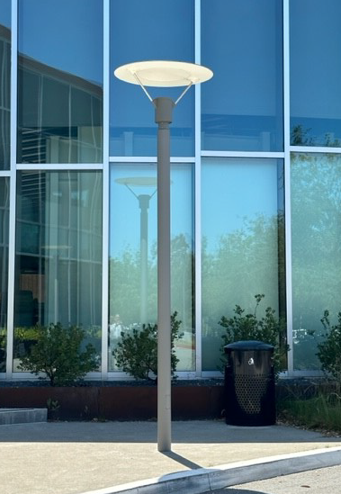
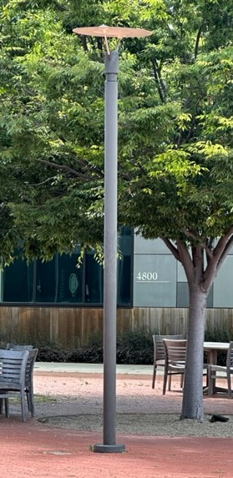
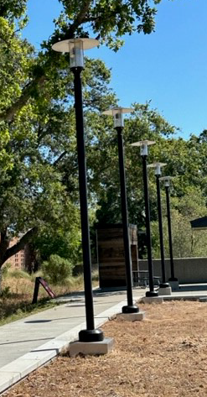
Various Light Fixtures Currently on the Foothill Main Campus

Slide 7
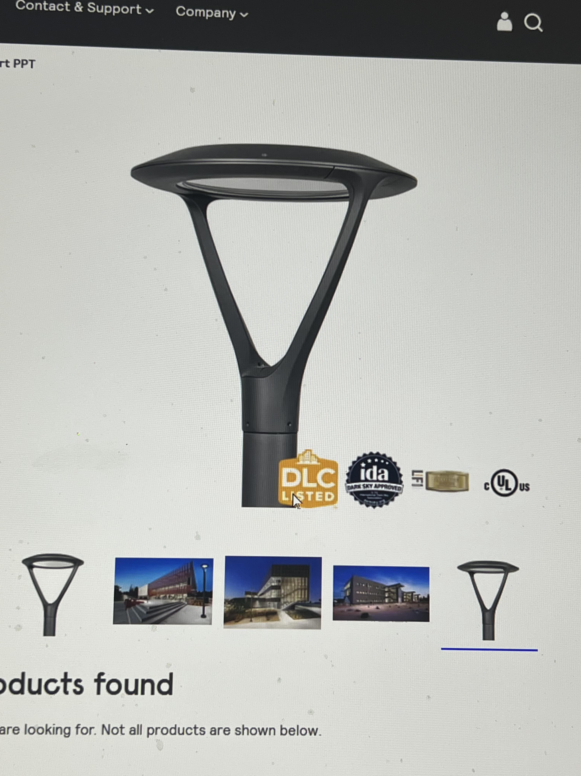
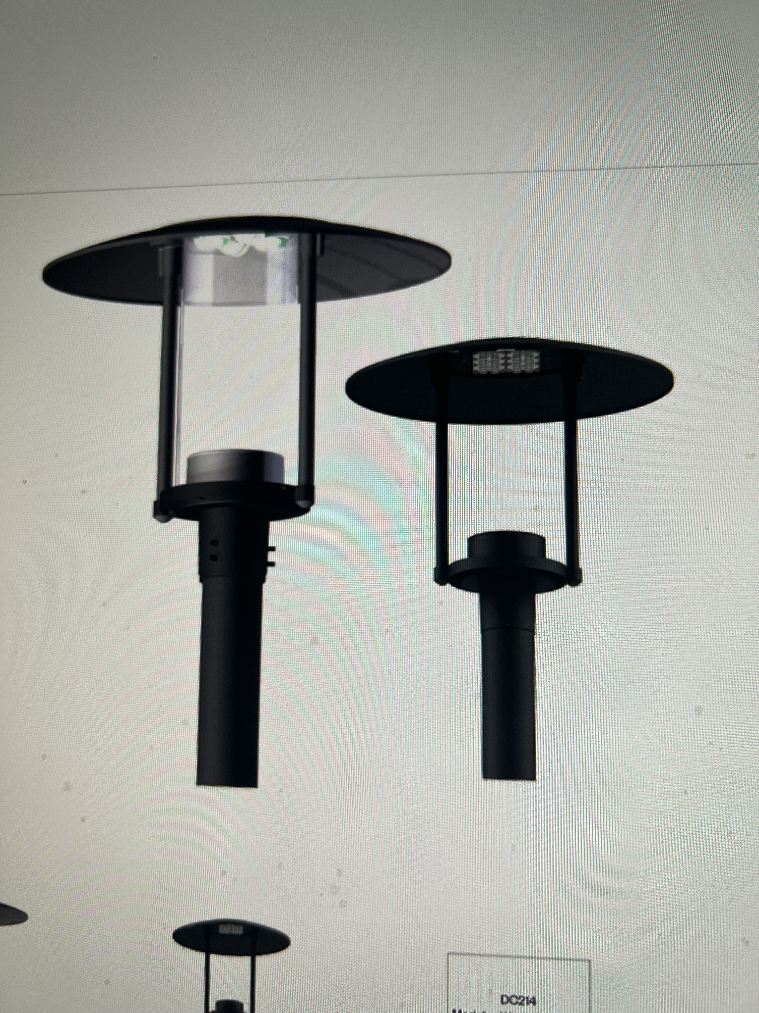
Possible Options for Future Lighting at Foothill

Slide 8
Next Steps
Install Sample lights
Review at Buildings,Grounds, & Sustainability
  How well do they meet the lighting and safety requirements?
  Cost of the options.
    Money left to address lighting deficiencies and work toward sustainability goals.

Slide 9
Signage, Campus Site Access, and Wayfinding
Measure G
  Project 111 – Upgrade Campus Site Access, Signage and Wayfinding
  Budget = $15,831,400

Slide 10
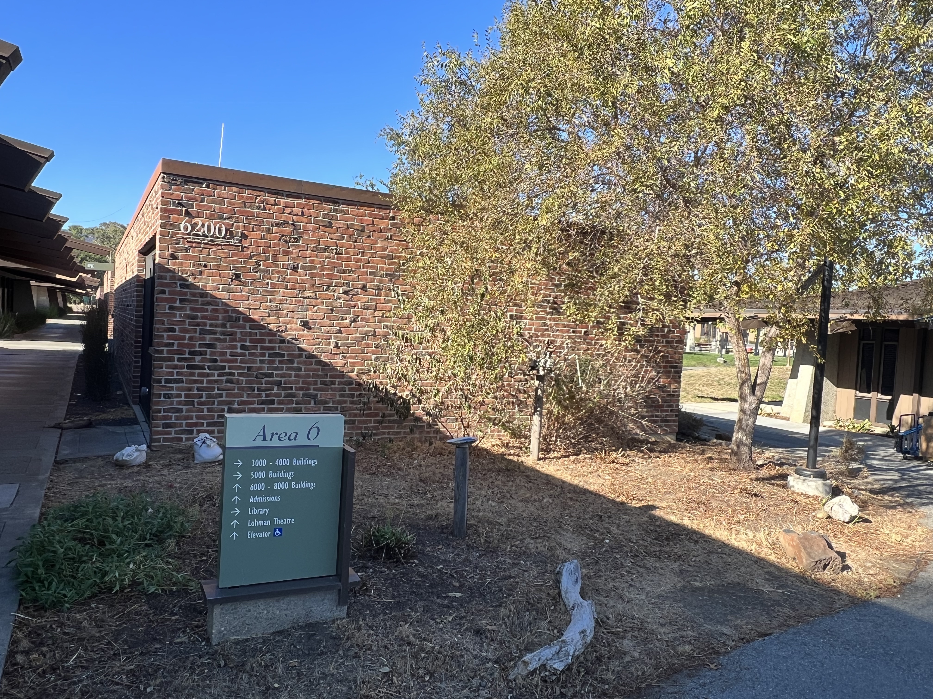
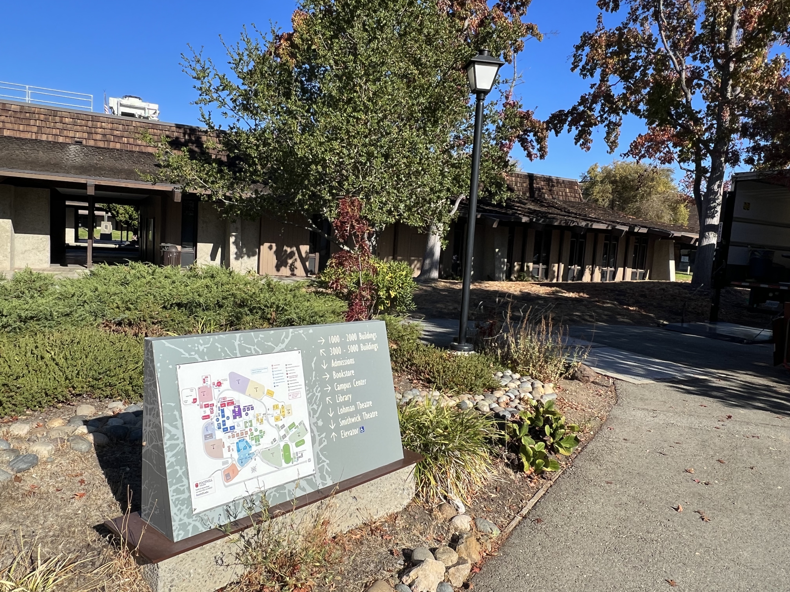
Campus Signage

Slide 11
Campus Signage Next Steps
Committee to investigate changes in signage
  Lighting and Signage sub-committee
  Other participants across the campus
Review existing signage
Select a vendor to assist
Provide feedback on progress

Slide 12
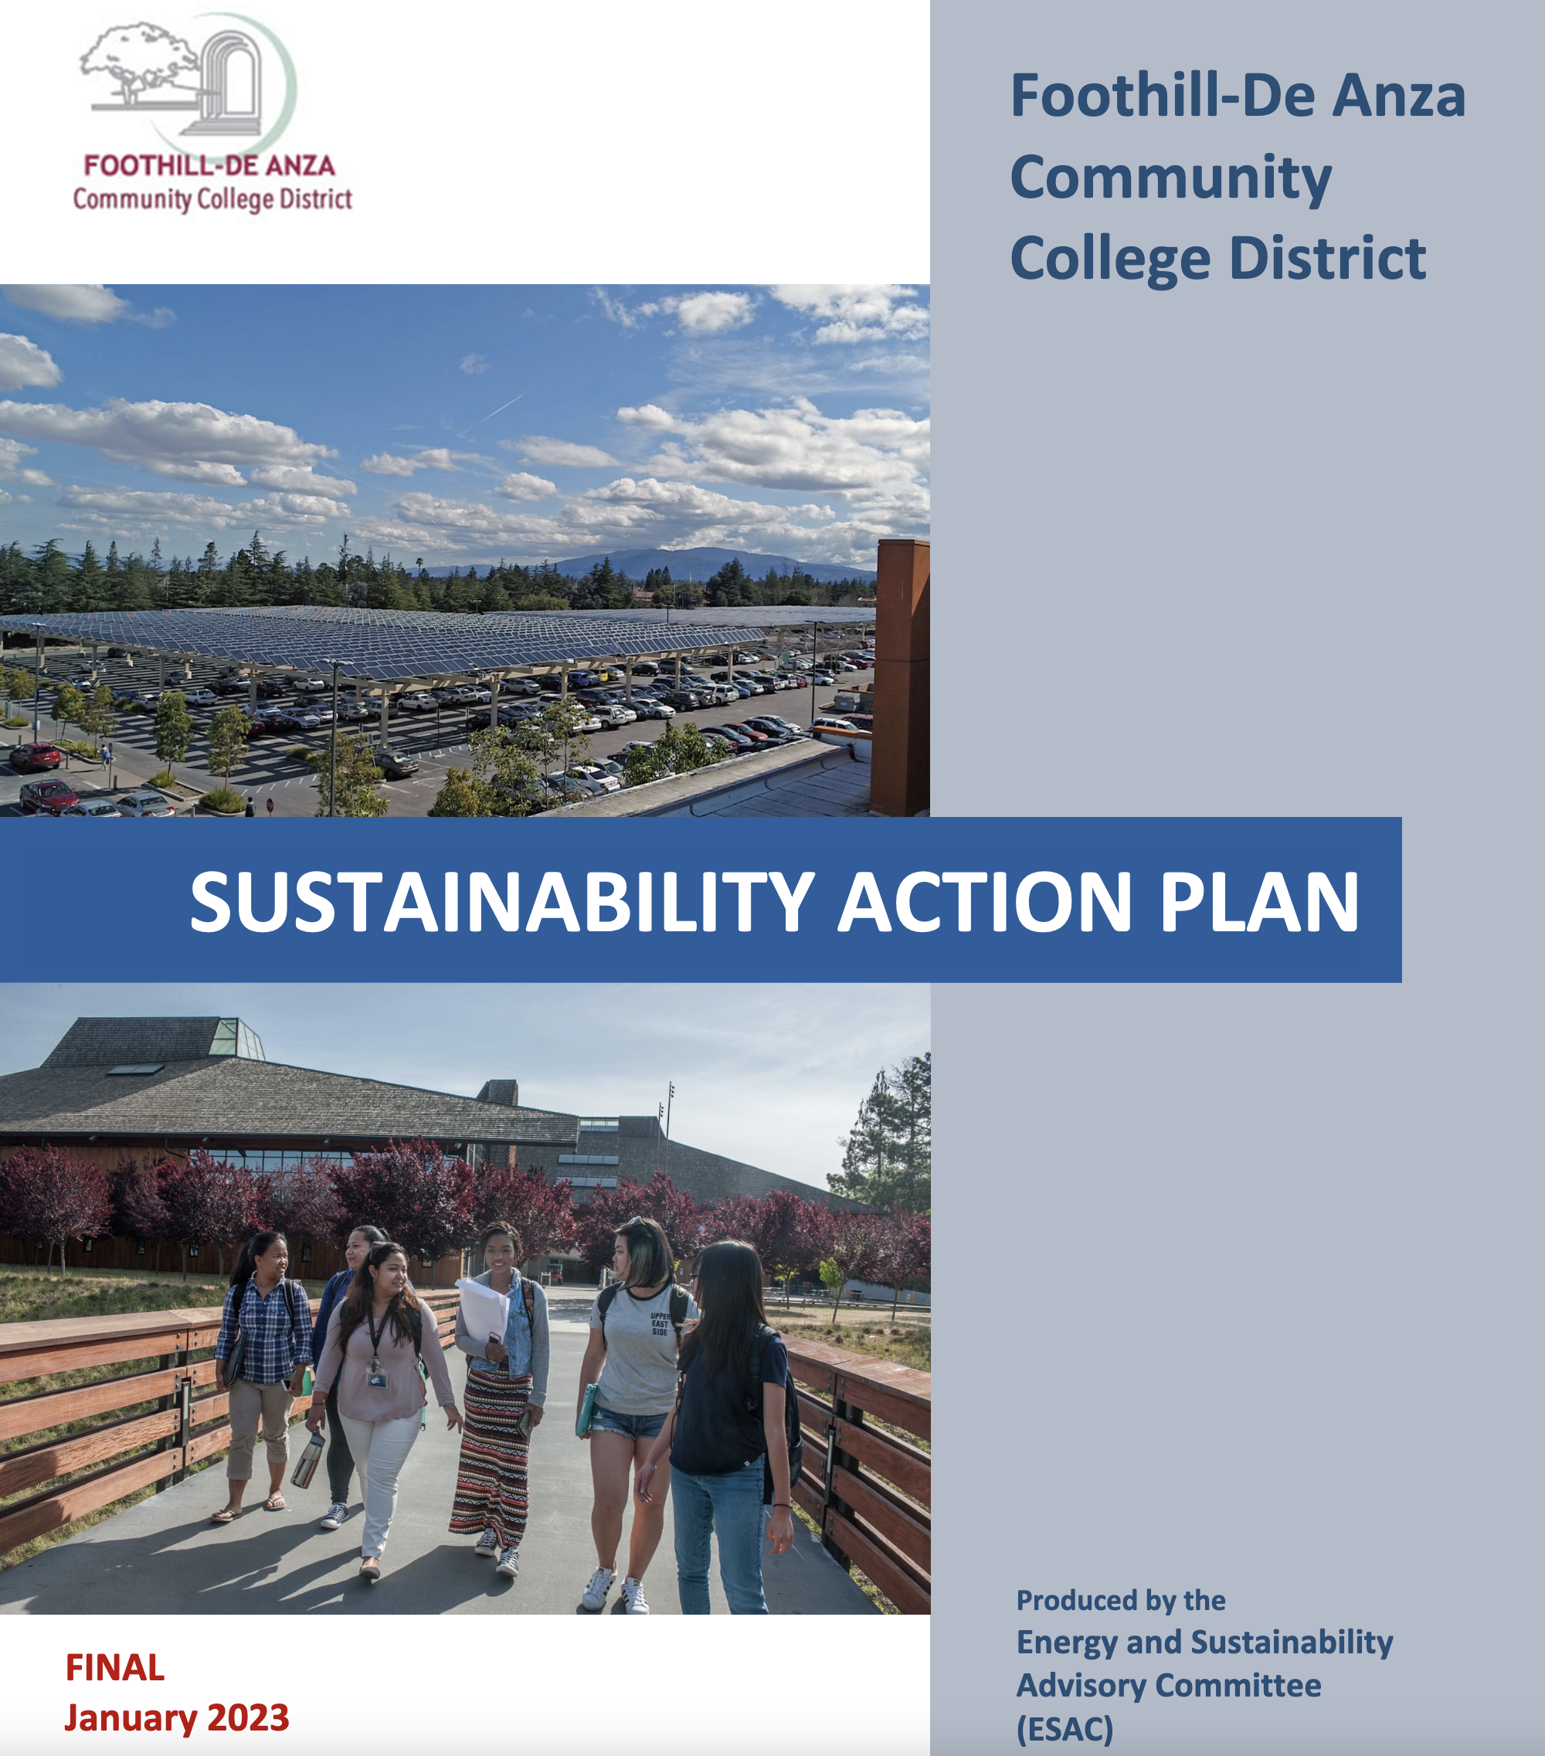
Sustainability Action Plan
Look at Issues to address this year and beyond
  Recology 3 Bin Pilot
  Lighting to LED
  Water conservation
Work with students (ASFC) on common goals
Integrate Strategic Equity Plan, Mission, Ed and Facilities Plans

Slide 13
Questions?

