Slide 1
Budget Reduction Update
Bret Watson
Vice President of Finance
January 31, 2018

Slide 2
Highlights:
Background Review of Reductions
Guiding Principles for Reductions
Projected Resident FTES for District & by College
P-1 Enrollment Figures. Impact on the 2018-19 Budget
Timelines

Slide 3
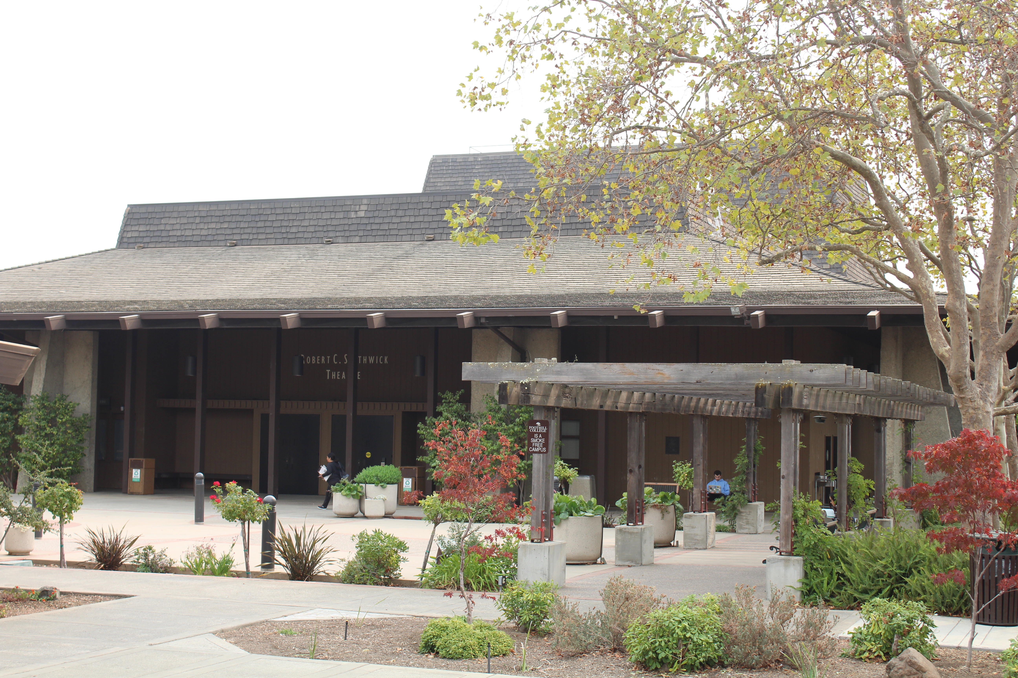
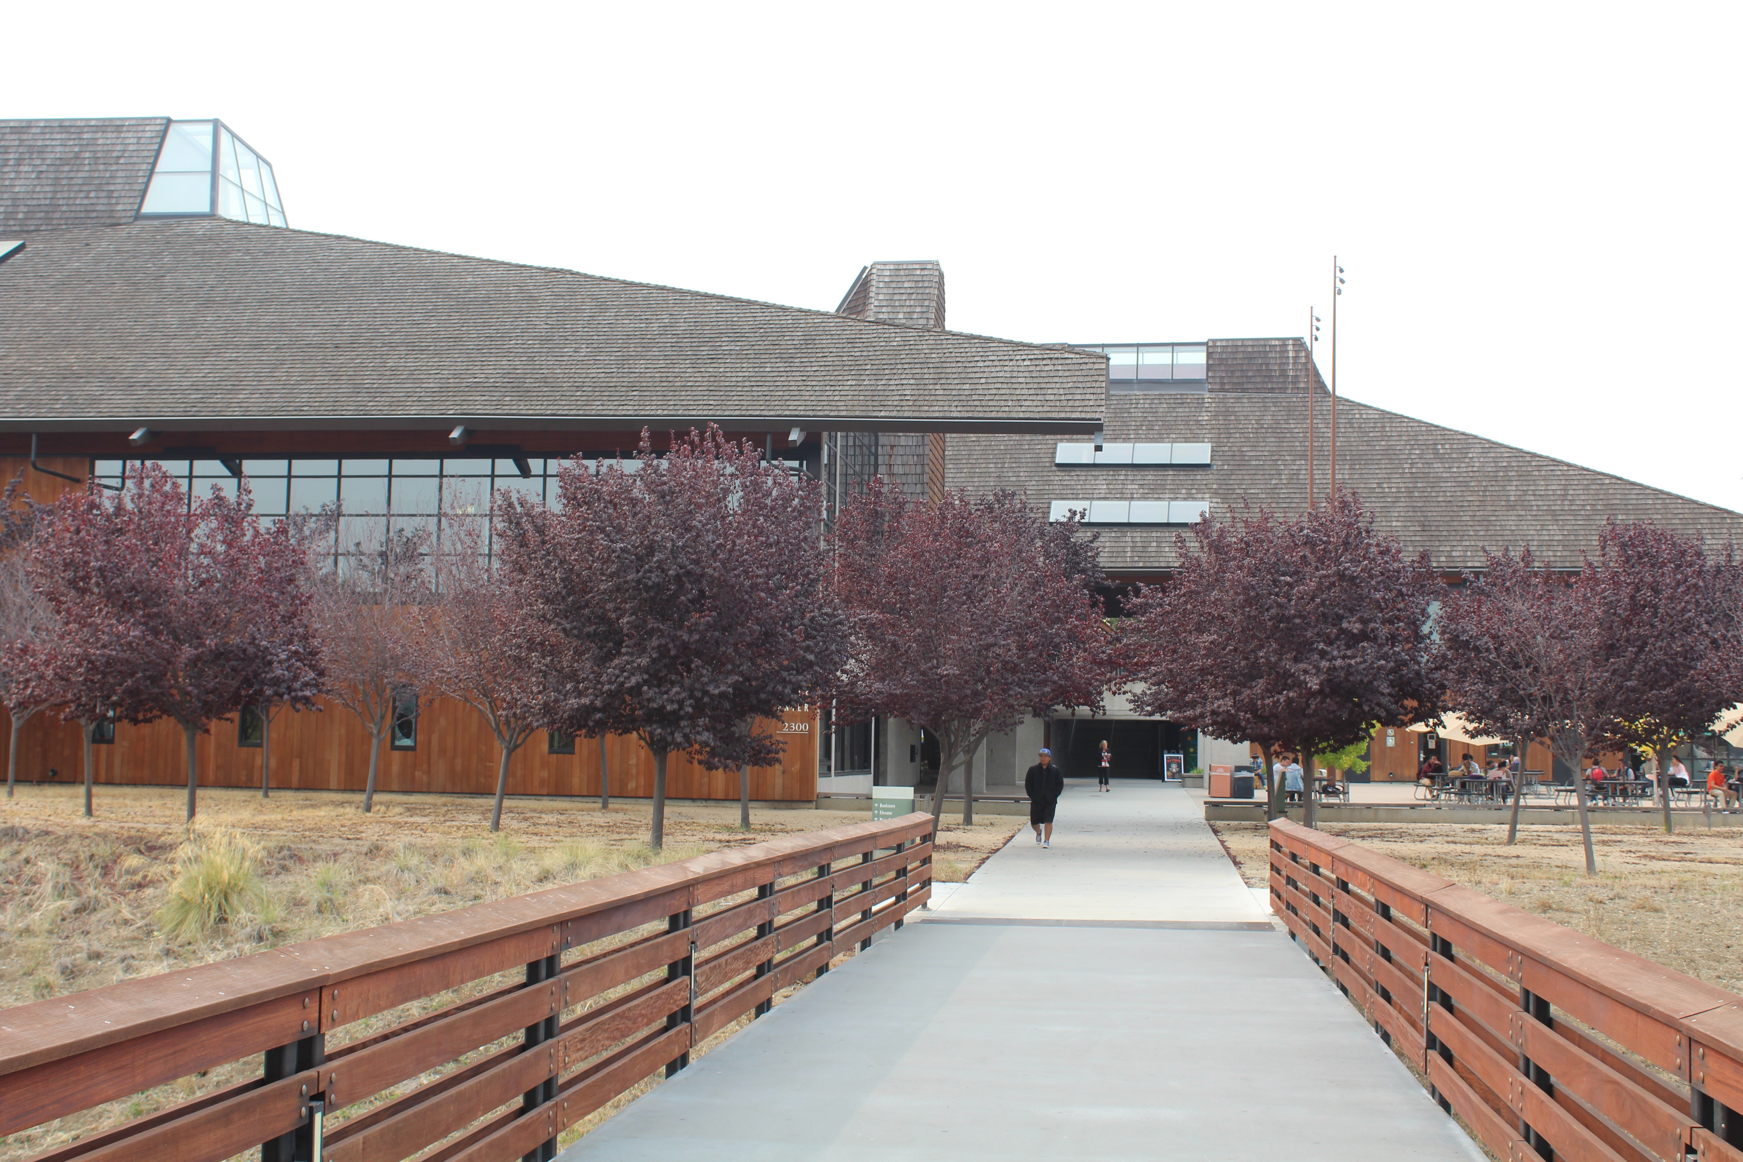
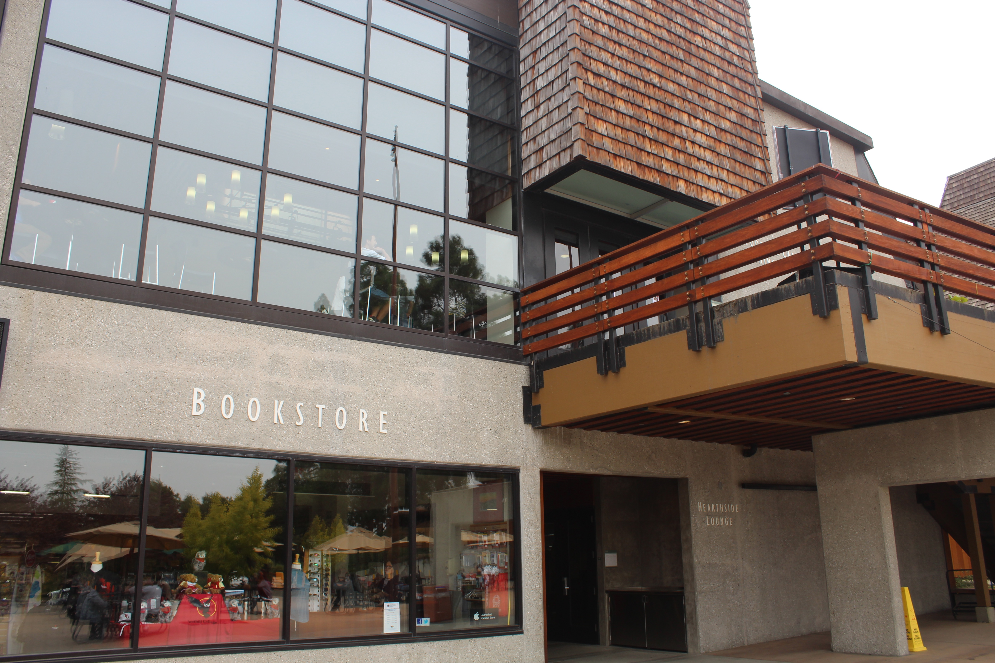
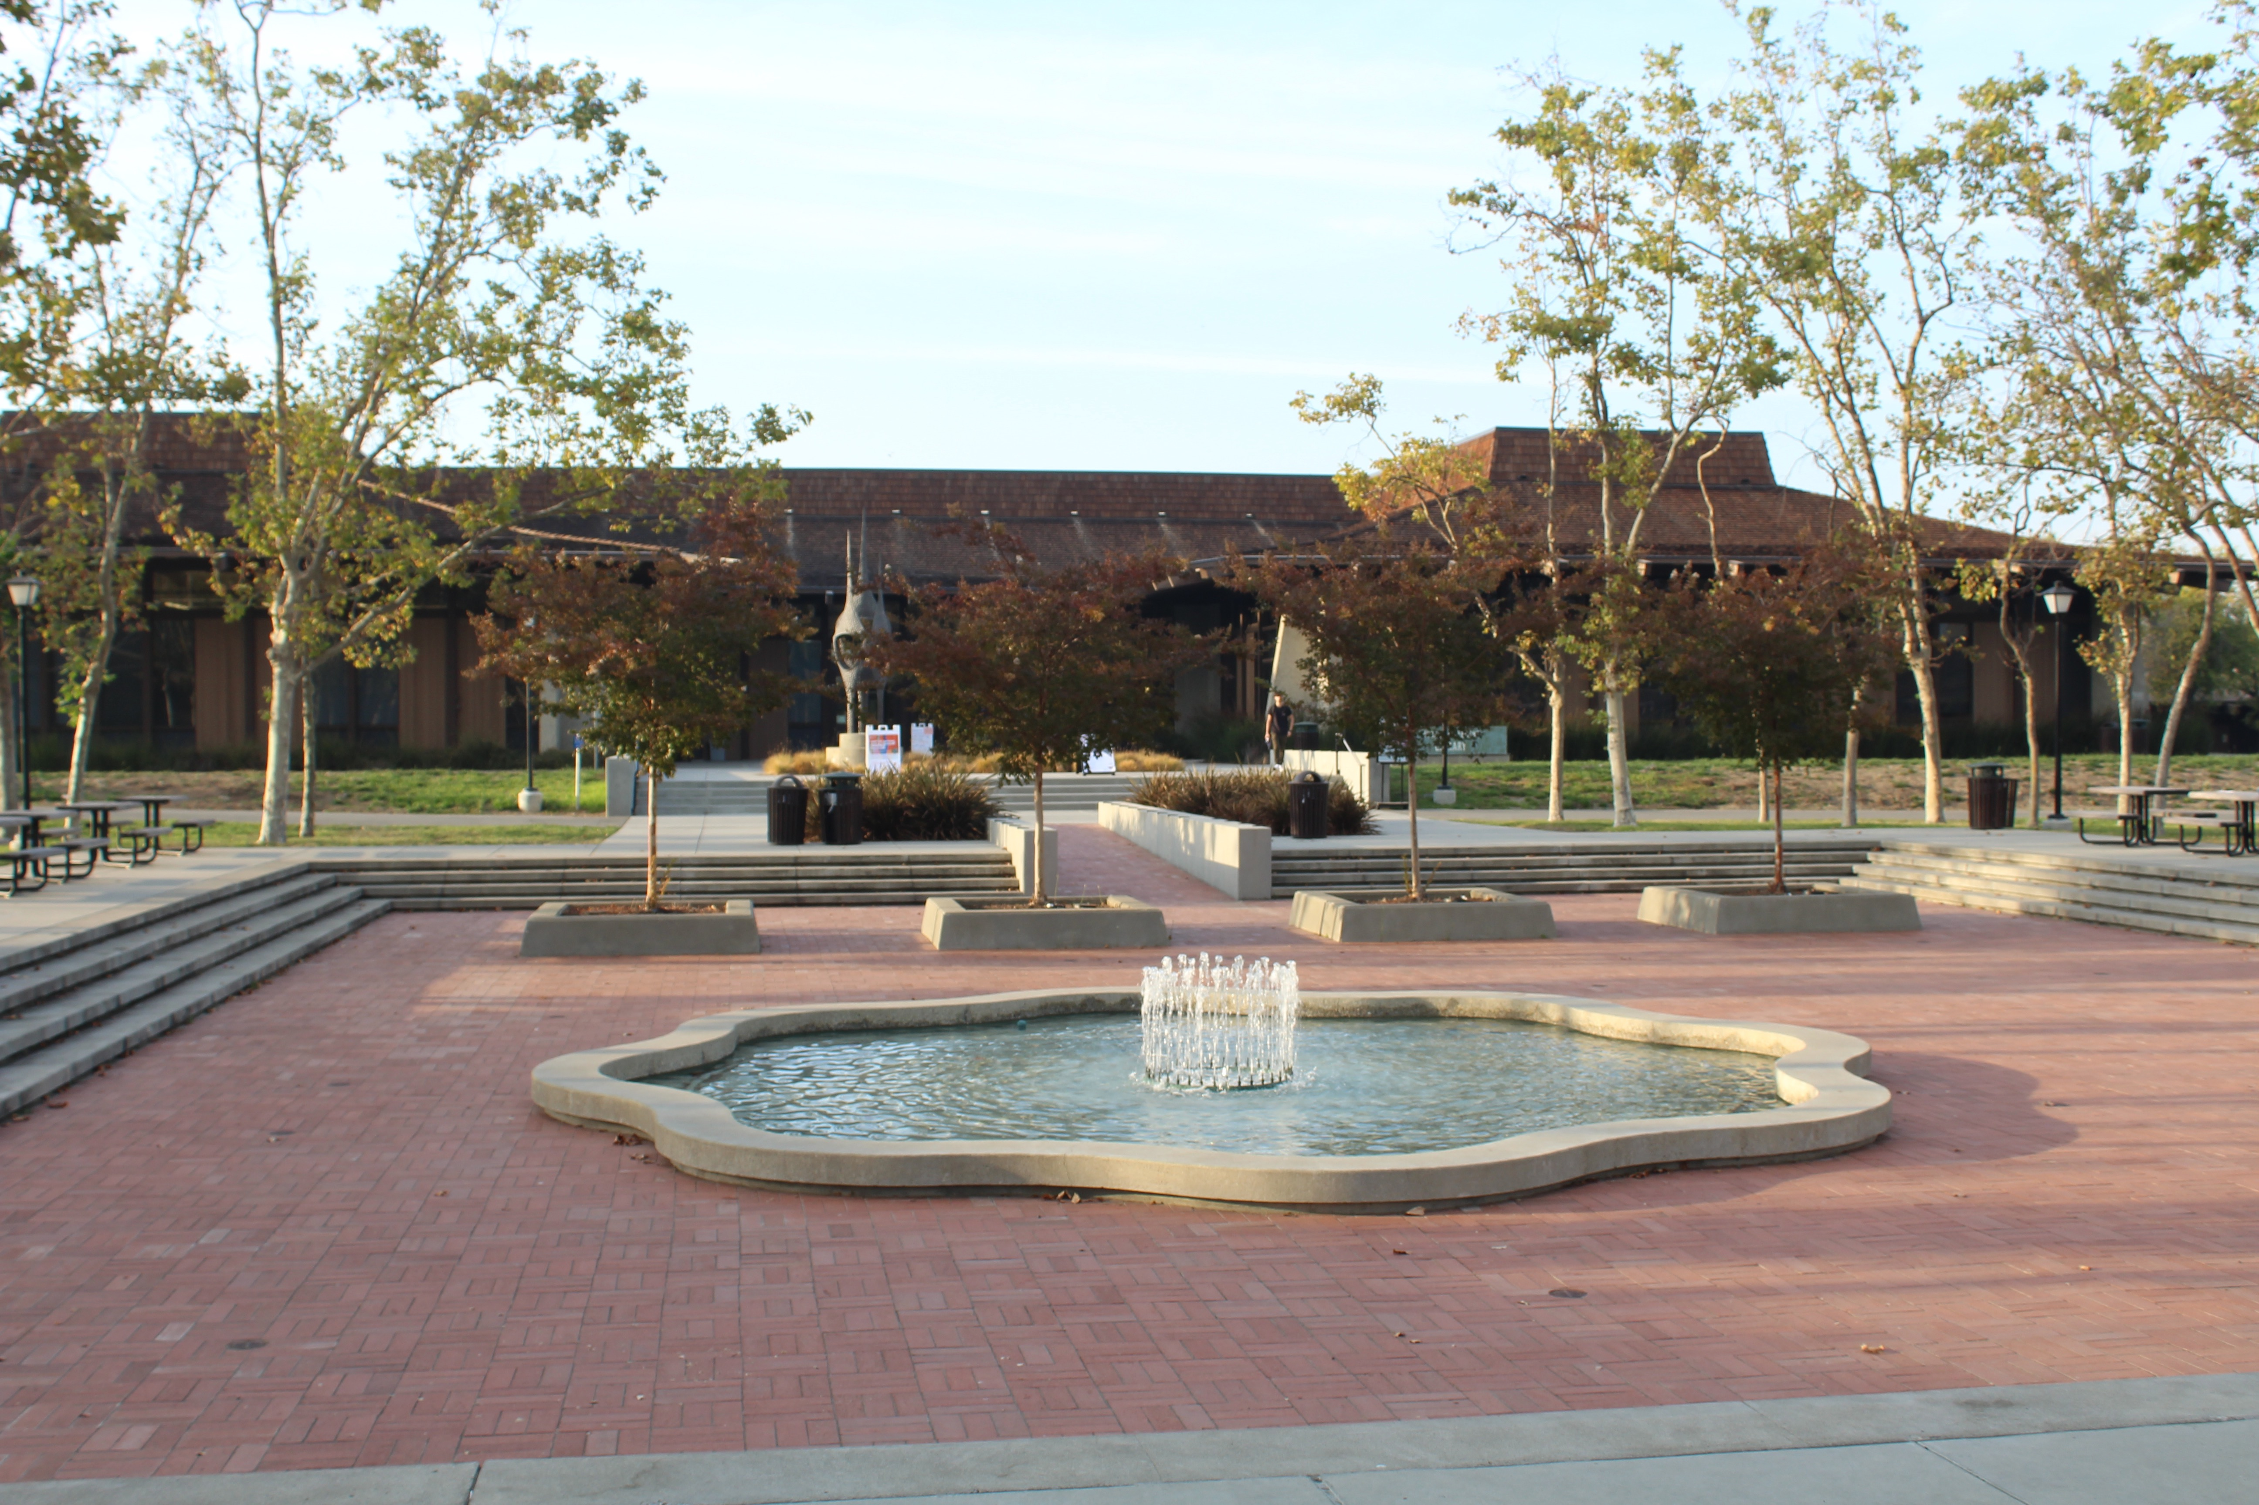
Our Mission
Believing a well-educated population is essential to sustaining and enhancing a democratic society, Foothill College offers programs and services that empower students to achieve their goals as members of the workforce, as future students, and as global citizens. We work to obtain equity in achievement of student outcomes for all California student populations, and are guided by our core values of honesty, integrity, trust, openness, transparency, forgiveness, and sustainability. Foothill College offers associate degrees and certificates in multiple disciplines, and a baccalaureate degree in dental hygiene.
Approved by Planning & Resource Council (PaRC) in April 2017; Approved by Board of Trustees in May 2017

Slide 4
Budget Reduction Background:
Structural budget deficit of -$10M for 2017/18.
District Budget reductions strategy includes:
    -$2M for 17/18, -$3M for 18/19, & -$5M for 19/20.
    Distribution of reductions is (35% Foothill, 50% De Anza, & 15% District).
    Foothill’s share of the reduction is $3.5M.

Slide 5
Breakdown Per Division:
Finance, Marketing & President’s Office = 20% or $700,000.
Instruction & Workforce Development = 40% or $1,400,000.
Student Services = 40% or $1,400,000.

Slide 6
Dollar Breakdown by Division:
Division | Year 1 & 2 | Year 3 | Total
Finance, Marketing, & President’s | $350,000 | $350,000 | $700,000
Instruction & Workforce Development | $700,000 | $700,000 | $1,400,000
Student Services | $700,000 | $700,000 | $1,400,000
Total | $1,750,000 | $1,750,000 | $3,500,000

Slide 7
What is Happening Now?
Divisions are communicating and planning.
Some costs savings are being identified for years 1 & 2 reductions.
Requesting input from areas on where to reduce expenses?

Slide 8
Proposed Suggestions for Savings:
    Categorical Programs (SSSP, Student Equity, Strong Workforce)
    Vacancies (full-time faculty, retirements)
    “B” Budget
    Self-Sustaining Fund (Rental Facilities/Fine Arts)
    Health Fees
    Mandated Cost (Health Fee Elimination)
    Foundation
    Student Body Funds (ASFC)
    Raise Printing Fees

Slide 9
Eight Proposed Guiding Principles for Reductions:
1) Preserve Quality Education
    Student centered focus
    Support equity
    Remain innovative
    Maintain our quality and excellence
2) Strategic Enrollment Growth
    Evaluate both qualitatively and quantitatively
    Maintain resources for growth
    Serve students in an innovative way
3) Cabinet Review/Approval
    Review overtime
    Approve hiring to fill all vacancies
    Review faculty positions that are 11 & 12 mo.
    Evaluate / approve reassigned time
    Review sabbaticals (planning/scheduling)
Notes:
Managed Hiring.
-Evaluate on a case by case basis the vacant positions.
-Full-time faculty want to be strategic. Look at FON and hire some full-time faculty in order to maximize enrollment.
Tightening of Budget

Slide 10
Guiding Principles Continued…
4) No layoffs of full-time positions for 2017-18 & 2018/19.
    Use one-time funds if needed.
    Person may do something different.
    May use different funding sources
    Open, consistent and sustained communication
    Respect for privacy and timing of notification
5) Spending relates to strategic objectives.
    Aligned with enrollment and productivity goals.
    Exceptions (i.e. students needing one class to earn ADT).
    Provide advanced annual offerings for students to plan.
Notes:
4) The group agrees with the proposal as written…however, delaying difficult decisions does not reduce pain in the long run if enrollment/budget challenges continue
-Transparency
-Open, consistent and sustained communication
Participation and opportunity for feedback
Respect for personal privacy
Reasonable timing
Hear probable news earlier

Slide 11
Guiding Principles Continued…
6) Transparency
    Open Communication
    Reasonable timing when sharing information.
7) Shared Pain
    Faculty, classified and management units will be impacted.
    Kindness & empathy
8) Program Review/Elimination
    Follow program review process/statutes/regulations
    Analysis of impact of program/college/community
    Transparency with clear rubric
    One-year timeframe to grow enrollment

Slide 12
Update on Enrollment:
Resident Enrollment by District
College Comparison
Figures reported to the State (P-1 Enrollment Report).

Slide 13
Resident Enrollment:
(2009/10 – 2017/18 Projected)

Slide 14
Resident Enrollment by College:

Slide 15
P-1 Resident and Non-Resident Enrollment Projections 2017-18
Resident Enrollment | 2016/17 | Projected 2017/18 | Total
De Anza | 15,340.54 | 14,372.28 | -968.26
Foothill | 10,626.98 | 10,735.61 | 108.63
Total | 25, 967.52 | 25,107.89 | -859.63
Non-Resident Enrollment | 2016/17 | Projected 2017/18 | Total
De Anza | 2,856.76 | 2,612.24 | -244.52
Foothill | 1,756.99 | 1,764.95 | 7.96
Total | 4,613.75 | 4,377.19 | -236.56
Grand Total | 30,581.27 | 29,485.08 | -1,096.19

Slide 16
Foothill & De Anza College Productivity (last 6 years):

Slide 17
Timelines:
July 1, 2018 - Budget Reductions for Years 1 & 2 (total of $1,750,000) must be identified.
July 1, 2019 - Year 1 & 2 cuts must be fully implemented.
December 31, 2018 - *Additional $1,750,000 for Year 3 reductions shall be identified.
July 1, 2020 – Year 3 cuts must be fully implemented.
*Based on FTES figures and financial outlook.

Slide 18
Consultation: Participatory governance and town hall
Round 1: Budget Reduction & Proposed Percentage Cuts in Each Division
    September 14, 2017: Governance Summit —> present information about budget reductions percentages
    November 8, 2017: Town hall at main campus (Hearthside)
    November 30, 2017 (Sunnyvale) / December 5, 2017 (Hearthside): District town halls
    November 1 & 15, 2017: PaRC regarding Proposed % Cuts in each Division
Round 2: Guiding Principles & Discussion by Divisions on Possible Budget Cuts
    January 22, 2018: Cabinet retreat
    January 25, 2018: Admin Council retreat
    January 31, 2018: PaRC
Round 3: Finalize list of reductions for Year 1 & 2
    March: Cabinet retreat
    March: PaRC
    April: town hall
    April: PaRC
    April/May: Finalize list to District

Slide 19
Questions?

