Slide 1
Foothill Strategic Objectives Update – Equity Plan and Enrollment
PaRC, January 17, 2017

Slide 2
Strategic Objective - Equity
Equity plan – Develop an integrated plan, identify goals for alignment with equity, student success, and basic skills; and focus on efforts to integrate with enrollment strategies (access, retention, and persistence) to close equity gaps while increasing enrollments at the same time
Plan accepted by Board on 1/16/18
Evaluation ongoing

Slide 3
Equity Plan Initiatives
Student Success Retention Team
Early Alert System
Mentoring Program
Professional Development
Research Agenda

Slide 4
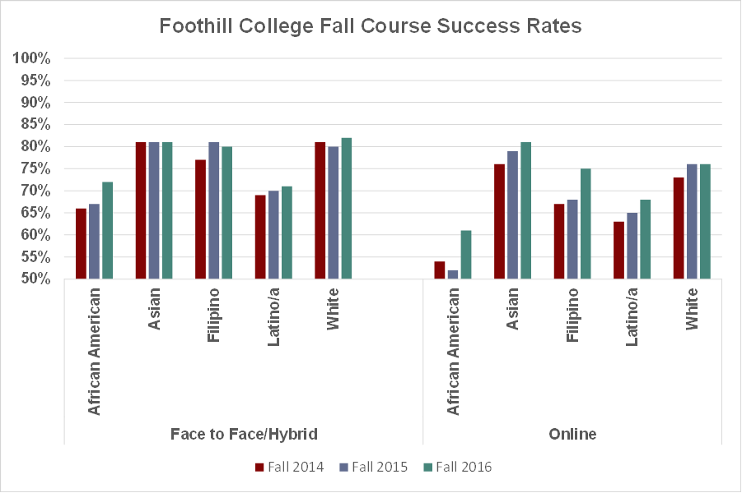
Equity Plan Goal: the goal is to narrow the achievement gap among disproportionately impacted student groups

Slide 5
Strategic Objective - Enrollment
Enrollment Growth –Achieve more than 1.5% FTES growth at 500 productivity (+/-25) with attention to integrating equity efforts related to enrollment, CTE, Sunnyvale Education Center, and education pathways
P1 estimate = +1.0%
2017-18 Prod estimated at 480
Notes:
5 unit class (5 hrs a week)
Load .1250
Prod for 50 students = 5 X 50 = 250 / (.1250 x 3) = 666
20 students = 100 / .375 = 266

Slide 6
Strategic Objective – Enrollment: seven focused areas to increase enrollment
A. Increase retention and persistence (including that of special populations such as EOPS, DRC, and other learning communities; basic skills courses; financial aid promoting completion; and STEM Center and TLC utilization);
B. Increase online enrollment (with attention to equity retention and persistence);
C. Increase noncredit courses that meet community needs;
D. Increase equity-focused dual enrollment efforts such as Early College Promise;
E. Develop Career Technical Education (with increase in FTES, job placement, and equity as dictated by state Strong Workforce Program funding);
F. Develop an identity for Sunnyvale Center; and
G. Implement EduNav as part of establishing education pathways identified in accreditation Quality Focused Essay.

Slide 7
Foothill Enrollment Interventions (selected)
Online-Deans Message to Faculty, email to second week
Email sent to Shopper/Dropper Students
Email sent to First Generation Students
Drop for Non-Payment Review
Homeschool / Community Ed Open House and Emails

Slide 8
Spring Initiatives
Focused Second Spring using data on students attending 4 year institutions
Foothill Academy - 3 Sequenced courses - spring to summer
Expanded YUBA
Expanded Dual Enrollment offerings
Expanded Adult Education offerings
Expanded community partners catholic charities and boys and girls clubs

Slide 9
P1 Projections
Projecting to be up 1% overall for 2017-18.
  Summer up 16%
  Fall flat
  Winter off 4%?
  Spring flat

Slide 10
Shoppers and Droppers
Strategy
Marketing Efforts – Emailing Shoppers and Droppers
644 droppers last two weeks in July, 112 enrolled at Census (19%)
391 shoppers last two weeks in July, 54 enrolled at Census (14%)
8,798 shoppers as of Sept 3, 678 enrolled at Census (8%)

Slide 11
Shoppers: At what type of institution were they enrolled?
75%
25%
N=991
N=2970
Note: Local includes SJCC, Mission, West Valley, Evergreen Valley, CSM, Canada, SJSU ,Stanford, Menlo, Palo Alto and Santa Clara.

Slide 12
Shoppers: Top Ten 2-year colleges
109 | 108 | 88 | 65 | 62 | 46 | 36 | 30 | 27 | 19
N=

Slide 13
Shoppers: Top Ten 4-year colleges
517 | 483 | 257 | 204 | 144 | 132 | 106 | 94 | 94 | 83
N=

Slide 14
Droppers: At what type of institution were they enrolled?
52%
48%
N=812
N=884
Note: Local includes SJCC, Mission, West Valley, Evergreen Valley, CSM, Canada, SJSU ,Stanford, Menlo, Palo Alto and Santa Clara.

Slide 15
Droppers: Top Ten 2-year colleges
N=
87 | 86 | 68 | 49 | 47 | 41 | 32 | 29 | 28 | 24

Slide 16
Droppers: Top Ten 4-year colleges
207 | 159 | 56 | 52 | 44 | 37 | 29 | 26 | 15 | 13
N=

Slide 17
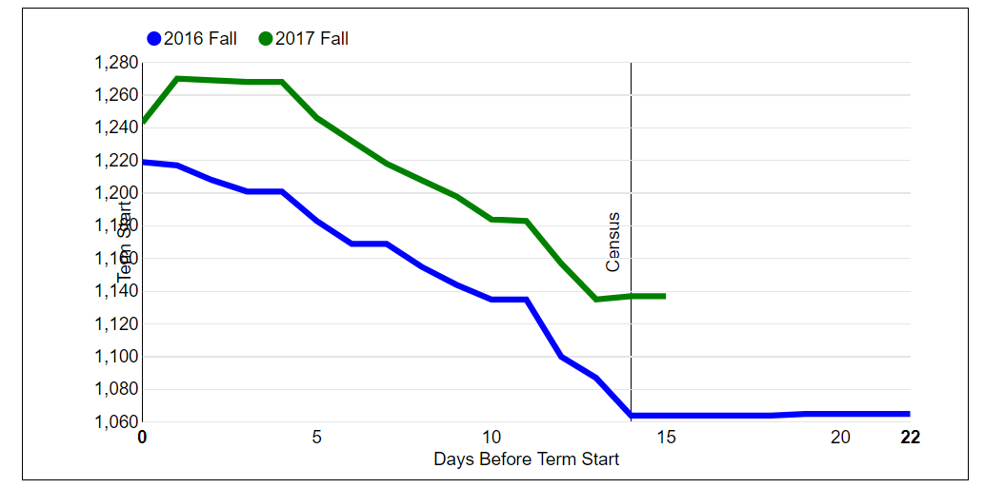
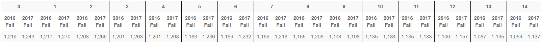
FALL17 On-Line Drop – Day One to Census
Year | FTES Change Day 0 to 14
2016 | Drop of 155 FTES
2017 | Drop of 106 FTES
At Census
Up
49 FTES

Slide 18
WINTER18 On-Line Drop – Day One to Census
Year | FTES Change Day 0 to 14
2017 | Drop of ?? FTES
2018 | Drop of ?? FTES
At Census
??

Slide 19
First Generation Students
3,677 emails sent to registered as of September 29 and again January 4, 2018
  3,431 enrolled at Census (93%)
  1,955 enrolled in winter
  (January 12, 2018)

Slide 20
Drop for Nonpayment
Strategy
Drop for Non-Payment
809 students dropped December 14
  510 re-enrolled at Census (63%)
  299 did not return (39%)
  Similar to Fall 2017
  First Gen Re-enrolled at slightly higher rate

Slide 21
International Students (F1 Visa)
Estimated 340 FTES in Fall 2017 – Approximately $1,700,000
Estimated 400 FTES in Fall 2016 – Approximately $2,000,000
  (-60 FTES) approximately $300,000
Number of Students
Visa (Census) | Fall 2015 | Fall 2016 | Fall 2017 | 1 yr chg
F1 | 1,193 | 1,004 | 911 | -93 (-9%)

Slide 22
Non-Residents Enrolled in 6 or fewer units (resident tuition)
About 550 Students in Fall 2017
Estimated FTES
Visa (Census) | Fall 2016 | Fall 2017 | 1 yr chg
6 or fewer | 40 FTES | 59 FTES | 19 (48%)

