Slide 1
Budget Update from April 25, 2018 PaRC meeting
Bret Watson
VP Finance & Admin. Services
June 6, 2018

Slide 2
Highlights:
Timelines & Important Dates
P-2 Enrollment estimates
Budget Reductions Update
Fund Balance & Productivity
Guiding Principles for Reductions

Slide 3
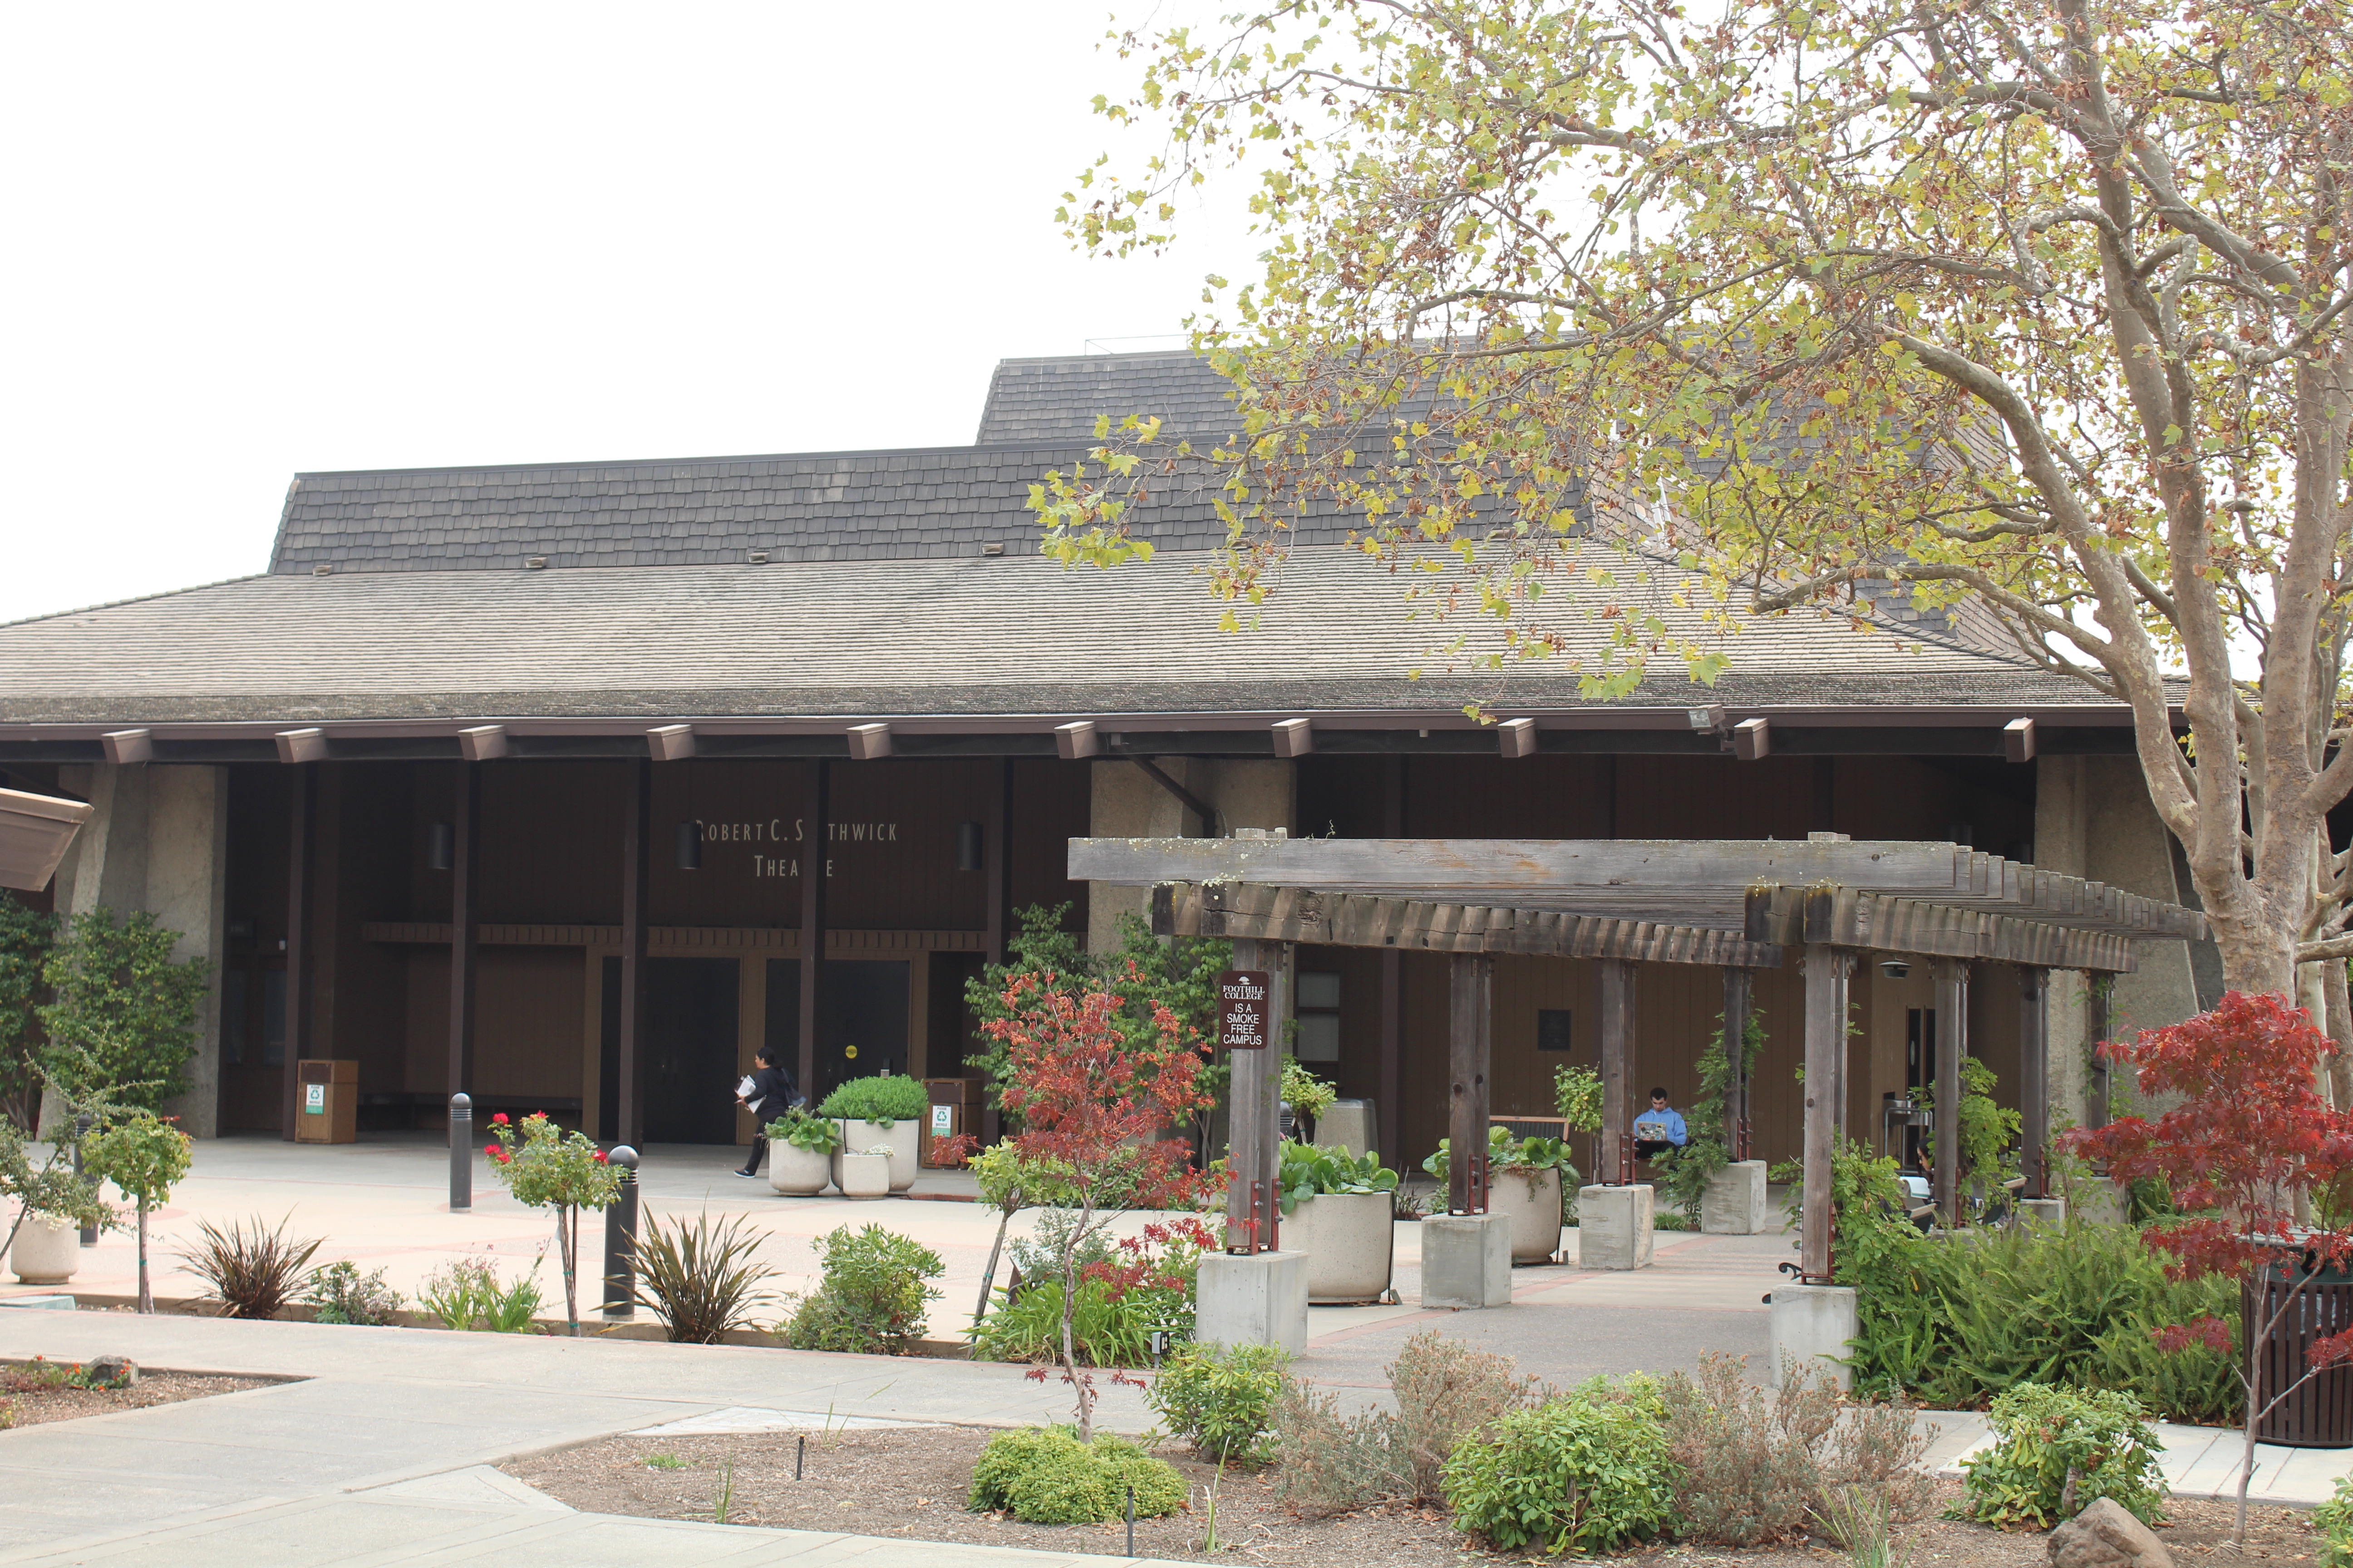
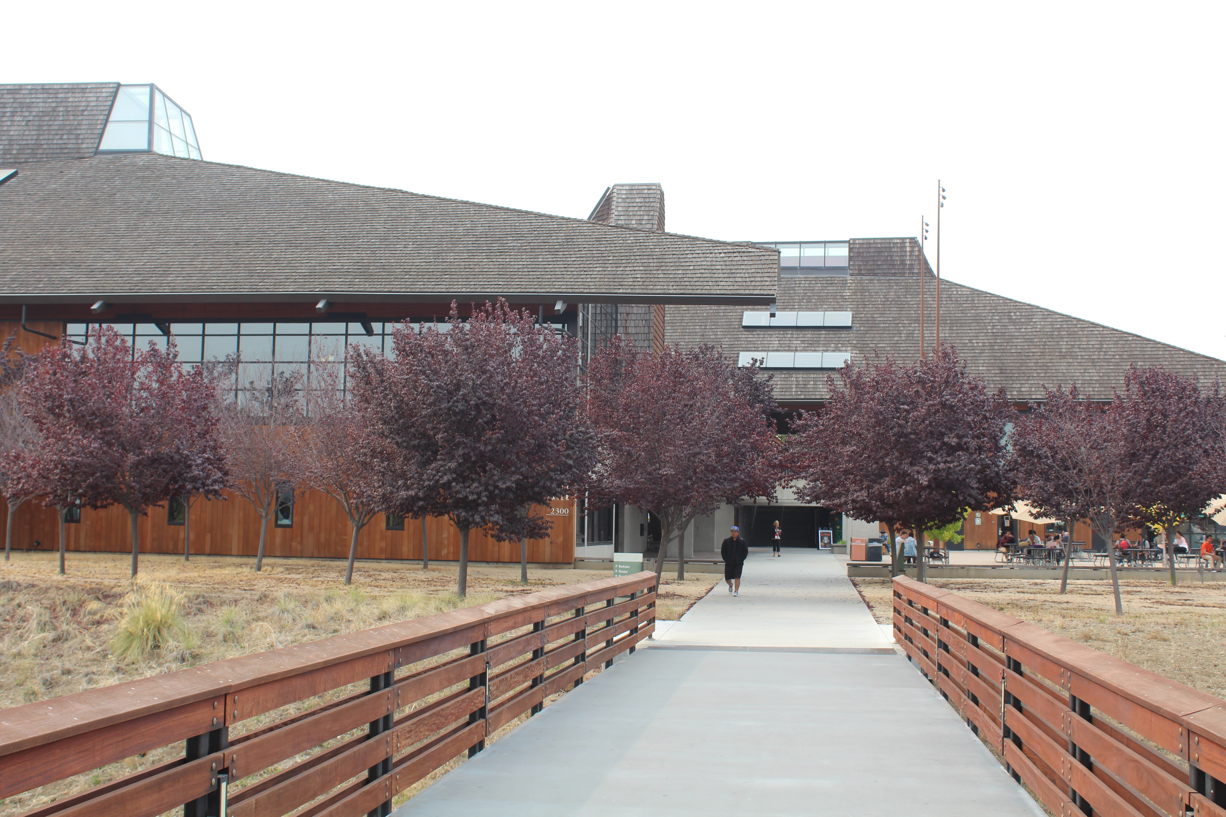
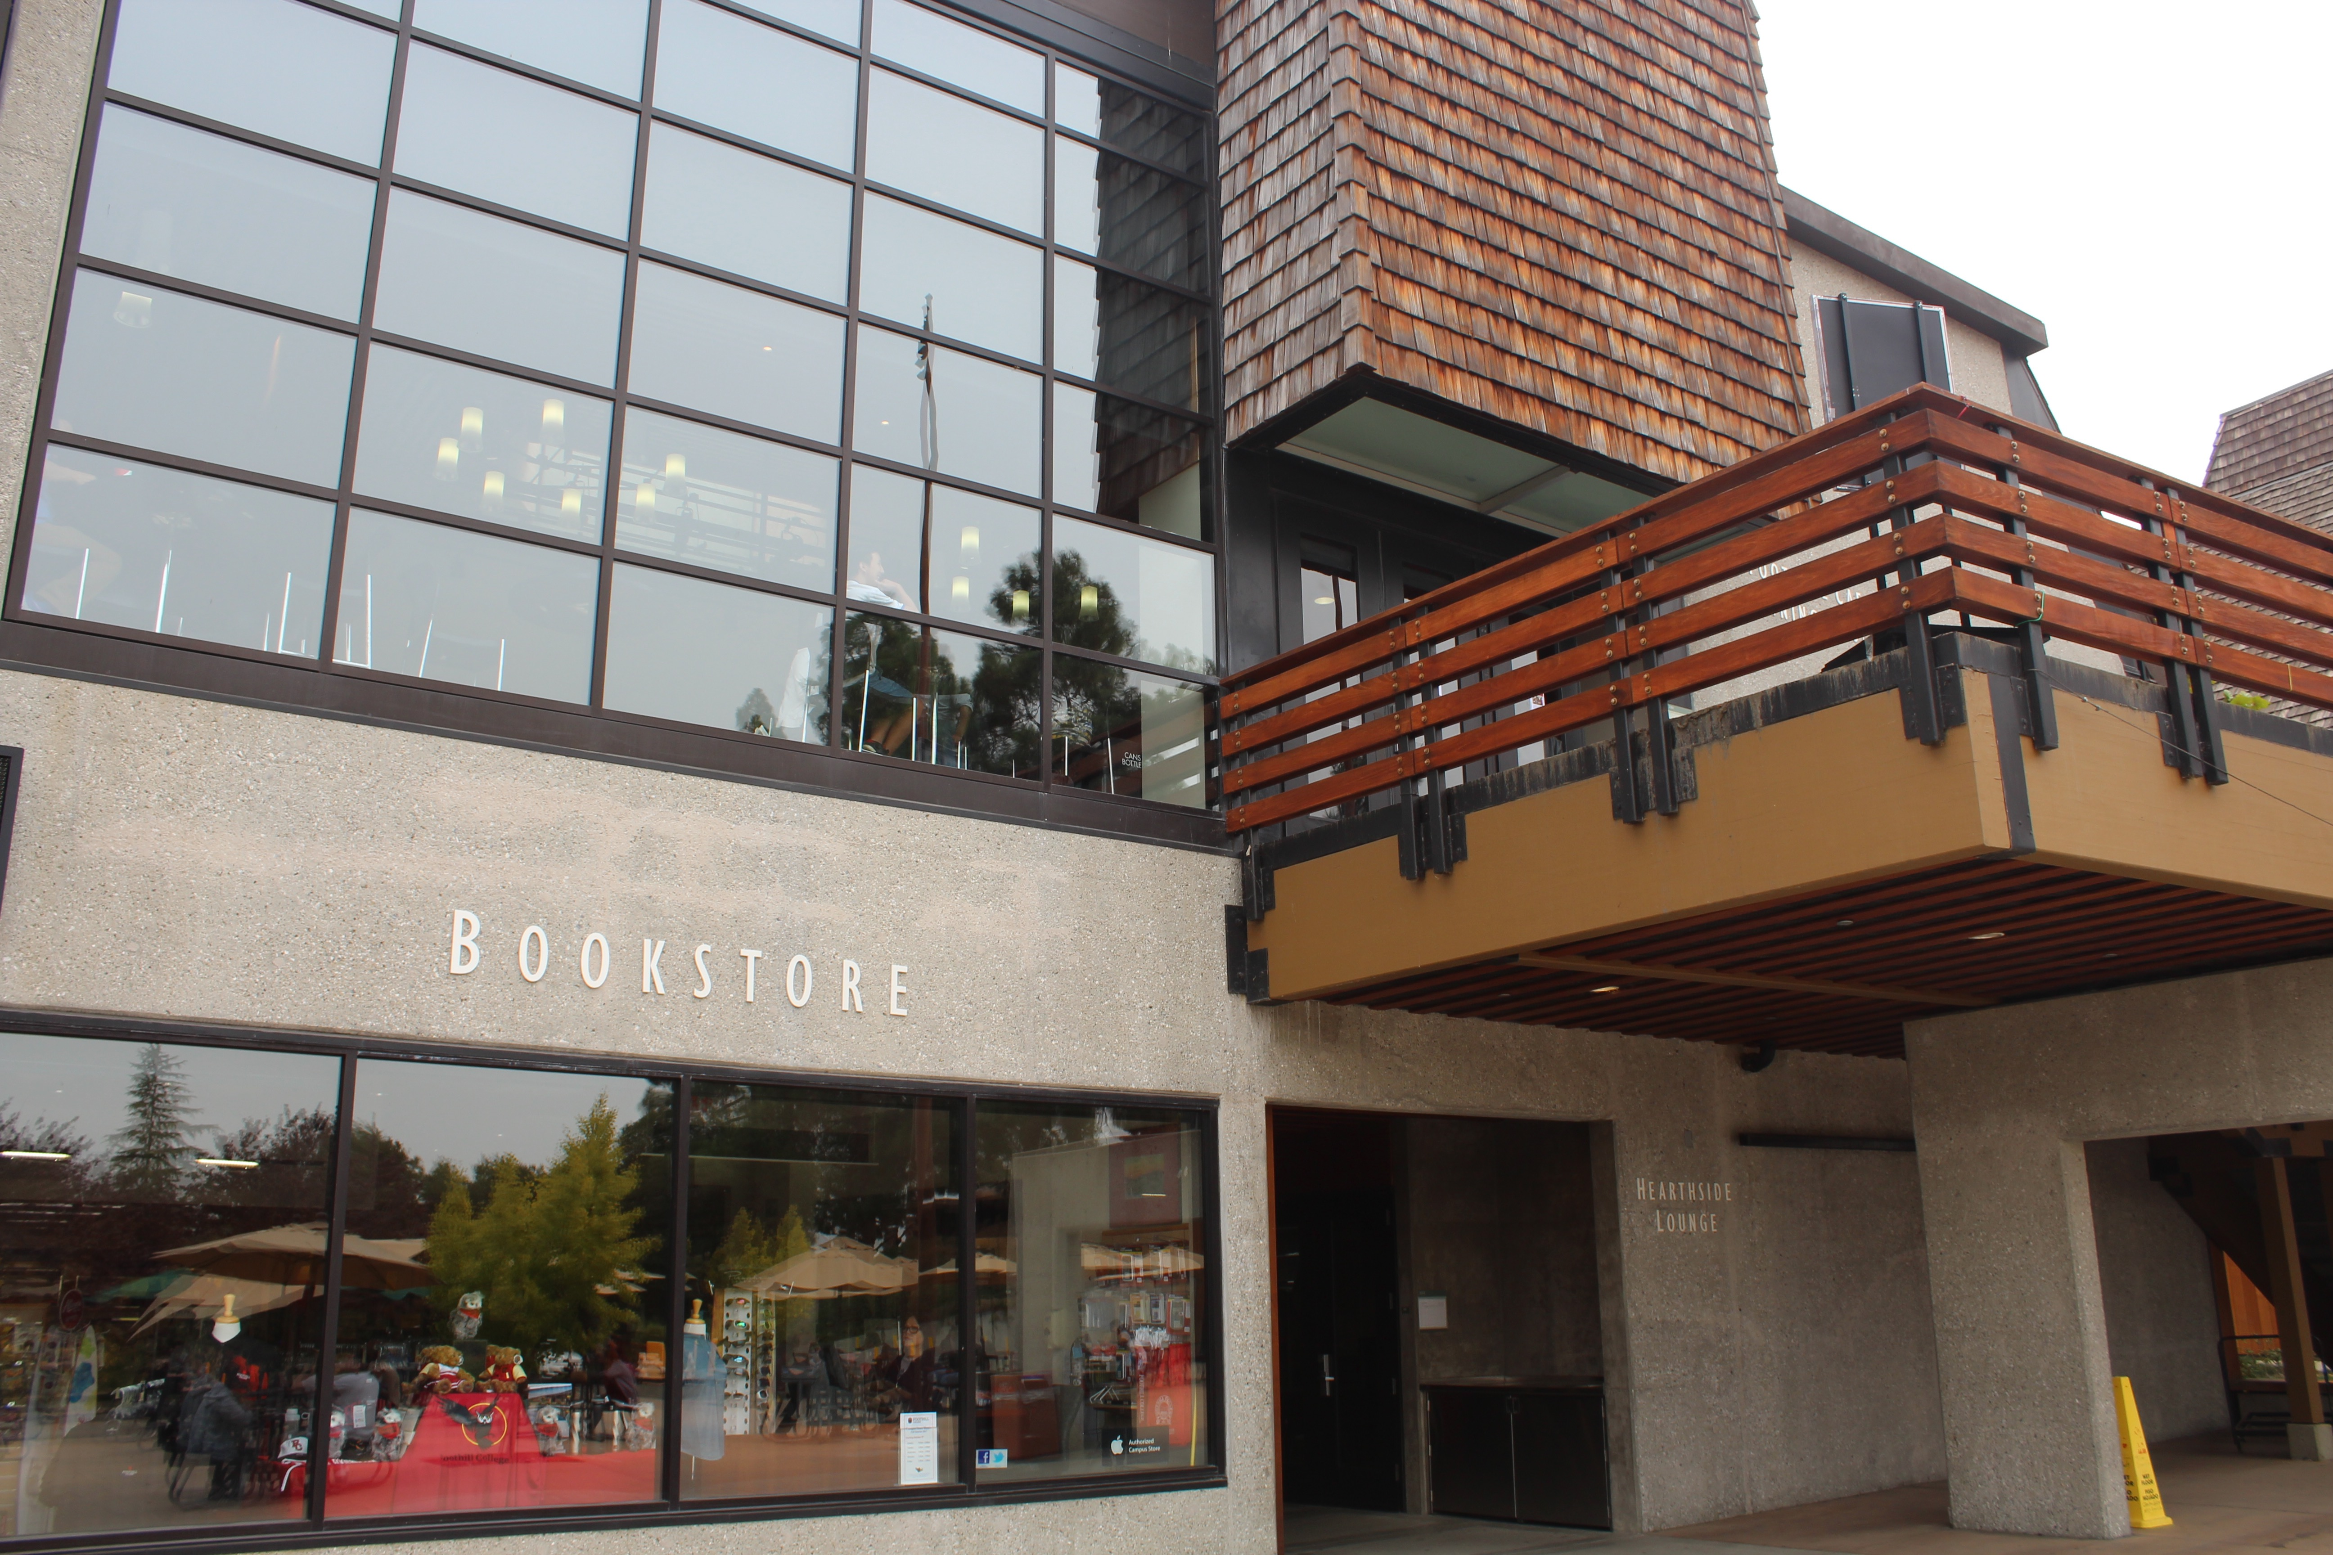
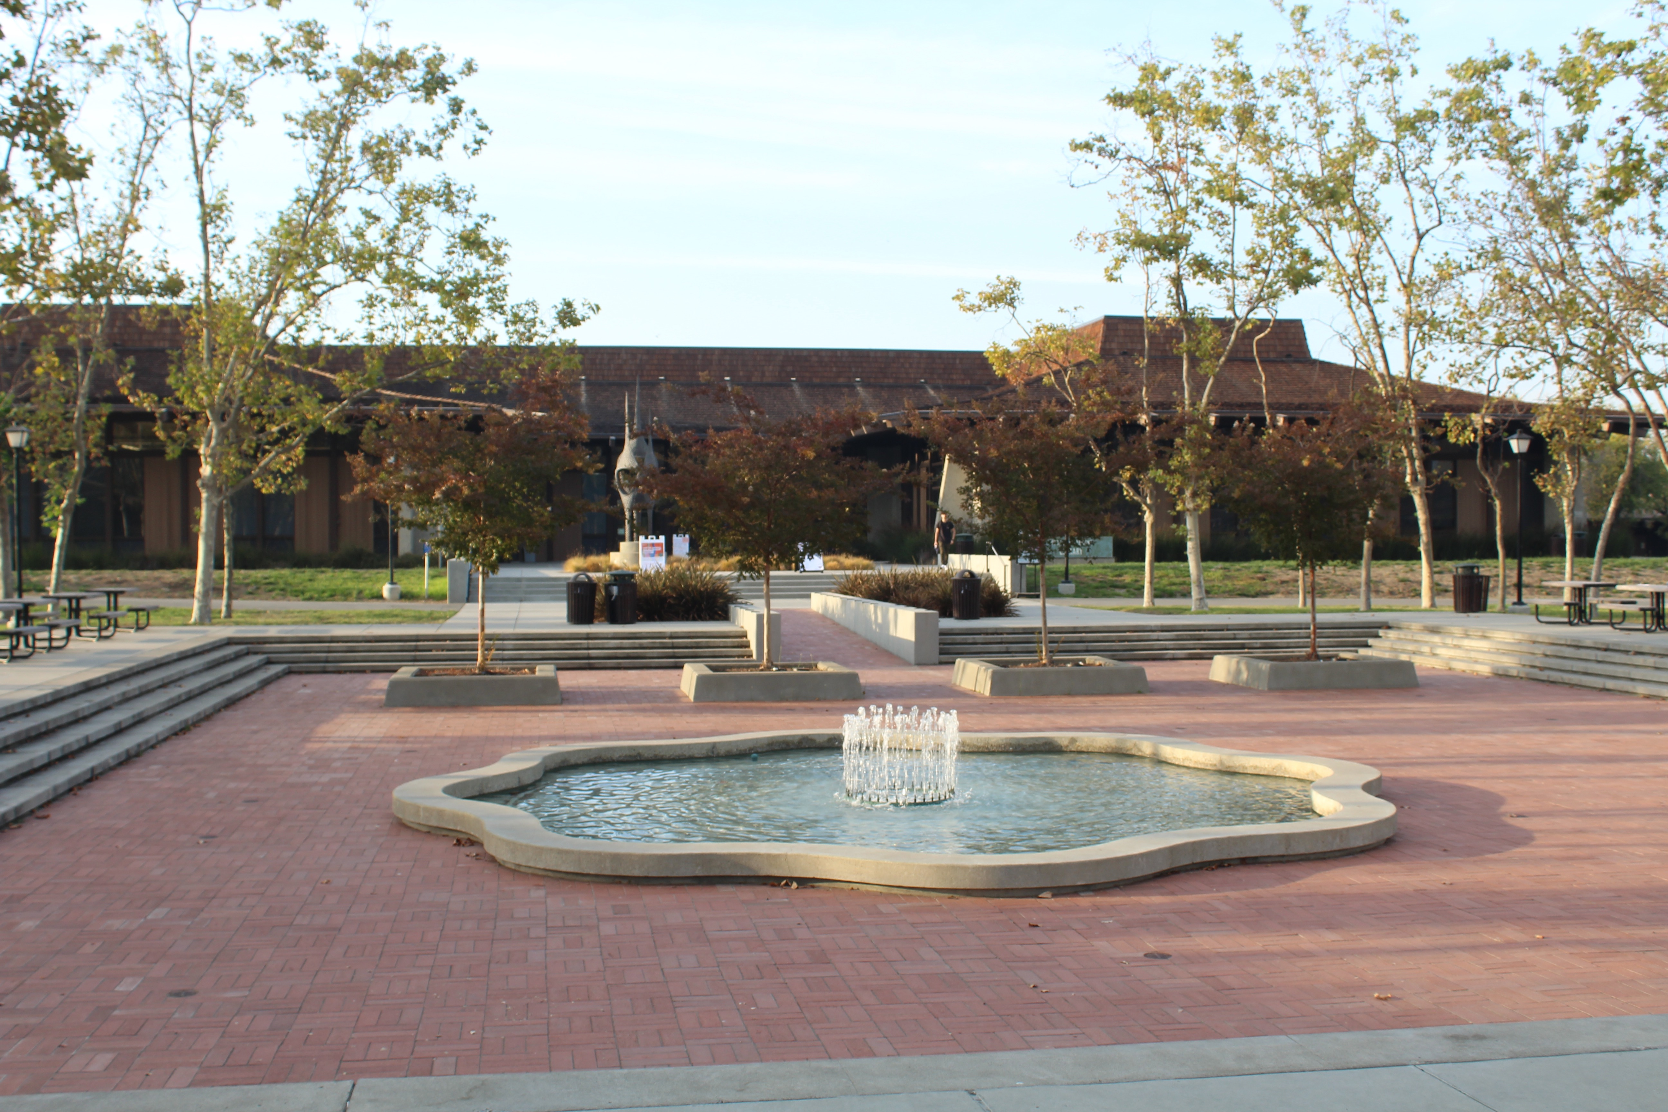
Our Mission
Believing a well-educated population is essential to sustaining and enhancing a democratic society, Foothill College offers programs and services that empower students to achieve their goals as members of the workforce, as future students, and as global citizens. We work to obtain equity in achievement of student outcomes for all California student populations, and are guided by our core values of honesty, integrity, trust, openness, transparency, forgiveness, and sustainability. Foothill College offers associate degrees and certificates in multiple disciplines, and a baccalaureate degree in dental hygiene.
Approved by Planning & Resource Council (PaRC) in April 2017; Approved by Board of Trustees in May 2017

Slide 4
Timelines:
July 1, 2018 - Budget Reductions for Years 1 & 2 (total of $1,750,000) must be identified.
July 1, 2019 - Year 1 & 2 cuts must be fully implemented.
December 31, 2018 – Year 3 cuts of $1,750,000 shall be identified.
July 1, 2019 – Year 3 cuts must be fully implemented.
Develop strategy and timeline for additional cuts due to 2017-18 decline of FTES.

Slide 5
Consultation: Participatory governance and town hall
Round 1: Budget Reduction & Proposed Percentage Cuts in Each Division
    September 14, 2017: Governance Summit —> present information about budget reductions percentages
    November 8, 2017: Town hall at main campus (Hearthside)
    November 30, 2017 (Sunnyvale) / December 5, 2017 (Hearthside): District town halls
    November 1 & 15, 2017: PaRC regarding Proposed % Cuts in each Division
Round 2: Guiding Principles & Discussion by Divisions on Possible Budget Cuts
    January 22, 2018: Cabinet retreat
    January 25, 2018: Admin Council retreat
    January 31, 2018: PaRC
Round 3: Finalize list of reductions for Year 1 & 2 (Tier 1)
    March 22, 2018: Cabinet retreat
    April 19, 2018: Town Hall
    April 18 & 25, 2018: PaRC
    April/May, 2018: Finalize list to District
    June 6, 2018: PaRC (Budget Update for Tier 1)

Slide 6
Resident Enrollment:
(2009/10 – 2017/18 Projected)

Slide 7
Resident and Non-Resident Enrollment Projections 2017-18 (Final P-2)
Resident Enrollment | 2016/17 | Projected 2017/18 | Total
De Anza | 15,340.54 | 14,259.77 | -1,080.77
Foothill | 10,626.98 | 10,221.91 | -405.07
Total | 25, 967.52 | 24,481.68 | -1,485.84
Non-Resident Enrollment | 2016/17 | Projected 2017/18 | Total
De Anza | 2,856.76 | 2,686.34 | -170.42
Foothill | 1,756.99 | 1,654.43 | -102.56
Total | 4,613.75 | 4,340.77 | -272.98
Grand Total | 30,581.27 | 28,822.45 | -1,758.82
P-2 enrollment figures are estimates as of April 20.
Decline in enrollment of 1,486 or approximately $7.65 million.
Non-Resident Enrollment is down approximately 273 FTES and is projected to be lower by $1 million.

Slide 8
Budget Reduction Background:
Structural budget deficit of -$10.3M for 2017/18. http://business.fhda.edu/budget/annual-budget-and-quarterly-report.html
District Budget reductions strategy includes:
    -$2M for 17/18, -$3M for 18/19, & -$5M for 19/20. Total of -$10 Million.
    Distribution of reductions is (35% Foothill, 50% De Anza, & 15% District).
    Foothill’s share of the reduction is $3.5M.

Slide 9
Additional Budget Reductions:
January 2018 - P-1 Enrollment estimates for 2017/18 reflected a decline of -859 FTES.
April 2018 - P-2 Enrollment estimate reflects a projected loss of approx. -1,486 FTES for 2017/18.
Due to the decline in FTES, District recommends an additional reduction of -$7.6 M for year 3 (total of -$17.6 M) for the 3 years.
New District Budget reductions strategy reflects:
    -$2M for 17/18, -$3M for 18/19 (Tier I), & -$12.6M for 19/20 (Tier II). Total of -$17.6 Million.
    Distribution of reductions is (35% Foothill, 50% De Anza, & 15% District).
    Foothill’s share of the reduction is now $6.16 M (original reduction was $3.5M).

Slide 10
Breakdown of Reduction Target Amounts by Division(s):
Division(s) | 2017-18 & 2018-19 (Tier I) | 2019-20 (Tier II) | (Subtotal) | Percent % | Additional (Tier II) | Total
Finance, Marketing, & President’s | $350,000 | $350,000 | $750,000 | 20%
Instruction & Workforce Development | $700,000 | $700,000 | $1,400,000 | 40%
Student Services | $700,000 | $700,000 | $1,400,000 | 40%
Total | $1,750,000 | $1,750,000 | $3,500,000 | 100% | $2,660,000 | $6,160,000

Slide 11
Fund Balance (Actual and Projected):
Projections assume SB361 funding formula with stability funding for 2017/18 and the same level of FTES (24,482) over the next 3 years. Revenues reflect a 2.71% COLA for 2018-19.
Ending fund balance and stability fund peaked in 2015/16 in part due to one-time mandated cost claim reimbursement of $15.1 million.
The chart reflects a decline in fund balance from 2015/16 to 2018/19. With the reduction of approx. $17.6 million in expenses, the fund balance and stability fund appear stable for 2018/19 through 2020/21.

Slide 12
Productivity by College:
Productivity = Weekly Student Contact Hours (WSCH) divided by Full-time Equivalent Faculty (FTEF).
District Adopted Budget for 2017-18 reflected 509 productivity.
Focus on staying within the 1320 budget.

Slide 13
Eight Proposed Guiding Principles for Tier 1 Reductions:
1) Preserve Quality Education
    Student centered focus
    Support equity
    Remain innovative
    Maintain our quality and excellence
2) Strategic Enrollment Growth
    Evaluate both qualitatively and quantitatively
    Maintain resources for growth
    Serve students in an innovative way
3) Cabinet Review/Approval
    Hiring to fill all vacancies
    Faculty positions that are 11 & 12 mo.
    Evaluate Reassigned time
    Sabbaticals (planning/scheduling)
Notes:
Managed Hiring.
-Evaluate on a case by case basis the vacant positions.
-Full-time faculty want to be strategic. Look at FON and hire some full-time faculty in order to maximize enrollment.
Tightening of Budget

Slide 14
Guiding Principles Continued…
4) No layoffs of full-time positions for 2017-18 & 2018/19.
    Use one-time funds if needed.
    Person may do something different.
    May use different funding sources
    Open, consistent and sustained communication
    Respect for privacy and timing of notification
5) Spending relates to strategic objectives.
    Aligned with enrollment and productivity goals.
    Exceptions (i.e. students needing one class to earn ADT).
    Provide advanced annual offerings for students to plan.
Notes:
4) The group agrees with the proposal as written…however, delaying difficult decisions does not reduce pain in the long run if enrollment/budget challenges continue
-Transparency
-Open, consistent and sustained communication
Participation and opportunity for feedback
Respect for personal privacy
Reasonable timing
Hear probable news earlier

Slide 15
Guiding Principles Continued…
6) Transparency
    Open Communication
    Reasonable timing when sharing information.
7) Shared Pain
    Faculty, classified and management units will be impacted.
    Kindness & empathy
8) Program Review/Elimination
    Follow program review process/statutes/regulations
    Analysis of impact of program/college/community
    Transparency with clear rubric
    One-year timeframe to grow enrollment

Slide 16
Savings by Division:

Slide 17
Savings by Division (continued):

Slide 18
Breakdown of Reduction Target Amounts by Division(s):

Slide 19
Breakdown of Reduction Target Amounts by Division(s):
10.3%
85.5%
4.2%

Slide 20
How we are Saving:
    Categorical Programs (Strong Workforce)
    Vacancies (full-time faculty, retirements)
    Self-Sustaining Fund (Rental Facilities/Fine Arts)
    Campus Center Use Fees (Fund 128)
    Raise Printing Fees (Support Printing Services Position)
    Reduce release time, stipends, comp-time & over-time

Slide 21
What have we done and what do we need to do?
Identified savings for years 1 & 2.
No planned layoffs of full-time filled positions through 2018-19.
Reductions to part-time faculty have been significant.
Ongoing cuts include:
  Moves to other funding sources
  Utilizing vacant positions
Identify additional Year 3 savings.
Continue to explore ways to become more efficient.

Slide 22
Information & Feedback:
Budget Updates can be found at: https://foothill.edu/president/updates.html
Feedback regarding budget conversations can be made at: https://foothill.edu/president/feedback.html

Slide 23
Questions?

Slide 24
Planning and Resource Council (PaRC) membership
PaRC Tri-Chairs
  Thuy Nguyen, College President (non-voting)
  Isaac Escoto, Academic Senate President
  Erin Ortiz, Classified Senate President
Associate Students of Foothill College (ASFC) Student Government Representatives
  Danya Adib, ASFC President
  Chinwe Idika, Student Trustee
  Marcel Vermeer, ASFC Representative
  Jashundeep Chahal, ASFC Representative
Basic Skills Tri-Chairs
  Lakshmi Auroprem, Classified
  Eric Reed, Faculty
  Ram Subramaniam, Administrator
Operations Planning Committee (OPC) Tri-Chairs
  Denise Perez, Classified
  Debbie Lee, Faculty
  Bret Watson, Administrator

Slide 25
Planning and Resource Council (PaRC) membership
Student Equity Tri-Chairs
  Adrienne Hypolite, Classified
  Micaela Agyare, Faculty
  Paul Starer, Administrator
Transfer Tri-Chairs
  Suzanne Yamada, Classified
  Cleve Freeman, Faculty
  Lan Truong, Administrator
Workforce Tri-Chairs
  Donna Wolf, Classified
  Phyllis Spragge, Faculty
  Teresa Ong, Administrator

