Slide 1
Onboarding : Navigating the Foothill College Website

Slide 2
Table of Contents
Foothill.edu > Application > Step 1 > General Route (Slide 3)
OpenCCCapply.net website (Slide 4)
Foothill.edu > Step 1b > Alternative Route > What kind of student are you? (Slide 5-6)
Welcome Email - Instructions for next steps (Slide 7)
Assessment (Slide 8)
Complete Orientation (Slide 9)
Education Plan and Schedule Your Appointment (Slide 10-12)
Register for Classes and Priority Registration (Slide 13- 15)

Slide 3
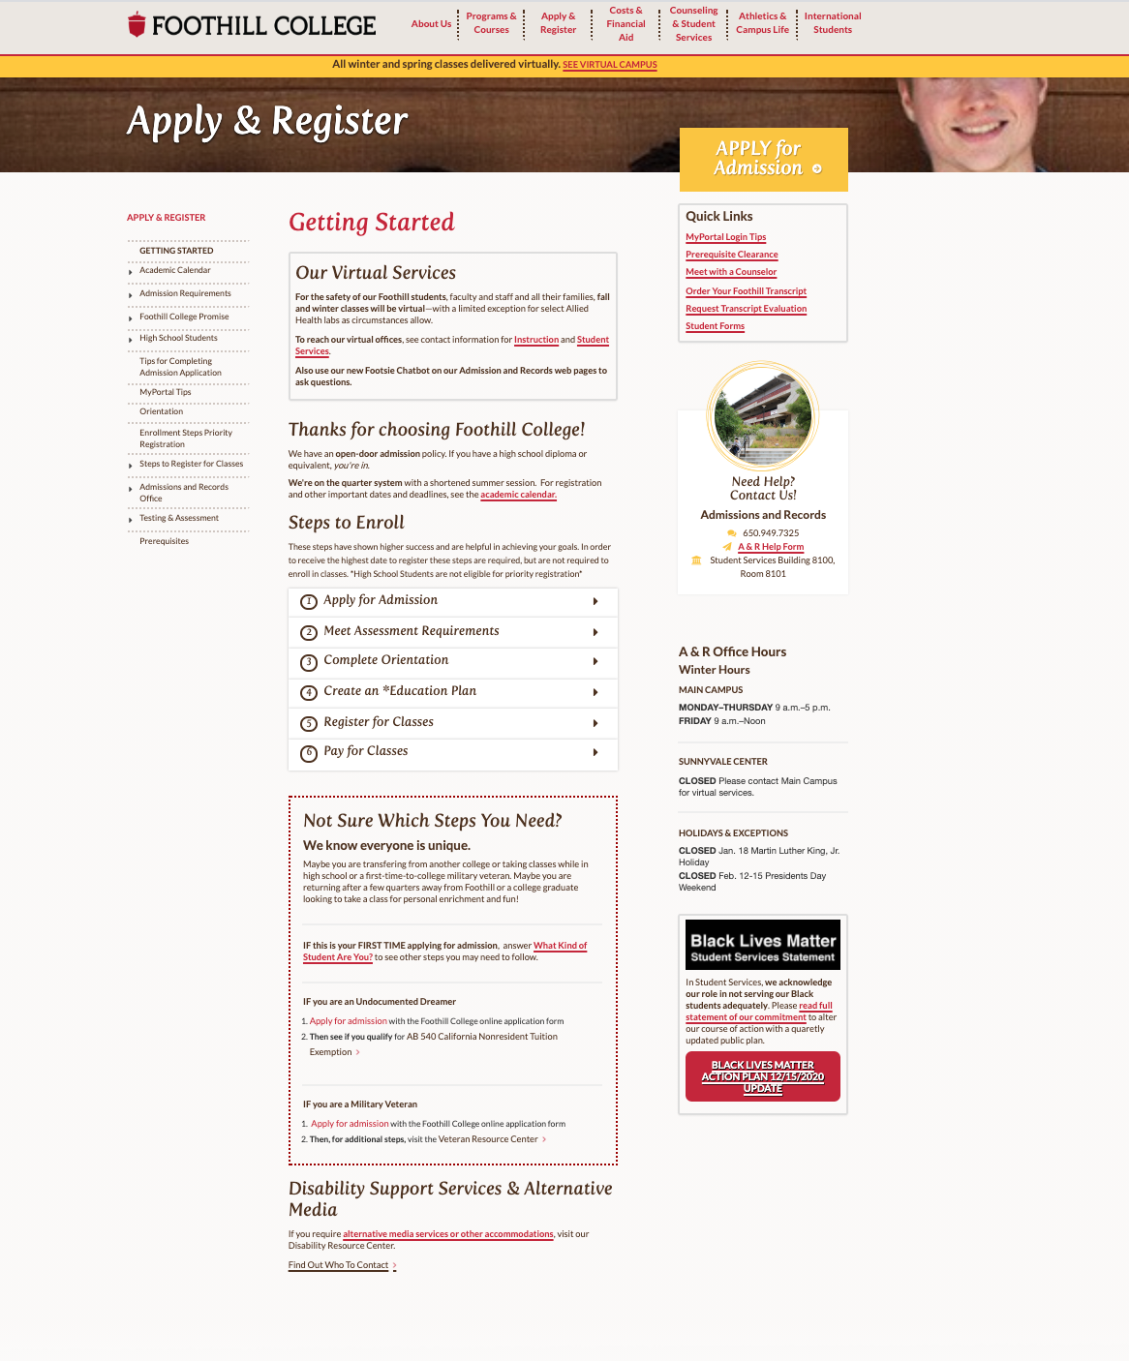
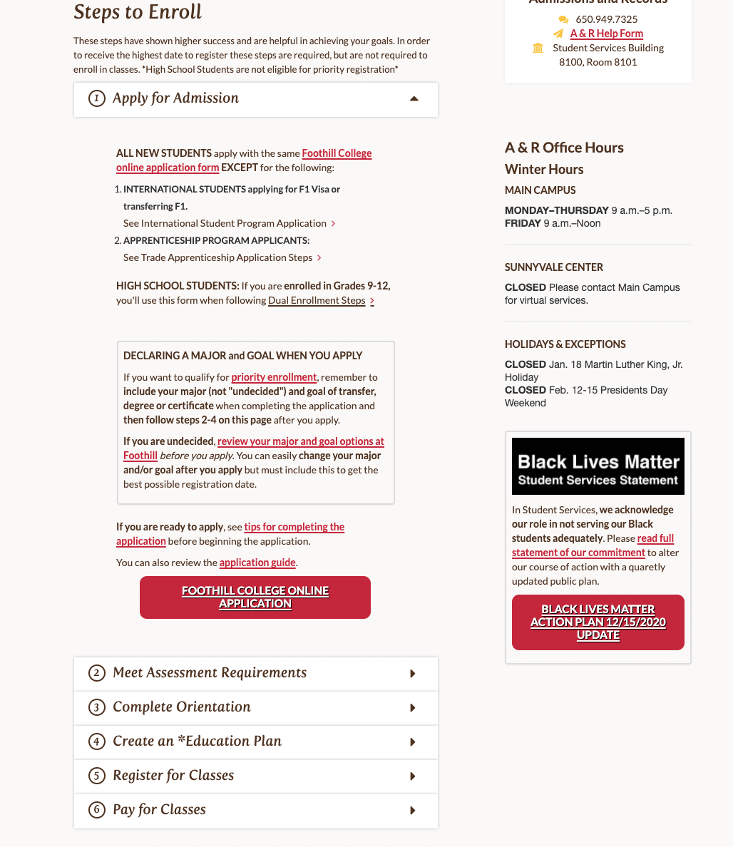
Foothill.edu > Application > Step 1 > General route
General Info. Navigates the user through different sites. Some hyperlink go to the same site (Star). Apply Now page has interesting “Tips” for applying.
Notes:
Foothill.edu

Slide 4
OpenCCCApply.net
Start of the OPENCCCapplication
24HRS later, you get a welcome email

Slide 5
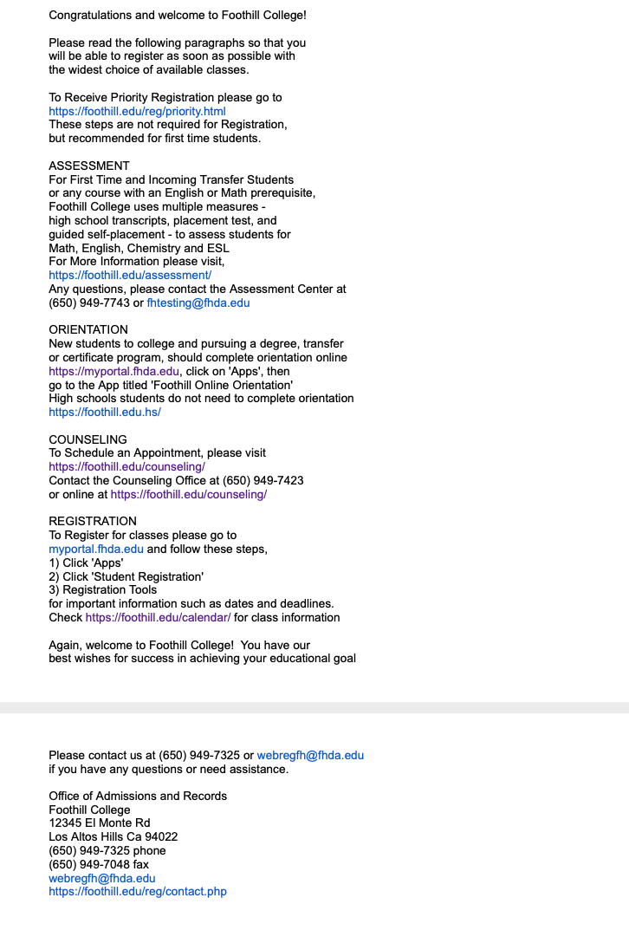
Welcome Email 24hours after submitting application

Slide 6
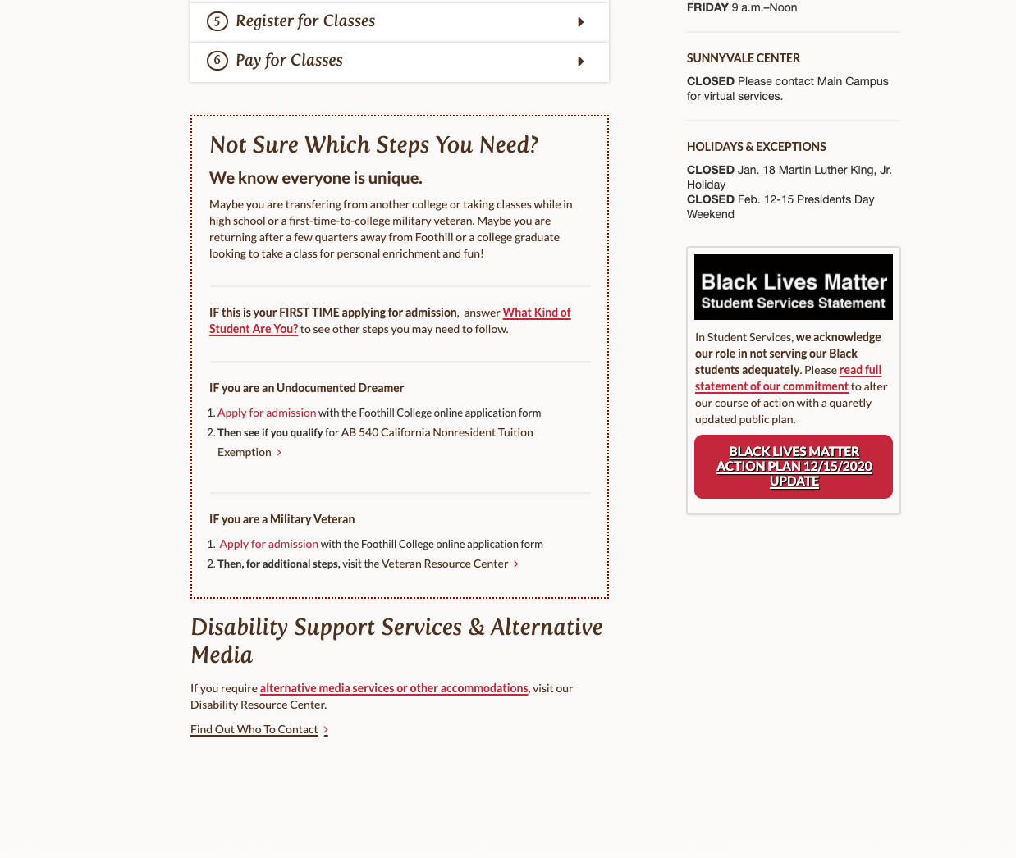
Foothill.edu > Step 1b > Alternative Route
This route specifies what type of student you are and provides only the information needed for that type of student.

Slide 7
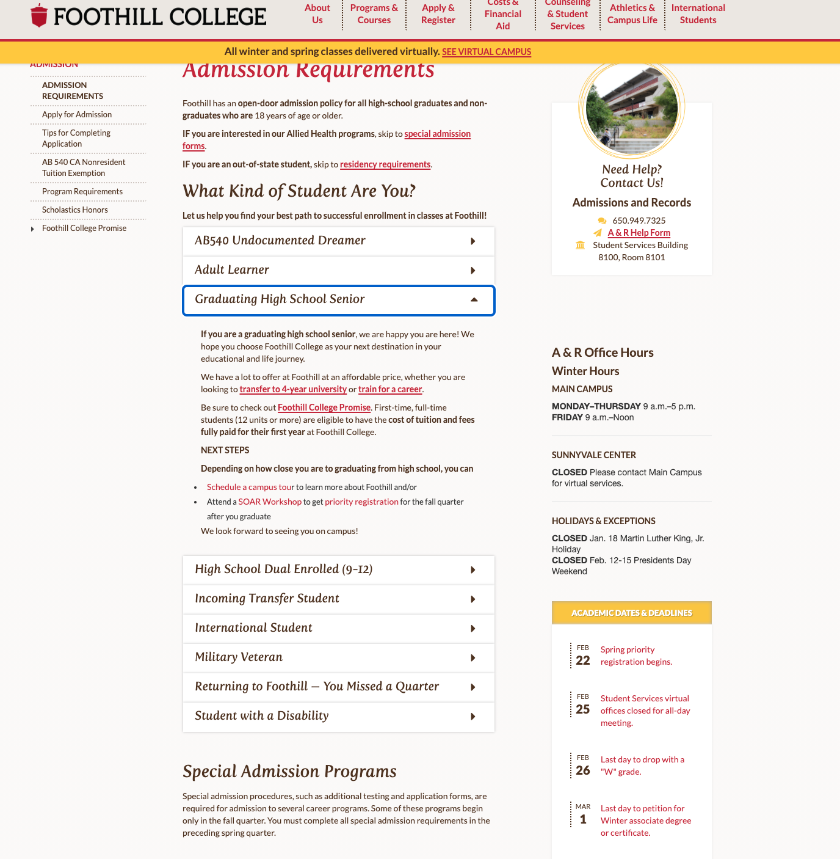
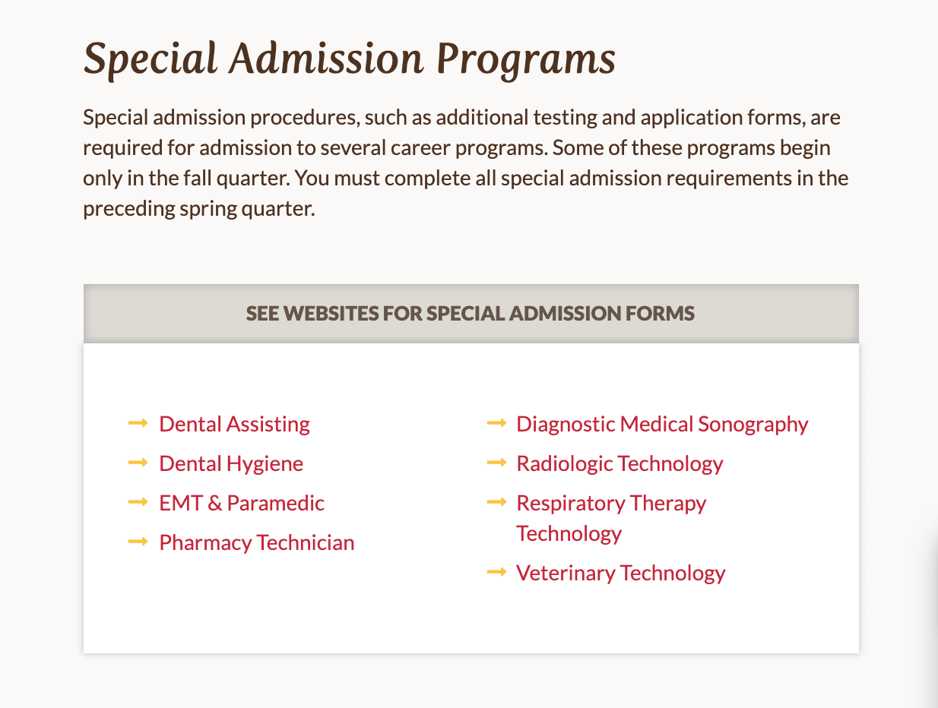
What kind of student are you?
This link also included Special Admission Application forms for Allied Health programs and link to program website. Apprenticeship info. not included.
https://foothill.edu/reg/admission/

Slide 8
Welcome Email 24hours after submitting application
If the student was asked to fill out a new application, they will receive a Welcome Email

Slide 9
Assessment Testing

Slide 10
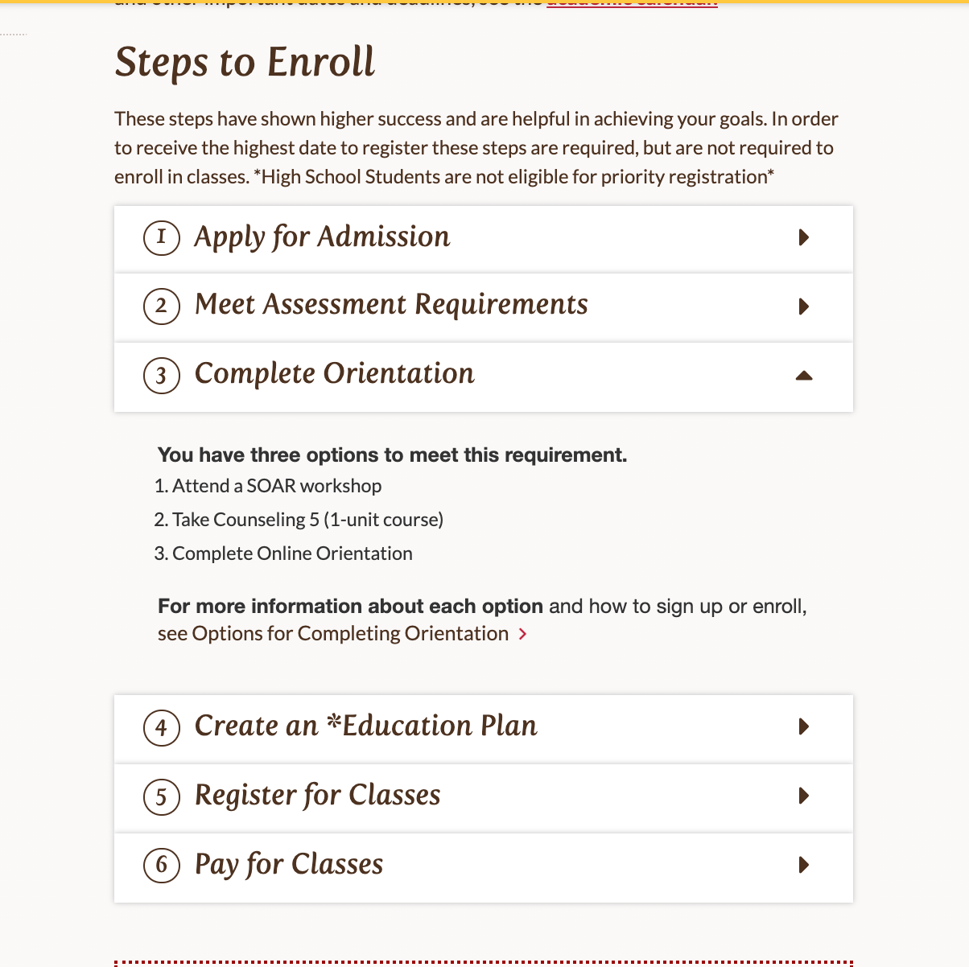
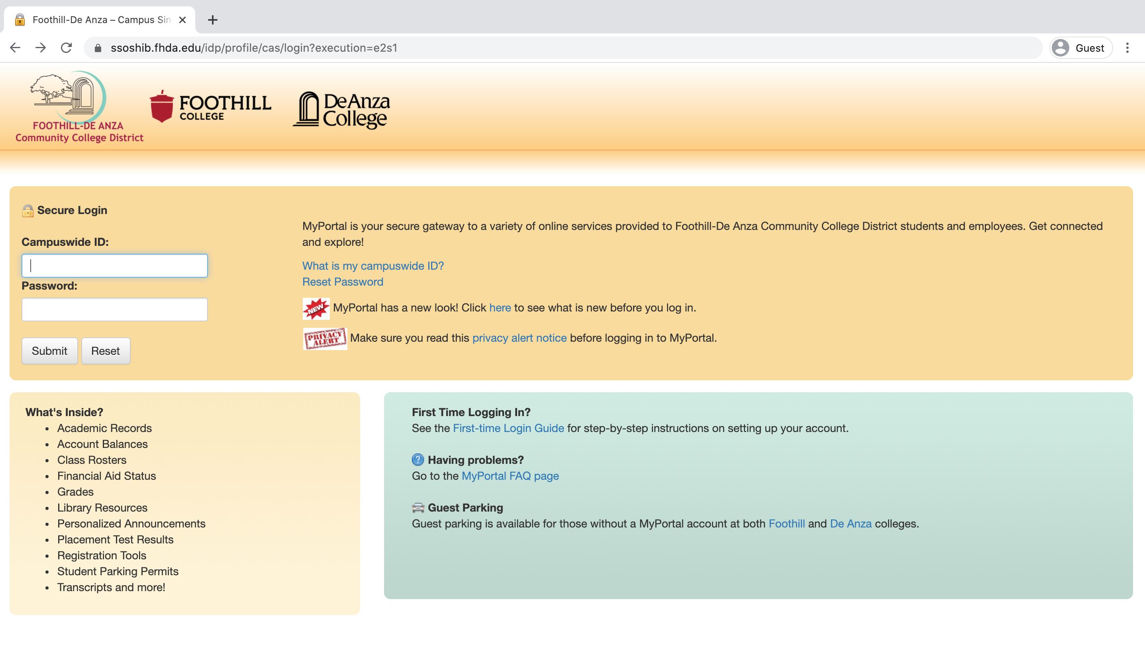
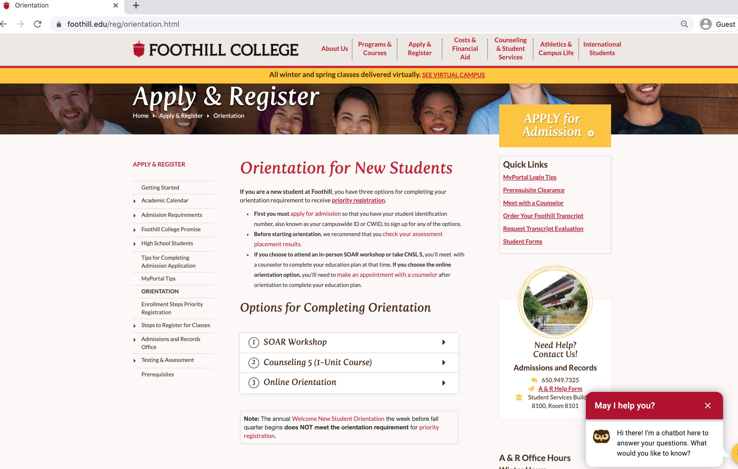
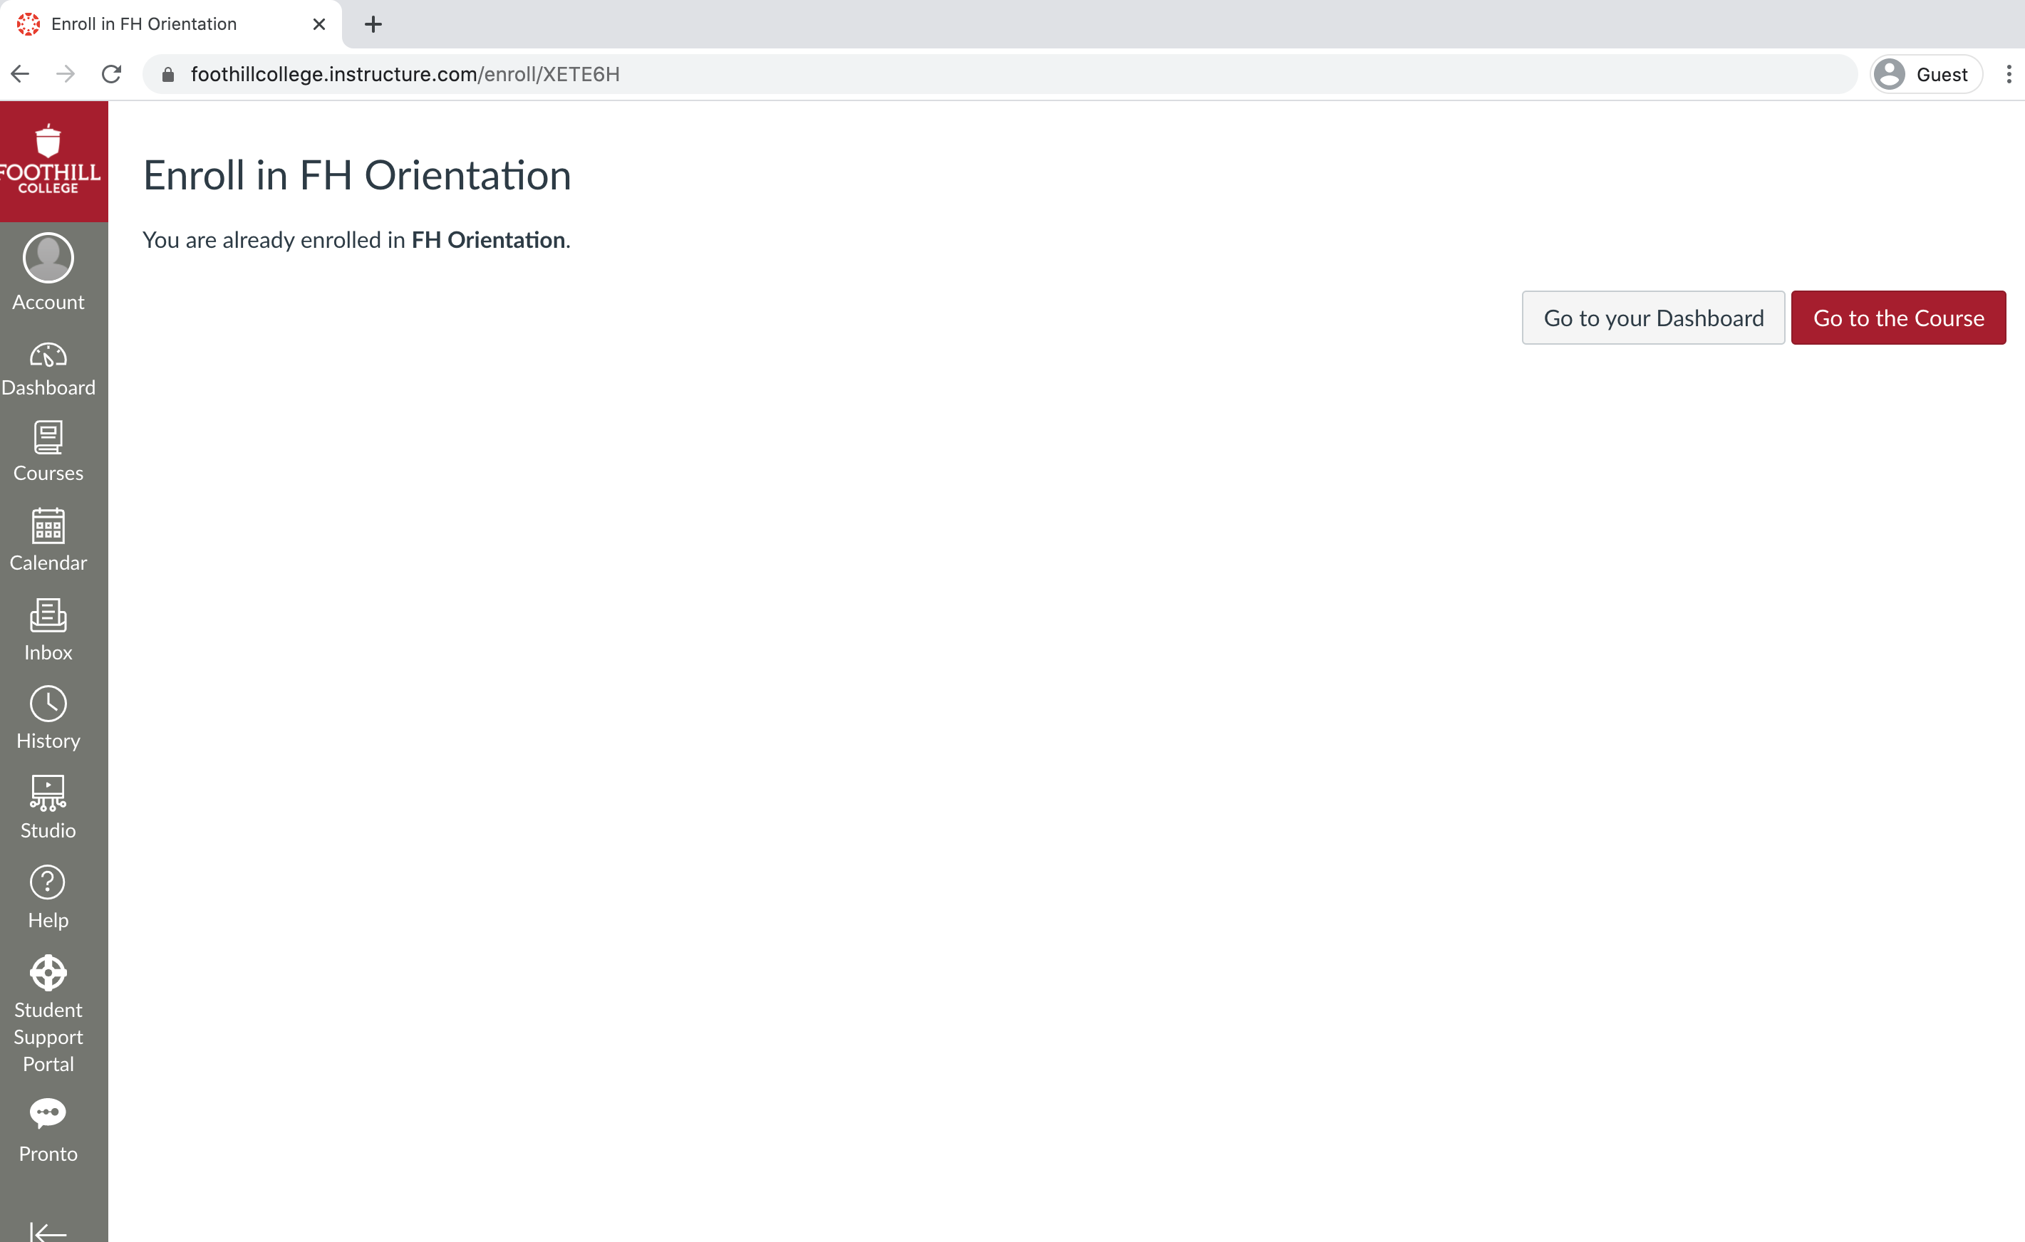
Complete Orientation
This orientation helps the student familiarize themselves with the school process. It also helps the student obtain priority registration.
- Instructs the student to make an appointment to see a counselor after completion.

Slide 11
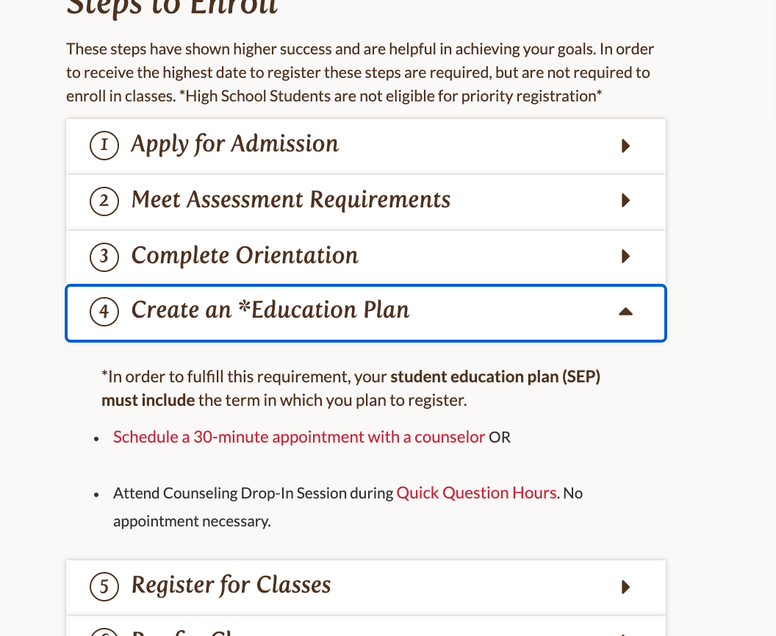
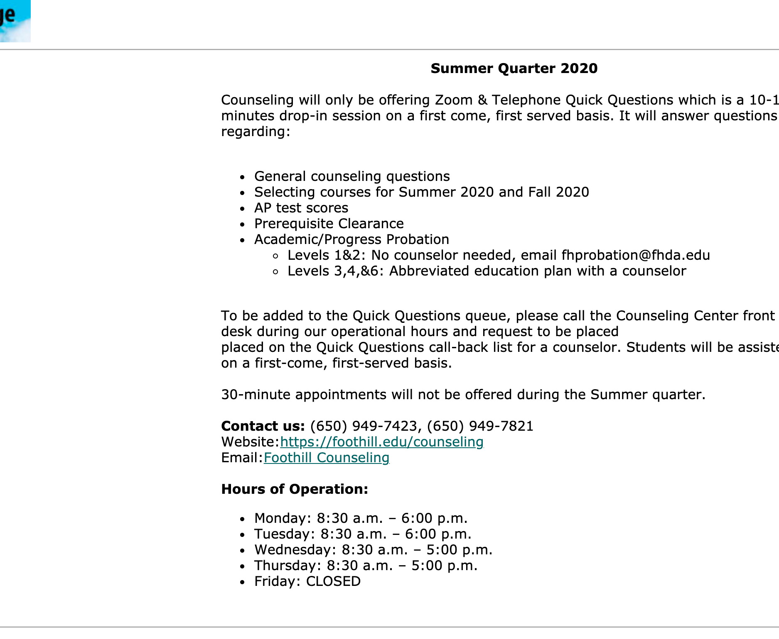
Education Plan
Foothill.edu – Drop down
https://fhcounseling.foothill.edu/esars/counseling/eSARS.asp?WCI=Init&WCE=Settings
https://foothill.edu/counseling/

Slide 12
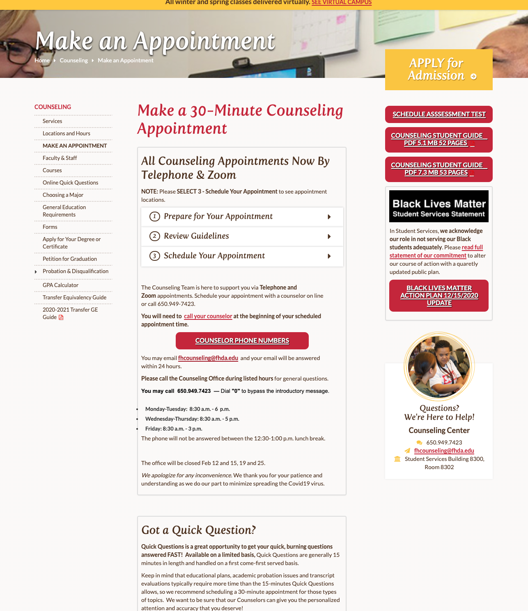
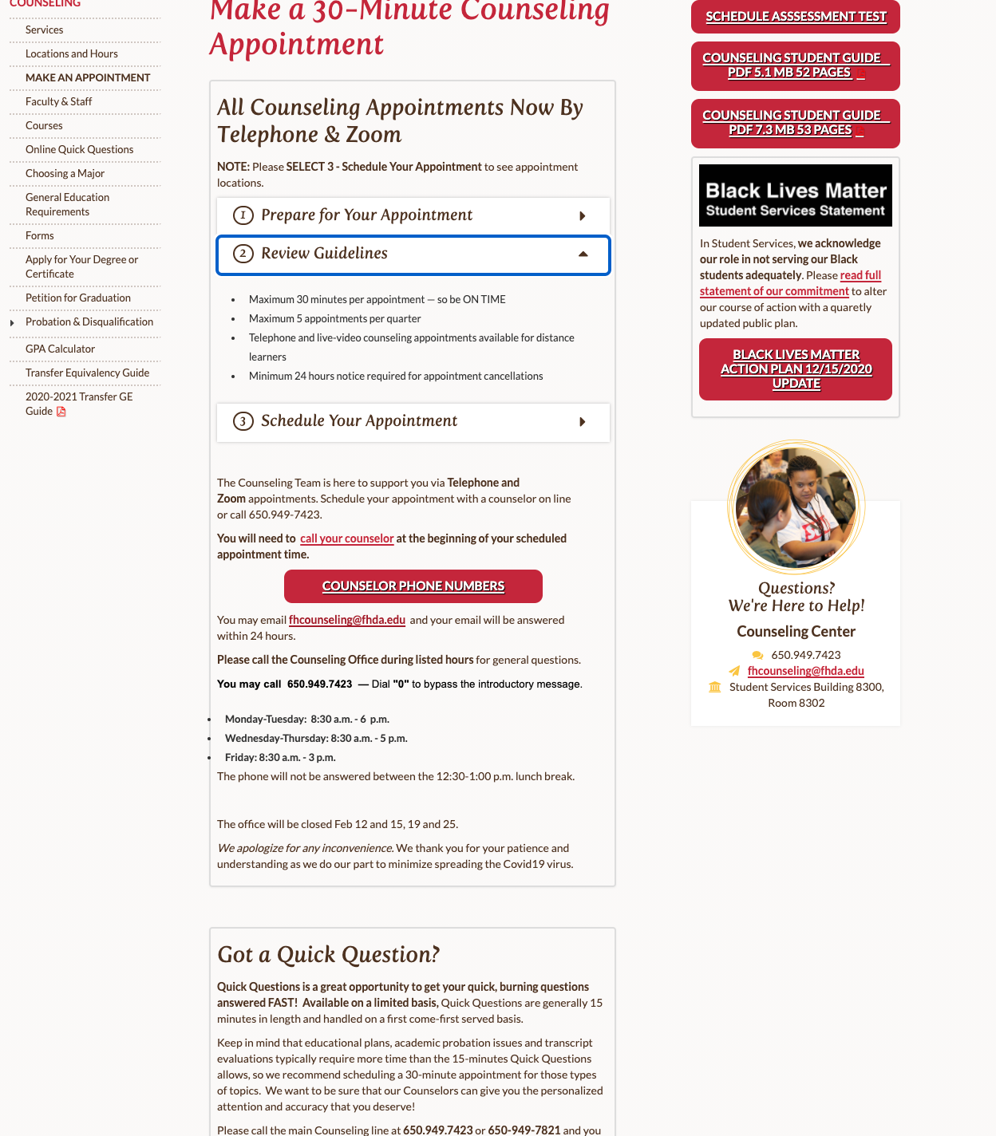
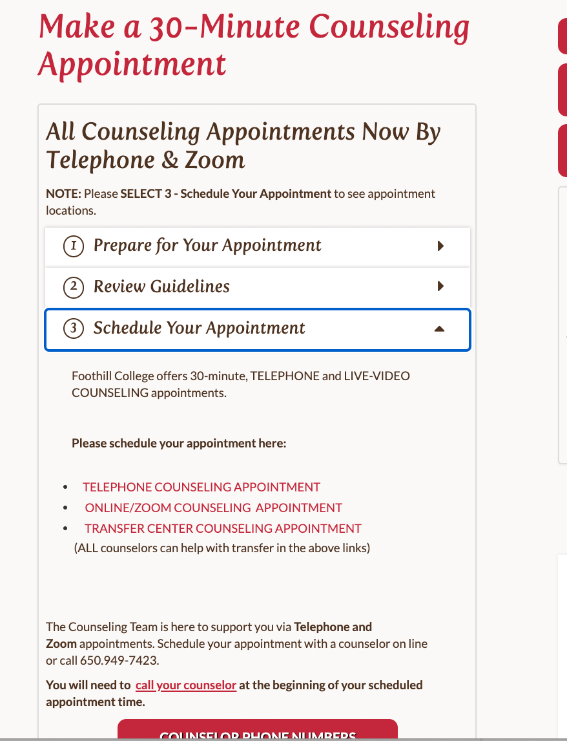
Ed. Plan continued
https://foothill.edu/counseling/counselappt.html
1. Prepare for Appointment
2. Review Guidelines
3. Schedule Your Appointment

Slide 13
Schedule Your Appointment
https://fhcounseling.foothill.edu/esars/counseling-web/eSARS.asp?WCI=Init&WCE=Settings

Slide 14
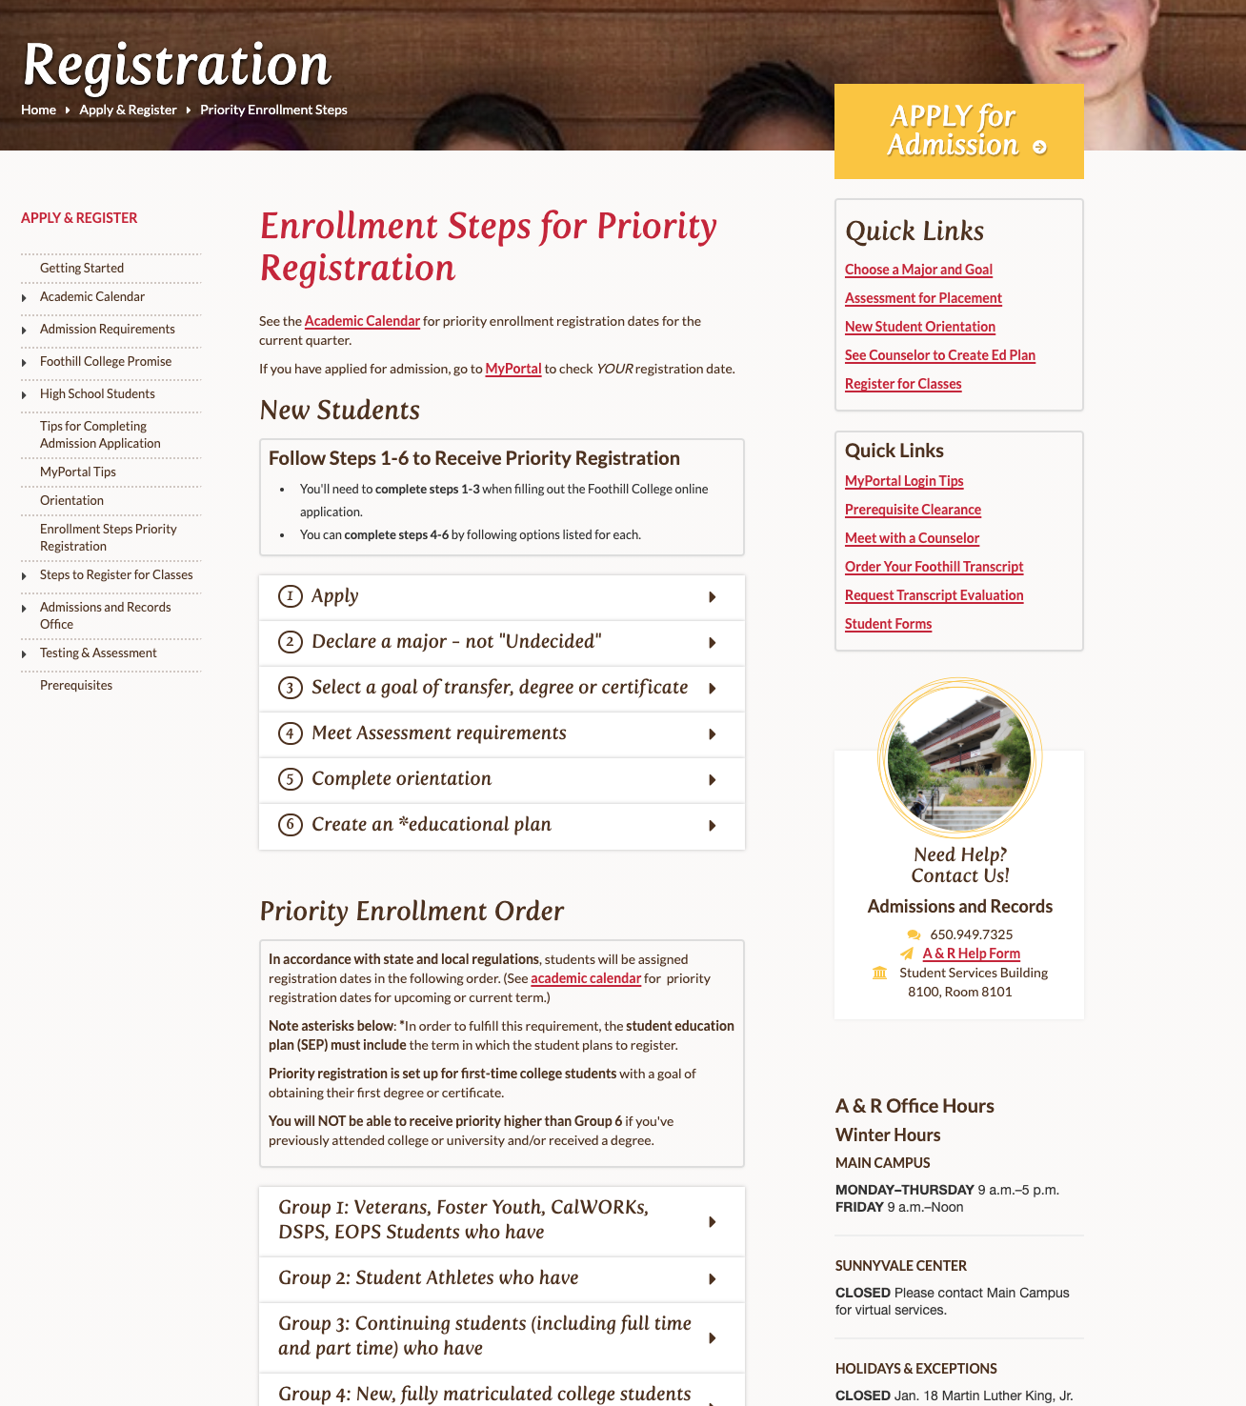
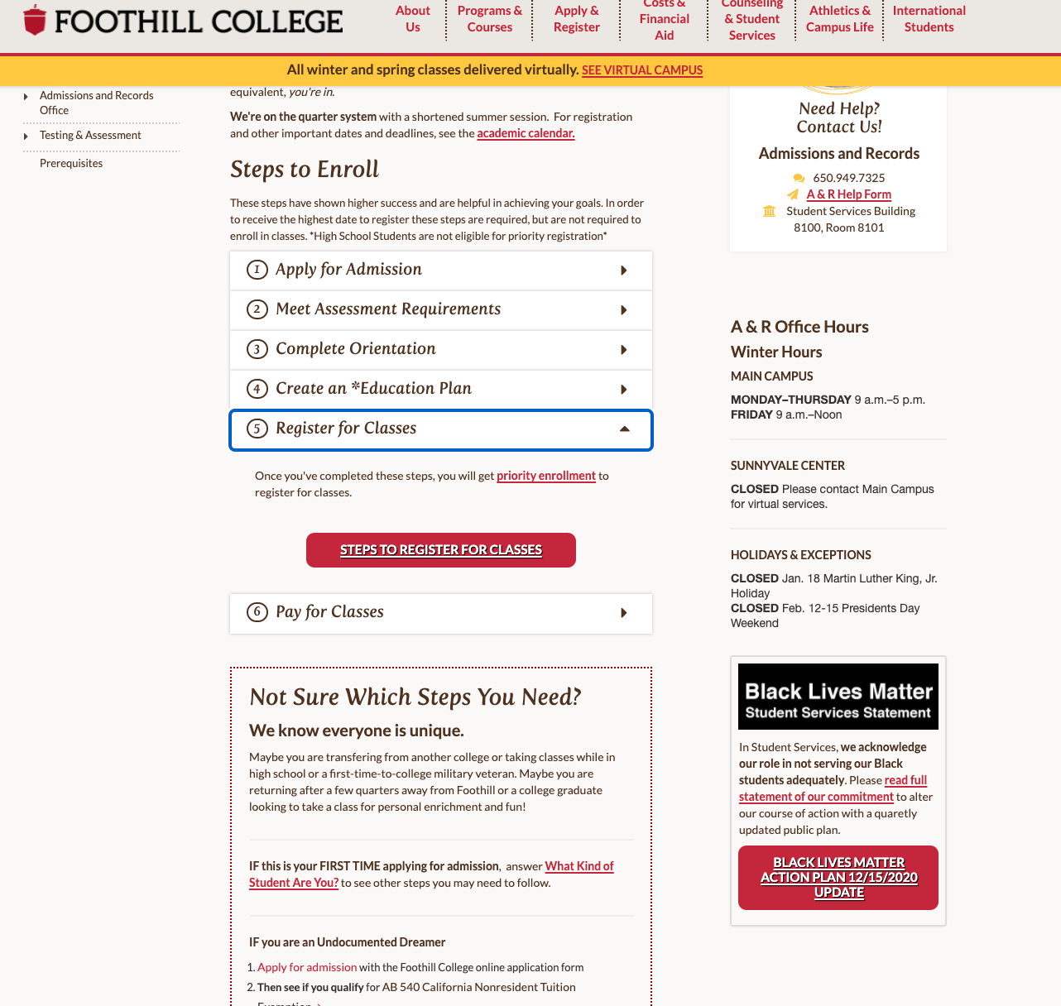
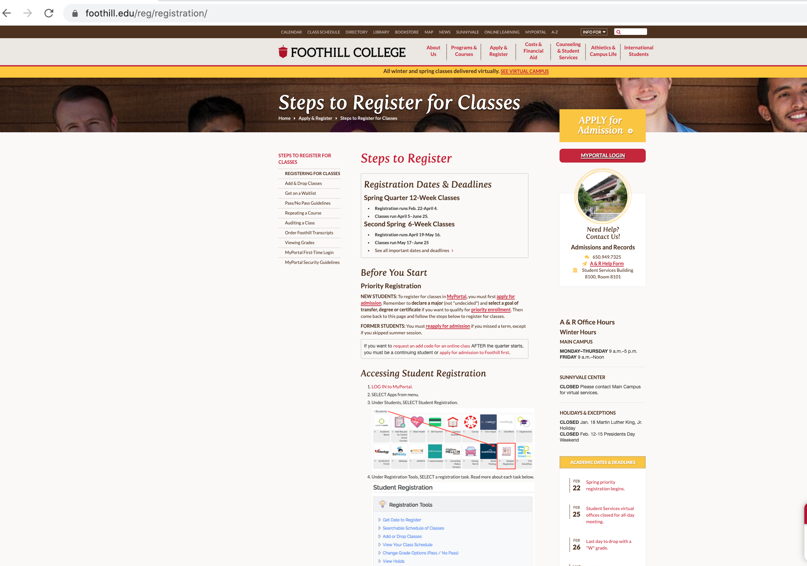
Register for Classes and Priority Registration info.
https://foothill.edu/reg/registration/

Slide 15
Priority Registration
Priority Registration:
Important to ensure continuing students are enrolling in their Education Plan courses for graduation, transferring, etc..
Students can check eligibility.
MyPortal > APPS > Priority Registration APP
https://foothill.edu/reg/priority.html

Slide 16
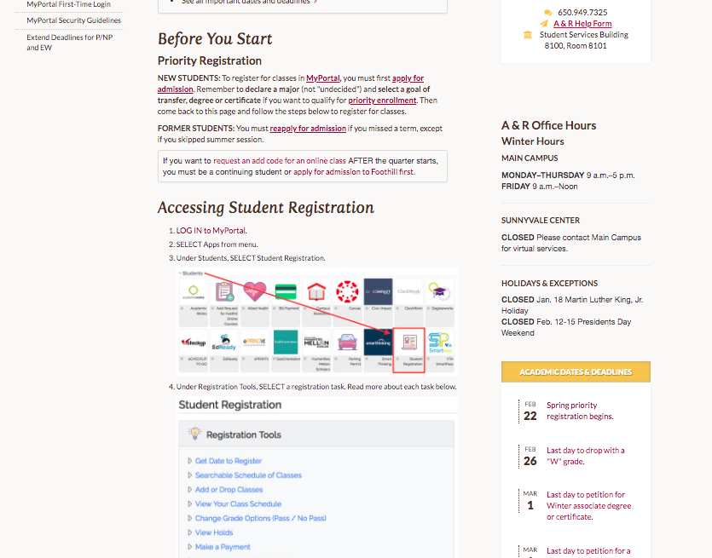
Register for classes.
Illustration of the registration process using MyPortal.
https://foothill.edu/reg/registration/

Slide 17
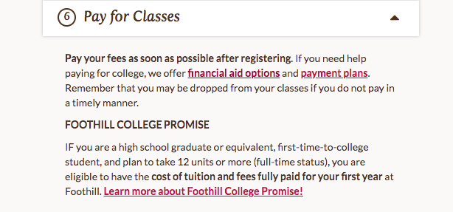
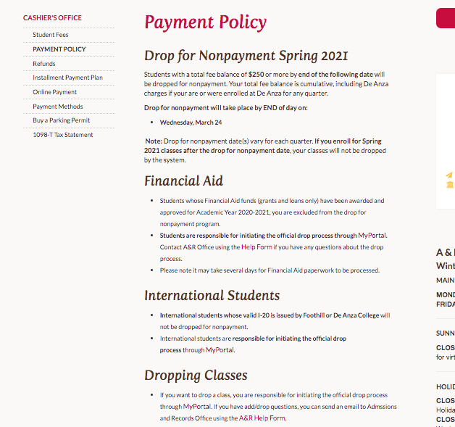
Step 6. Pay for Classes
<< Installment plans available
https://foothill.edu/financialaid/
https://foothill.edu/reg/cashier/nonpayment.html

Slide 18
Foothill College Promise
https://foothill.edu/promise/

