Slide 1
Resources to End Homelessness for Student Success
Homeless Student Exploratory Launch Meeting
Thursday, November 7, 2019

Slide 2
Objectives for Today
Provide the most recent Foothill College student data on Homelessness and Housing insecurity.
Give an Overview of the History and Current Efforts/Partnerships.
Brainstorm future possibilities (group activity).
Determine funding resources to meet program needs.
Discuss Next Steps/ A Plan of Action

Slide 3
New Roles & New Faces
Dr. Laurie Scolari
Associate VP Student Services
April Henderson
EOPS Director/
Oversight of Homeless Services
Leticia Maldonado
Dean of Students/
Oversight of Food Bank

Slide 4
Key Definitions
Housing Insecurity
a set of broad housing issues including frequent moves, crowded living space, poor housing quality, or the inability to afford rent or bills.
Homelessness
the absence of a place to live, which includes those who live in shelters, vehicles, or abandoned structures

Slide 5
Survey Data
Foothill Survey
Conducted by Institutional Planning & Research Office
August 2018
Emails to all enrolled students (11,799): 781 surveys were completed (Response rate 7%).
#RealCollege Survey
Report prepared by the Hope Center for College, Community, and Justice at Temple University
April 2019
Survey emailed to 15,700 Foothill students: 789 students participated (Response rate 5.0%)

Slide 6
Foothill Survey Key Findings (2018)
Homelessness was reported by 11% of survey respondents (84 students).
More Foothill students (205 or 26%) are likely to indicate they doubled up or shared a room and moved in with other people due to financial problems at a higher rate compared to the national rate.
The two homelessness survey items that had the highest response rates are:
did not know where they were going to sleep, even for one night (67 students or 9%)
they didn't have a home (42 students or 5%).

Slide 7
Foothill Survey Key Findings (2018)
Pell grant recipients and those with disabilities were more likely to indicate a higher rate of basic needs insecurities compared to their peers.
Latinx and African Americans were more likely to indicate higher rates of basic needs insecurity compared to all other population groups.

Slide 8
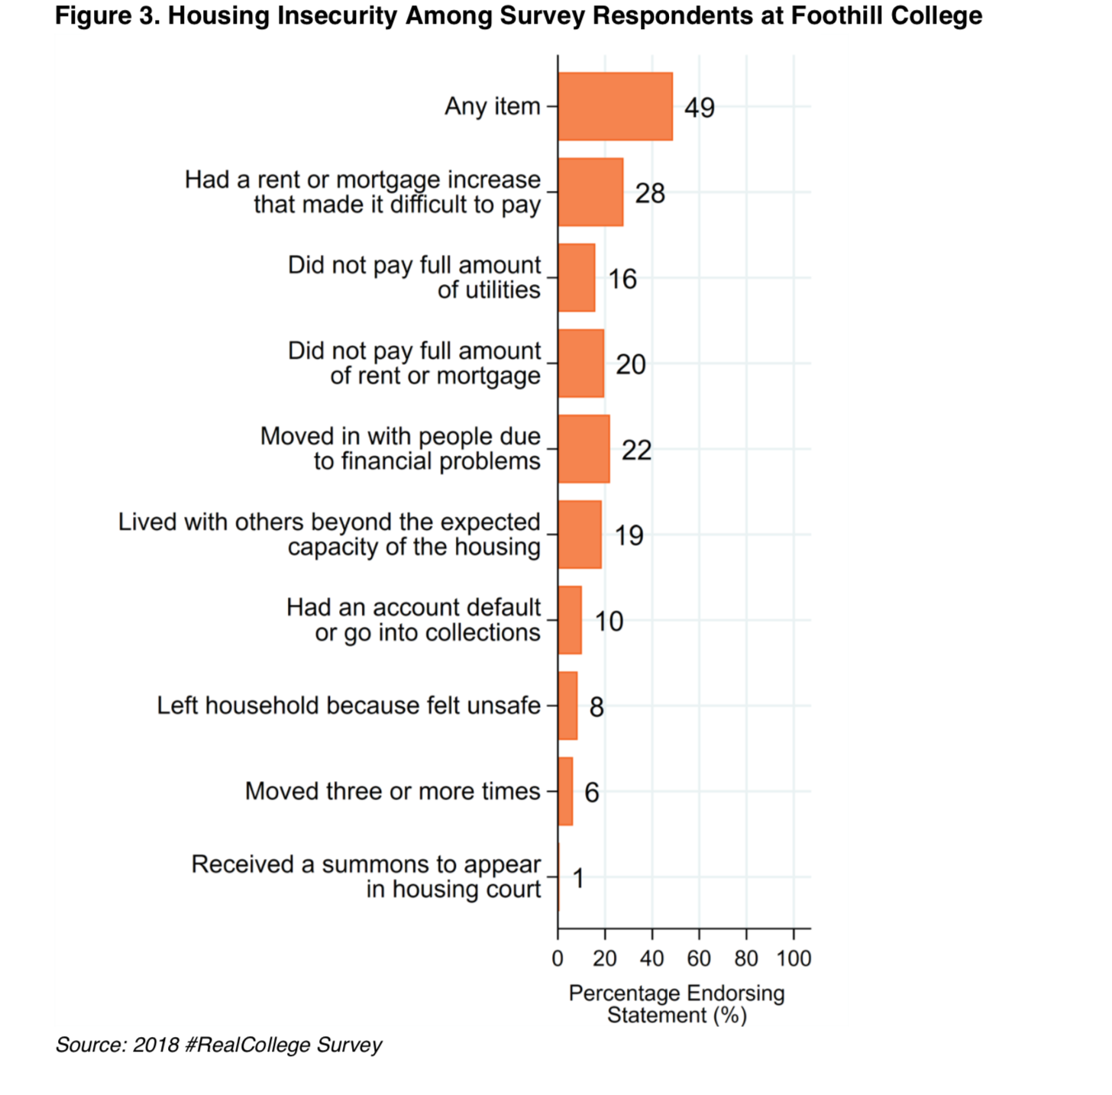
Hope Survey 2019

Slide 9
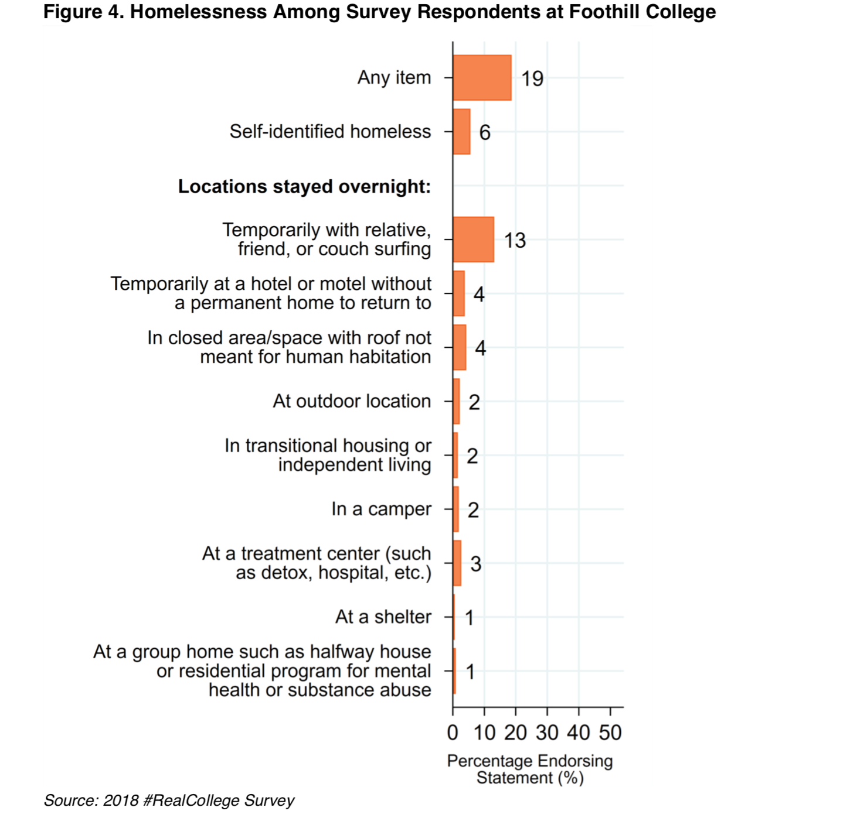
Hope Survey 2019

Slide 10
History & Current Efforts

Slide 11
June 14, 2019: Summit on Student Homelessness

Slide 12
Current Efforts: Partnerships
To address the needs of students who are homeless or who are housing insecure, Foothill College has formed partnerships with local agencies to help eliminate this barrier.

Slide 13
Catholic Charities
House Sharing

Slide 14
What is Housing Sharing?
The House Sharing Program is a free matching service that helps match people looking for a room to rent, with someone who has a room to rent. All applicants go through background checks, preference checklists, and personality profiles to ensure matches are safe, mindful, relevant, and mutually rewarding.

Slide 15
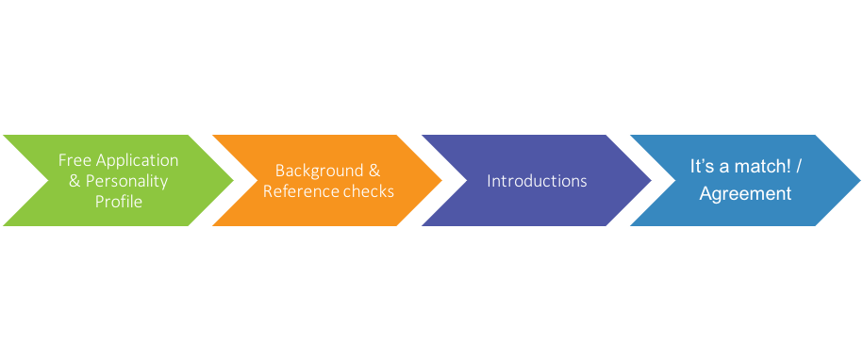
The Process to Housing a Student

Slide 16
House Sharing Program Role

Slide 17
Bill Wilson Center
Rental Assistance & Immediate Housing Support

Slide 18
Do you or someone you know need help with housing?

Slide 19
Do you or someone you know need help with housing?

Slide 20
100-Day Challenge
Challenge: In 100 days Santa Clara County will house 100 college engaged youth and young adults ages 18-24 experiencing homelessness
Photo: San Jose Mercury News

Slide 21
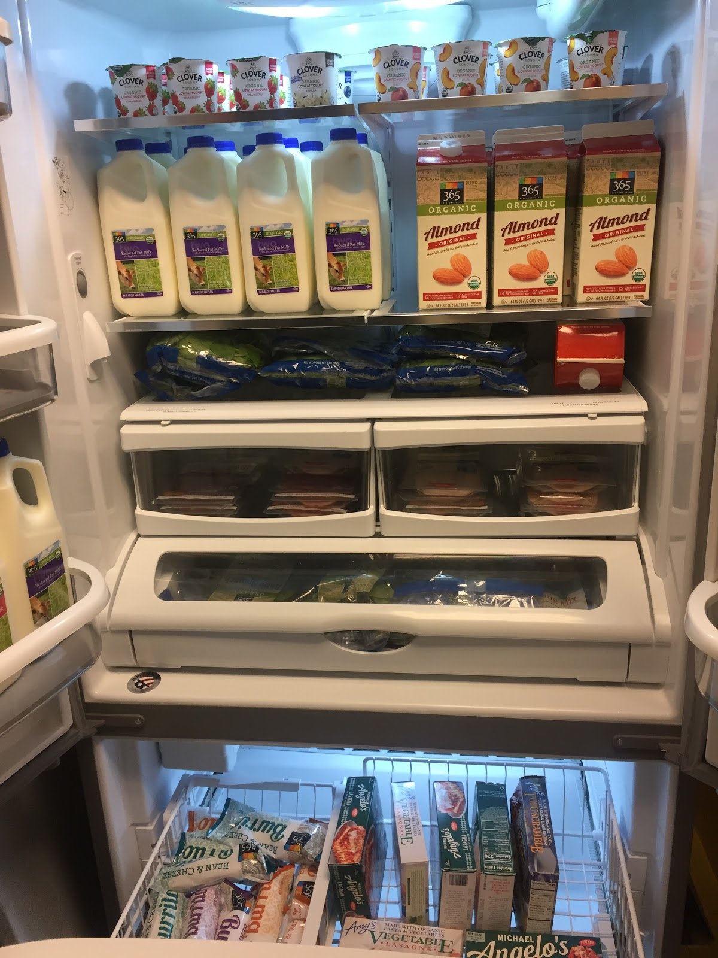
Food Bank: Campus Center, Rm 2007
In partnership with Whole Foods Market, Foothill College offers students access to nutritional, high quality perishable food, regardless of income.
Students pre-register online and receive a bag of groceries the following week with their selected items: Foothill.edu/foodpantry
Students can pick up a bag of groceries or snack items anytime (drinks, chips, yogurts, snack bars, frozen burritos, etc.).

Slide 22
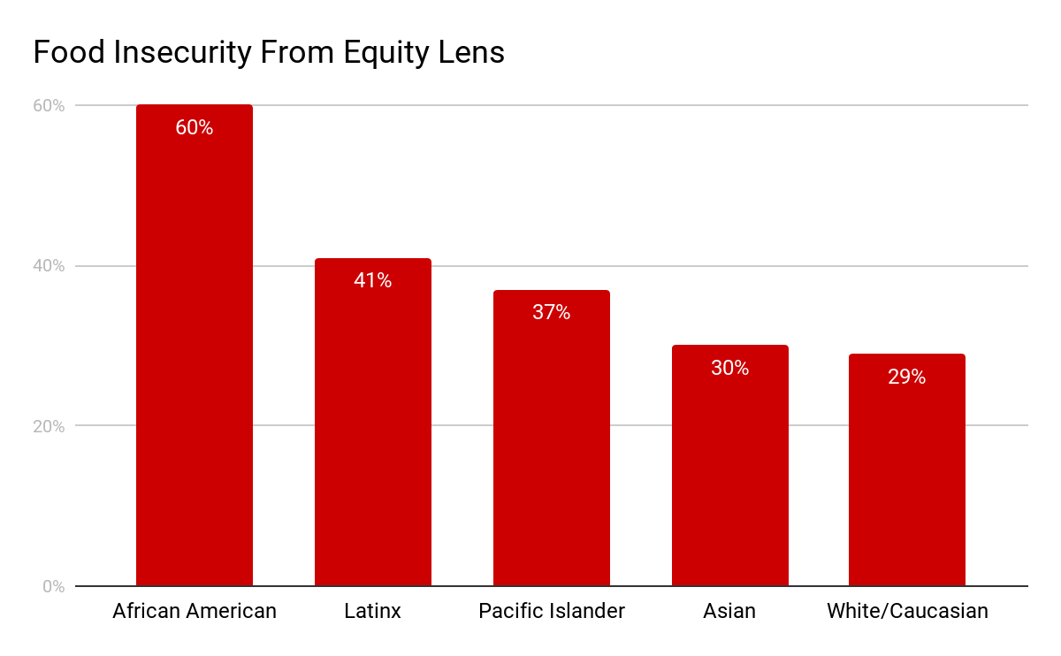
Food Bank: Campus Center, Rm 2007
Approximately 33% of surveyed students at Foothill College experience food insecurity
Foothill pantry serves about 100 students a week
Plans to host a Food Bank Planning Launch in the coming months

Slide 23
To Be Announced:
Workshops to encourage eligible student sign-up to receive CalFresh benefits
Use of EBT cards in cafeteria (pending contract)

Slide 24
Future Possibilities Group Activity

Slide 25
Brainstorm: What could our homeless services look like?
Aspirational Ideas
TOPICS
SERVICES: What homeless services/resources could we provide?
SPACE NEEDS: Location & space considerations
STAFF: What could the staffing structure look like?
PARTNERSHIPS: What partnership opportunities would we deepen or form?
FUNDRAISING: What fundraising ideas come to mind?
OTHERS?

Slide 26
Activity
Put your ideas on stickies and place them with the appropriate topic
We will form teams for each topic
Teams will sort stickies and report out

Slide 27
Next Steps
We will draft an action plan & timeline & distribute for feedback
Follow up with the foundation to discuss a fundraising campaign
Quarterly meeting updates
Stay tuned: Food bank launch

Slide 28
Contact Info
April C. Henderson, Ed.M. Director of EOPS/CARE, FYHS Programs
Hendersonapril@fhda.edu
Laurie Scolari, Ed.D.
Associate Vice President Student Services
Scolarilaurie@fhda.edu
Leticia Maldonado. M.S.
Dean of Students
Maldonadoleticia@fhda.edu
Simon Pennington, M.A.
Interim Associate Vice President of College and Community Relations, Marketing, and Communications
Penningtonsimon@fhda.edu

