Slide 1
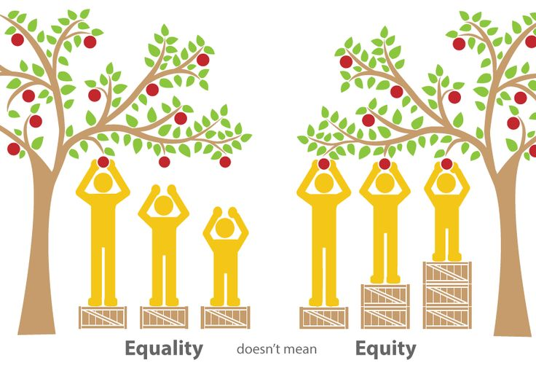

Update on 2015-16 Student Equity Plan Activities
Kelaiah Harris, ANDREW Lamanque, Angel Tzeng
SEW, Spring 2015

Slide 2
Definition
“For purposes of this plan, student equity is defined as a helping students achieve equal outcomes on success indicators as compared to either their own percentage in the community or college student body, or to other student groups.”
CCCO Student Equity Template

Slide 3
Student Equity Plan Success Indicators
Access
ESL, Math, English Basic Skills Completion
Course Success/ Completion
Degree and Certificate Completion
Transfer

Slide 5
Budget by Activity

Slide 6
New Positions
Director of Equity Programs (Admin)
Instructional Services Coordinator –Equity (Classified)
Instructional Support Technician (PSME Center) (Classified)
Faculty Professional Development Coordinator – Equity (Faculty Release)
Administrative Assistant (Classified)

Slide 7
Planned Interventions
Early Alert System
Mentoring Program
Multiple Measures
Embedded Tutoring
Learning Communities - First Year Experience
Professional Development
Umoja

Slide 8
Equity in Program Review (sample)
UNIT | Program Review Committee Recommendation to PaRC
Admissions and Records | PRC commends the department for doing a good job addressing student equity efforts and working to foster a sense of community for the students served.
Biology | PRC commends the department for its effort to achieve equitable outcomes for its students. The department has done so in a collaborative way that has involved part time faculty. This work has ranged from helping to organize the Teaching and Learning Summit, to reaching out for embedded tutors, to looking at alternative textbooks to reduce costs for students, to writing a WestEd Grant to pilot reading apprenticeships across the STEM fields.
Economics | PRC commends the department for its efforts to reach out to students to improve success rates, including through the use of embedded tutoring, and special programs (e.g. India).
Psychology | PRC commends the department for its equity efforts (e.g. embedded tutoring).
Athletics (Student Services) | PRC commends the department for its student equity efforts (counseling, progress reports, and mentorship by coaches).
General Studies - Science | PRC commends the Division Deans (2x) for getting together to discuss student equity effort across both divisions.
Pass the Torch | PRC commends the program for its assistance to underrepresented student populations and its contribution as an important part of the College’s equity agenda.
EOPS | PRC commends the program for its contribution to the College’s student equity efforts.
Dean – Physical Sciences, Mathematics and Engineering (PSME) | PRC commends the unit for a program review document that clearly outlined the division’s equity efforts.
Business and Education Partnerships | PRC commends the unit on serving a diverse range of students in the internship program.

Slide 9
Access: Marketing and Outreach to Recruit Students from Under-represented Groups
Develop Women in STEM Marketing Materials (Summer 2016)
Develop Marketing Plan for under-represented student groups (Summer 2016)

Slide 10
Course Completion: Develop a Mentoring Program
Director of Equity Programs - Search in progress
Mentoring activities for 50-100 students spring 2016 and expand to 150-200 students in fall 2016. (not yet started)
Instructional Support Technician- Hired (April, 2016)
Connect students in the STEM center to student services resources
DRC 2 Educational Coach Interns - Hired (2016)
Currently serving 43 students
Tutorial Center Assistant TEA – Hired (2016)
Support TLC and Pass the Torch
Serving 85-100 students
Notes:
Tutorial Center Assistant TEA : 85 students per week in Fall, 85 per week in Winter, and 91 per week in Spring

Slide 11
Professional Development Conferences / Events
Date of Event | Conference | Number of Attendees
September 2015 | CCCO Student Equity Training | 4
 | Women in STEM Training | 40
November 2015 | AMATYC | 4
 | UMOJA | 5
January 2016 | “White People” a documentary by Jose Antonio Vargas | 180
February 2016 | FYE | 1
 | Dr. Frances Kendall | 45
March 2016 | Academic Academy: Implementing and Embedding Equity Across the College | 3
April 2016 | Cultural Competent Instruction and Assessment Workshop | 8
 | Multiple Measures/Common Assessment | 7
 | Movie: “Don’t Tell Anyone” | 192

Slide 12
Professional Development Events-Future
Date of Event | Conference | Number of Attendees
May 2016 | Courageous Conversations | 45
June 2016 | UMOJA Summer Learning Institute | 6
September 2016 to June 2017 | Faculty Teaching & Learning Academy | 20
Total served: (about 500)

Slide 13
Course Completion: Support Early Alert
Early Alert Administrative Assistant TEA -Hired (January -May 2016)
Support Early Alert activities and voucher program
Equity Administrative Assistant - Hired (April, 2016)
Support Director of Equity Programs , PD and Early Alert
Early Alert activities through 3SP targeting basic skills and cohort students have served 643 students for Fall and Winter

Slide 14
Course Completion: Plan for the Expansion of First Year Experience
45 Students Registered in Cohort, Starting, Fall 2015
Summer 2015: CNSL 5 (10750)
Fall 2015:
ENGL 209 (20543)
ENGL 1S (21521)
ENGL 242A (21522)
ART 1 (22456)
Winter 2016:
ENGL 110 (30229)
ENGL 1T (31606)
ENGL 242B (31607)
LIBR 10 (32743)
HIST 10 (32425)
Spring 2016:
ENGL 1A (40332)
ENGL 1B (40970)
LIBR 10 (41656)
SOC 1 (41451)

Slide 15
Course Completion: Provide Equity Research on Student Needs and New Programs
Research on student needs and identifying student curricular bottlenecks
FYE Survey results analysis will be completed by Fall 2016
FYE focus group will be conducted by Fall 2016
Instructional Services Coordinator – Equity: Hired (April, 2016)
Chemistry Department Research Spring 2016
Research on the development of a service learning program (not started)
Research on offering a program to support African American Students Umoja (under way)

Slide 16
Course Completion: Develop Online Access to Data
Inquiry Tool: Online Section Analysis Comparisons (May, 2016)
Program Review Data Tool: Compare Disaggregated Data on Course Success (May, 2016)
Student Education Plan (SEP) Data
Initial Discussion Only

Slide 17
Course Completion: Reduce Financial Barriers
Served about 50 students in winter
Will serve about 80 additional students in spring
Laptop loan program served 20 students

Slide 18
ESL & Basic Skills: Pilot Multiple Measures of Assessment
Office Coordinator II- TEA (Hired 2016 )
Needed to review transcripts
Assessment Specialist will be hired under 3SP
English Pilot project in Spring, 2016 (small N)
Future pilots planned for English and math
Assessment Center Director has communicated with both departments and the Assessment Taskforce

Slide 19
Degree and Certificate Completion: Use Student Educational Plan Data
Identify courses students may need that have not been offered but are needed for graduation
Identify students that are close to the completion of their certificates and degrees (priority one - by End of June)
Project demand (# sections needed) for courses listed in students’ educational plans
Working with ETS / 3SP funded programmer. Initial meetings only.

Slide 20
Transfer Completion: Facilitate the Assessment of ADT Learning Outcomes for Disproportionate Impact
Faculty Professional Development Coordinator Hired (Spring, 2016)
Program level assessments for ADTs-initial discussion
Working with Student Learning Outcomes Committee
New Transfer Plan with Equity Focus – Transfer Workgroup

Slide 21
What needs more work?
Marketing plan and research for outreach
Direct support to students
Hire the Director of Equity Program
Support for faculty curricular development
Mentoring program
Equity Research - including “Research the development of a service learning program”
Use Student Educational Plan Data
Multiple Measures Pilot

Slide 22
What have we accomplished?
Direct Support for Students - Book Vouchers
Professional Development
Early Alert Program underway
Research on FYE and UMOJA Programs
Online Access to Data (beta)
Discussions across campus – SLO Committee, Assessment Taskforce, PRC, OPC, Transfer WG

Slide 23
2015-16 Equity Plan Activity Progress
Activity | Description | Rating
A.1 | Marketing and Outreach to Recruit Students from Under-Represented Student Groups | More work to be done
B.1 | Develop a Mentoring Program | Little Activity
B.2 | Professional Development to Develop Greater Awareness of Student Needs | Some Progress
B.3 | Support Early Alert Activities | Some Progress
B.4 | Plan for the Expansion of First Year Experience (FYE) | Some Progress
B.5 | Provide Equity Research | More work to be done
B.6 | Develop Online Access to Data about Subpopulations of Students | More work to be done
B.7 | Reduce Financial Barriers to Course Success for Low Income Students | Some Progress
C.1 | Pilot Multiple Measures of Assessment | More work to be done
D.2 | Use Student Educational Plan Data to Project Student Needs | Little Activity
E.2 | Facilitate the Assessment of ADT Learning Outcomes for Disproportionate Impact | More work to be done

Slide 24
Next Steps
Next Meeting:
Review ongoing budget commitments
Meeting in June:
Discuss demographics of students served this year
September – October:
Analyze outcomes from this year
Re-run metrics
November (depending on CCCO guidelines):
Review revised plan

Slide 25
Questions?

