Slide 1

Student Equity Report Planning
ANDREW Lamanque, phd
Fall 2015
Thanks to Elaine Kuo, Chen Li, and Carolyn Holcroft for their contributions to this powerpoint.

Slide 2
To Start: The Numbers
Source: Liz Leiserson, Foothill 3Sp Plan

Slide 3
The Numbers Continued
Source: Liz Leiserson, Foothill 3Sp Plan

Slide 4
Master Plan Goals Related to Equity (DRAFT)
Create a culture of equity that promotes student success and strong support for underserved students.
Reduce barriers and facilitate students’ ease of access across the District and region.
Enhance support for online quality and growth for instruction and student services.
Collaborate with K-12, adult education and four-year institutions in ways that serve students and society.
Partner with business and industry to prepare students for the workforce.

Slide 5
3SP and Basic Skills Activities
Supporting Equity Goals
Basic Skills
Embedded Tutoring
Math Summer Bridge
English Summer Bridge
3SP
Early Alert
Revamped Orientation Options
Counseling Support for Student Education Plans
Multiple Measures Pilots
Enrollment Priorities
Research and Professional Development Activities for Both

Slide 6
Student Success Collaborative (3SP, BS, Equity)
Framework for Activities
  Met in Summer 2015 and Agreed on 3 College-wide Initiatives
  1) Creating and implementing a comprehensive early alert program
  2) Developing, implementing and coordinating a mentoring program
  3) Targeted professional development.

Slide 7
Student Success and Retention Team
Students
Early Alert Coordinator
Early Alert / Retention Counselor
Part-Time Counselor
Prof Dev & Mentoring Program Coordinator
Supplemental Instructors
Student / Peer Mentors
Faculty Coordinator
Researchers

Slide 8
Proposed Student Success Positions

Slide 9
Initial Focus
Early Alert / Mentoring program initiative to begin Fall 2015 for:
  Athletes
  English, Math Summer Bridge,
  First Year Experience (FYE),
  Embedded tutoring students.
Once initiative in place, use available software available (e.g. Starfish) to identify other students/students groups that may benefit from mentorship

Slide 10
Fall 15 Equity Planning Process
Review Feedback (and other plans)
Review Equity Data
Discuss Ideas for Plan Activities, Goals, and Benchmarks
Feedback from CCCO meeting; Plan Activities Continued
PaRC November 4 and 18; Board December 7; Due December 18
September 22
September 29
October 13
Homework!

Slide 11
Student Groups That Require Analysis
American Indian or Alaska Native
Asian
Black or African American
Hispanic or Latino
Native Hawaiian or other Pacific Islander
White
Some other race
More than one race
“For purposes of this plan, student equity is defined as a helping students achieve equal outcomes on success indicators as compared to either their own percentage in the community or college student body, or to other student groups.”
CCCO Student Equity Template
Males | Students with disabilities
Females | Low-income students
Current or former foster youth | Veterans

Slide 12
Student Equity Plan Success Indicators
Access
ESL, Math, English Basic Skills Completion
Course Success/ Completion
Degree and Certificate Completion
Transfer

Slide 13
Equity Plan Template
Data
Conclusions: Identify Disproportionately Impacted Student Groups
Set Baseline Data and Identify Goals
Identify
Activities to be Implemented to Improve Outcomes for Disproportionately Impacted Student Groups
Identify Expected Outcomes
Process for Each Success Area

Slide 14
For Each Success Area
For groups with “gaps,” select a target reduction in gap
Activity Type(s)
DI Student Group(s) & # of Each Affected
Activity Implementation Plan
  Planned Start/End Date(s), Student Equity Funds, Other Funds
Link to Goal
Evaluation

Slide 15
SEP Expenditure Categories
Outreach
Student Services & Categoricals
Research and Evaluation
SE Coordination & Planning
Curriculum/ Course Dev. & Adaptation
Professional Development
Instructional Support
Direct Student Support

Slide 16
Some Feedback From Last Year’s SE Plan
Was a business/budget representative, student(s), EMP/accreditation representative, or Program Review representatives involved in the collaboration?
Coordination with SSSP was lacking.
Mention of specific activities, identifying more long term goals, and a list of budget expenditures would have been helpful.

Slide 17
Percentage Point Gap Methodology
Compares success rate of ALL students to success rate* of a disaggregated subgroup of students
Success rate (%) of ALL students
Success rate of subgroup of students
Percentage Point Gap
*or other outcome

Slide 18
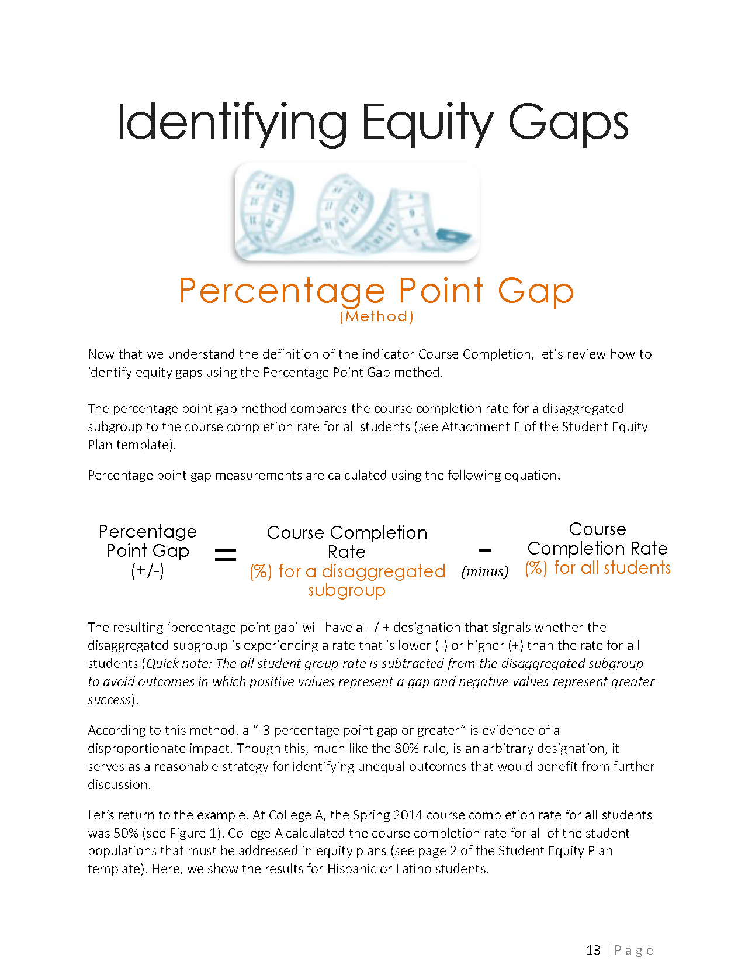

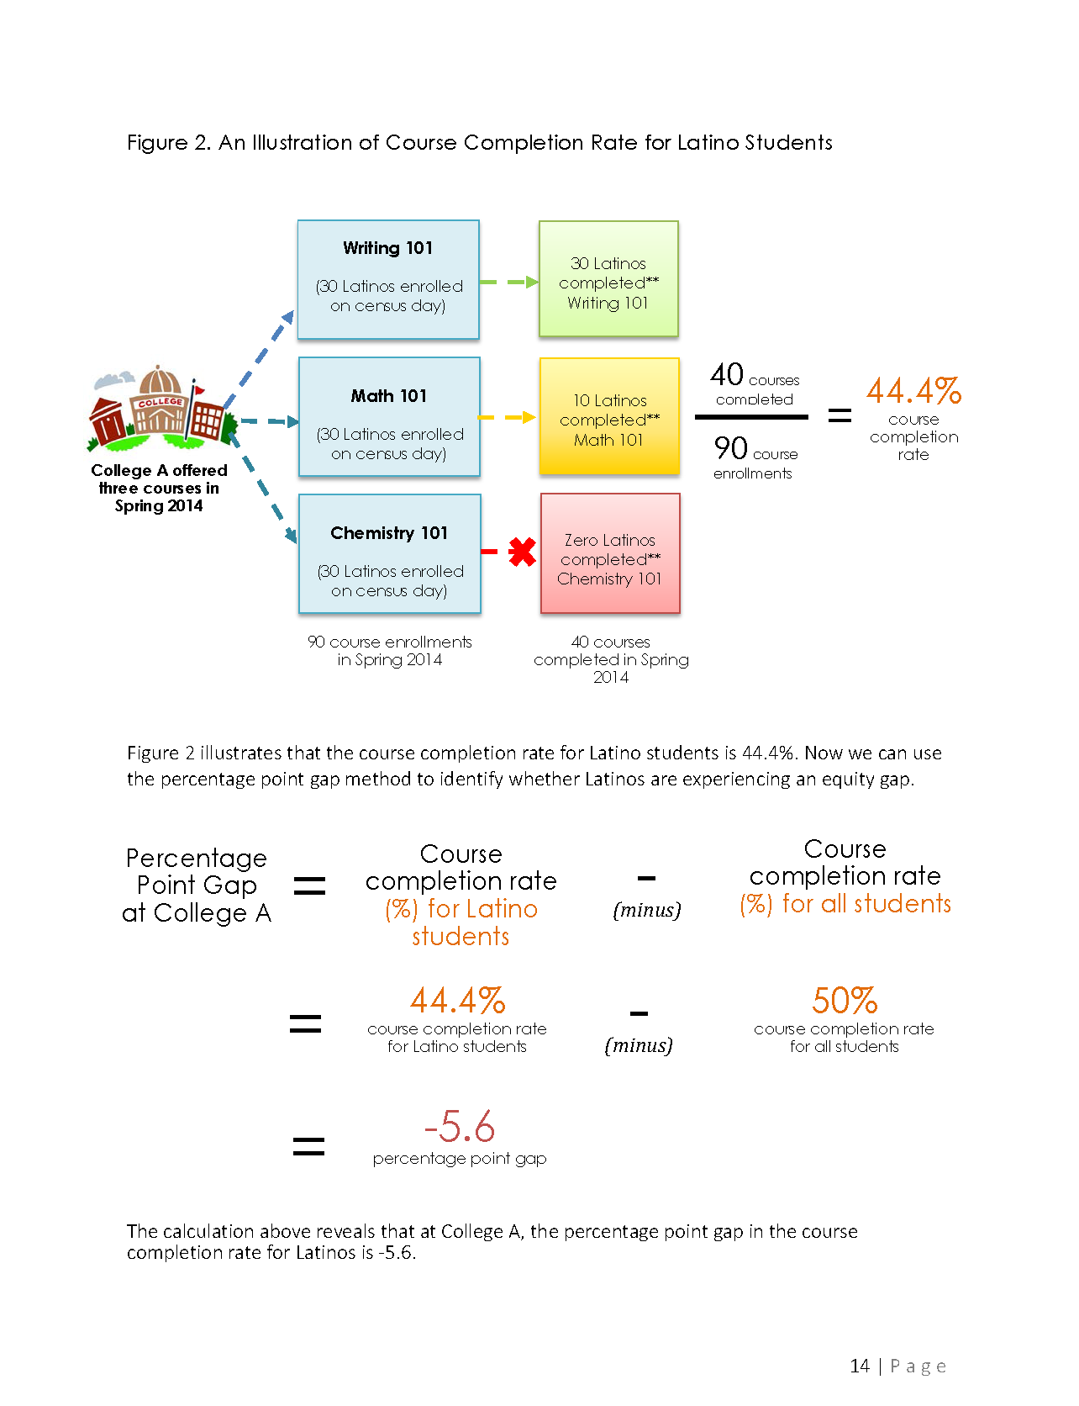

Slide 21
% Point Gap Method
All Students
Achieve Course Success*
GAP
=
50% - 67%, =
-17 percentage points
The disaggregated group has a success rate 17 percentage points LOWER than the success rate for all students
% Success*: 4 out of 6, or 67%
Disaggregated Subgroup
% Success*: 1 out of 2 or 50%
*or other outcome

Slide 22
Interpreting the Percentage Point Gap
-3 percentage point gap or greater can serve as evidence that a student group is not achieving the outcome at the same rate as other students and thus can be seen as being “disproportionately impacted.“
  “Though this, … , is an arbitrary designation, it serves as a reasonable strategy for identifying unequal outcomes that would benefit from further discussion … .” CCCO Equity Template

Slide 23
Interpreting the Percentage Point Gap
Consider:
Number of students impacted
  Rates calculated using smaller numbers [of students] will be subject to greater variability; it may make sense to prioritize a gap that impacts a greater number of students.
Disaggregated subgroup’s proportion of the total population: The larger the proportion a subgroup represents of the total population, the more similar their success rate will be to the all student average.

Slide 24
Course Success / Completion

Slide 25
Course Success / Completion

Slide 26
Student Aspirations

Slide 27
Additional Data
See attached tables for data on each success area.

Slide 28
For Discussion
How can / will our activities (early alert, mentoring, PD) help us ‘close the gaps’?

Slide 29
Questions?

