Slide 1
FOOTHILL COLLEGE
OPENING DAY
September 23, 2016

Slide 2
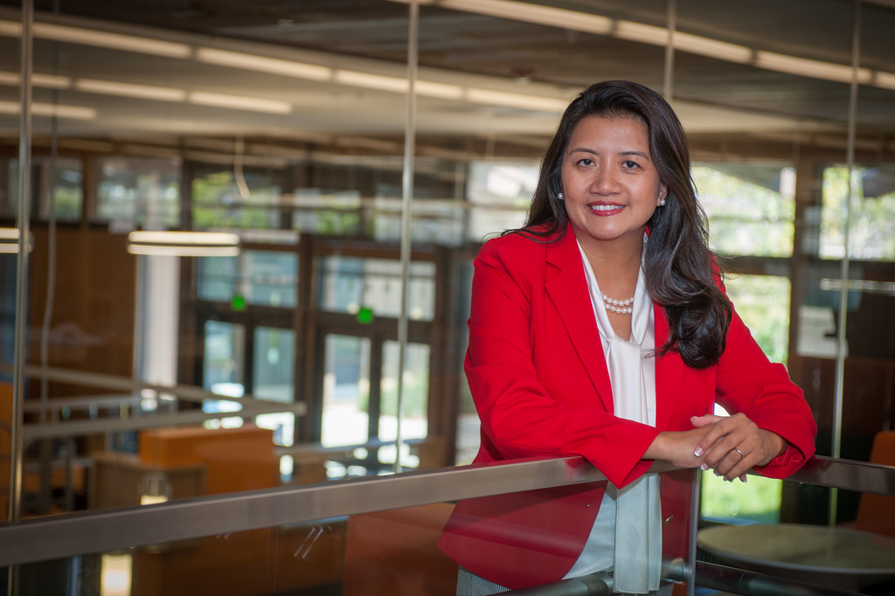
WELCOME & INTRODUCTION
THUY THI NGUYEN
PRESIDENT
Twitter: @FoothillPrez

Slide 3
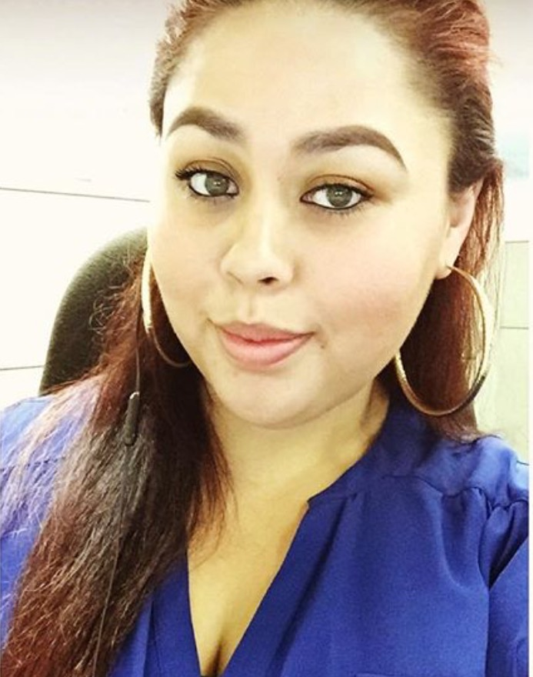

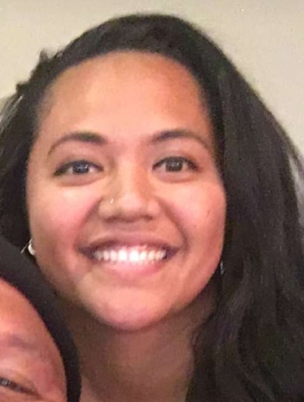
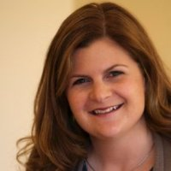
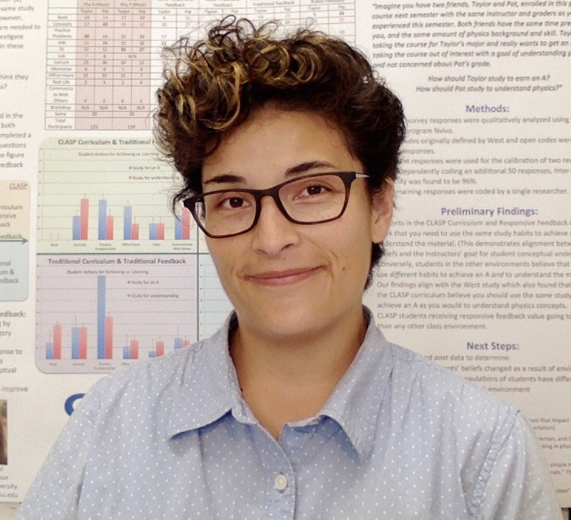
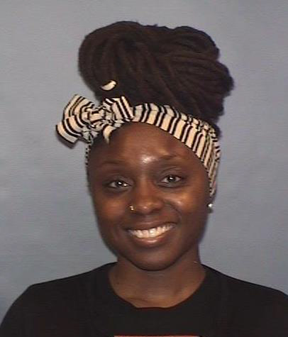
NEW COLLEAGUES
MAYRA AGUILLERA
LATISHA BRIGGS
PAULINE BROWN
Student Success Specialist
Evaluation Specialist
Executive Assistant
Student Services
ELIZABETH BRUMBAUGH
ANNIE CHASE
FOUNTAINETTA COLEMAN
Teacher in Residence
Krause Center for Innovation
Instructor – Physics
Assessment Specialist

Slide 4
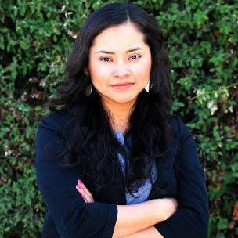
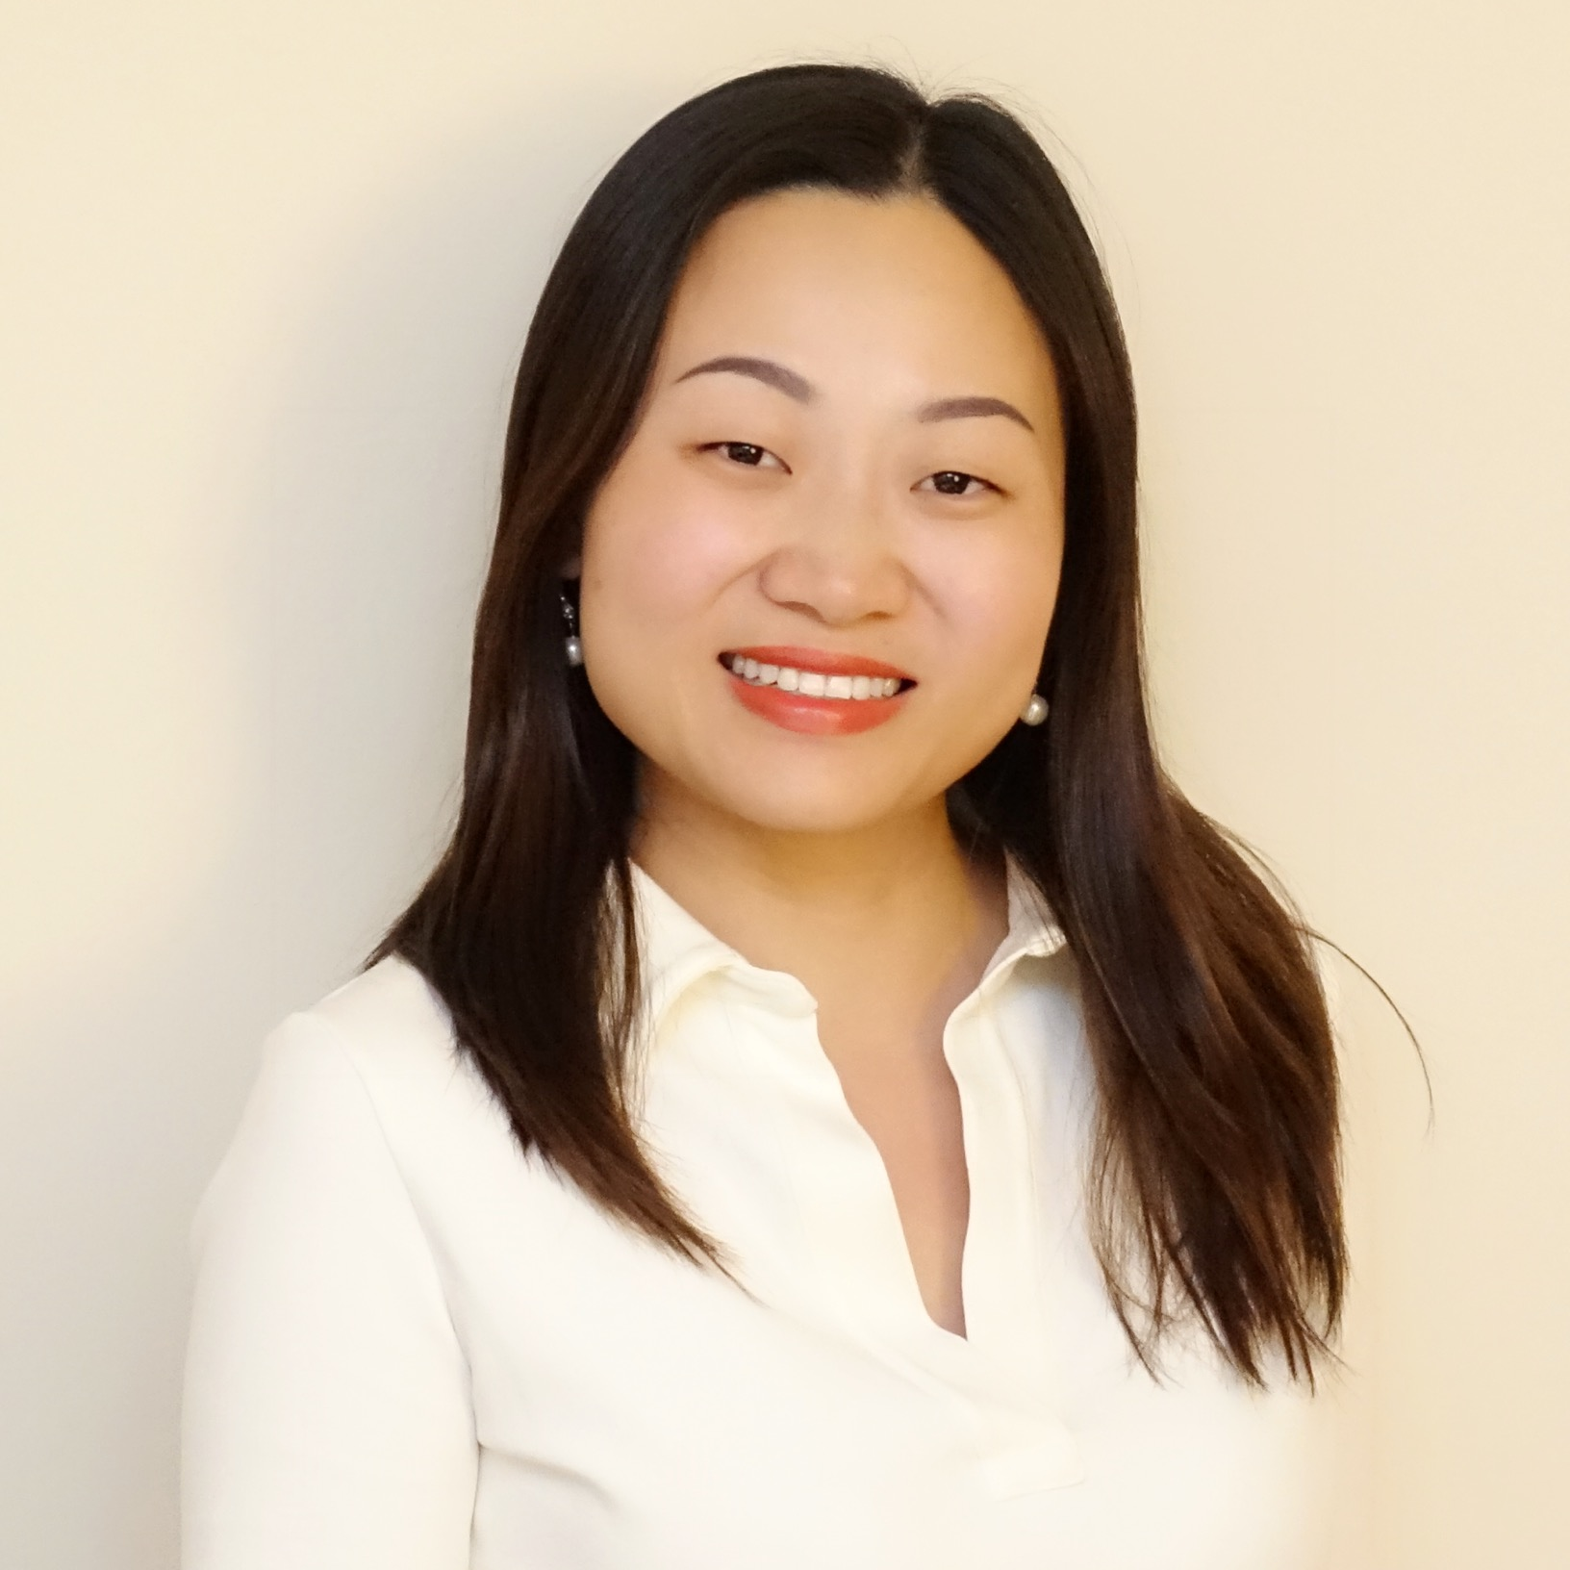
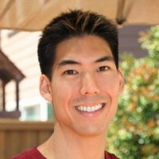
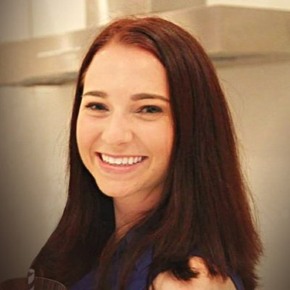
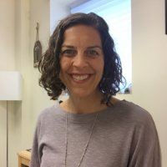
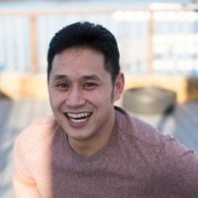
NEW COLLEAGUES
NANCY CORTEZ
DANMIN DENG
CLIFTON DERBING
Human Resources Technician II
Instructional Support Coordinator
Sunnyvale Center
Counselor
Psychological Services
VALERIE DIAZ DE ARCE
ALEXIS DONATO
JORDAN FONG
Graphic Design Technician
Counselor
Instructor – Graphic Design

Slide 5
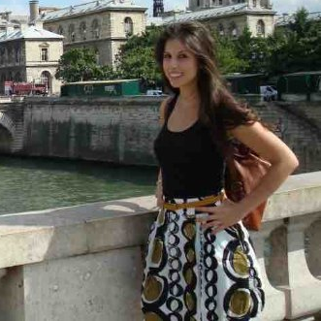
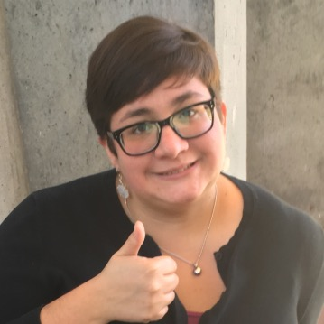
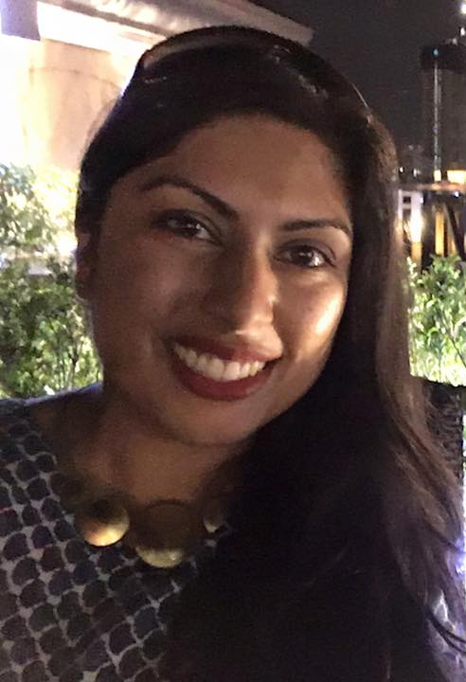

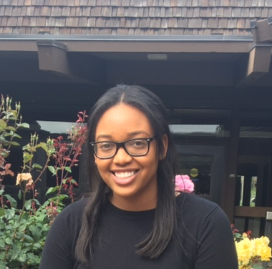
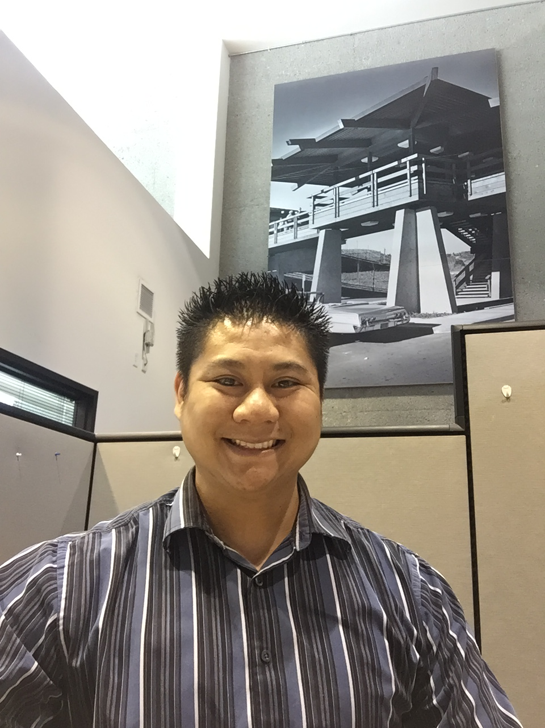
NEW COLLEAGUES
CLAUDIA FLORES
KATHERINE FORTUNE
MILONI GANDHI
Health Career Program Coordinator
Senior Administrative Assistant
Student Affairs
Director – International Market Development & Student Experience
SAMERA HADI
KELAIAH HARRIS
HIEU HUYNH
Financial Aid Outreach Assistant
Administrative Assistant I
Equity Programs
Program Coordinator II
Enrollment Services

Slide 6
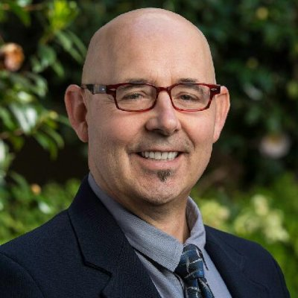
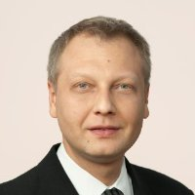
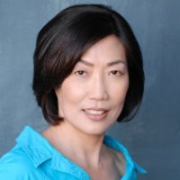
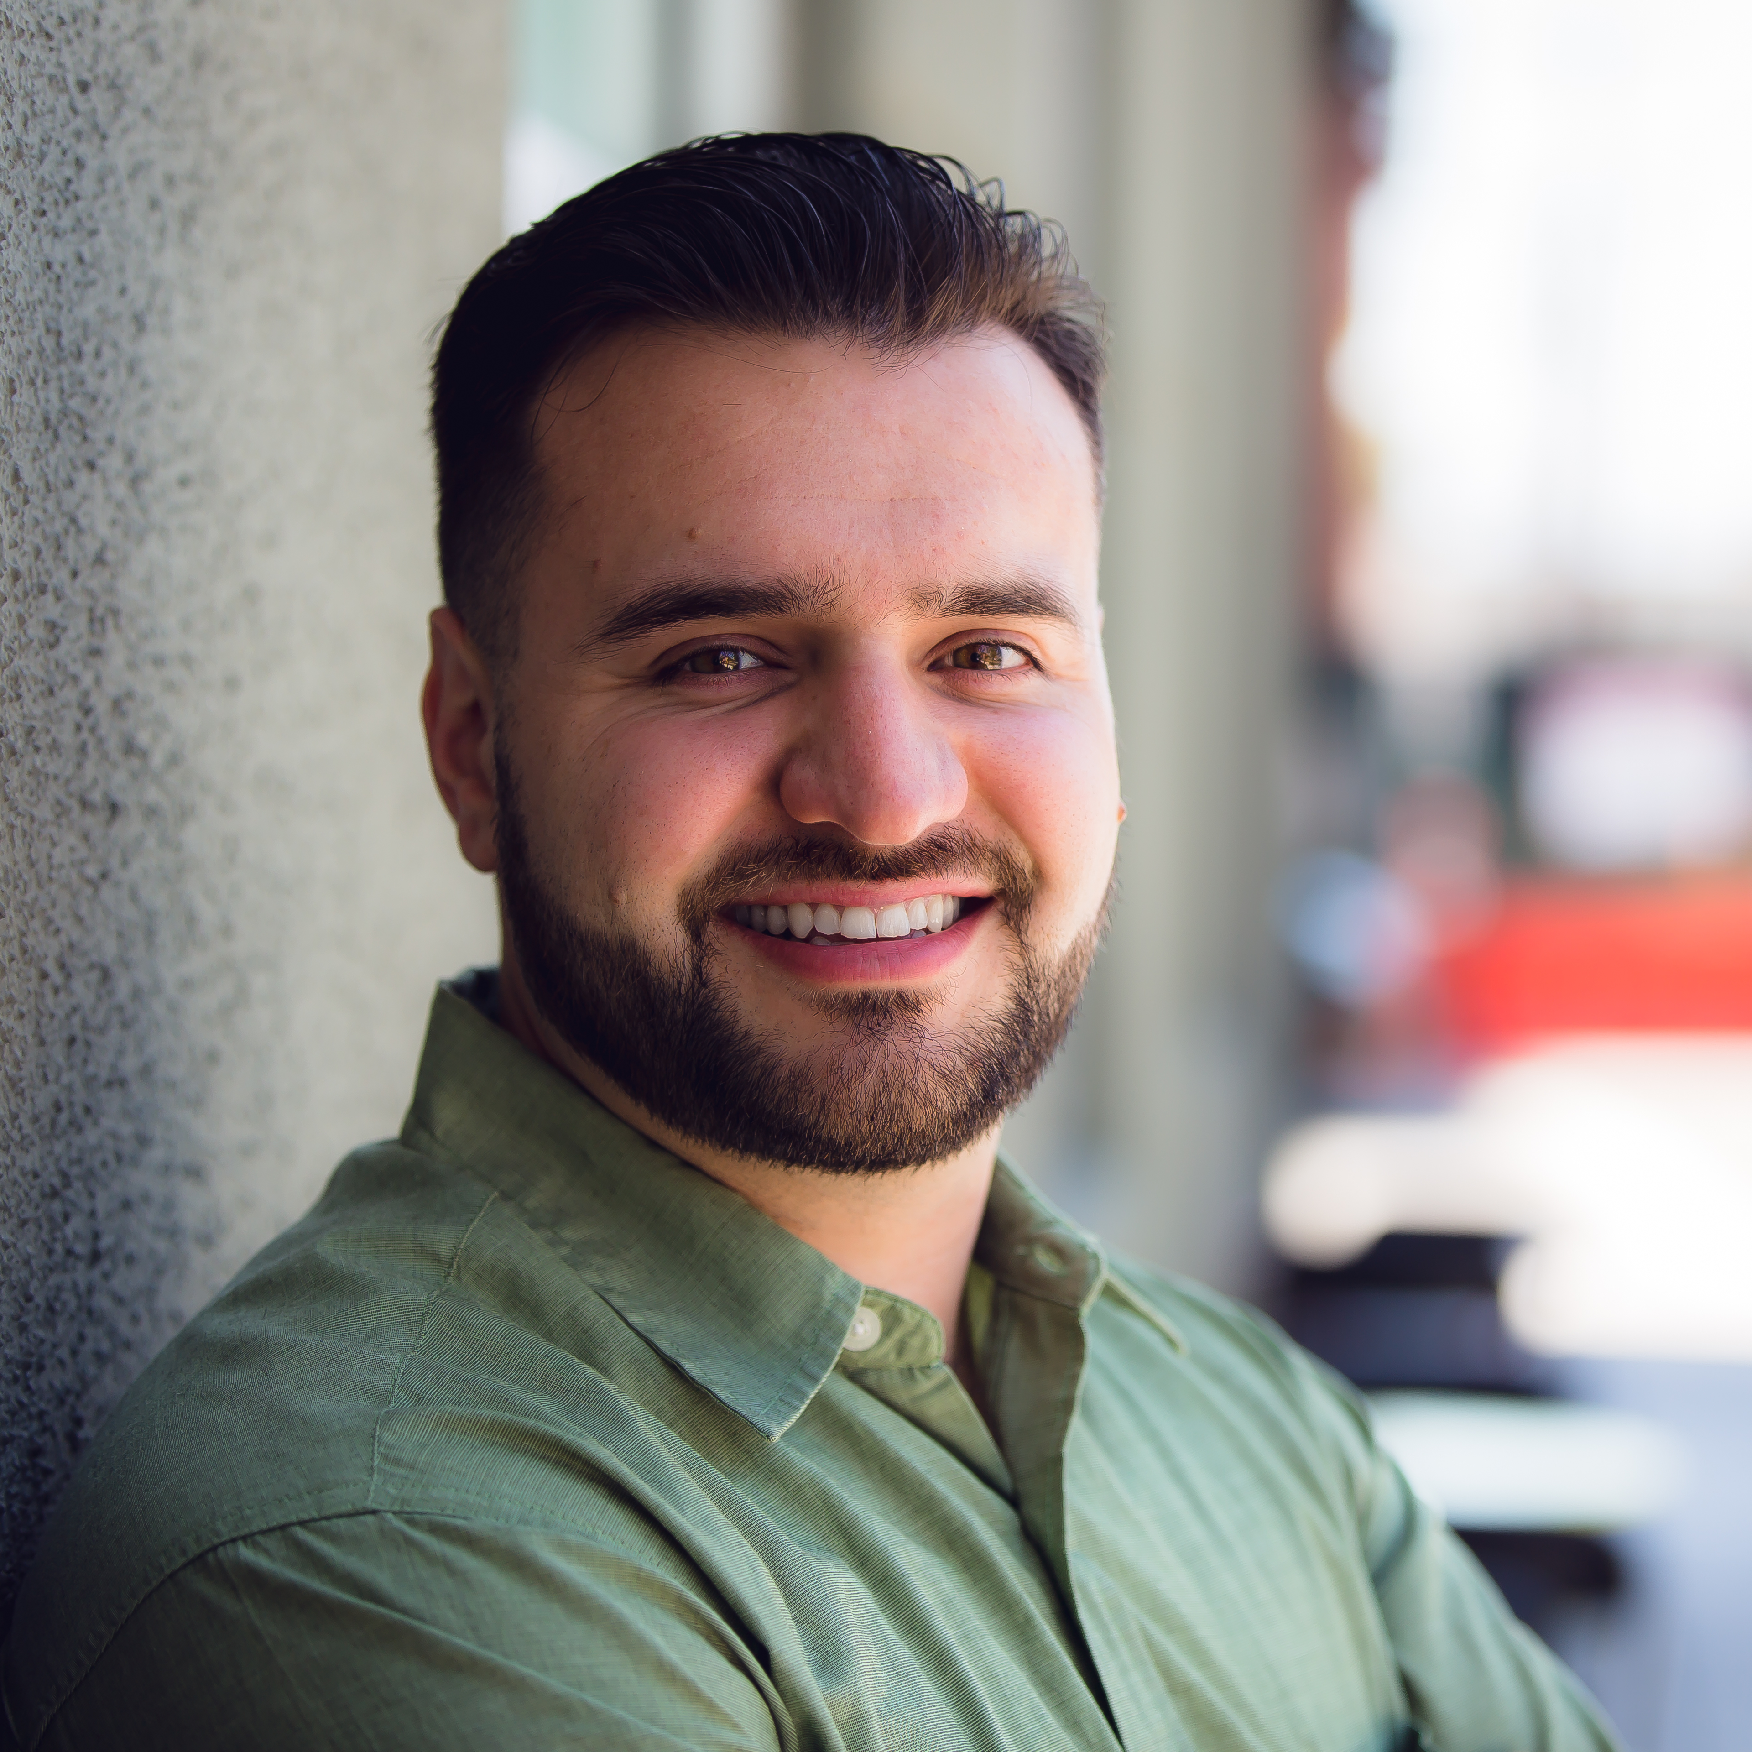
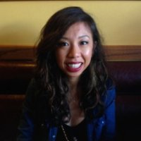
NEW COLLEAGUES
STEVEN KNIGHT
ALEXANDER KORNIAKOV
JIIN LIANG
Program Director
Diagnostic Medical Sonography
Instructor – Accounting
Instructional Support Technician
GABRIEL LOMELI
DONNA MIRANDA
FAN ORR
Outreach Assistant
Program Coordinator I
Financial Aid Assistant

Slide 7

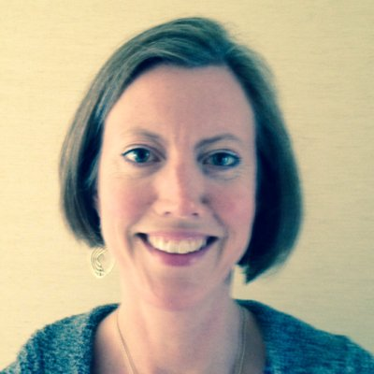
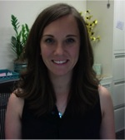
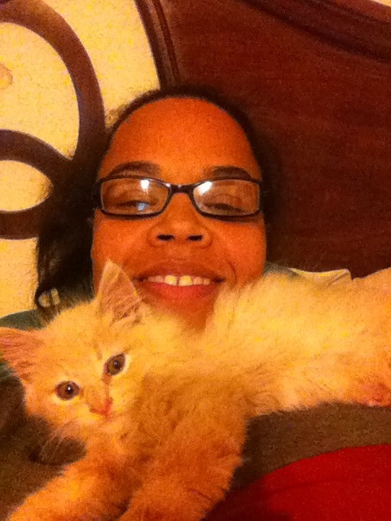
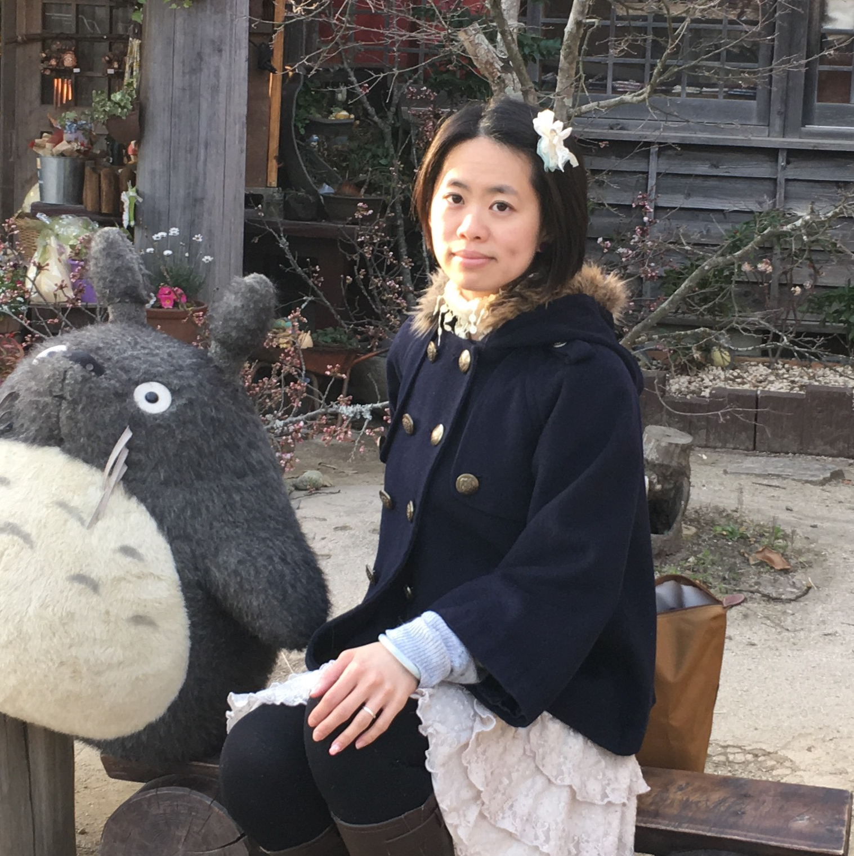
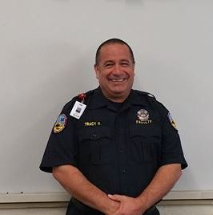
NEW COLLEAGUES
JOSHUA PELLETIER
LISA SLEDE
RACHEL SOLVASON
Instructional Associate – Library
Counselor
Psychological Services
Articulation Specialist
SHAELYN ST. ONGE-COLE
ANGEL TZENG
TRACY VILLANUEVA
Instructor – Veterinary Technology
Instructional Services Coordinator
Equity Programs
Instructor – EMS / Paramedic

Slide 8
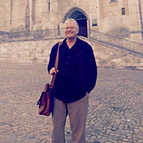
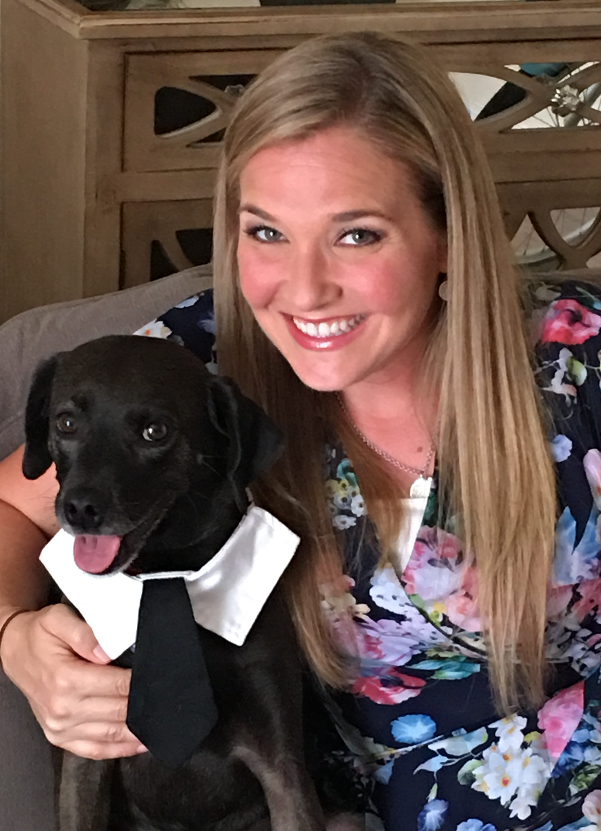
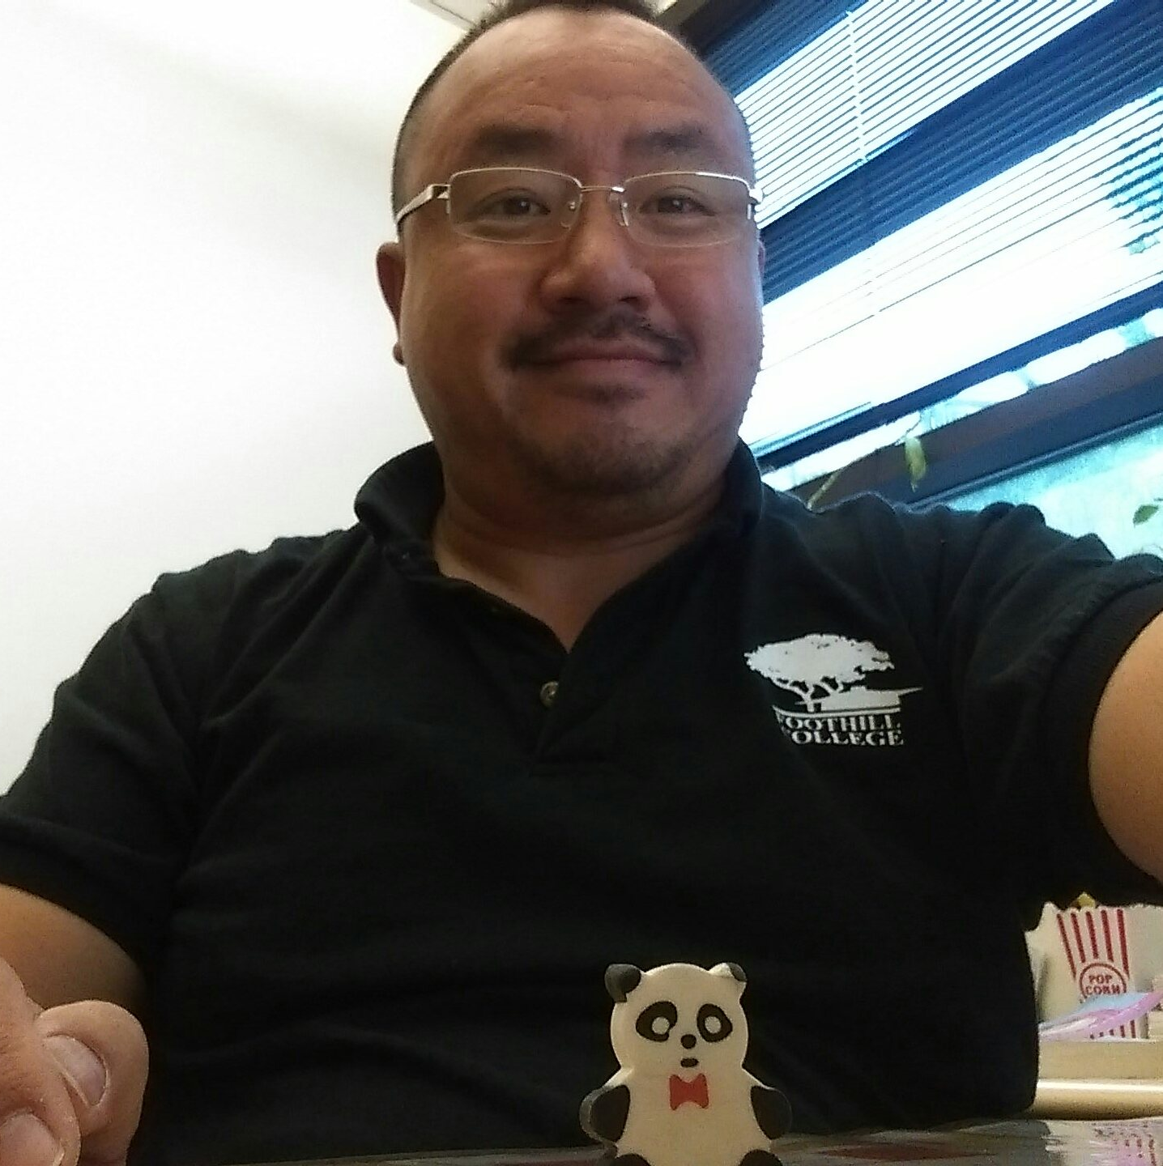
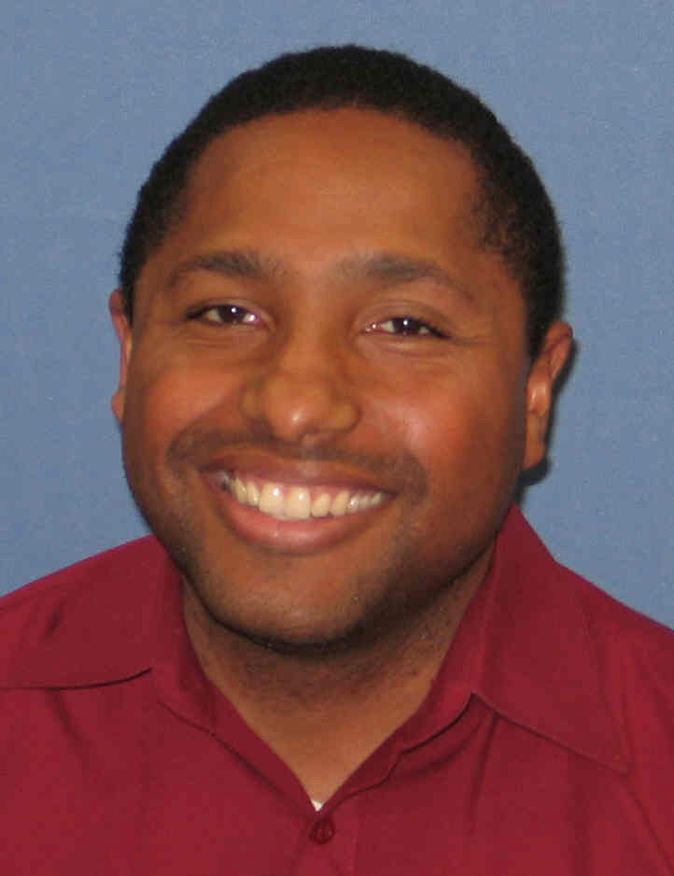
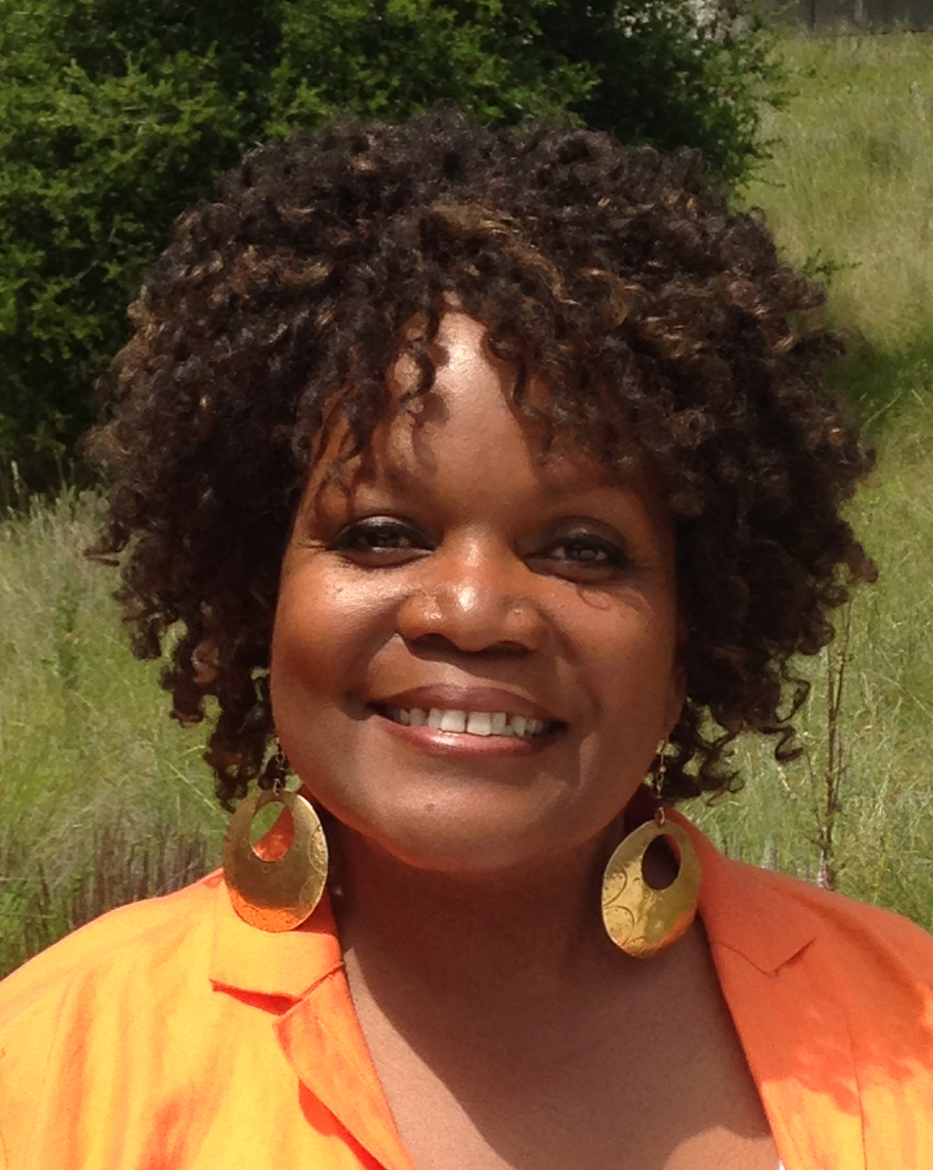
FAMILIAR FACES IN NEW PLACES
MARK ANDERSON
HILARY BACON
KAI CHANG
Instructor – Music
Counselor
Senior EOPS Specialist
CLEVE FREEMAN
APRIL HENDERSON
HENRY JUNG
Transfer Center Director
EOPS Supervisor
Senior Admissions & Records
Coordinator, Sunnyvale Center

Slide 9
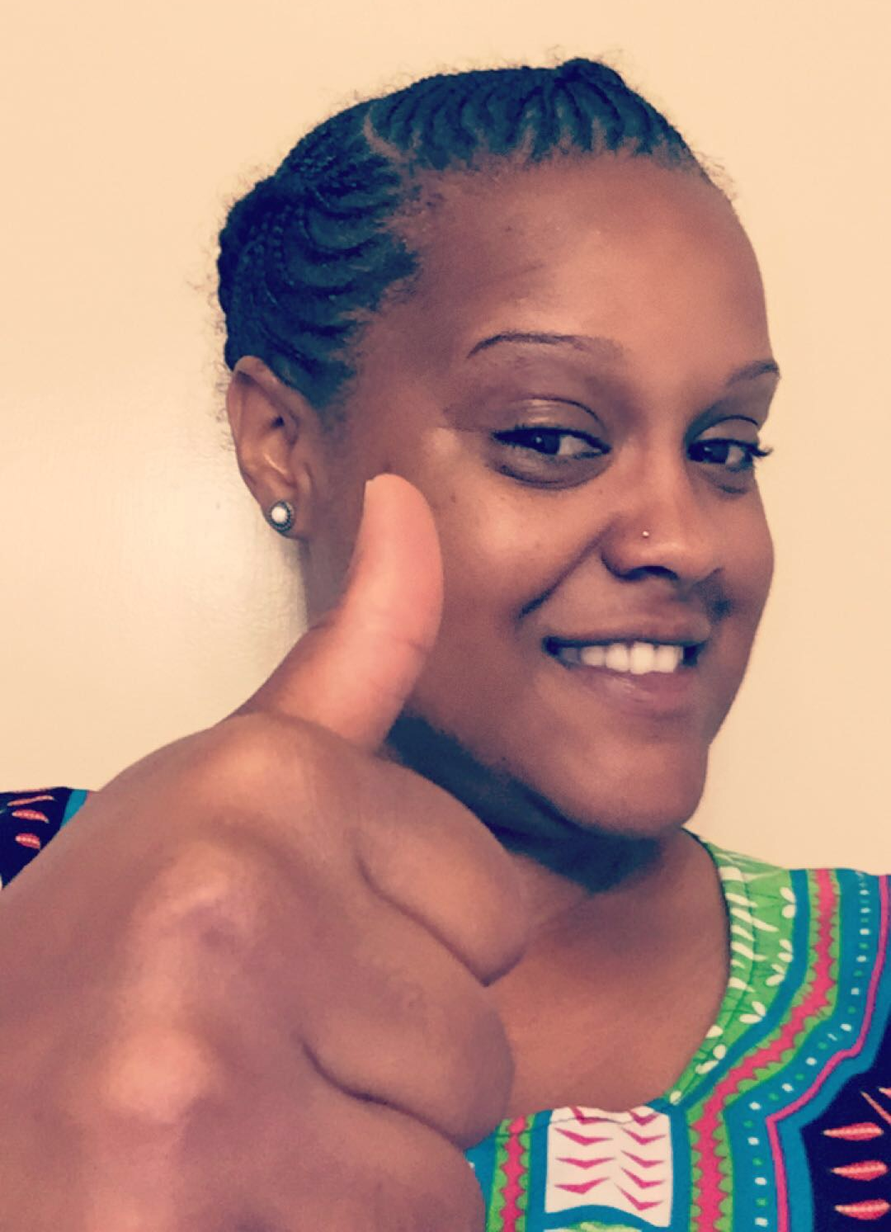
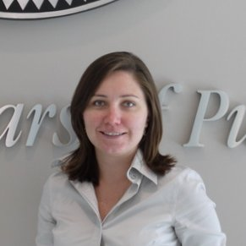
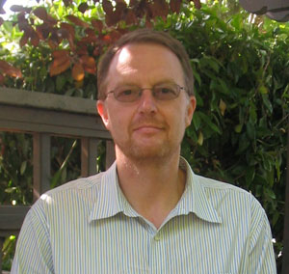
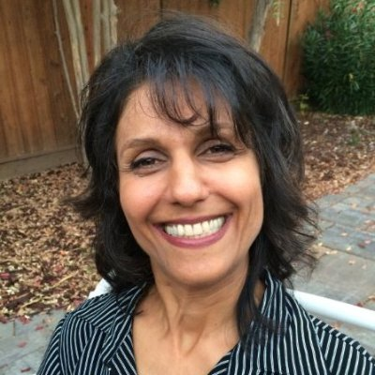
FAMILIAR FACES IN NEW PLACES
KENT McGEE
DOKESHA MEACHAM
OXANA PANTCHENKO
Graduation & Evaluation Coordinator
Counselor
Director
Science Learning Institute
SIMON PENNINGTON
ATOUSA POJHAN
BRIAN ROBERTS
Interim Dean – Fine Arts,
Communications, Kinesiology & Athletics
Evaluation Specialist
Senior Evaluations Specialist

Slide 10
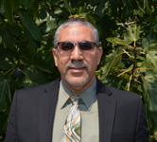
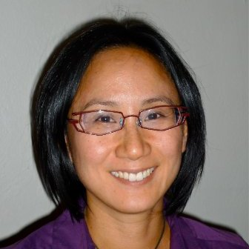
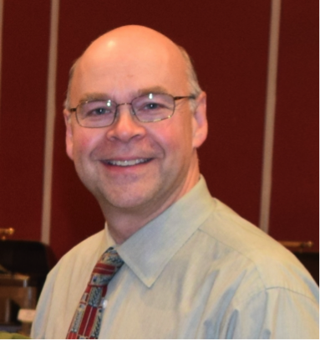
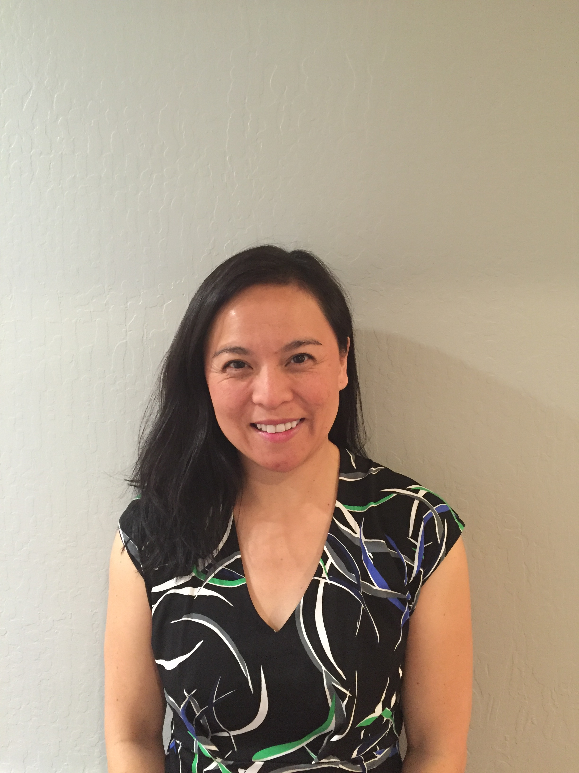
FAMILIAR FACES IN NEW PLACES
MOATY FAYEK
ELAINE KUO
Interim Vice President – Workforce Development & Institutional Advancement
Interim Director of Equity Programs
ANDREW LAMANQUE
LORI SILVERMAN
Interim Vice President – Instruction
& Institutional Research
Interim Dean – Physical Sciences, Mathematics & Engineering

Slide 11
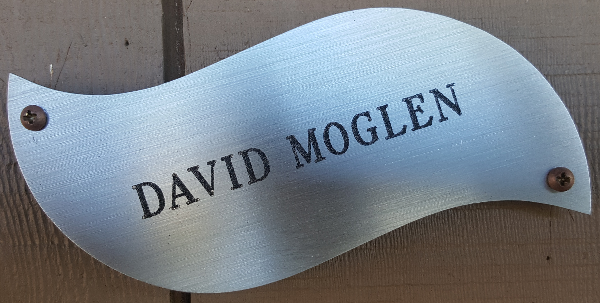
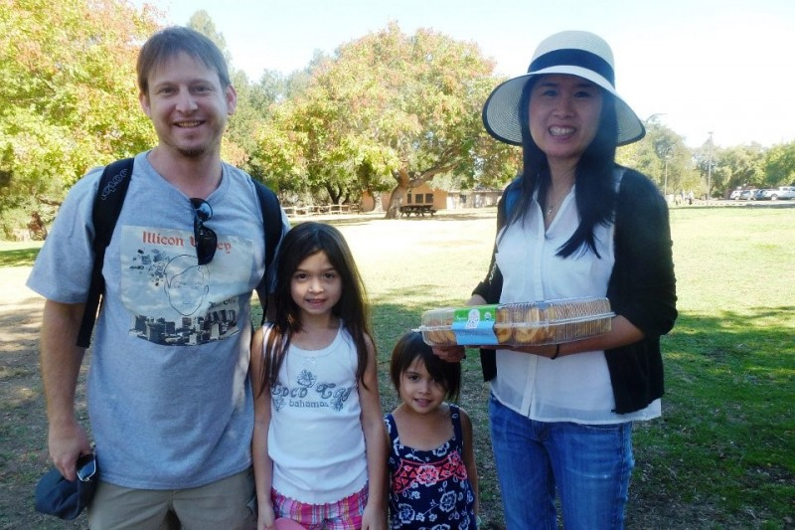
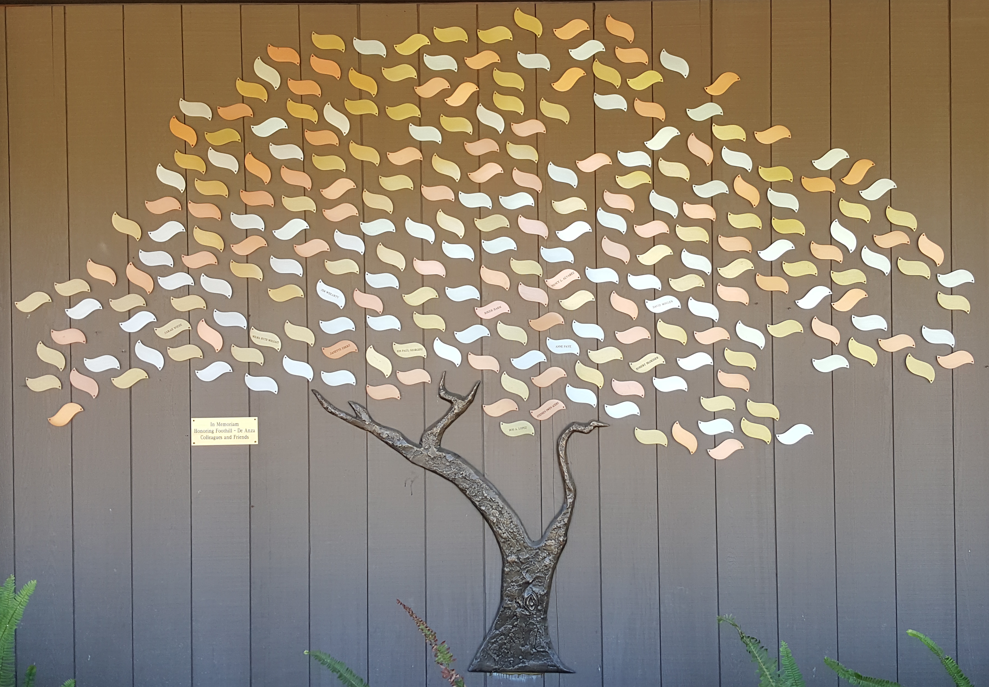
IN MEMORIAM …

Slide 12
CELEBRATING 7 YEARS AT FHDA
7
Scott Goldstone
Brenda Hanning
Yuh Ni
Norman Paris
Liz Roberts
Diana Uilecan
Robert Ward
William Webb
Tai Wong

Slide 13
CELEBRATING 15 YEARS AT FHDA
15
Luis Barreto
Laurie Bertani
Ru Yu Chen
Marilyn Cheung
Setsuko Chiba
Bradley Creamer
Roberto Cormia
Patricia Crespo-Martin
Bernie Day
Leticia Delgado
Nancy Ghodrat
Hilary Gomes
Kevin Harral
Elvia Herrera
Wilbert Hollins
Zohreh Jazaeri
Henry Jung
Arthur Levine
Jeffrey Levitch
Debra Lew
Brian Lewis
Kent McGee
Charlie McKellar
Martin Melia
Sherri Mines
Patrick Morriss
Erin Ortiz
Elaine Piparo
Amelia Quiros
Ikuko Rakow
Julio Rivera-Montanez
Doren Robbins
Jo Rodgers
Al Ruffinelli
Leticia Serna
Mary Thomas
Kristin Tripp Caldwell
Lan Truong
Francisca Varela-Ramirez

Slide 14
CELEBRATING 25 YEARS AT FHDA
25
Kimberly Cook
Marnie Francisco
Theresa Hansen
Meredith Heiser
Najwa Jardali
Ellen Mastman
Natalia Menendez
Cara Miyasaki
Preston Ni
Amidollah Salari

Slide 15
CELEBRATING 35 YEARS AT FHDA
35
Betsy Parravi
Roberto Sias

Slide 16
TOTAL YEARS OF SERVICE?
968

Slide 17
Educational Master Plan
Approved by Board of Trustees on February 08, 2016
Three Goals
  Equity
  Community
  Improvement and Stewardship of Resources

Slide 18
Strategic Objectives to
Operationalize the Ed Master Plan
S
SUNNYVALE & ENROLLMENT GROWTH
HISPANIC SERVING INSTITUTION (H.S.I.)
EQUITY PLAN
ACCREDITATION
H
E
A

Slide 19
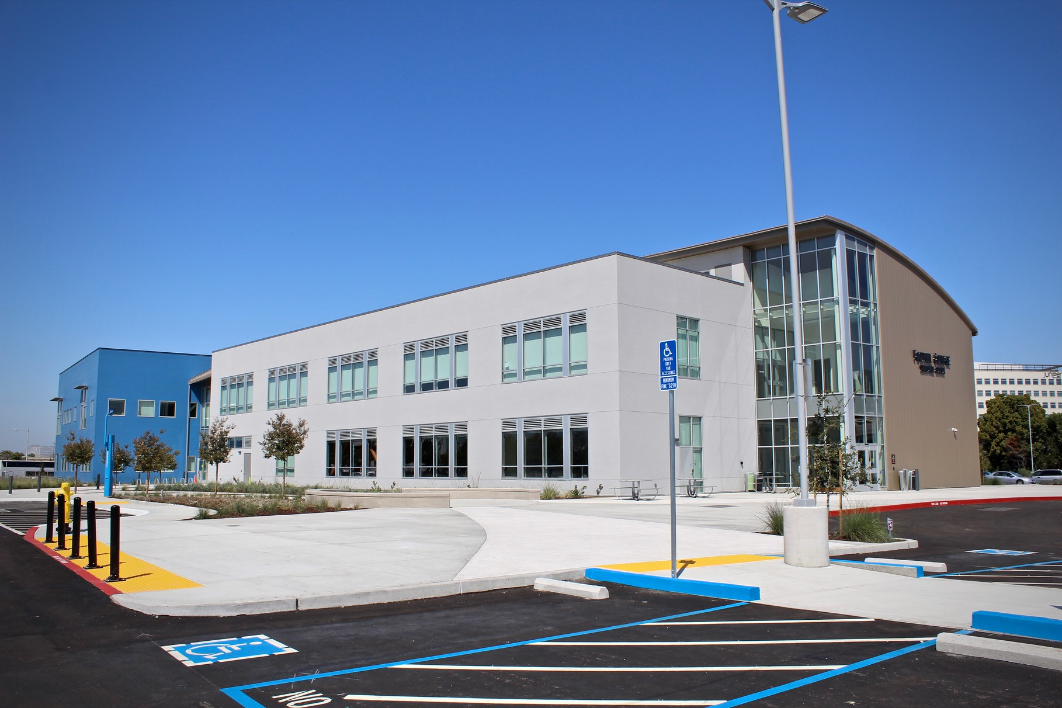
S.H.E.A.
SUNNYVALE & ENROLLMENT GROWTH
More than 1.5 percentage point increase in FTES, with
successful operation of Sunnyvale Center

Slide 20
S.H.E.A.
FULL TIME EQUIVALENT STUDENTS (FTES)
1% GROWTH
2014-2015 – Total FTES: 13,468
2015-2016 – Total FTES: 13,710

Slide 21
S.H.E.A.
HISPANIC SERVING INSTITUTION (H.S.I.)
Increase from 22% to 25% Latino students

Slide 22
S.H.E.A.
EQUITY PLAN
Implementation & Assessment
  Access
  Course Completion
  ESL and Basic Skills Completion
  Degree and Certificate Completion
  Transfer

Slide 23
S.H.E.A.
ACCREDITATION
College Self-Study (Site Visit – October 2017)
Bachelor’s Degree in Dental Hygiene

Slide 24
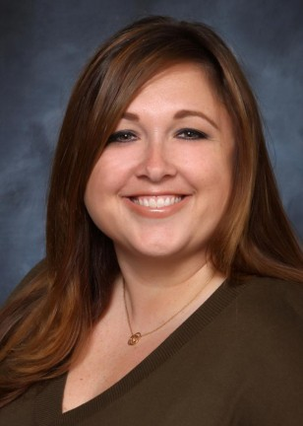
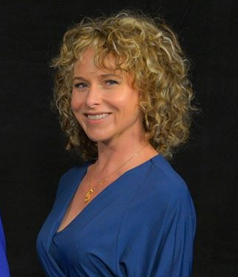
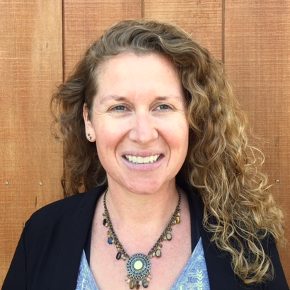
S.H.E.A.
ACCREDITATION STEERING COMMITTEE
I
II
ANDREA HANSTEIN
Director of Marketing & Public Relations
CAROLYN HOLCROFT
Academic Senate President
III
IV
ERIN ORTIZ
Classified Senate President
ANDREW LAMANQUE
Interim Vice President
Instruction & Institutional Research

Slide 25

EQUITY
STUDENTS LEARN A POWERFUL
LESSON ABOUT PRIVILEGE

Slide 26

EQUITY
SHARED VISION

Slide 27
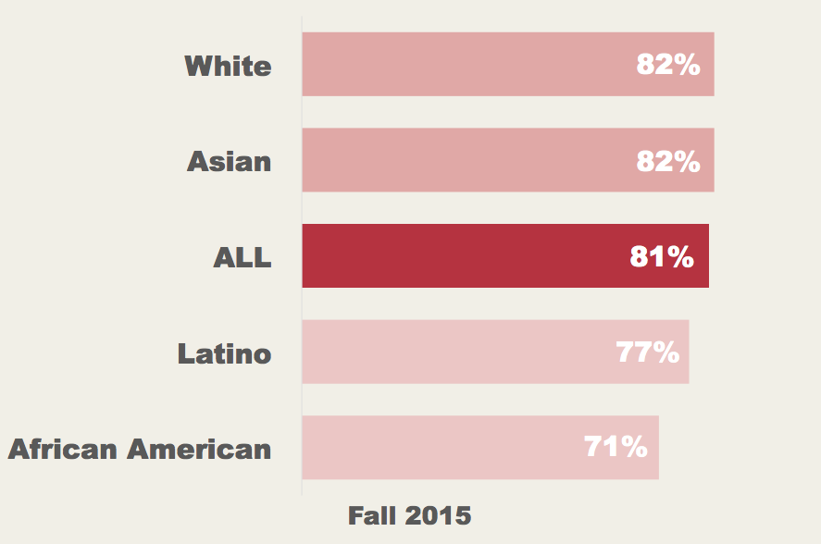
EQUITY MYTH #1 – SOCIO-ECONOMIC
COURSE SUCCESS RATES
BY ETHNICITY AMONG THOSE NOT RECEIVING FINANCIAL AID
11% GAP
Source: FHDA IR&P, ODS, Fall 2015. N=35,125, Financial Aid African American=949, Asian=2,589, Latino=4,101, White=2,261;
No Financial Aid African American=742, Asian=6,060, Latino=4.435, White=8,412.
Fall 2015 credit course data. Excludes American Indian/Alaskan Native, Pacific Islanders, Unknown/Other.

Slide 28
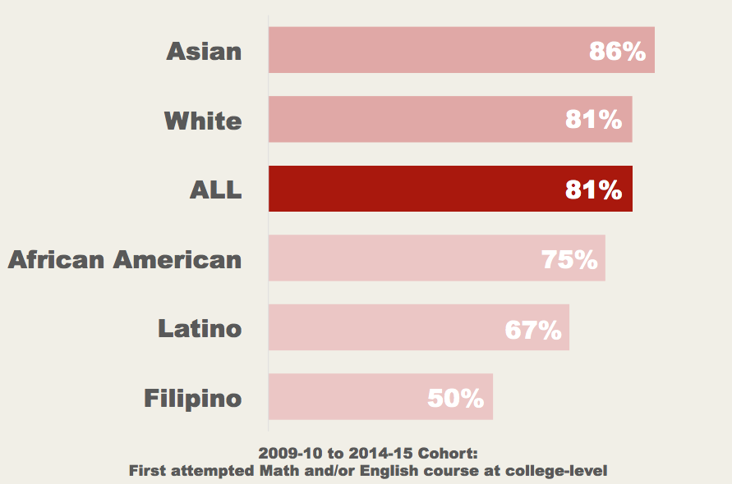
EQUITY MYTH #2 – UNPREPARED
COMPLETION RATES
BY ETHNICITY AMONG THOSE WHO ARE COLLEGE PREPARED
36% GAP
Source: Student Success Scorecard 2016, 2009-10 cohort tracked through 2014-15. Prepared for College N=457, Unprepared for College N=600. Unprepared=lowest course attempted in Math and/or English was below college level; Prepared=lowest attempt Math and/or English course at college level; Excludes Pacific Islanders. Prepared student counts among African American, American Indian/Alaskan Native, Filipino and Pacific Islander are fewer than 10 students. Completion indicator defined as attaining a degree/certificate/transfer/transfer prepared outcome among first-time students with minimum of 6 units earned who attempt any Math or English in the first three years.

Slide 29
EQUITY MYTH #3 – FLAVOR OF THE MONTH
LET’S TALK
ABOUT IT!

Slide 30
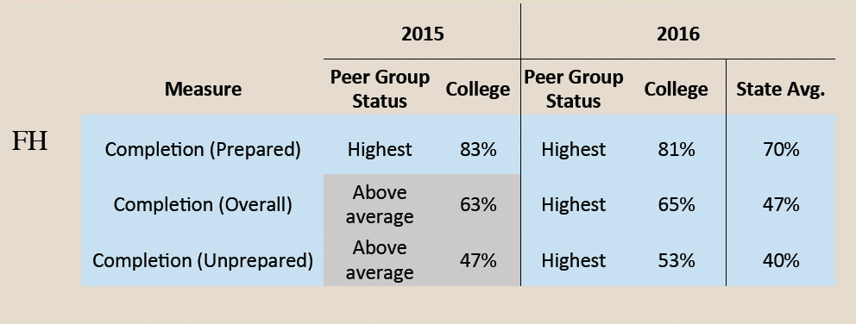
EQUITY – TAKING IT TO THE NEXT LEVEL
PEER GROUP COMPARISON – COMPLETION RATES

Slide 31

EQUITY – TAKING IT TO THE NEXT LEVEL
COURSE SUCCESS RATES
BY ETHNICITY
21% GAP
Source: CCCCO Data Mart, Credit Course Success Rate Summary Report, Fall 2015. Not online N=24,397; Online N=10,712.
Chart excludes American Indian/Alaskan Native, Multi-Ethnicity and Unknown.

Slide 32
EQUITY – TAKING IT TO THE NEXT LEVEL
3-POINTER – THE GREAT EQUALIZER

Slide 33

EQUITY – TAKING IT TO THE NEXT LEVEL

Slide 34
EQUITY – TAKING IT TO THE NEXT LEVEL
5% INCREASE
in course success rates of disproportionately impacted student groups
(68% [2012-13]; 73% [2015-16])
7% INCREASE
in online course success rates of disproportionately impacted student groups
(57% [2012-13]; 64% [2015-16])

Slide 35
3-POINTER – THE GREAT EQUALIZER
THE NEXT BIG IDEA!
STUDENT ACCESS – Online Education
STUDENT SUCCESS – Scorecard
STUDENT EQUITY –
?

Slide 36
EQUITY IS …
Student Success for All …
Student Success FOR ALL …
Student Success FOR ONCE & FOR ALL …

