Slide 1
Enrollment Update

Slide 2
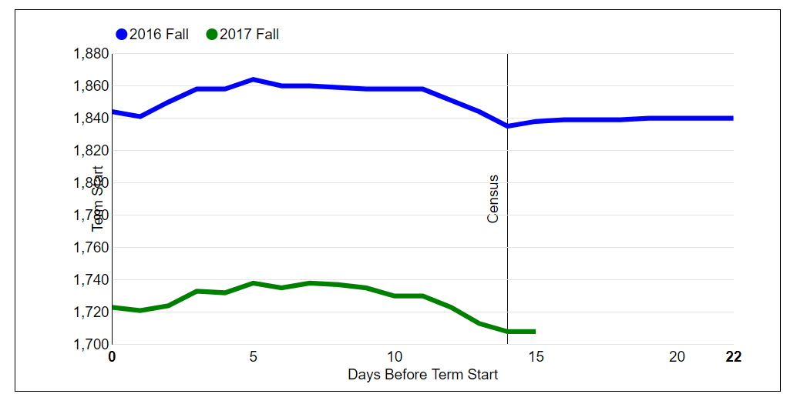
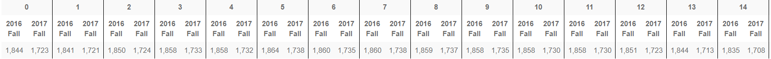
Year | FTES Change Day 0 to 14
2016 | Drop of 9 FTES
2017 | Drop of 15 FTES

Slide 3
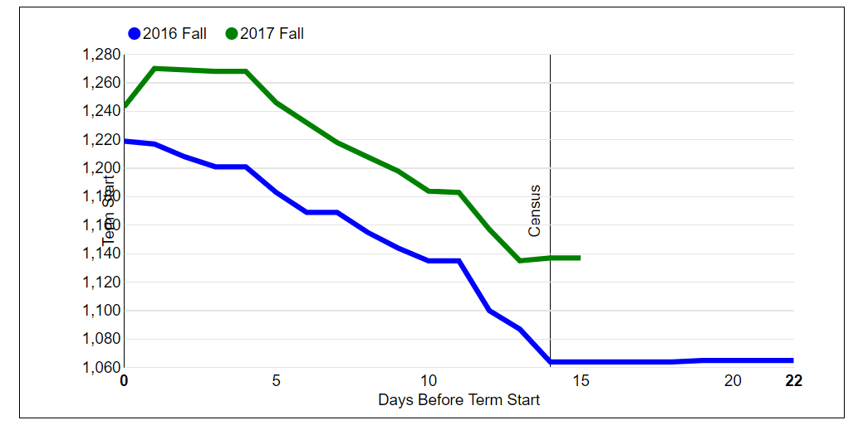
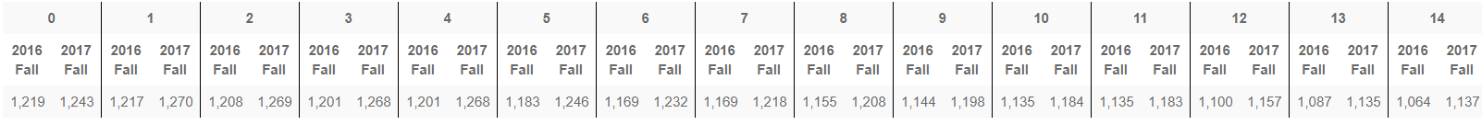
Year | FTES Change Day 0 to 14
2016 | Drop of 155 FTES
2017 | Drop of 106 FTES
At Census
Up
49 FTES

