Slide 1
ACCJC’s Annual Report Institution-Set Standards
March 5, 2014
PaRC Presentation
E. Kuo
Foothill IR&P

Slide 2
Overview
ACCJC Annual Report
Enrollment
Student Achievement
Student Learning Outcomes and Assessment
Substantive Change Items
Changes
Additional questions
SLO narratives
CTE Standards (institution-set)

Slide 3
Institution-Set Standards
Student Achievement Data
Course completion rate
Program completion number (degrees + certificates)
Degree completion number
Certificate completion number
Transfer to 4-yr institutions
Licensure exam pass rates
Job placement rates for CTE program completers
College to set standards based on data and discussion

Slide 4
What is a standard?
ACCJC
“…identified level of performance determined by the institution to be acceptable.”
“measure will be assessed for reasonableness and effectiveness by peer external evaluators”
Different from benchmark or goal
College should annually meet and easily exceed—at minimum
Implications of not meeting standards may require action plan to get back “up” to standard

Slide 5
Foothill Approach
Data
Most recent term/year (Fall 2013 or 2012-13)
Longitudinal (2008-09 to 2012-13, 2010-11 to 2012-13)
Disaggregation (ethnicity, program)
Sources
CCCCO Data Mart, FHDA IR&P, California Community College Core Indicator Report
Discussion
PaRC
Documentation

Slide 6
Standard Recommendations

Slide 7
Student Course Completion
Keep standard same as last year
Fall rates:
2013: 75%
2012: 76%
2011: 74%
2010: 77%
2009: 77%
Completion based on passing course with A, B, C, or P grade; includes all courses offered in Fall term

Slide 8
Student Program Completion
Keep standard same as last year
Number of AA, AA-T, AS and certificates
Numbers:
2012-13: 979
2011-12: 1042
2010-11: 835

Slide 9
Student Degree Completion
New Standard
Number of AA, AA-T and AS
Numbers:
2012-13: 573
2011-12: 558
2010-11: 541

Slide 10
Student Certificate Completion
New Standard
Number of Certificates of Achievement
Numbers:
2012-13: 495
2011-12: 570
2010-11: 357

Slide 11
Student Transfer to Four-Year
New Standard
Last yr: 775
CSU transfers
UC transfers
In-State Privates and Out-of-State transfers (transfer volume on Data Mart)
Cohort Number & Rate:
2012-13: 1069
2011-12: 1004
2010-11: 978
2009-10: 828
2008-09: 885
Note: ISP and OoS data is always one-year behind to the 2012-13 rate is calculated based on the number of 2011-12 transfers to these institutional types.

Slide 12
Student Licensure Exam Pass Rate
New Standard
for CTE
Source: CA Community College Core Indicator Report
Standard based on roughly 75% of rate

Slide 13
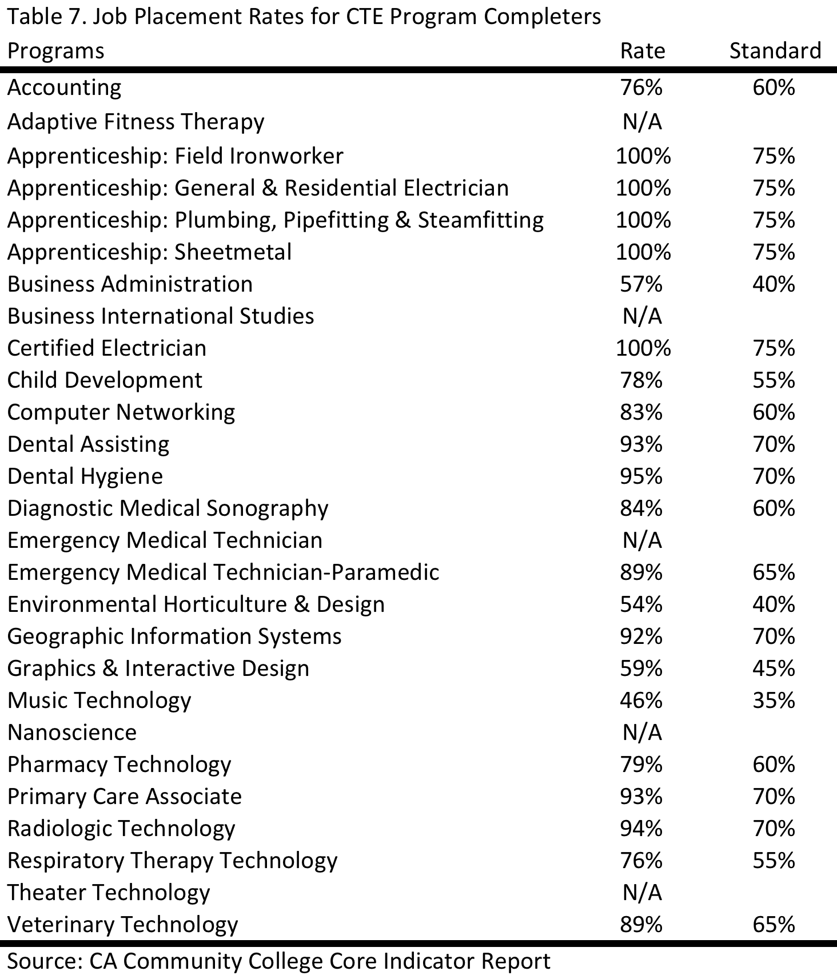
Student Job Placement
New Standard for CTE Completers
Standard based on roughly 75% of rate

Slide 14
Thoughts? Questions?

